Slide 1

Electric Car Industry
Project 1 Team 5
Oswaldo Solano
Fernando Escamilla
Juan Alberto Reyes

Slide 2
Objective
The objective of this project is to conduct an general analysis of data from the electric car industry to identify patterns or trends that can help any customer that want to by an electric car. The data is limited to low-cost electric vehicles in the UK and Germany.
Sources
The electric car information on https://ev-database.org/ was scraped and made available in comma separated list format in the following source: https://www.kaggle.com/datasets/kkhandekar/cheapest-electric-cars?resource=download

Slide 3
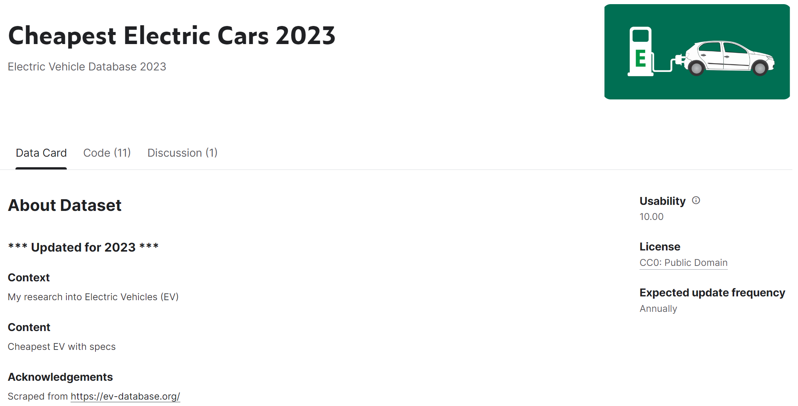

Slide 4
Process
Once we had downloaded the database we were sure we could work with, we started to clean the data in Jupyter Notebook as a team. This code was uploaded to a shared Github repository which contains all the necessary information about the project and some folders that includes the individual work done by each member of the team (visualizations).

Slide 5
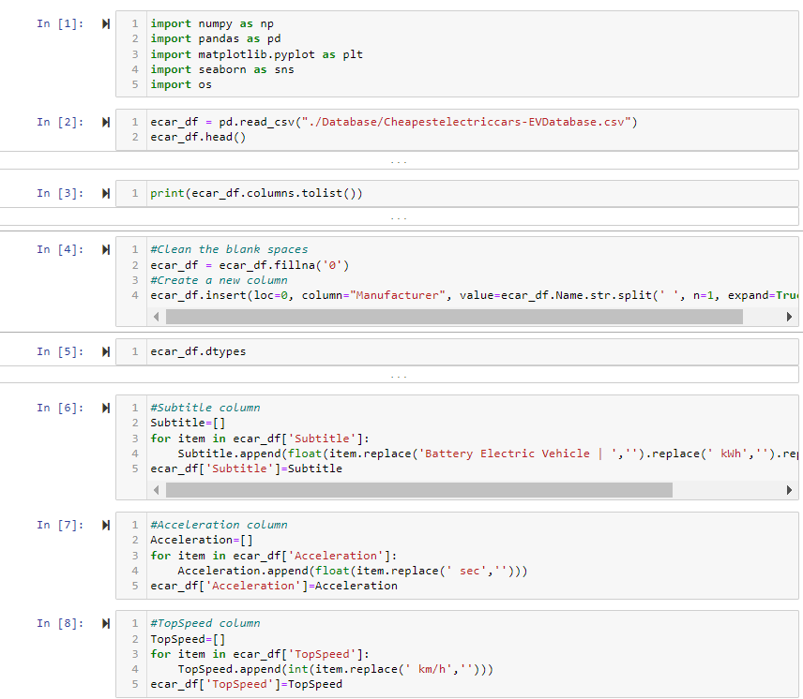

Slide 6
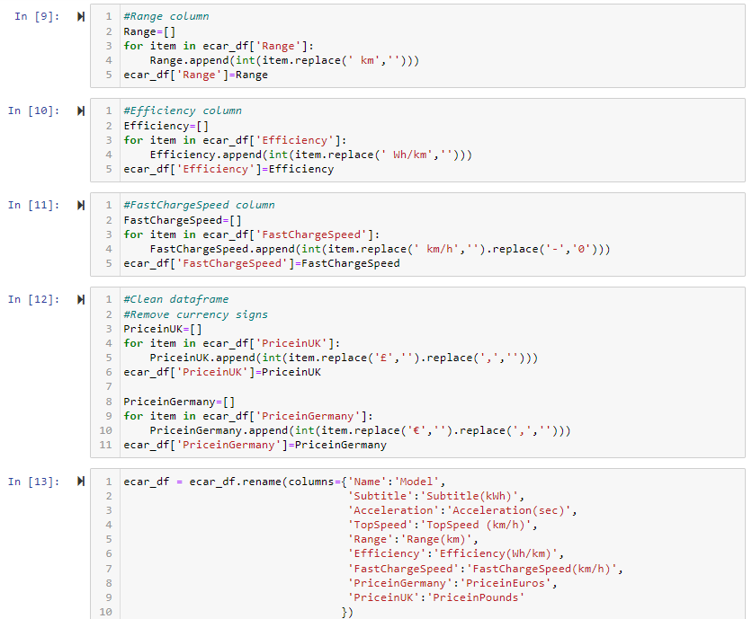

Slide 7
Visualizations

Slide 8
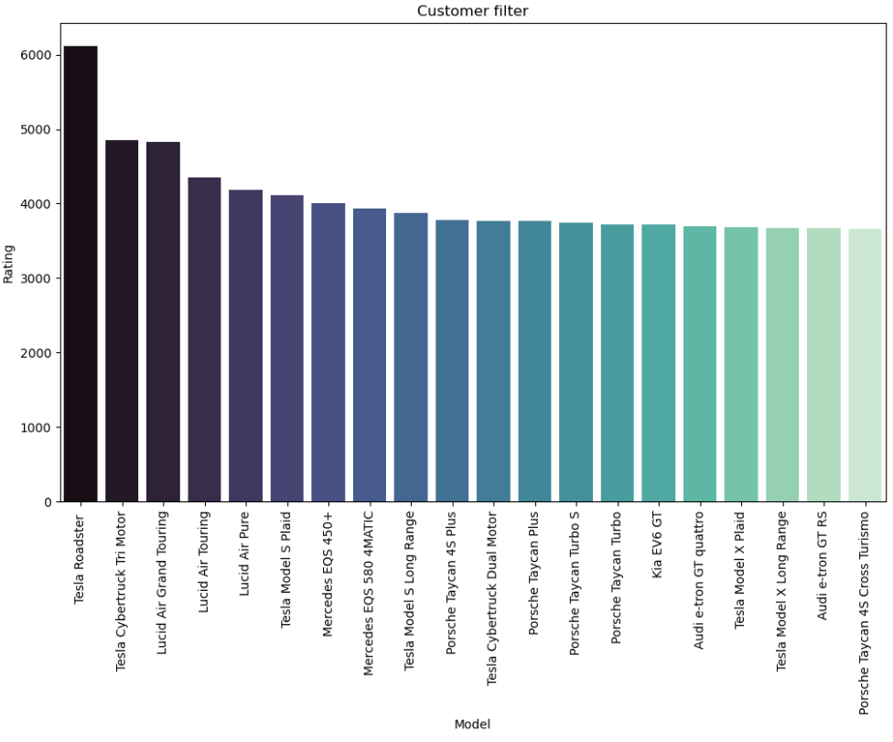
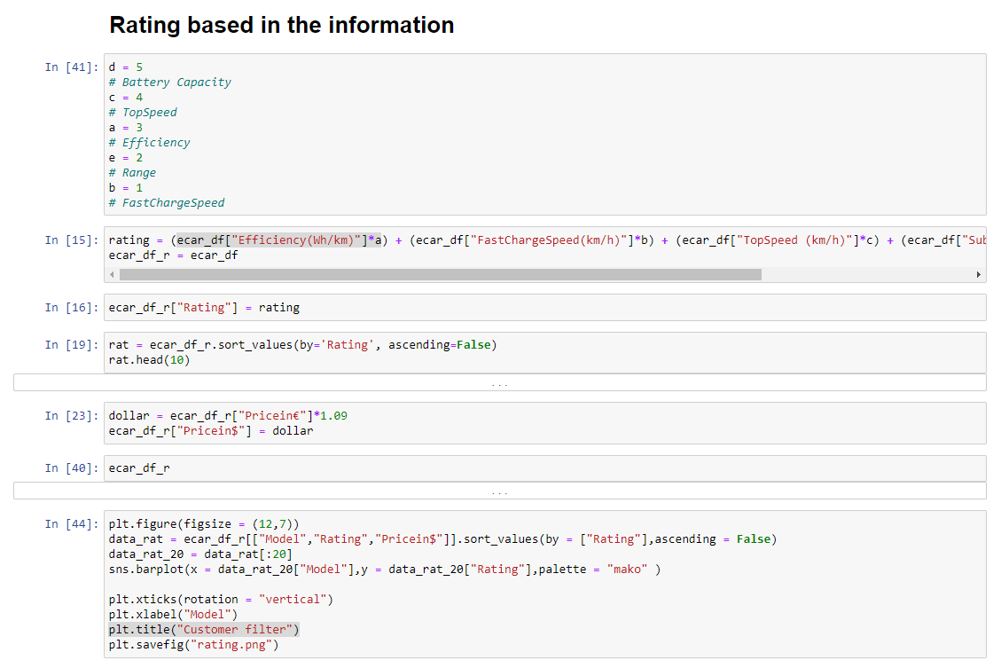
Model vs Rating

Slide 9
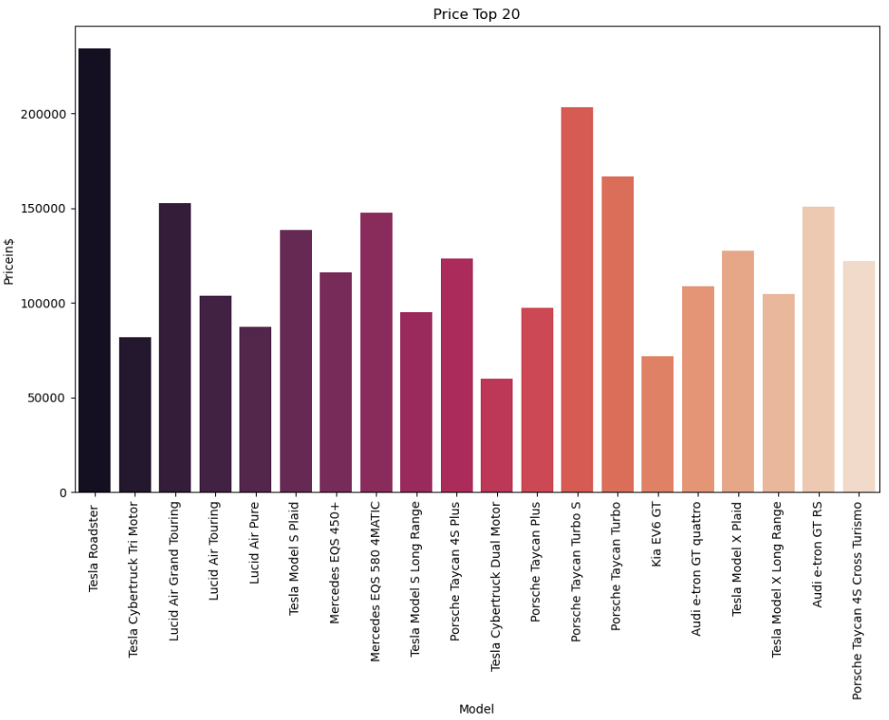
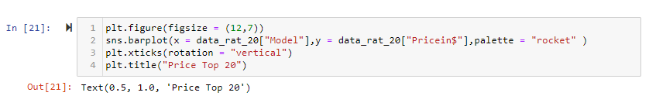
Price Top 20

Slide 10
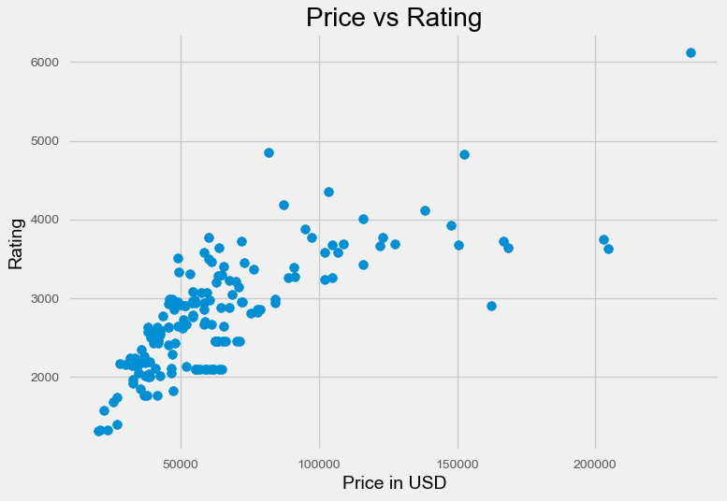
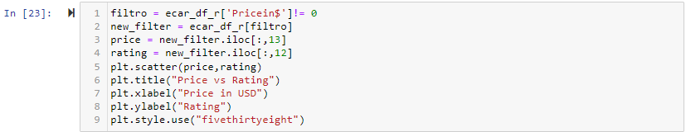
Price vs Rating

Slide 11
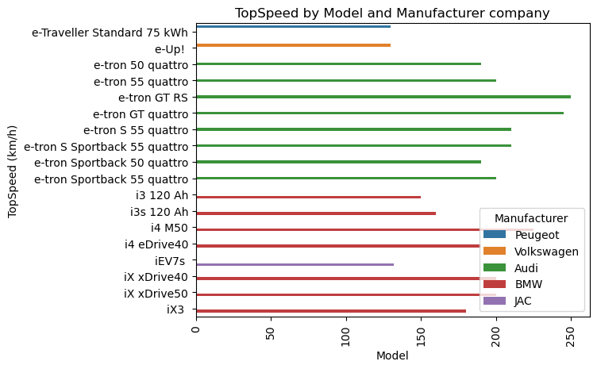
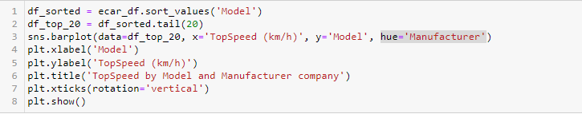
TopSpeed vs top20 Models

Slide 12
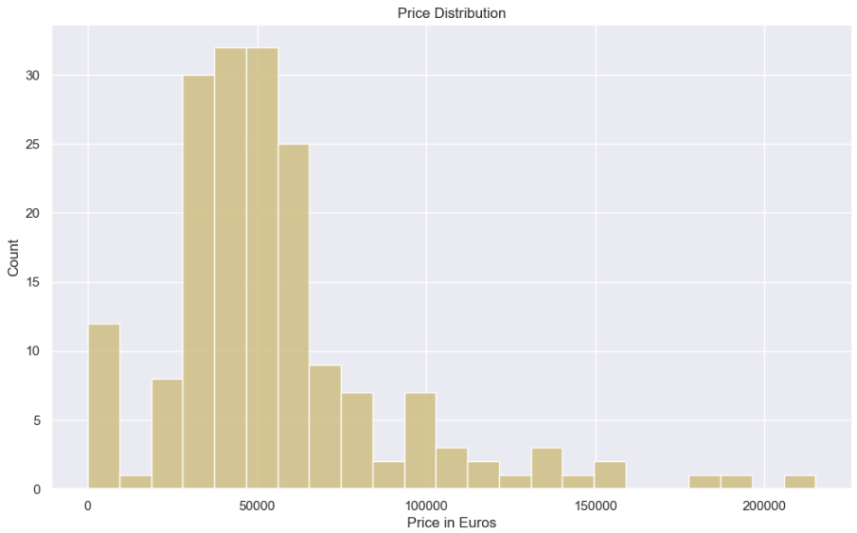
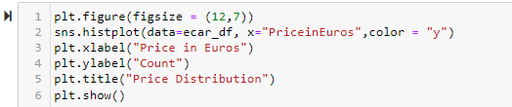
Number of times the same price is repeated in Euros

Slide 13
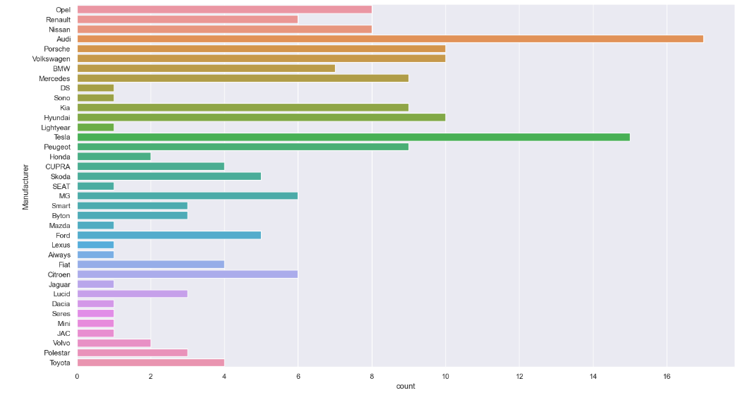

Number of models of each manufacturer

Slide 14
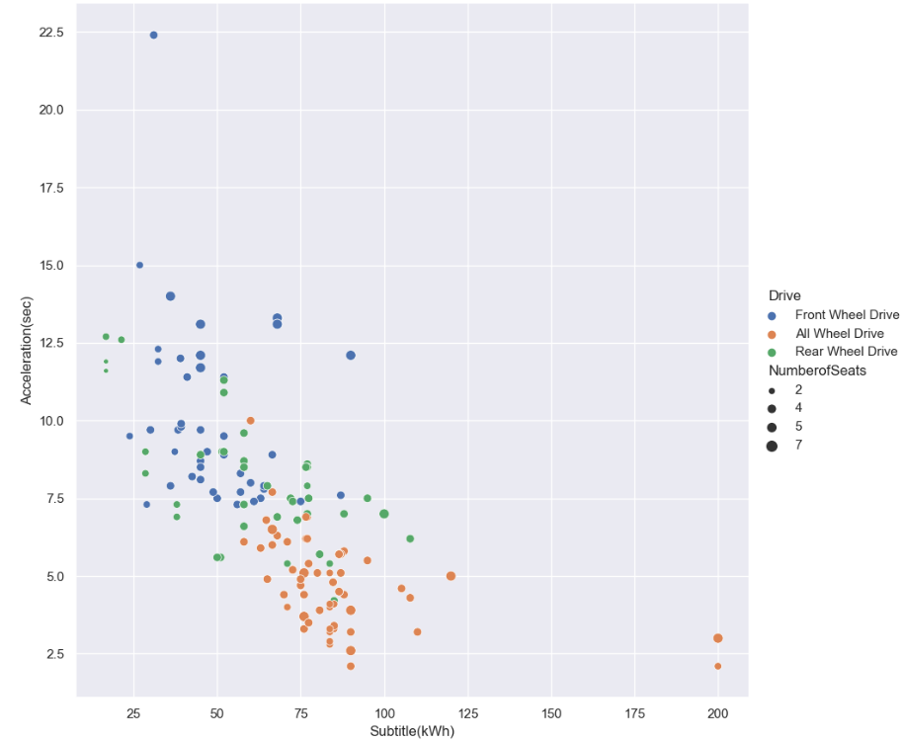
kWh and Acceleration in seconds (with #seats)

Slide 15
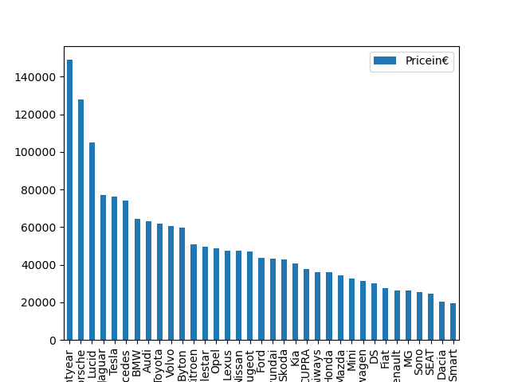
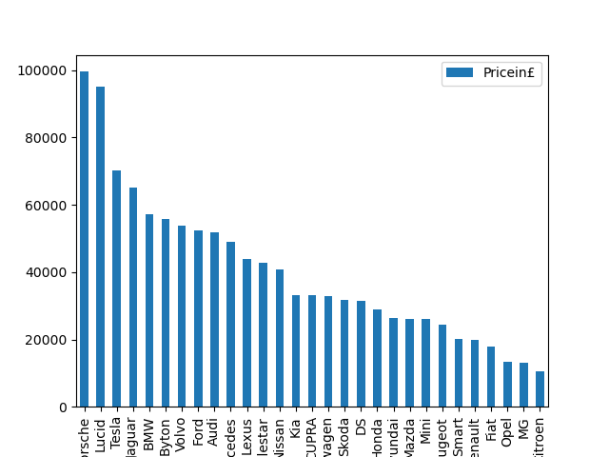
Average price in ‘£’ and ‘€’

Slide 16
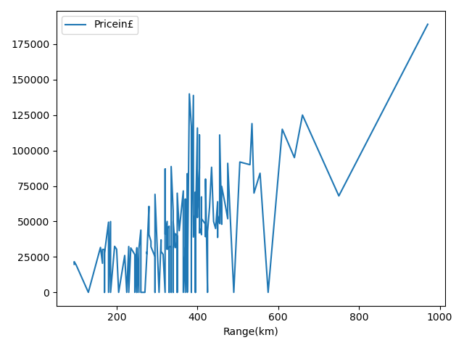
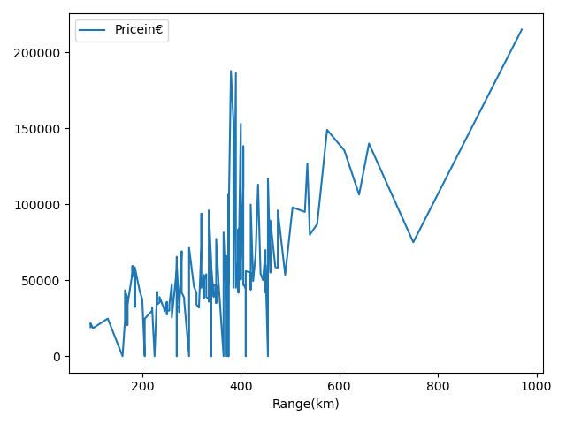
Model VS Range

Slide 17
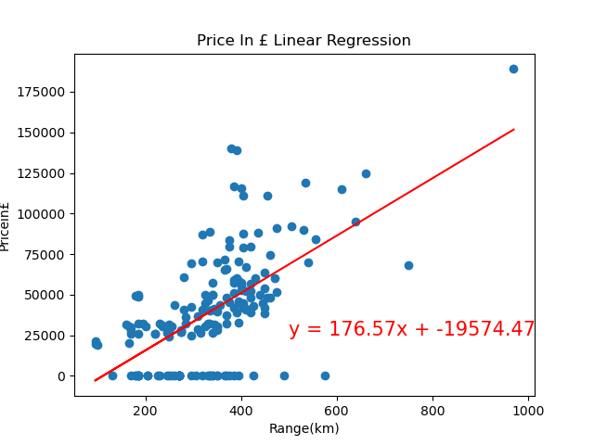
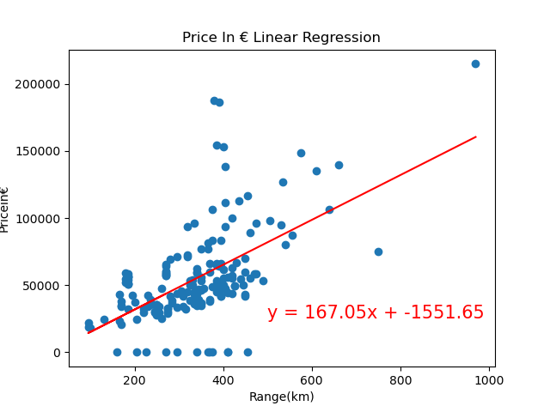
Linear Regression in Range VS Price

Slide 18
Summary of the last visualizations
The first two visualizations are bar charts displaying the average price of electric cars in pounds and euros. The third and fourth visualizations are line plots displaying the sorted range and price of electric cars in Germany and the UK.
The code then calculates the correlation between range and price for both the UK and Germany data. The next step is to define a function that creates linear regression plots. The function takes in x and y values, a figure title, a title, text coordinates, and a file name for the plot. The function calculates the slope, intercept, and r-value of the linear regression line and annotates the plot with these values.
Finally, the function is called twice to create two separate linear regression plots for the price of electric cars in pounds and euros.

Slide 19
Conclusion
We were able to obtain very valuable information with which we can continue working in a more personalized way depending on the needs we are looking for in the market. At the same time, we realized that there is a wide variety of manufacturers and models to choose from. In case someone would like to perform this type of analysis, I believe it would be feasible to keep checking the market constantly because the automotive chip crisis may start to improve, which would lead to a greater stock of products and, consequently, prices may suffer a change. But at this moment we believe that we obtained a satisfactory result and gave us a great perspective of how the market is currently working.

