Slide 1
Sign Language Recognition Micro-Project #4 https://github.com/juansaracho/ANA500_Class_Repository
Juan Saracho
26 February 2023

Slide 2

Problem Statement
Background: A sign language image dataset will be used to analyze which features of the image have the greatest predictive power in classifying the image correctly. The we will build and train a neural network to classify the images.
Objective(s):
What are the factors that have the largest effect on car prices in 2022
Which features (factors) are having the greatest effect on the classification of the image?
Which features (factors) are having the least effect on the classification of the image?

Slide 3

Hypothesis Formulation
With predictor_features = [‘pixel_1 … pixel_784]
$$H_{0}:The predictor_{features}have no effect onimage classification.$$
$$H_{A}:The predictor_{features}have positive effect on imageclassification.$$
The null hypothesis ($H_{0}$) states that the predictor features have no association on correctly classifying the image (dependent variable).
The alternative hypothesis ($H_{A}$) states that the predictor features have a positive effect on correctly classifying the image

Slide 4
Acquire
“The dataset format is patterned to match closely with the classic MNIST. Each training and test case represents a label (0-25) as a one-to-one map for each alphabetic letter A-Z (and no cases for 9=J or 25=Z because of gesture motions). The training data (27,455 cases) and test data (7172 cases) are approximately half the size of the standard MNIST but otherwise similar with a header row of label, pixel1,pixel2….pixel784 which represent a single 28x28 pixel image with grayscale values between 0-255.”
Data source: https://www.kaggle.com/datasets/datamunge/sign-language-mnist

Slide 5
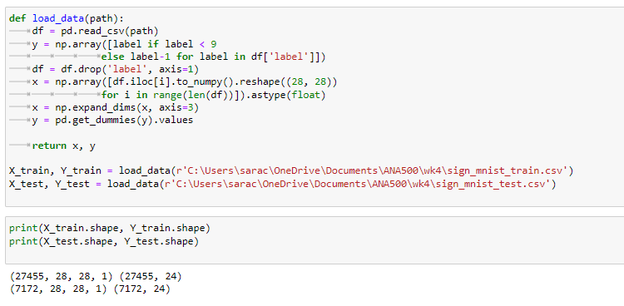
Prepare
We begin by loading our data, creating dummy variables, and partitioning our data into training and testing samples.

Slide 6
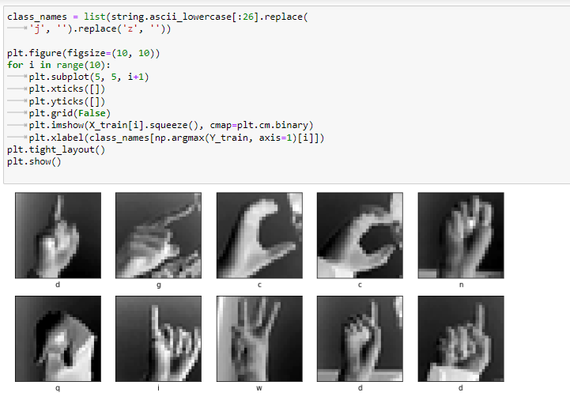
Analyze
Then we plot our images to see the data we are working with.

Slide 7
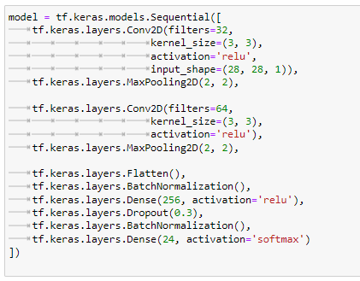
Analyze cont.
We build a convolutional neural network using Keras’ Sequential() model function and implement Conv2D(), MaxPooling2D(), Flatten(), BatchNormalization(), and Dense() layers, where we use the ‘relU’ and ‘softmax’ activation functions.

Slide 8
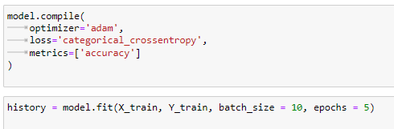
Analyze cont.
Next we can begin training our neural network. We select the ‘adam’ optimizer, the ‘categorical_crossentropy’ loss function, and ‘accuracy’ as the metrics.

Slide 9
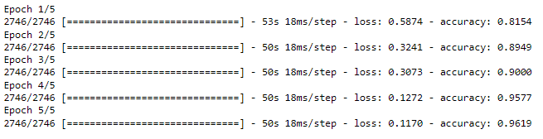
Report
Share our accuracy results:
At the end of our training the model achieved 96% classification accuracy.

Slide 10
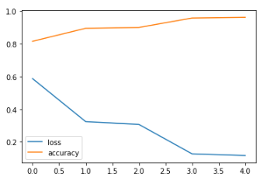
Report cont.
Loss function and Accuracy plot.
As our epochs increase we see our loss function decrease and our accuracy increase.

Slide 11
Act
In this project we chose TensorFlow Keras Sequential() function to build a Convolutional Neural Network model. Our final model obtained 96.19% accuracy after five epochs.
Overall, our training model reached a high 96% accuracy in correctly classifying sign language images and could be safely deployed as part of an application.

