Slide 1
Car Price Prediction with Machine Learning Micro-Project #1 https://github.com/juansaracho/Car_Price_Prediction
Juan Saracho
5 February 2023

Slide 2
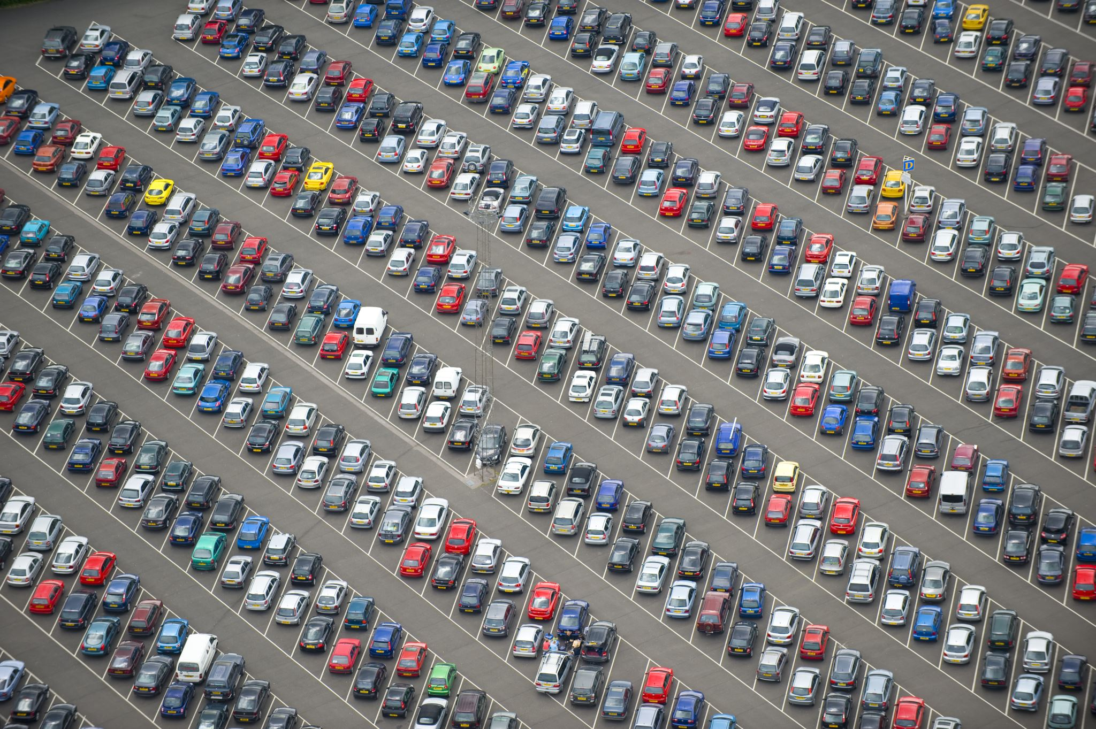
Problem Statement
Background: A 2022 car dataset will be used to analyze which features (or factors) have the largest effect on the value of cars. Additionally, a machine learning regression model will be called to predict the future value of cars.
Objective(s):
What are the factors that have the largest effect on car prices in 2022
Which features (factors) are having the greatest effect on the price of the car?
Which features (factors) are having the least effect on the price of the car?

Slide 3

Hypothesis Formulation
With predictor_features = ['Fuel.Type', 'Gearbox.Type', 'Power.hp', 'Displacement.l', 'Torque.lbft', 'Cylinders', 'Drivetrain', 'MPG.City', 'MPG.Highway', 'Seats', 'Doors', 'Height.in', 'Length.in', 'Width.in', 'Wheelbase.in']
$$H_{0}:The predictor_features have no effect on car prices.$$
$$H_{A}:The predictor_features have positive effect on car prices.$$
The null hypothesis ($H_{0}$) states that the predictor features have no association on the price of a car (dependent variable).
The alternative hypothesis ($H_{A}$) states that the predictor features have a positive effect on the price of cars, e.g., an increase in a car’s horsepower will also increase its price.

Slide 4
Acquire
New Cars data was acquired through Kaggle.com, which is a popular place for data scientists, machine learning practitioners, engineers, and data scientists to post projects, participate in data science competitions and acquire open-source datasets.
Data source: https://www.kaggle.com/datasets/tymekurban/new-cars-usa-202223-dataset?select=cars_us_2022.csv

Slide 5
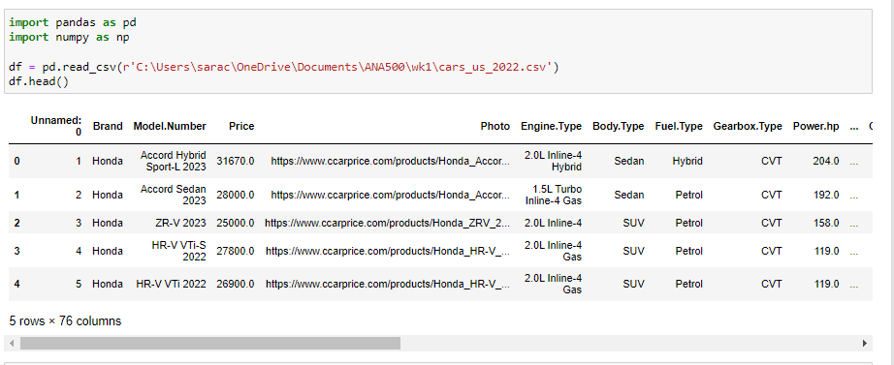
Prepare
‘data.head()’ function outputs the column headers and the first five rows of the dataset

Slide 6
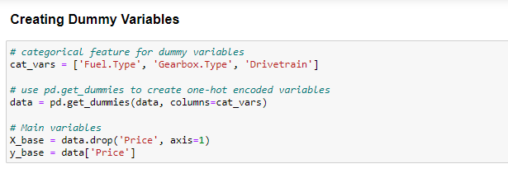
Prepare cont.
‘pd.get_dummies()’ function uses one-hot encoding to transform our categorical variables into binary numeric variables.

Slide 7
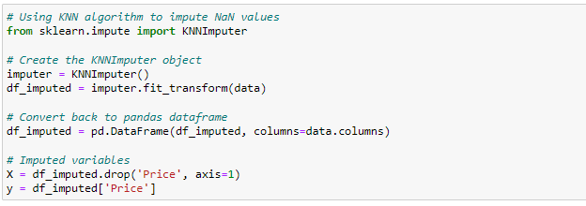
Prepare cont.
‘KNNImputer()’ function uses K Nearest Neighbors algorithm to impute missing values in our dataset.

Slide 8
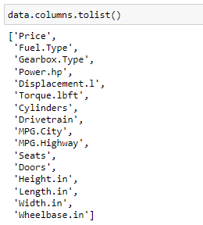
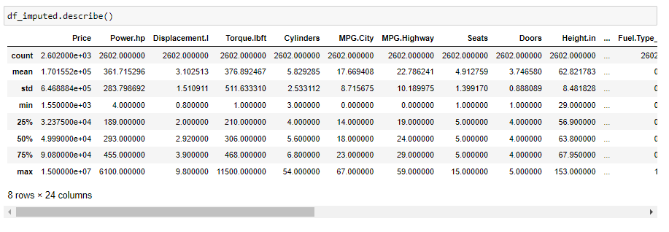
Prepare, cont.
The Data Science Process (2/5)
Features:
Summary stats:

Slide 9
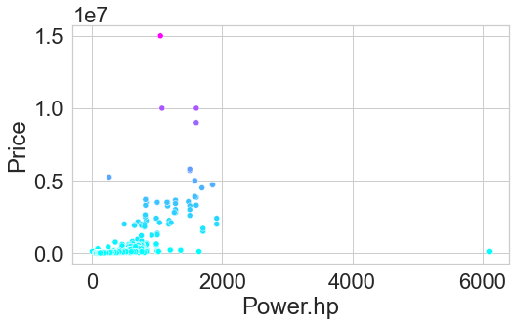
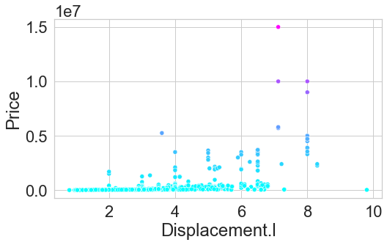
Prepare, cont.
The Data Science Process (2/5)
Visualization of how median car price relates to features

Slide 10
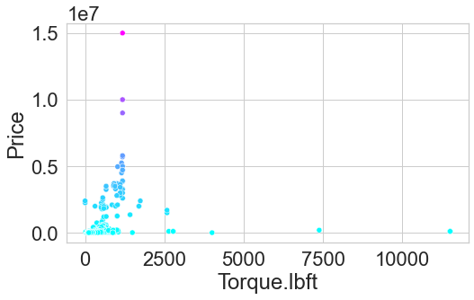
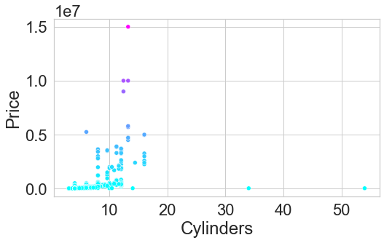
Prepare, cont.
The Data Science Process (2/5)
Visualization of how median car price relates to features

Slide 11
Analyze data
<select analytical technique, build models>

Slide 12
Report
<communicate results>

Slide 13
Act
<apply results, connect results with the chosen problem statement or business question>

