Slide 1
StreamCam
CMSI 402 Senior Project
Juan S. Carrillo

Slide 2


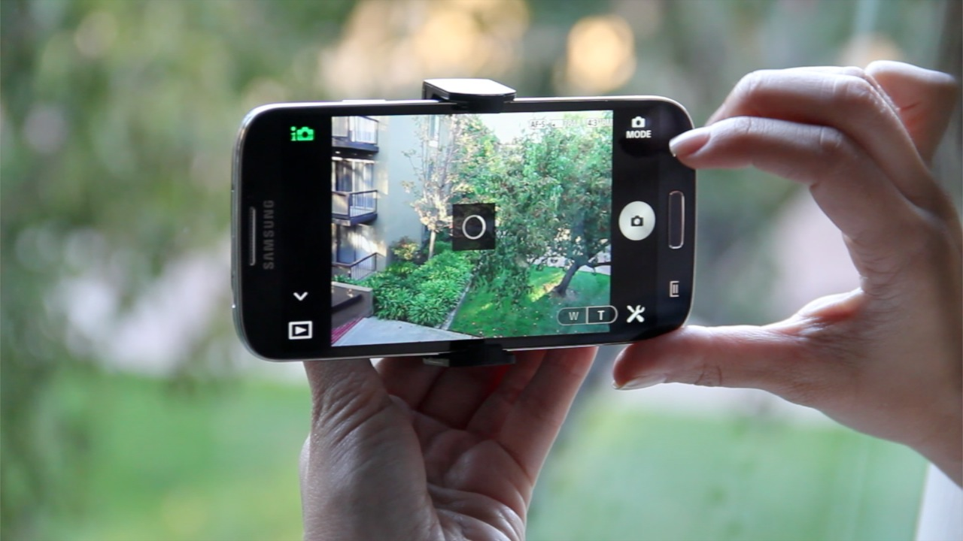
Project Description
Mobile app that allows users to stream their videos to the cloud and store them as they record.

Slide 3


Project Justification
Mobile and Web Clients
Database
Useful

Slide 4
User’s POV
Mobile
Login / Create Account
Record
Watch recent videos
Watch remotely stored videos
Delete videos from client only w passord
Web Client
Login / Create Account
Manage all videos
Download videos

Slide 5
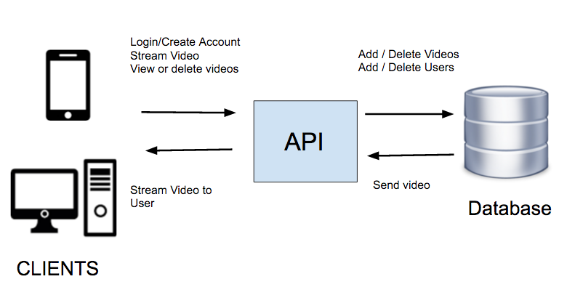
How It Works

Slide 6




Technologies

Slide 7
Tentative Schedule
Develop Android Client
Implement Streaming or use existing library
Develop back-end
Save streamed videos to database
Allow users to access streamed videos
Additional features

Slide 8
Questions?

