Slide 2
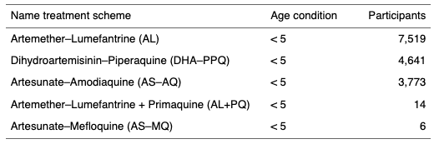
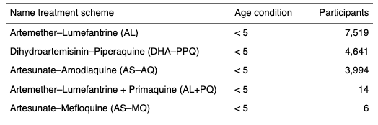
Generalities
PCR domain in MAPPER is not the same that WWARNSET (outcome). We identified that the outcome was ACPR when the PCR domain was RC.

Slide 3
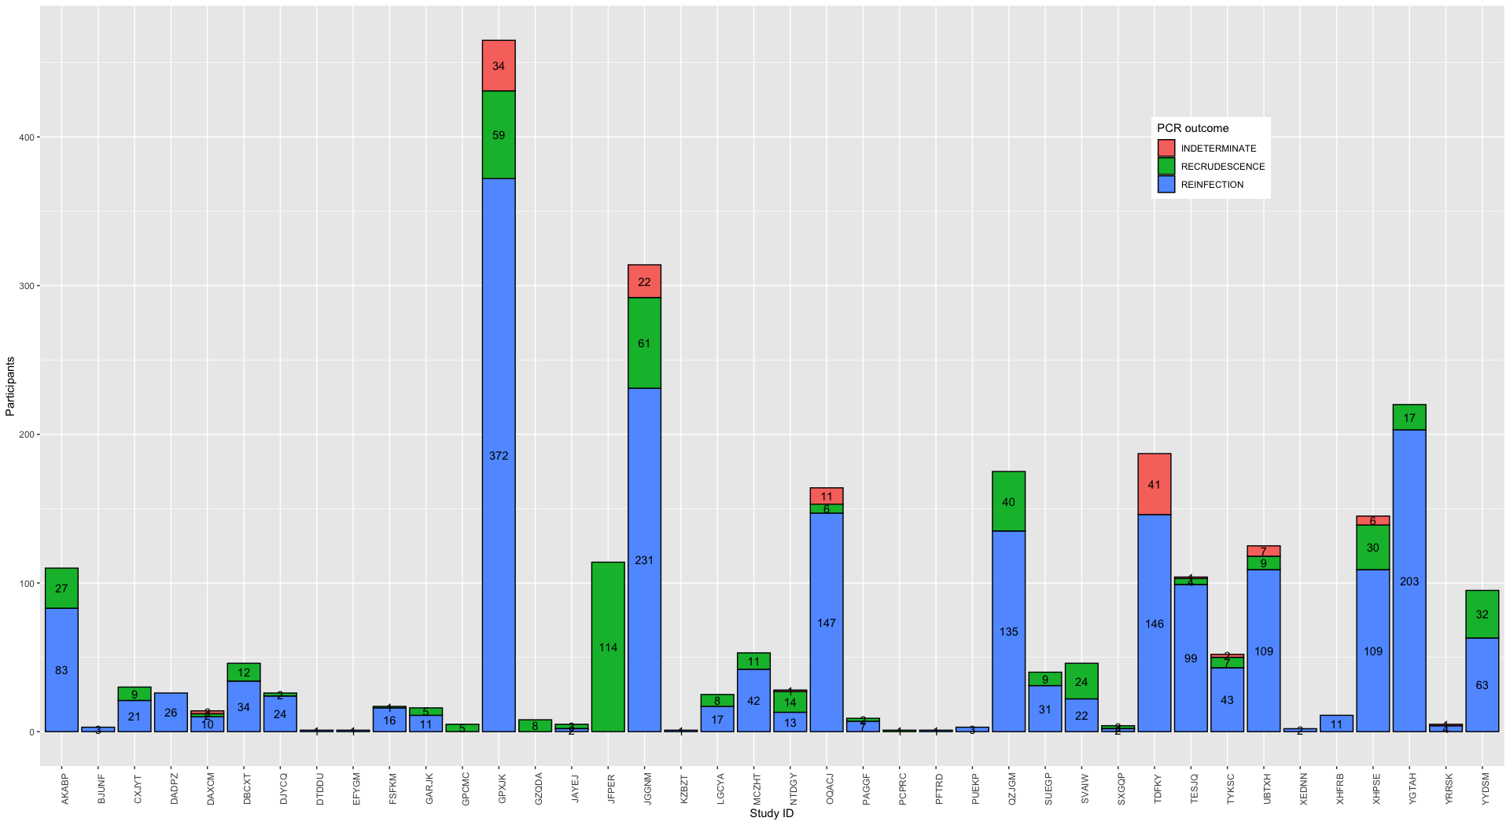
Outcomes distribution by study
It was excluded NA, which corresponded to a negative PCR

Slide 4
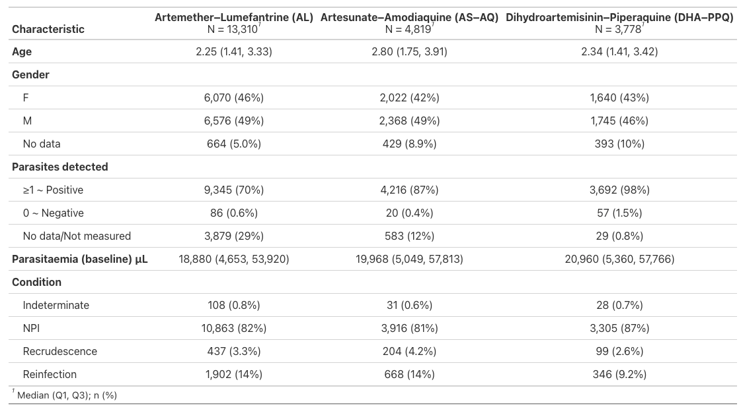
**
** NPI = No parasite identified/N

Slide 5
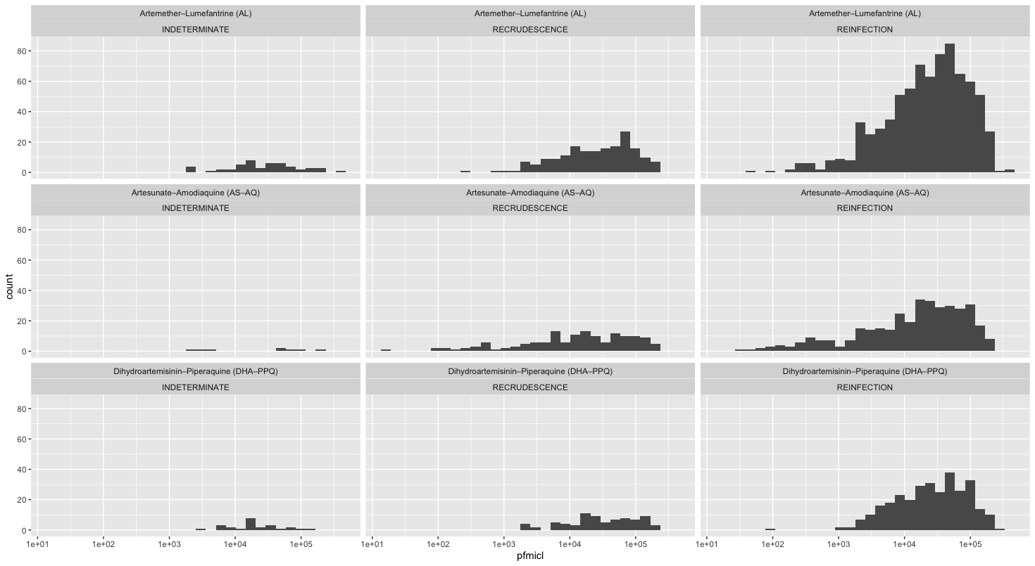

Slide 6
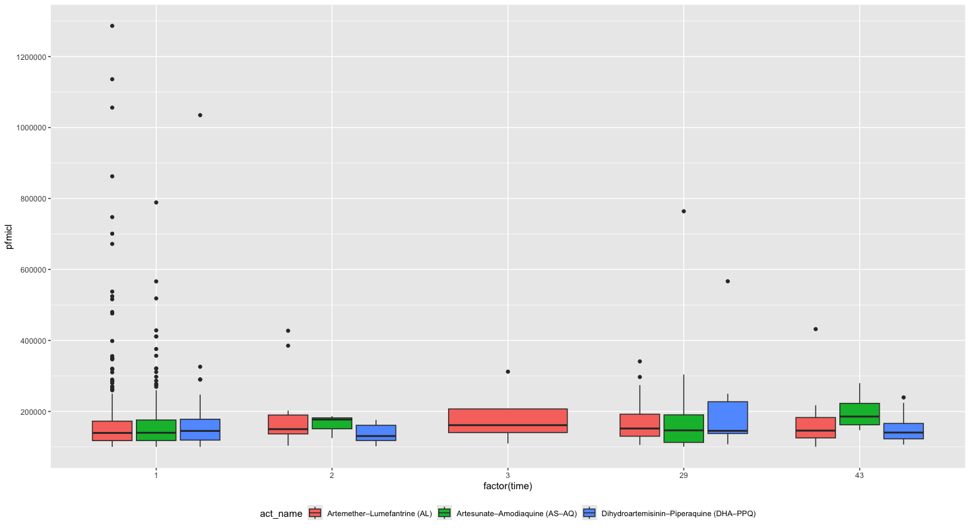

Slide 7
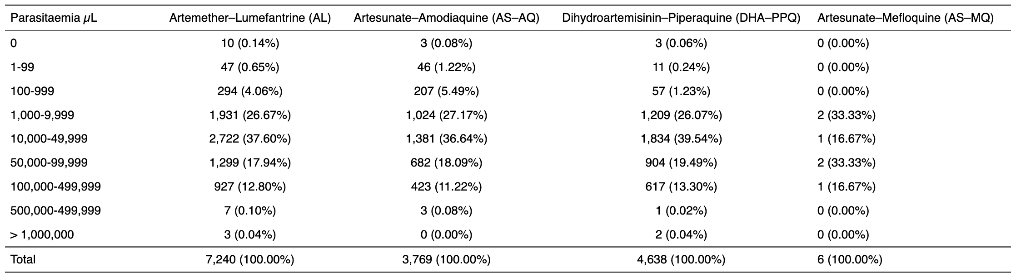
Baseline

