Slide 2
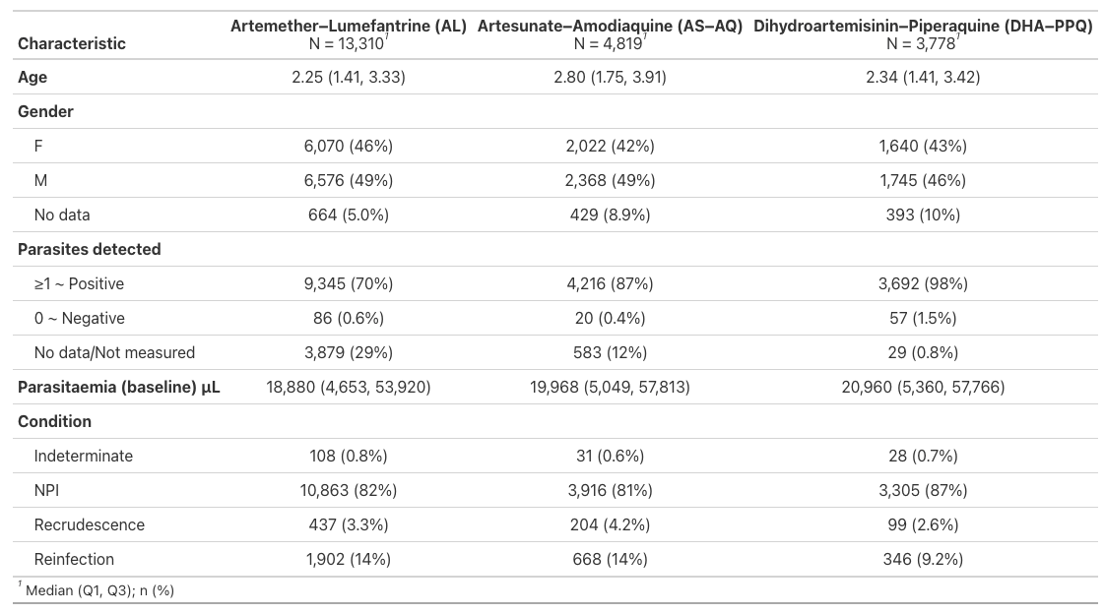
**
** NPI = No parasite identified/N

Slide 3
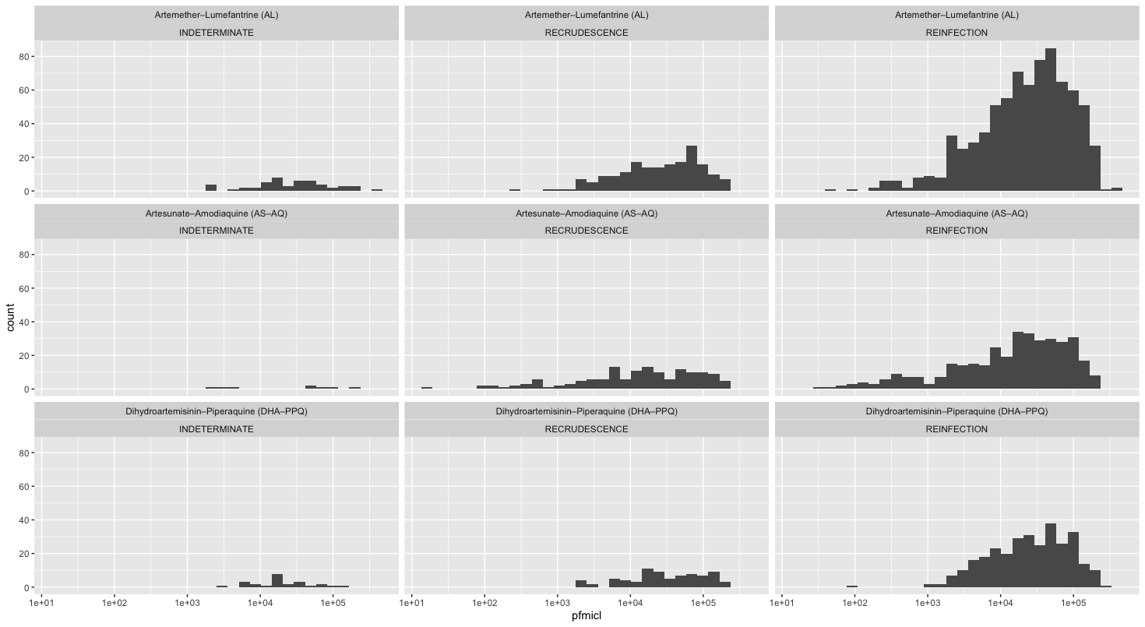

Slide 4
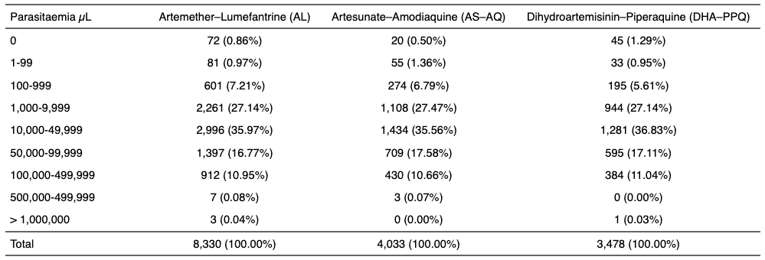
Baseline

Slide 5
