Slide 1
Escape Artist Agent
Generalization-focused RL: Monte Carlo control & Q-Learning on a random-trap grid world
Joowhan Song
Notes:
Open with a short looped rollout. Mention: randomized traps, slip=0.10, lethal traps, per-episode randomized layouts for training/eval (generalization).

Slide 2




Concept & Objective
Agent escapes a trap-filled grid to reach extraction under slip noise and lethal traps.
Randomized traps per episode; solvable layouts by construction (BFS check).
Generalization focus: per-episode randomized layouts (no map memorization).
Deliverables: reproducible code, CLI, tests, notebook, visuals.

Slide 3
TL;DR Results
Easy (6×6): MC(First) 91.5%, Q-Learning 88.0%; ~10 steps (optimal), timeouts 0%.
Medium (10×10 randomized): MC(Every) 21.5%, MC-OFF 20.5%, Q-Learning 23.0%; successes ~19–21 steps; timeouts ≈0%.
Evaluation = greedy rollouts (ε=0) over 200 unseen layouts; metrics saved to CSV/MD.
Notes:
Give reviewers the headline in 30 seconds; deeper tables come later.

Slide 4
Evaluation Setup (Generalization)
Per-episode randomized layouts (layout_mode=per_episode).
Config (Medium): 10×10, traps=10%, slip=0.10, lethal, max_steps=200.
Metrics: Success Rate, Avg Steps (success), Detection Rate (≥1 trap hit), Timeout Rate.
Multi-seed optional; ablations sweep trap density × slip.
Notes:
Highlight that results are averages over unseen layouts; we avoid overfitting to a single map.

Slide 5
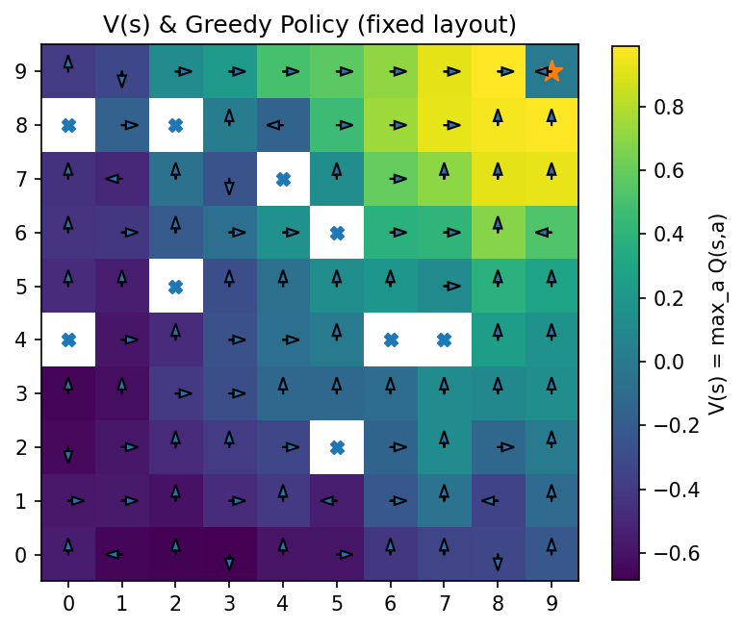
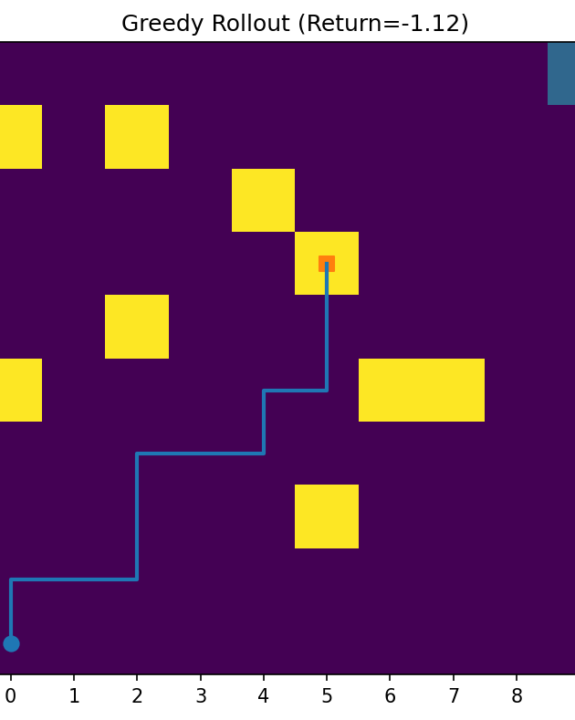
Environment Design
Notes:
Rewards: step −0.01, trap −1.0, goal +1.0. Slip causes off-intended moves. Exclusion radius near start/goal; BFS check guarantees at least one solution.

Slide 6
Algorithms (MC on/off, Q-Learning)
MC Control: First-Visit & Every-Visit (episode-based updates).
MC-OFF: Ordinary & Weighted Importance Sampling (behavior vs target policy).
Q-Learning: bootstrapped TD with decaying α; ε-greedy behavior.
Exploration rate(ε): slow decay; nonzero floor to ensure coverage under randomness.
Notes:
Q-Learning update: Q(s,a) ← Q(s,a) + α [ r + γ max_a' Q(s',a') − Q(s,a) ].
MC return: G_t = Σ_k γ^k r_{t+1+k}; First-Visit updates first occurrence; Every-Visit updates all occurrences.
Off-policy MC (weighted IS): episode weight W; normalized update ~ (W/ΣW) (G − Q). Behavior ε trades coverage vs. variance; consider weight clipping to reduce variance spikes.
ε-greedy: P(greedy)=1−ε+ε/|A|, P(each other)=ε/|A|; keep ε_end ≳ slip/2 on Medium.

Slide 7
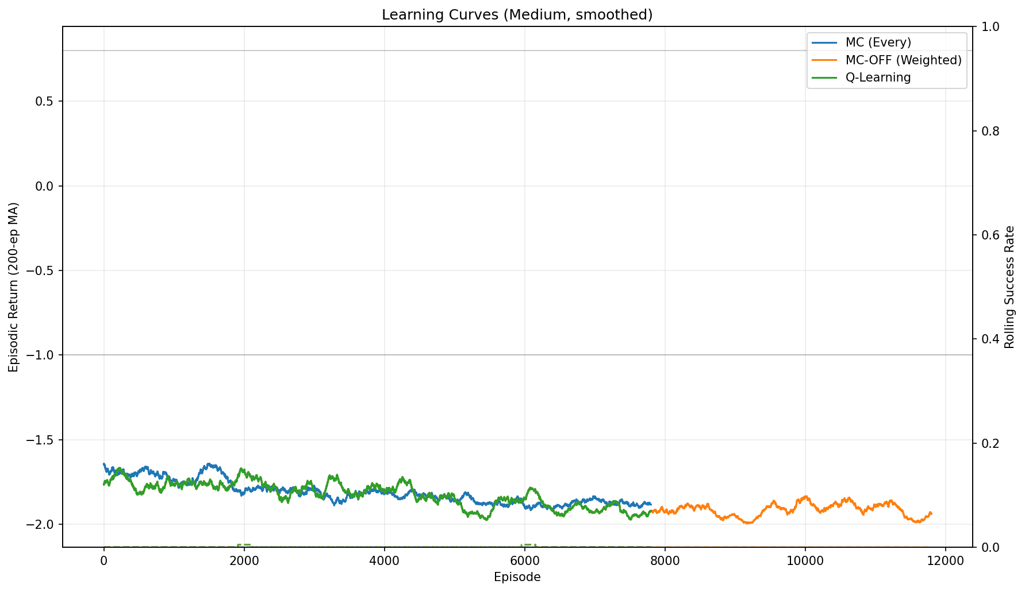
Learning Curves (Medium, smoothed)
Notes:
Discuss convergence and variance: MC-OFF noisier; MC-Every steadier; Q-Learning fast early then plateaus.

Slide 8
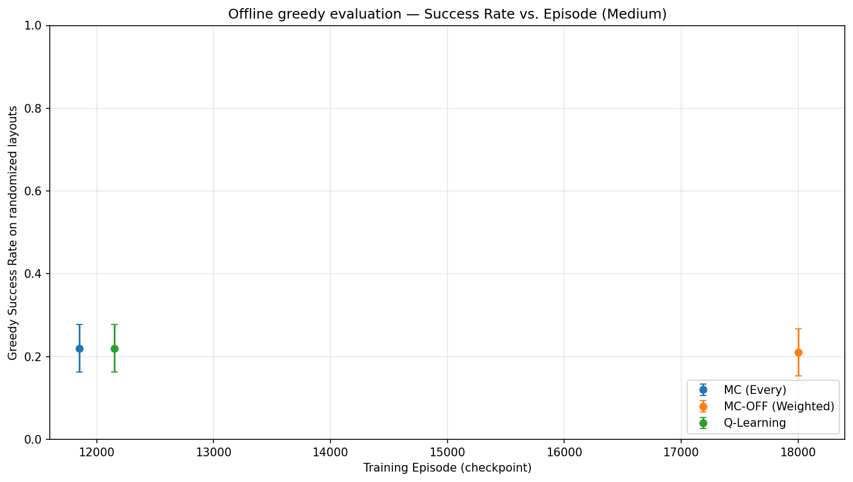
Offline greedy evaluation (medium)
Notes:
Each dot: greedy (ε=0) success rate over 200 fresh randomized layouts at a checkpoint. Observed: MC(E)=0.22 @12k, Q-Learning=0.22 @12k, MC-OFF=0.21 @18k.
Error bars: 95% CI ≈ ±1.96 * sqrt(p(1−p)/N). At p≈0.22, N=200 ⇒ ±~0.06. Overlapping CIs ⇒ no meaningful difference at these budgets.

Slide 9
Training Setup & Schedules
Episodes: MC-Every 12k–20k; MC-OFF 18k–30k; Q-Learning 12k–20k.
ε: 0.35 → 0.02 over ~80–90% of episodes (ε_end ≳ slip/2).
Q α: 0.5 → 0.05 over ~12k; optional optimistic Q init ≈ 0.2.
Seeds logged per run; YAML configs control env/algo; plot-only regenerates figures.
Notes:
Longer runs + slower ε help generalization on randomized layouts.

Slide 10
Results — Easy (6×6, per-episode)
Method | Success Rate ↑ | Avg Steps ↓ | Detection Rate ↓ | Timeout Rate ↓
MC (First) | 91.5% | 10.0 | 8.5% | 0.0%
Q-Learning | 88.0% | 10.0 | 12.0% | 0.0%
(200 randomized layouts; greedy rollouts from learned Q)
Notes:
10 steps ≈ Manhattan optimal; pipeline & env validated.

Slide 11
Results — Medium (10×10, per-episode)
Method | Success Rate ↑ | Avg Steps ↓ | Detection Rate ↓ | Timeout Rate ↓
Every-Visit MC (12k) | 21.5% | 19.4 | 78.5% | 0.0%
MC-OFF (Weighted, 18k) | 20.5% | 19.8 | 79.5% | 0.0%
Q-Learning (12k) | 23.0% | 20.6 | 77.0% | 0.0%
(200 randomized layouts; traps=10%, slip=0.10, lethal; greedy rollouts)
Notes:
Success ~20–23% is reasonable for tabular baselines with randomized layouts and slip; failures are trap hits, not timeouts.

Slide 12
Policy Behavior by Algorithm (same fixed layout)
MC (Every-Visit)
MC-OFF (Weighted IS)
Q-Learning
Same map & seed (per_env), 10×10, traps=10%, slip=0.10, lethal; greedy eval (ε=0).
• All converge to a similar corridor on this map; differences are subtle.
• MC (Every): slightly wider clearance near traps; smoother path via multi-visit averaging.
• MC-OFF: often widest arcs; behavior coverage + weighted IS emphasize safe detours.
• Q-Learning: more direct; corner-hugging; marginally fewer steps when corridor is clear.
Notes:
Use diagnostics if asked: steps, min trap distance, % near traps (≤1 cell), backtracks from slip, revisit rate.

Slide 13
Diagnostics (same fixed layout)
Method | Steps ↓ | Min trap dist ↑ | Near-trap % ↓ | Backtracks ↓ | Revisit % ↓
MC (Every) | 18 | 1.0 | 15.8% | 0 | 0.0%
MC-OFF (Weighted) | 18 | 1.0 | 10.5% | 0 | 0.0%
Q-Learning | 18 | 1.0 | 15.8% | 0 | 0.0%
Same layout & seed as Slide 11. Compute via notebook diagnostics.
Notes:
Paste your real numbers here to make differences explicit.

Slide 14
Engineering & Reproducibility
Installable package (pyproject); pytest tests for env & learning sanity.
YAML configs + seeds; runs/ for artifacts; assets/ for curated figures.
CLIs: training, evaluation (CSV/MD), GIFs/figures; notebook reproduces results.
CI-ready structure; deterministic seeds for plot-only regeneration.
Notes:
Add repo URL/QR in this slide or Title footer if desired.

Slide 15
Takeaways & Next Steps
Tabular MC/Q: optimal on easy; partial generalization on medium under randomness.
Failures are trap hits; successes remain near-shortest-path despite slip.
Tuning: longer training + slower ε; IS weight clipping; optimistic Q init.
Extensions: function approximation, richer observations, curriculum.
Notes:
Close with production relevance and concrete next experiments.

