Slide 1


Day 1 Lecture 1: Introduction to R (1)
Short course on modelling infectious disease dynamics in R
Ankara, Türkiye, June 2023
Dr Juan F Vesga

Slide 2
Aims of the session
Understand why R is a great option for epidemiology
Get started with R and Rstudio
Understand the value of R and Rstudio compared to other programming languages
Familiarize with the R environment

Slide 3

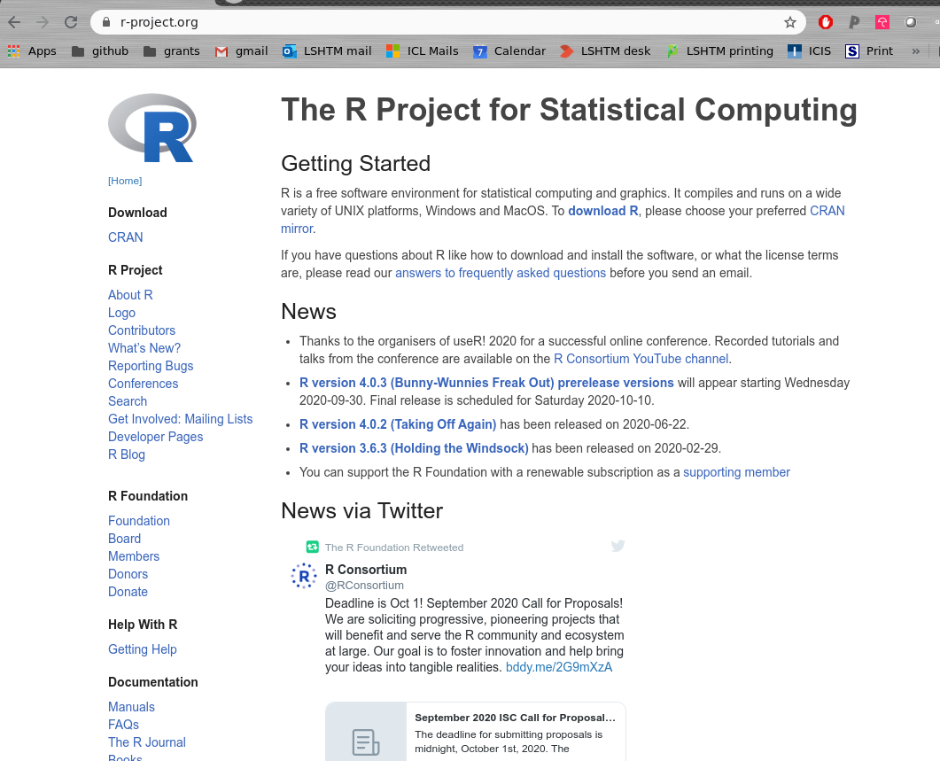
What is ?
a free software for data analysis
an interpreted programming language, derived from `S-plus’
initially developed by R. Ihaka and R. Gentleman (1996)
currently developed by the R Core Team (~20 people)
largest collection of tools for data analysis (1,000s of contributors and specific packages)

Slide 4

Where can you get it?
The R project: www.r-project.org
archiving / distribution network CRAN: cran.r-project.org/mirrors.html
available on Windows, MacOSX, Linux

Slide 5

What can you do with it?
basic statistics: statistical tests, linear modelling, multivariate analysis
spatial statistics: GIS, mapping, clustering
graph theory: social sciences, network analysis, graph algorithm
genetics: phylogenetic trees, genetic markers, genomics
epidemiology!

Slide 6

What does “free” mean?
Freedom = ability to make informed decisions
you don’t pay for it
the code is accessible by anyone
anyone can use, modify and share the code

Slide 7
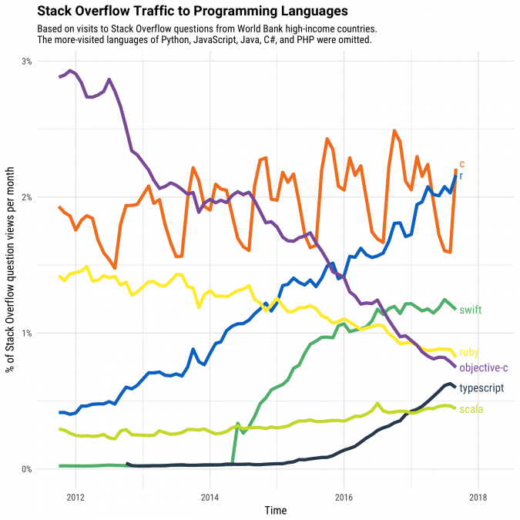
Growing use
Notes:
https://www.google.com/search?q=r+popularity+over+time&rlz=1C1GCEV_enGB824GB824&sxsrf=ALeKk03fhtiXNSrqg9gSiebeluxYbhsAeQ:1609253445085&source=lnms&tbm=isch&sa=X&ved=2ahUKEwjqlMqfuPPtAhUCQxUIHdIpCF8Q_AUoAXoECA4QAw&biw=1366&bih=657#imgrc=1MeGV5XO7KAq_M

Slide 8




and the ‘epi’ community
R Epidemics Consortium (RECON)
NGO for the development of resources for health emergencies, with strong focus on outbreak response
20+ packages for outbreak analytics
Share needs on COVID-19 challenge
www.repidemicsconsortium.org
R4epis
Partnership between MSF + RECON
Analysis templates for field epidemiologists
R4epis.netlify.app
RECON learn
Free / open training material by RECON
www.reconlearn.org

Slide 9


Alternatives to R
Python
Both are frequently used in data science, and both are free
Python is better for analyses that need scaling up
R is better for investigative “one-time” analyses
R more commonly used in medical research
Python more commonly used in industry
Stata
R and Stata most commonly used languages in medical research
Commonly taught in medical statistics & epidemiology courses
Requires a licence, but has official help
Strong statistical analyses capabilities
Less developed data visualization

Slide 10


Alternatives to R
SPSS
Statistical Package for the Social Sciences
Excel
Very widely used
Many researchers’ first exposure to a statistical program
Usually used as a “point and click”, although can write code
Use is declining, and also requires a licence
Can be helpful for “having a look” at the data
Generally not suitable for research-level inferential statistical analyses

Slide 11

Getting started
get R for your system (download from CRAN)
get a Graphical User Interface (GUI): RStudio, emacs + ESS, Tinn-R
(or at least) get a text editor to write code: notepad++, emacs, vi, Tinn-R, …

Slide 12

R Studio
R Studio is an Integrated Development Environment (IDE) for R
i.e. it makes doing things in R easier and more structured
Some advantages include:
An organised environment for your projects
Colour-coding, auto-completed brackets, auto-structuring
Keeping track of which packages have been installed, and which variables have been defined
Fixed quadrants for code and graphical outputs
Notes:
Show Rstudio
Show how to run code, see the output (e.g. 2+2), create a variable

Slide 13
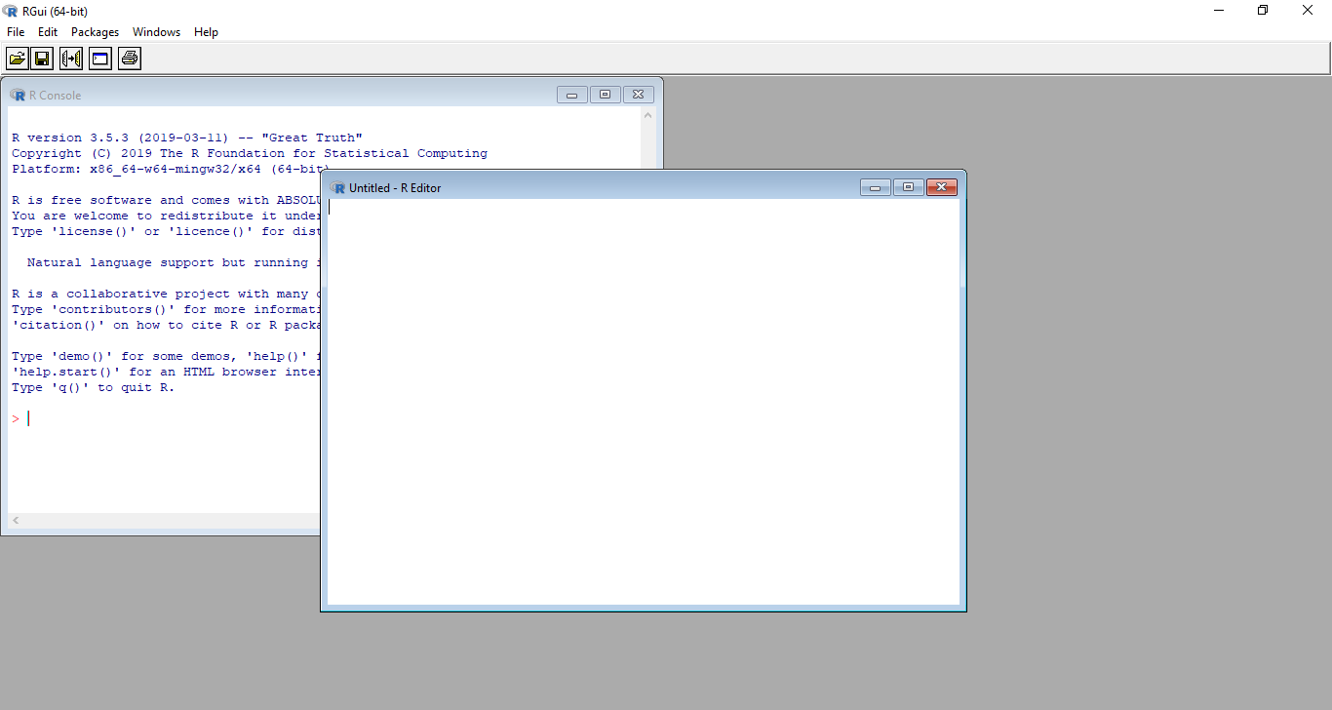
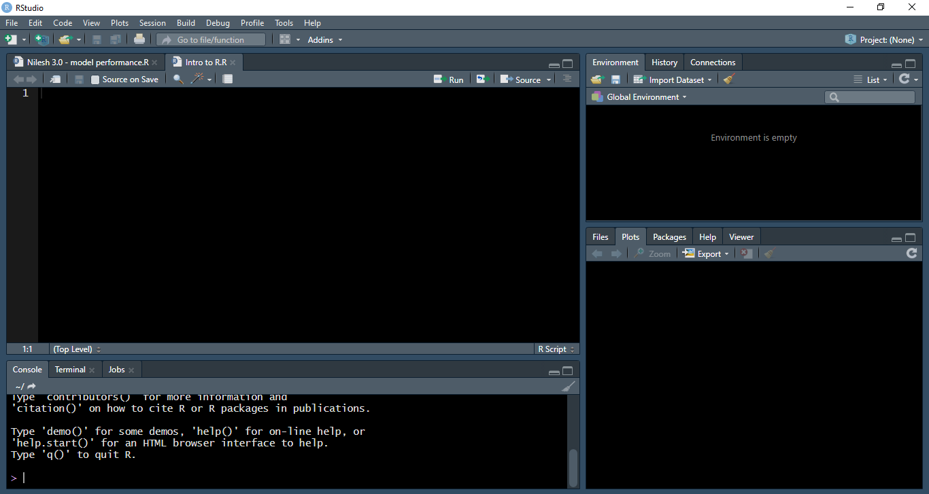
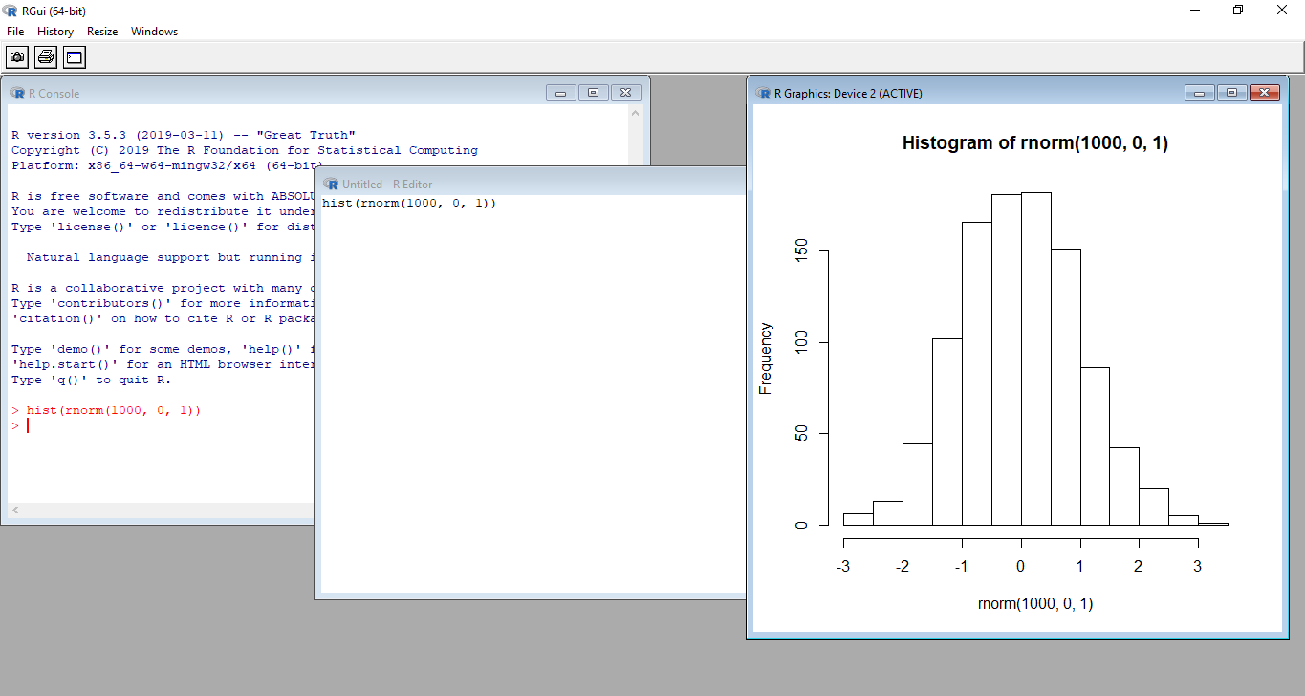
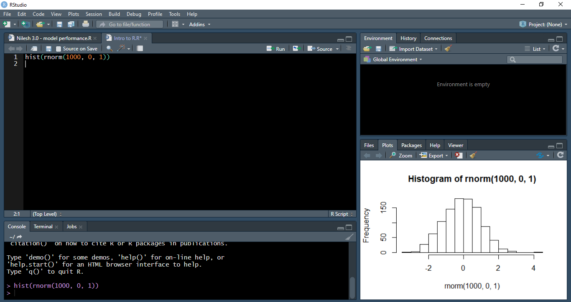
R (without R Studio)
graphs appear in a new window
R Studio
graphs appear in bottom-right quadrant
Notes:
Much easier to keep track of, and can easily cycle through old plots too

Slide 14
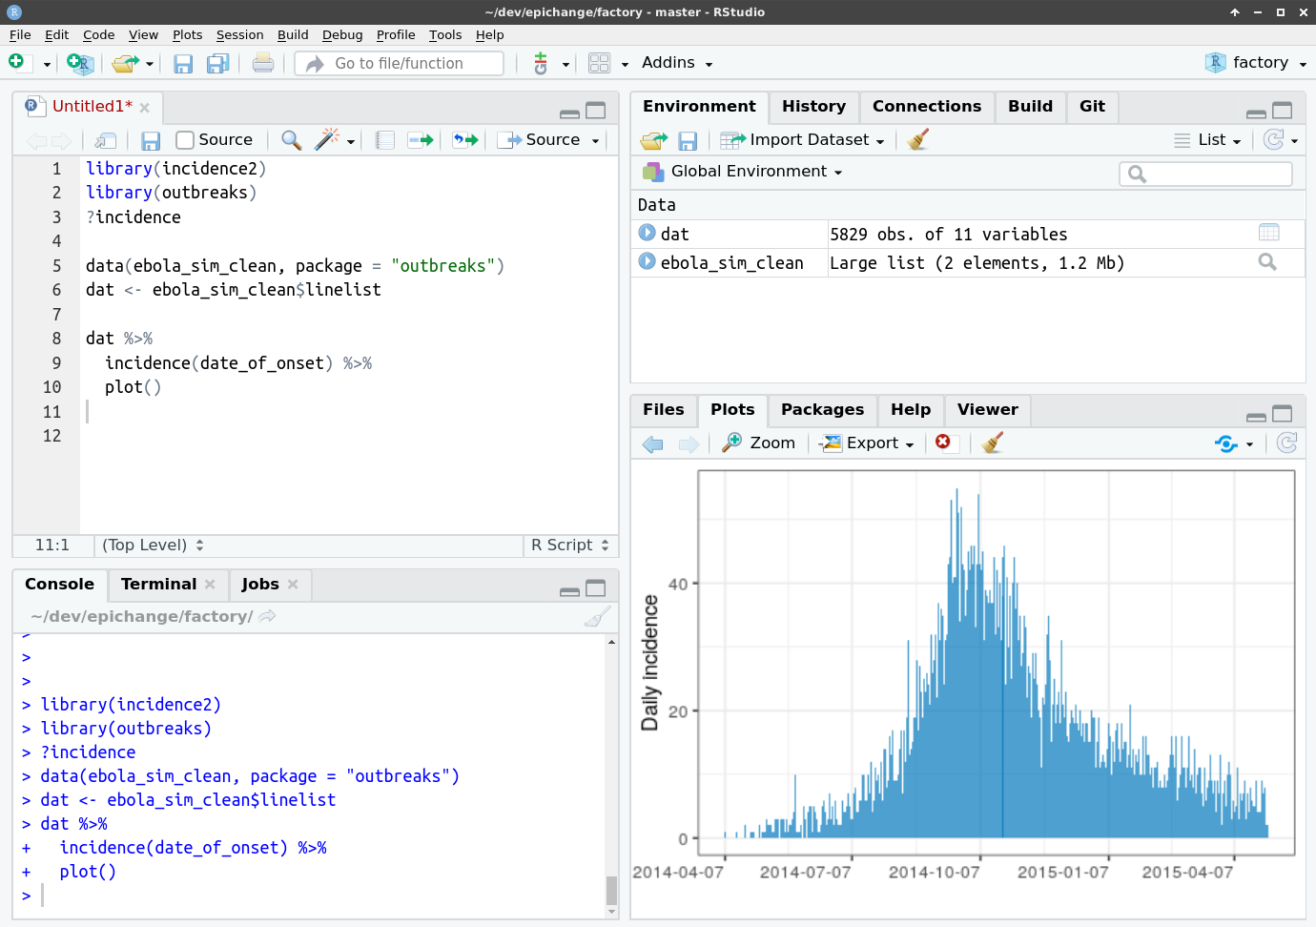
Getting familiar with RStudio
Overview of objects in the session
Script file:
write code here
R console: Evaluate code here
File browser, Graphics, help, packages loaded

Slide 15
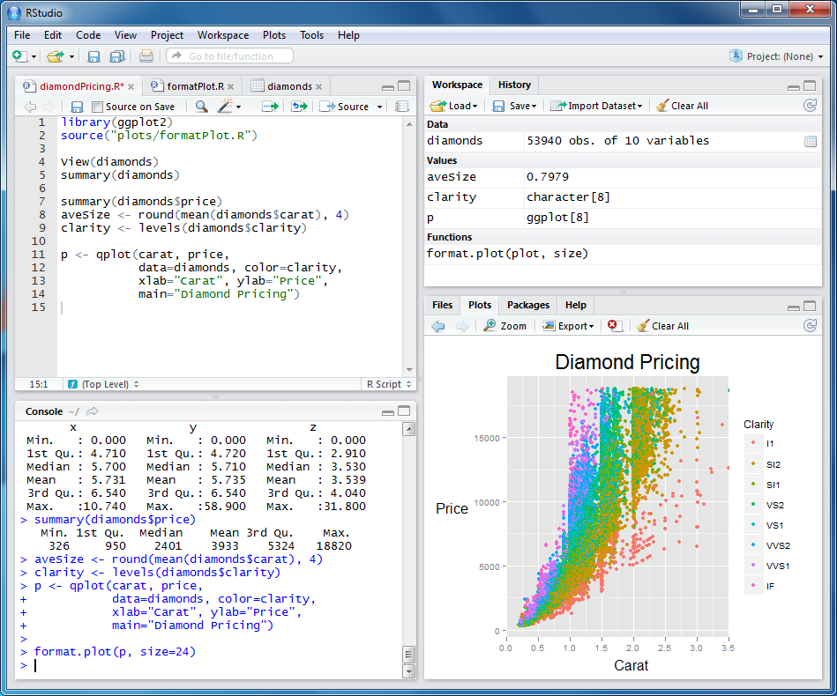
And then…

Slide 16

Getting help
?foo or help("foo"): access the help page of foo
??bar or help.search("foo"): look for foo in help pages
dedicated mailing lists: stat.ethz.ch/mailman/listinfo
the RECON forum: http://www.repidemicsconsortium.org/forum/
google

Slide 17



Someone’s done it before!
Stack overflow
Stack exchange (methods )
R-bloggers (chat, templates, examples)
https://stackoverflow.com/
https://stats.stackexchange.com/
https://www.r-bloggers.com/

