Slide 1


Day 1 Lecture 2: Getting started with R
Short course on modelling infectious disease dynamics in R
Ankara, Türkiye, June 2023
Dr Juan F Vesga

Slide 2
Aims of the session
Understand the R engine and syntax
Introduce initial important notions of R programming
Learn the basic syntax of R language
Understand data objects
Understand user defined functions

Slide 3
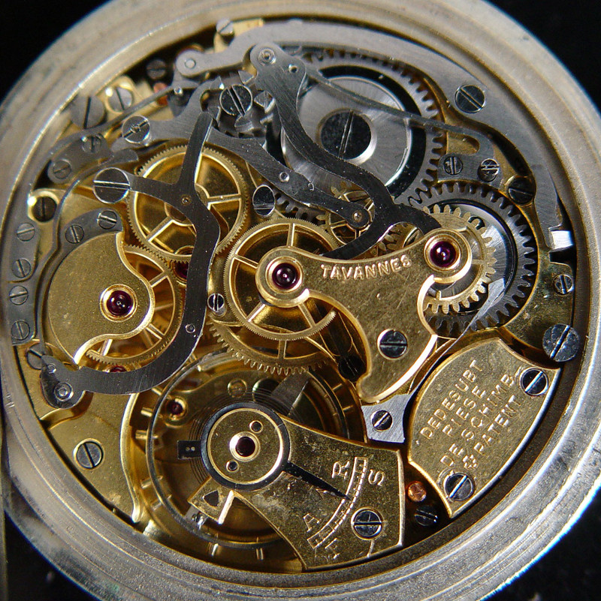
How does R store information?
no files, all in the RAM (i.e. temporary memory)
data, results, functions, etc. are all R objects
one object can be saved / loaded using saveRDS/readRDS (output: .rds files)
several objects can be saved / loaded using save/load (output: .RData files)
an entire session can be saved using save.image

Slide 4
How to create objects?
General syntax: object_name <- content:
Assignment
Object
script
toto <- 1:8
toto # check content: 1, 2, 3, ...
console
## [1] 1 2 3 4 5 6 7 8
Result if you check in the console
Note: In R, the syntax “<-” is used to reflect assignment, if you use “=” it will work but can
be confusing as is not the convention among R users

Slide 5
How to create objects?
General syntax: object_name <- content:
script
toto <- “some text”
toto # reassigned a different value
console
## [1] "some text"
Note: The object “toto” is just an envelope. You can put inside any value you want and change it as you want.

Slide 6
Round numbers: integer
a <- 1:10
a
## [1] 1 2 3 4 5 6 7 8 9 10
class(a)
## [1] "integer"

Slide 7
Decimal numbers: numeric
b <- c(-0.1, 10.123, pi)
b
## [1] -0.100000 10.123000 3.141593
class(b)
## [1] “numeric"

Slide 8
Text: character
a <- c("hello world", "hello Turkey!")
a
## [1] "hello world“ "hello Turkey!"
class(a)
## [1] "character"

Slide 9
Categorical variables: factor
a <- factor(c(“red", “blue", “green", “red") )
a
## [1] red blue green red
## Levels: blue green red
class(a)
## [1] “factor"
levels(a)
## [1] "blue" "green" “red"

Slide 10
Booleans: logical
The logical type can be TRUE or FALSE:
a <- c(TRUE, FALSE, TRUE,TRUE)
a
## [1] TRUE FALSE TRUE TRUE
class(a)
## [1] “logical"
Booleans can also be interpreted as 0’s (FALSE) and 1’s (TRUE), hence:
a + 1
## [1] 2 1 2 2

Slide 11
Vectors
A vector stores several values of the same type as a one-dimensional array:
a <- c(1, 2, -2 , 1.123)
a
## [1] 1.000 2.000 10.000 -1.000 1.123
length(a)
## [1] 5

Slide 12
Matrices
A matrix stores several values of the same type as a table:
a <- matrix(sample(1:12),ncol = 4)
a
## [,1] [,2] [,3] [,4]
## [1,] 12 7 8 4
## [2,] 11 10 2 5
## [3,] 1 6 9 3
class(a)
## [1] “matrix”
dim(a)
## [1] 3 4

Slide 13
Data Frames
A data.frame is a table where variables (columns) can have different types (equivalent to a spreadsheet):
a <- data.frame(age = c(10, 54, 3), sex = c("m", "f", "m"))
a
## age sex
## 1 10 m
## 2 54 f
## 3 3 m
class(a)
## [1] “data.frame”
dim(a)
## [1] 3 2

Slide 14
Lists
A list is a collection of objects of any types and sizes, stored as different slots. It is a powerful structure to save information
age <- c(10, 54, 3)
sex <- factor(c("m", "f", "m"))
swab <- matrix(
sample(c("+", "-"), replace = TRUE, 10), nrow = 2,
dimnames = list(NULL, paste("t", 1:5, sep = "")))
x <- list(age = age, gender = sex, swab_results = swab)

Slide 15
Lists (continued)
A list is a collection of objects of any types and sizes, stored as different slots. It is a powerful structure to save information
x
## $age
## [1] 10 54 3
##
## $gender
## [1] m f m
## Levels: f m
##
## $swab_results
## t1 t2 t3 t4 t5
## [1,] "+" "+" "-" "+" "+"
## [2,] "+" "+" "+" "-" "+"

Slide 16
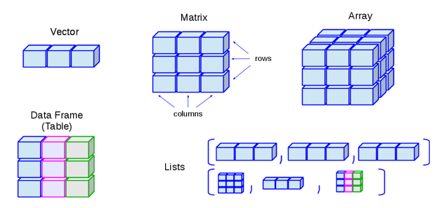
Data structures summary
Vectors
Matrices and arrays
Data frames
Lists
R has some datasets already loaded
G. Tiwari, 2019. https://medium.com/@tiwarigaurav2512/r-data-types-847fffb01d5b

Slide 17
Accessing contents in an object
The objects we reviewed can be accessed or subsetted by index, name, or logical condition. Using:
object_name[] for a vector
object_name[rows, columns] for a matrix / data.frame
object_name[[]] for a list
An index is an integer or set of integers that points to the position of an element in an array: my_vector[2]
Lists can be accessed using the name of the slot : my_list[[“age”]]
Note that square brackets imply access to an object, while parenthesis contain the arguments of a function

Slide 18
Using functions

Slide 19
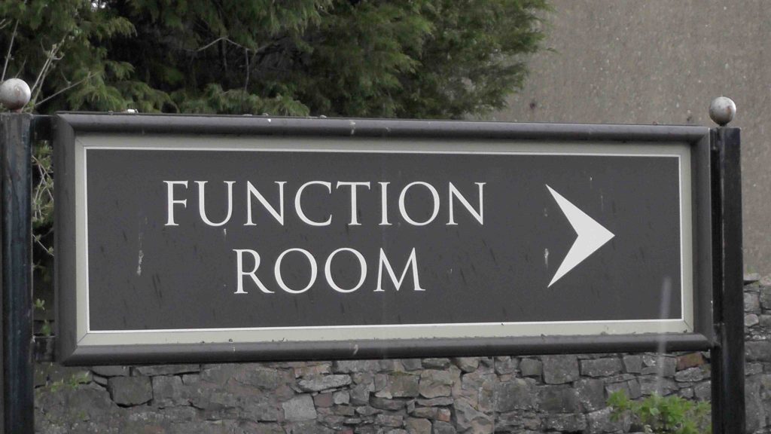
Functions
Functions are short-cuts for doing complicated things, e.g.
sort(c(2, 1, 3))=c(1, 2, 3)
abs(-4)=4
Functions can be written by:
R (i.e. already installed)
the user (i.e. you)
someone else (in a package)

Slide 20
What is a function?
A set of operations made on a given output
Syntax: function_name(argument1, argument2, …)
Example:
rnorm(8, mean=5, sd=3)
## [1] 2.713883 7.373878 9.364017 1.173302 6.436040 5.624428 7.107626
## [8] -1.727200

Slide 21
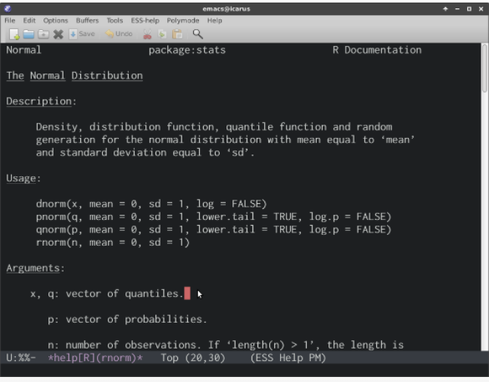
How to use a function?
When a function is created either by R or the user or a package, its definition can be retrieved using “?”
?rnorm

Slide 22
User defined functions
Apart from base R functions and functions in packages, you can create your own functions.
Syntax: function_name <- function(argument1, argument2,…)
{
# perform an operation using your arguments
x <- argument1 + argument2
return(x)
}
Naming functions is an important part of good coding: use meaningful names! : Sum_arguments (Good); func1 (Bad)

Slide 23
What we should know by now
How the R engine works
How to store information using R objects
Accessing your information
What are functions
How functions can be defined by the user

Slide 24
Good R resources to explore
R for Data Science - https://r4ds.had.co.nz/
Advanced R http://adv-r.had.co.nz/
R packages http://r-pkgs.had.co.nz/
RECONLearn https://www.reconlearn.org/

