Slide 1


Day 2 Lecture 1: Introduction to infectious disease modelling
Short course on modelling infectious disease dynamics in R
Ankara, Türkiye, June 2023
Dr Juan F Vesga

Slide 2
Aims of the session
To Understand what do we mean by infectious disease models
Introduced core concepts of infectious diseases dynamics
Familiarize with existing types of ID models

Slide 3
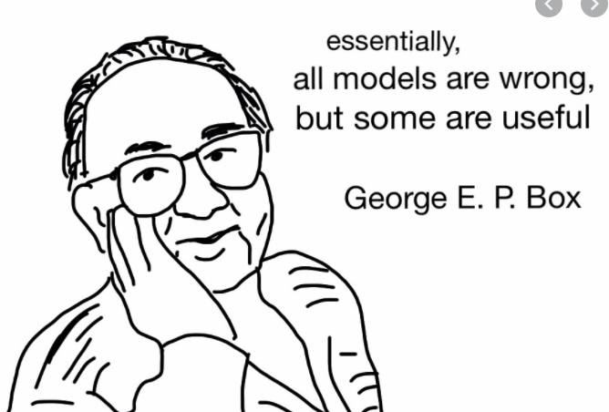
[Widely repeated quote goes here ]
…and it is true!

Slide 4
What are models
Some models intend to infer conclusions as we accrue more data
Most statistical models -> the model emerges from the data !
Some models intend to describe a mechanism behind a phenomenon
Mathematical models
Used for example in weather, physics, engineering, ecology, and infectious diseases!

Slide 5
We need to understand the phenomenon
Weather: very predictable -> laws of physics
Infectious diseases -> very complex!
Biology of the pathogen
Clinical characteristics
Host behaviour
Population dynamics
By definition a multidisciplinary field (all are welcome!)

Slide 6
So how does an ID model looks like?
For most people …
Danger!
complicated stuff inside
Data of all shapes and colours !
Shiny model output
Let’s unpack this black box (in three days!)

Slide 7
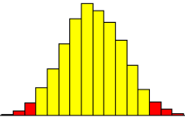



So how does an ID model looks like?
How it really looks…
A dynamic component!
Ia
$$λ$$
$$δ$$
S
Is
$$1−δ$$
Carefully selected
data to fuel
our mechanism
A design of our
phenomenon
described with maths
A model projection

Slide 8
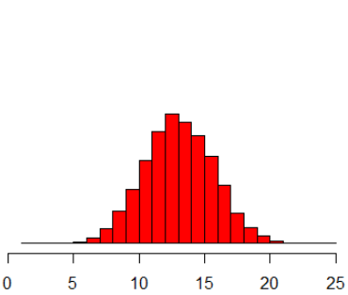


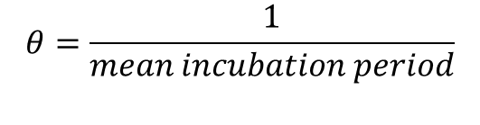
What type of data inputs?
Given we understand the mechanism we want to describe:
Let’s imagine a cohort where infected individuals become symptomatic
Model inputs are the pieces of information (facts) that bind together our model design.
We need statistics to interpret these binding links.
Infected
$$θ$$
Symptomatic
$$θ=\frac{1}{mean incubation period}$$
$$θ=\frac{1}{12 days}$$

Slide 9
What do we need to design a mathematical model?
Some maths
For compartmental models we use ordinary differential equations (ODEs)
Some statistics : for summarising model inputs and for processing model results

Slide 10
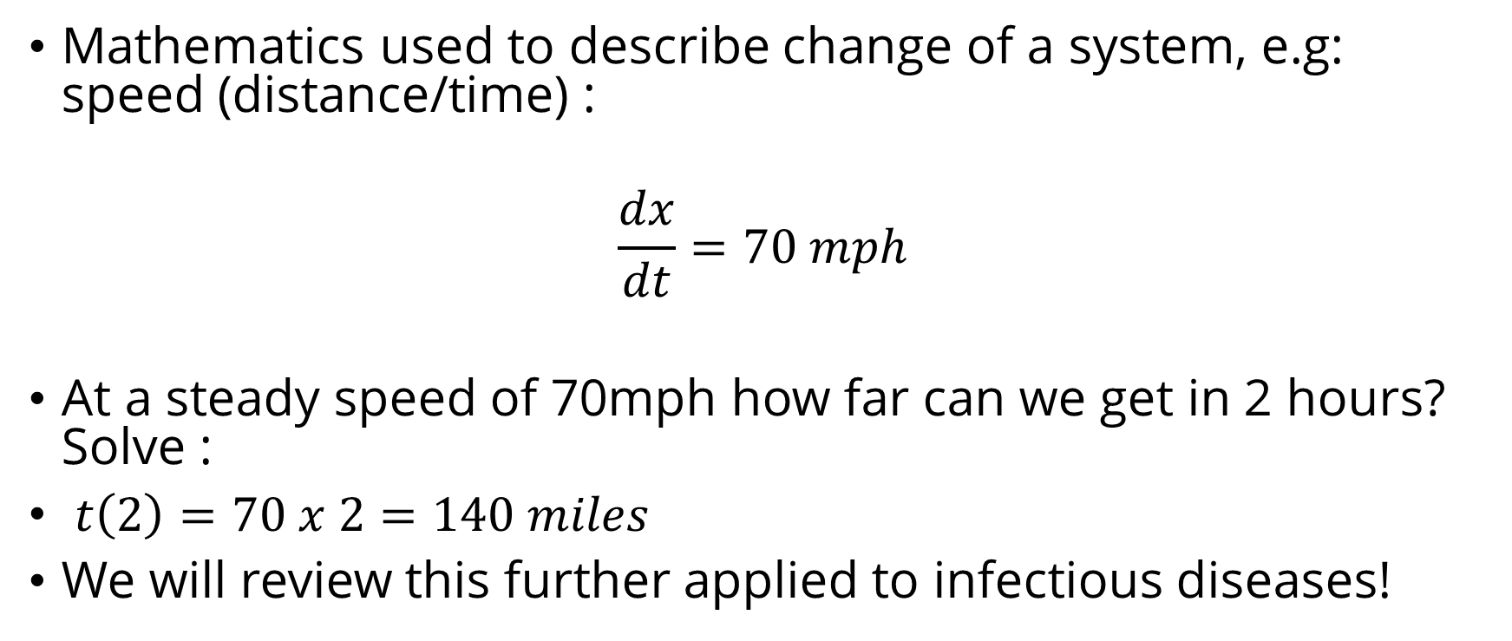
Ordinary differential equations (ODEs)
Mathematics used to describe change of a system, e.g: speed (distance/time) :
$$\frac{dx}{dt}=70 mph$$
At a steady speed of 70mph how far can we get in 2 hours? Solve :
$t\left(2\right)=70 x 2=140 miles$
We will review this further applied to infectious diseases!
Change in distance
Change in time

Slide 11



What about compartments?
The previous example requires one single function
We are interested in ODE systems with more than one state
It is clear that this system describes the average behaviour for such phenomenon
$$\frac{dI}{dt}=−I\left(t\right)θ$$
$$θ$$
Infected
Symptomatic
$$\frac{dS}{dt}=I\left(t\right)θ$$

Slide 12
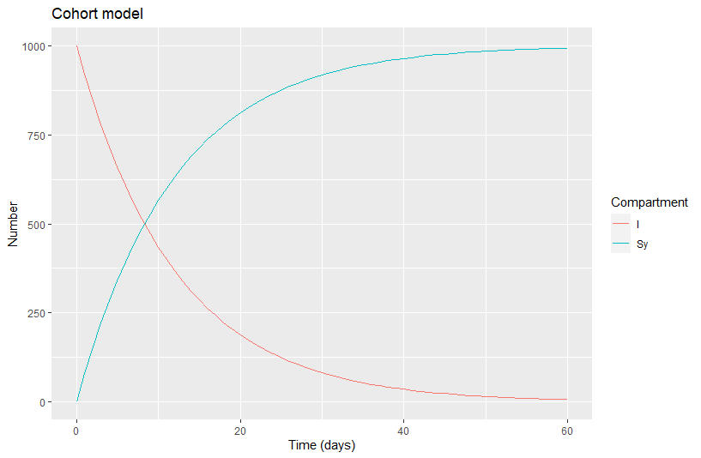


How we produce model output ?
Back to our previous system
$$\frac{dI}{dt}=−I\left(t\right)θ$$
Numerical integration using a software , R !
$$\frac{dS}{dt}=I\left(t\right)θ$$

Slide 13
What is the output?
Is the integration of our system over a time period
We project the value of our state variables (I and Sy) over 60 days
We don’t predict since our results come from a simplified systems and assumptions
Prediction is for statistics!

Slide 14
What about uncertainty in our results?
Ia
$$λ$$
$$δ$$
S
Is
$$1−δ$$
Uncertainty
in the inputs
Uncertainty
in the system
Results in uncertainty around our projections
We can explore this range
by calibrating our parameters
If we introduce stochasticity

Slide 15
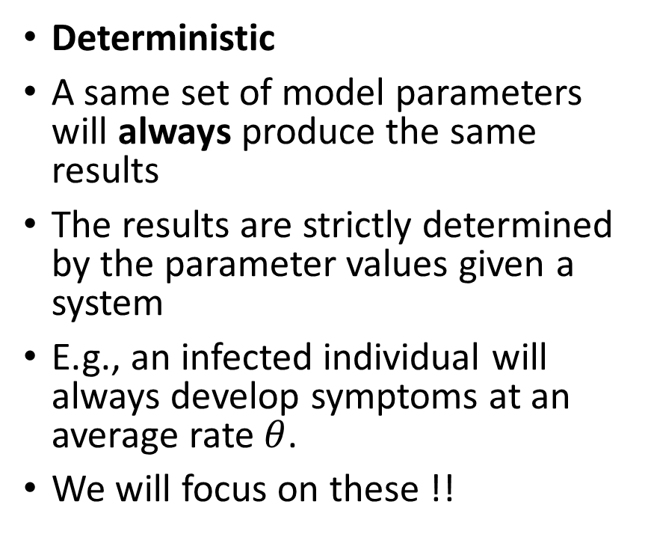
Types of mathematical models
Deterministic
A same set of model parameters will always produce the same results
The results are strictly determined by the parameter values given a system
E.g., an infected individual will always develop symptoms at an average rate $θ$.
We will focus on these !!
Stochastic
A same set of model parameters can produce different results
The results combine the input and randomness in the events of transition
E.g., an infected individual can or cannot develop symptoms out of chance.

Slide 16
Types of mathematical models
Compartmental
Describe the system of interest at the population level
Are good to understand the average behaviour of a phenomenon
Easier to interpret
Sometimes hard to code!
Individual
Simulate individuals
Easier to code
Harder to interpret
Computationally expensive
Require much more data

Slide 17
Focus in this short course
We are interested in public health, not in maths!
We want to apply mathematics and statistics to understand infectious diseases
These methods have a strong role in the current landscape of public health and can help improve global health!

Slide 18
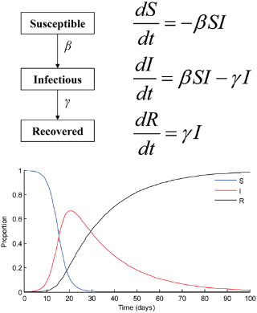
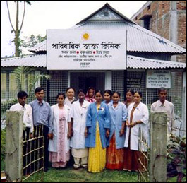

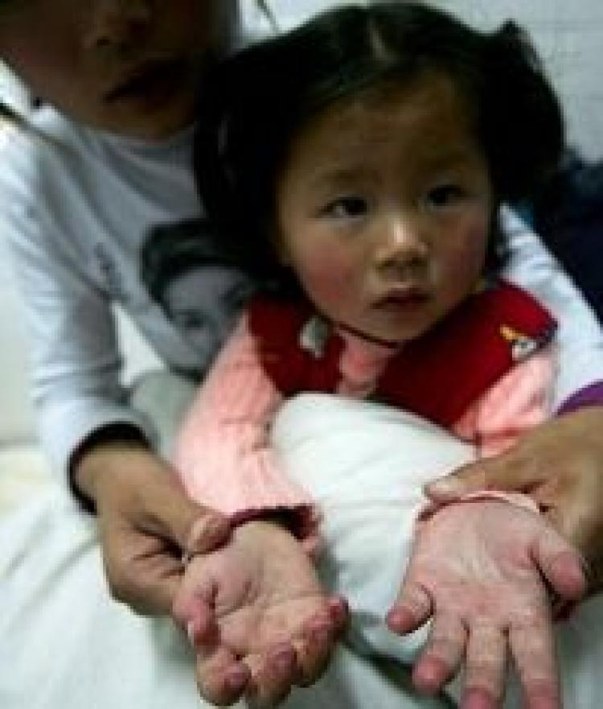
Roles of transmission models in public health
Supporting healthcare delivery
Informing decision-making
Basic science: contributing
to evidence base for policy
Notes:
These are fairly artificial distinctions really, since they overlap tremendously, but I think they give some overview of some of the roles that modelling has played in public health

Slide 19
What we should know by now
What is a mathematical model
What are the building blocks of models
What are the basic maths for describing a model
What types of mathematical models there are
How can models contribute to public health

