Slide 1


Day 2 Lecture 2: Basic concepts of compartmental models
Short course on modelling infectious disease dynamics in R
Ankara, Türkiye, June 2023
Dr Juan F Vesga

Slide 2
Aims of the session
To Understand how disease models are designed
Review concepts of probabilities, rates and competing hazards
Understand the assumptions behind compartmental models

Slide 3
Checklist for designing a disease model
Describe the natural course of disease
Identify the necessary transitions between compartments
Interpret these transitions and find the relevant data to estimate the parameters
Review your research question and adapt your model complexity accordingly
Code your model!

Slide 4




A simple example
Susceptible
Exposed
Infected
Recovered
S
$$λ$$
E
$$θ$$
I
$$γ$$
R
$$μ$$
Force of infection: Dynamic component
Let’s focus on this for now!

Slide 5


A cohort model
Infected
Recovered
How do we specify rates of transitions?
How multiple rates affect a compartment?
I
$$γ$$
R
$$μ$$

Slide 6
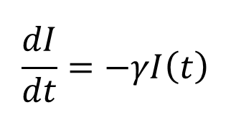
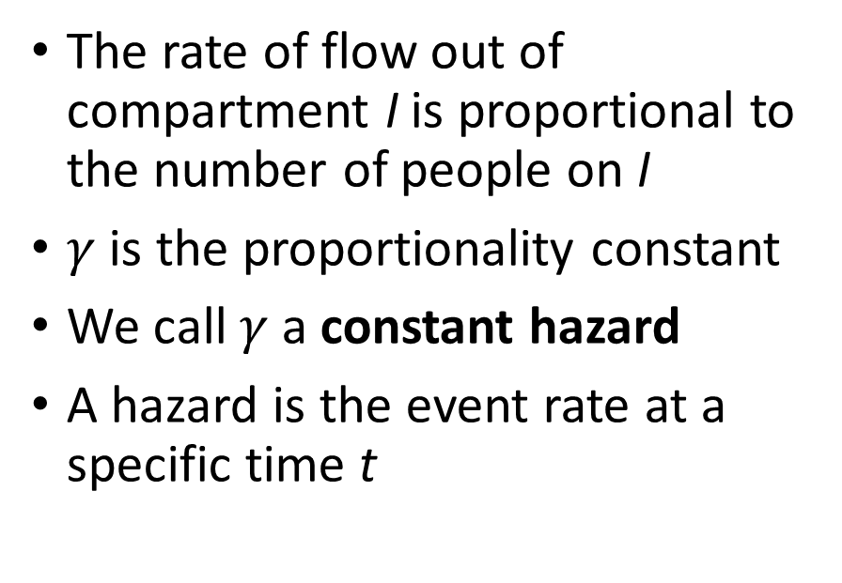
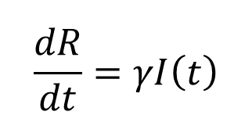
A cohort model
Infected
Recovered
The rate of flow out of compartment I is proportional to the number of people on I
$γ$ is the proportionality constant
We call $γ$ a constant hazard
A hazard is the event rate at a specific time t
I
$$γ$$
R
$$\frac{dI}{dt}=−γI\left(t\right)$$
$$\frac{dR}{dt}=γI\left(t\right)$$

Slide 7
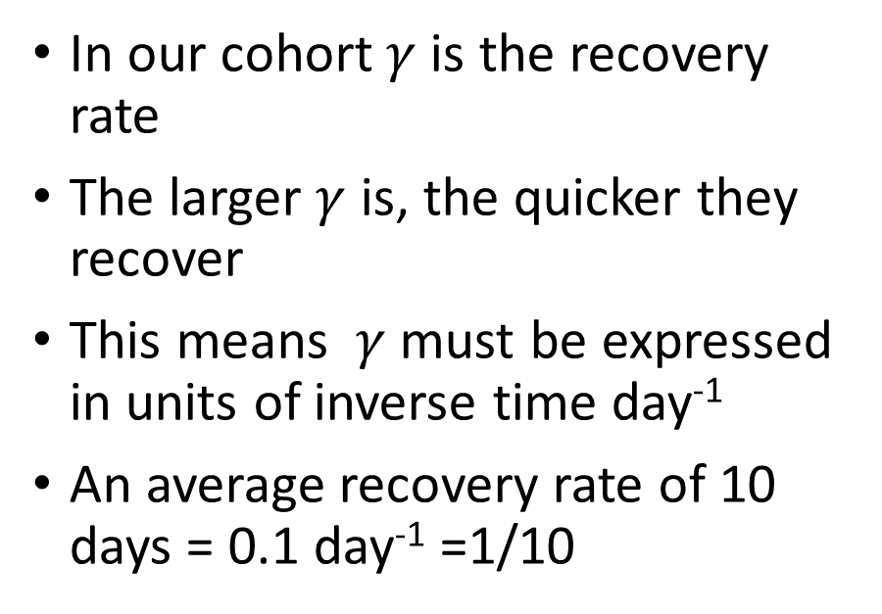
A cohort model
Infected
Recovered
In our cohort $γ$ is the recovery rate
The larger $γ$ is, the quicker they recover
This means $γ$ must be expressed in units of inverse time day⁻¹
An average recovery rate of 10 days = 0.1 day⁻¹ =1/10
I
$$γ$$
R
$$\frac{dI}{dt}=−γI\left(t\right)$$
$$\frac{dR}{dt}=γI\left(t\right)$$

Slide 8
So how do we interpret this transitions?
Infected
Recovered
An initial cohort of 1000 people infected
A recovery rate of 0.1 day⁻¹ (10 days)
When will 50% of infected be recovered?
I
$$γ$$
R
$$\frac{dI}{dt}=−γI\left(t\right)$$
$$\frac{dR}{dt}=γI\left(t\right)$$

Slide 9
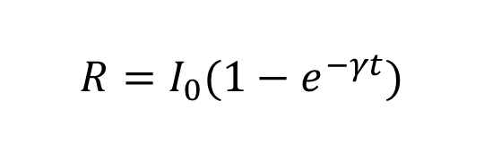

So how do we interpret this transitions?
Infected
Recovered
An initial cohort of 1000 people infected
A recovery rate of 0.1 day⁻¹ (10 days)
When will 50% of infected be recovered?
I
$$γ$$
R
Solution
$$\frac{dI}{dt}=−γI\left(t\right)$$
$$I=I_{0}e^{−γt}$$
$$\frac{dR}{dt}=γI\left(t\right)$$
$$R=I_{0}{(1−e}^{−γt})$$

Slide 10
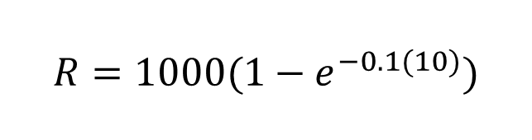
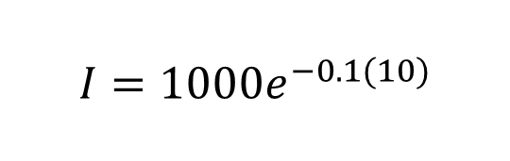
So how do we interpret this transitions?
Infected
Recovered
An initial cohort of 1000 people infected
A recovery rate of 0.1 day⁻¹ (10 days)
When will 50% of infected be recovered?
I
$$γ$$
R
Solution
$$\frac{dI}{dt}=−γI\left(t\right)$$
$$I=1000e^{−0.1(10)}$$
$$\frac{dR}{dt}=γI\left(t\right)$$
$$R=1000{(1−e}^{−0.1(10)})$$

Slide 11
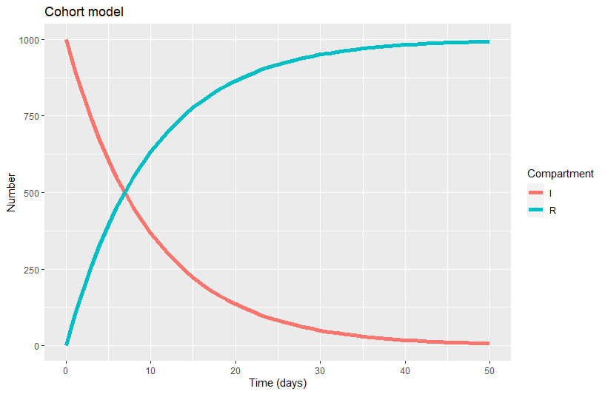
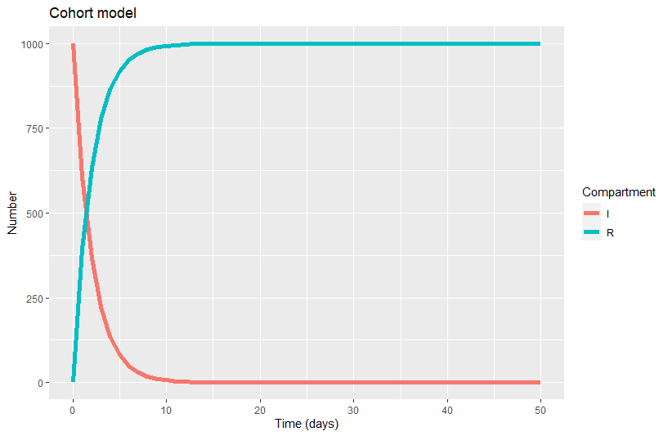
So how do we interpret this transitions?
Recovery rate of 10 days
Recovery rate of 2 days. Much quicker !

Slide 12
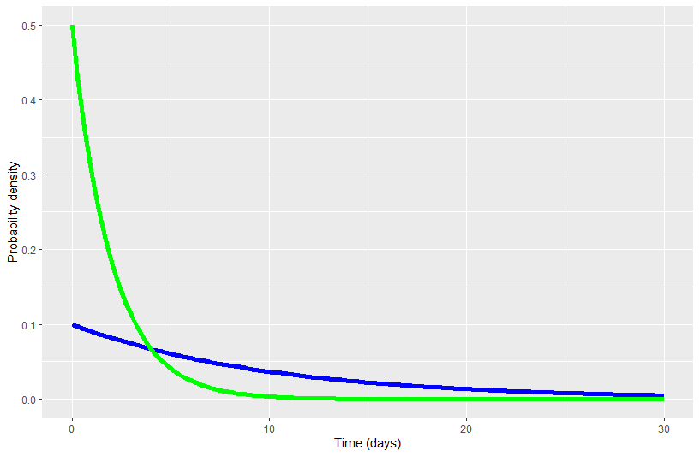
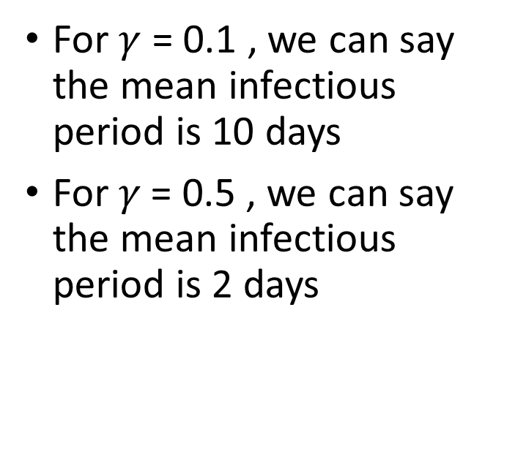


Behaviour of the exponential distribution
For $γ$ = 0.1 , we can say the mean infectious period is 10 days
For 𝛾 = 0.5 , we can say the mean infectious period is 2 days
$$γ=0.5$$
$$γ=0.1$$

Slide 13
Behaviour of the exponential distribution
The time spent in I follows an exponential distribution with exponential parameter 𝛾
The mean of that distribution is 1/ 𝛾 , which is in our case the mean infectious period (in days)
The shorter the infectious period, the larger (quicker) the recovery rate !
$$γ=0.5$$
$$γ=0.1$$

Slide 14
Competing Hazards
Infected
Recovered
Let’s add some complexity by adding a mortality rate
I
$$γ$$
R
$$\frac{dI}{dt}=−γI\left(t\right)$$
$$\frac{dR}{dt}=γI\left(t\right)$$

Slide 15
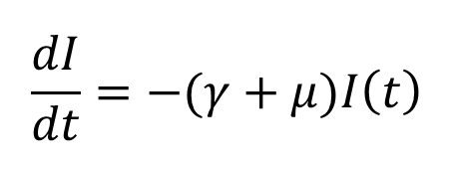
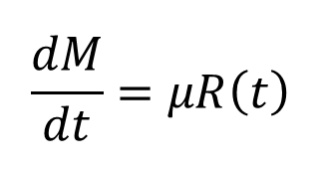
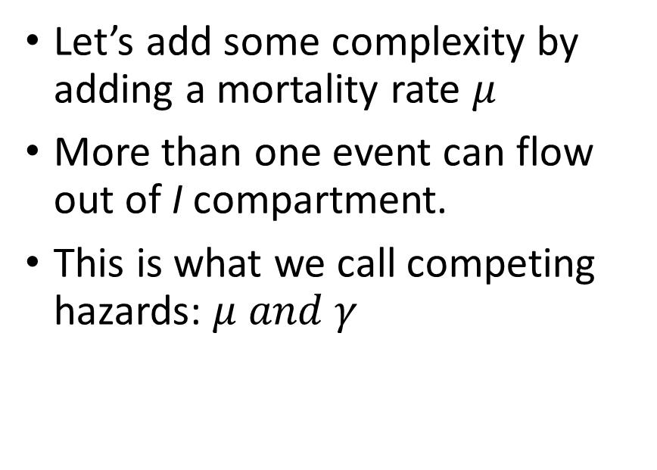
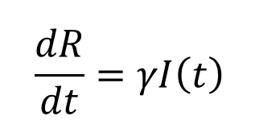
Competing Hazards
Infected
Recovered
Let’s add some complexity by adding a mortality rate $μ$
More than one event can flow out of I compartment.
This is what we call competing hazards: $μ and γ$
I
$$γ$$
R
$$μ$$
M
$$\frac{dI}{dt}=−(γ+μ)I\left(t\right)$$
$$\frac{dR}{dt}=γI\left(t\right)$$
$$\frac{dM}{dt}=μR\left(t\right)$$

Slide 16
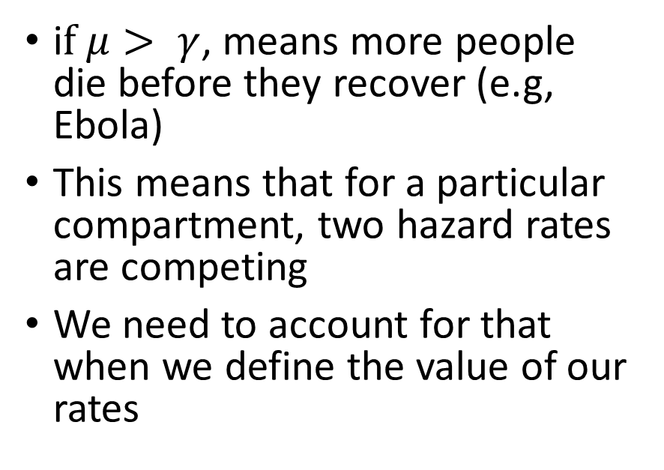
Competing Hazards
Infected
Recovered
i$f μ> γ$, means more people die before they recover (e.g, Ebola)
This means that for a particular compartment, two hazard rates are competing
We need to account for that when we define the value of our rates
I
$$γ$$
R
$$μ$$
M
$$\frac{dI}{dt}=−(γ+μ)I\left(t\right)$$
$$\frac{dR}{dt}=γI\left(t\right)$$
$$\frac{dM}{dt}=μR\left(t\right)$$

Slide 17
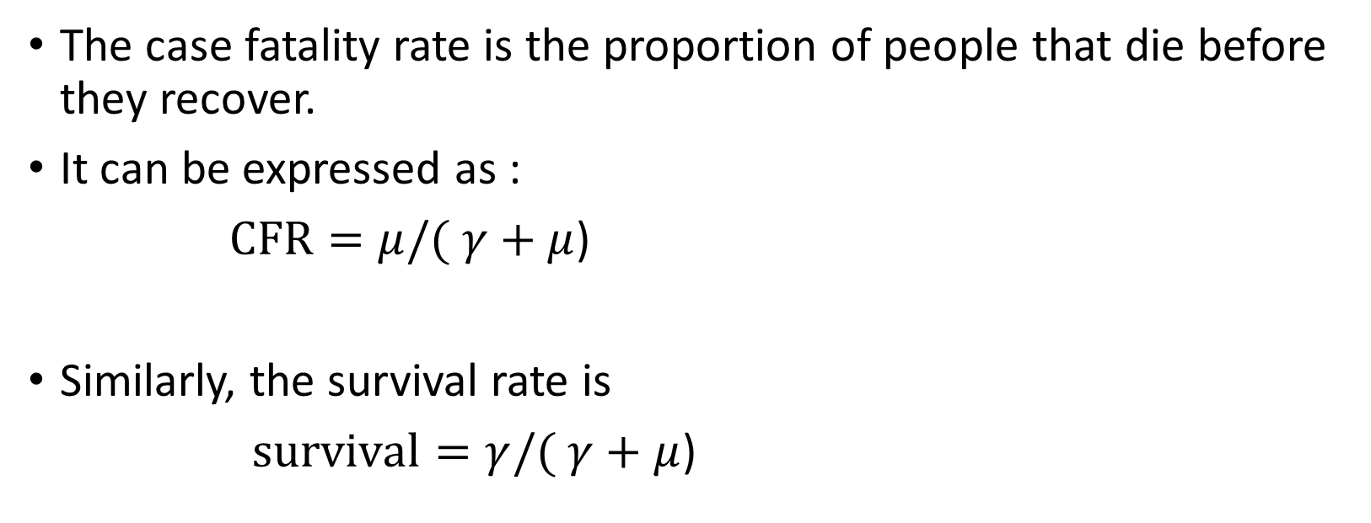
Competing Hazards: CFR
The case fatality rate is the proportion of people that die before they recover.
It can be expressed as :
$CFR=μ/( γ+μ$)
Similarly, the survival rate is
$survival=γ/( γ+μ$)

Slide 18
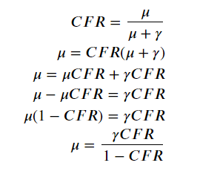
Competing Hazards: estimate μ from CFR
Some algebra
This is what we need

Slide 19
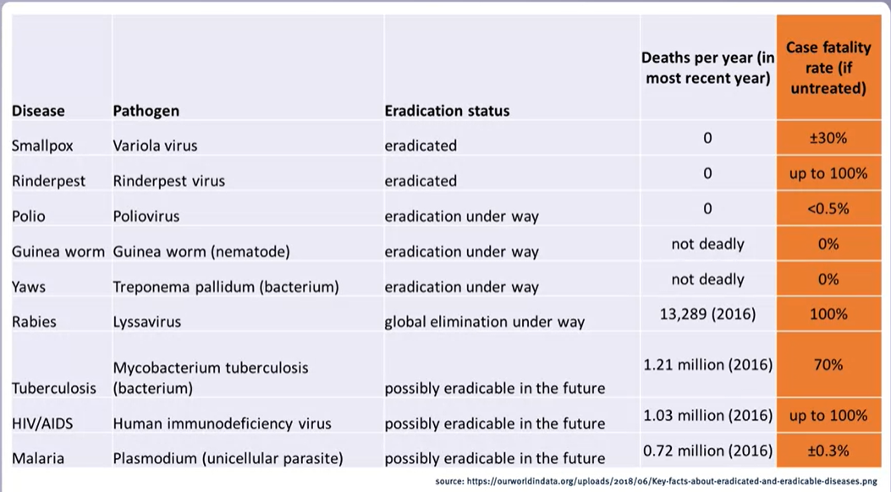

Slide 20
What we should know by now
What are compartmental models
How we use ODEs to write these models
What are hazard rates and how can be interpreted
What are competing hazards and why are these important.
What is the case fatality rate (CFR)

