Slide 1


Day 3 Lecture 1: The SIR model
Short course on modelling infectious disease dynamics in R
Ankara, Türkiye, June 2023
Dr Juan F Vesga

Slide 2
Aims of the session
Learn what is the process of transmission in the SIR model
Understand the assumptions of the SIR model
Describe the force of infection and its components

Slide 3



The SIR model
Susceptible
Infected
Recovered
We have explored linear transitions in a cohort model I -> R
What does it take to introduce a process of transmission?
S
$$λ$$
I
$$γ$$
R
$$μ$$

Slide 4
The Force of Infection (FOI)
Susceptible
Infected
Recovered
An increase in FOI should reflect an increase in the chance of any S meeting an infected person
How do we do that?
S
$$λ$$
I
$$γ$$
R
$$μ$$
Force of infection: Dynamic component

Slide 5
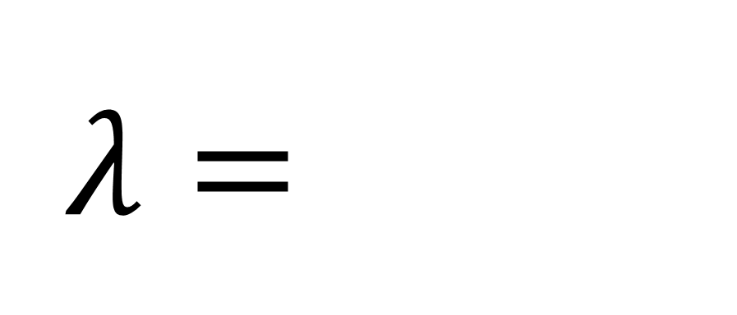
The Force of Infection (FOI) deconstructed
$$λ=pc\frac{I}{N}$$

Slide 6
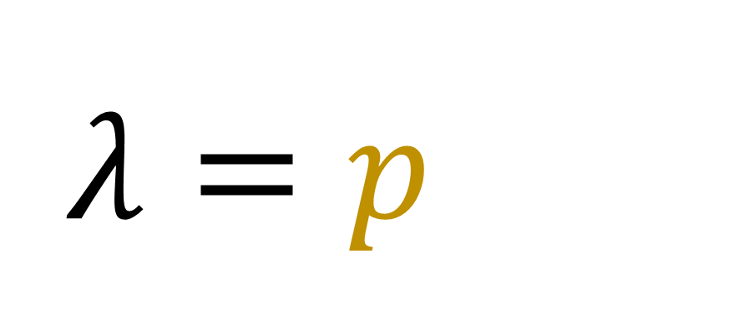
The Force of Infection (FOI) deconstructed
Per contact probability of transmission
$$λ=pc\frac{I}{N}$$

Slide 7
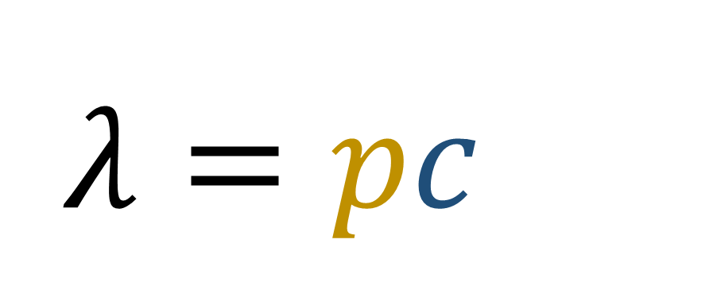
The Force of Infection (FOI) deconstructed
Average contact rate per unit time
Per contact probability of transmission
$$λ=pc\frac{I}{N}$$

Slide 8
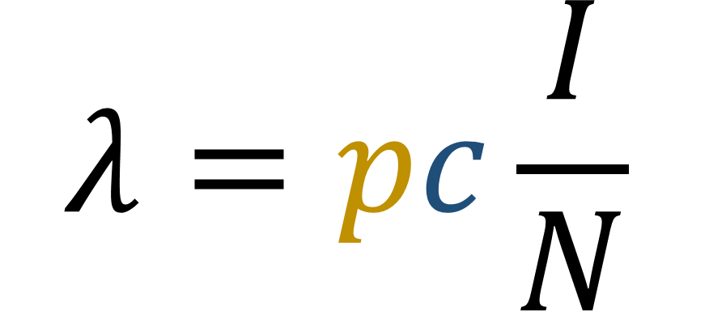
The Force of Infection (FOI) deconstructed
Average contact rate per unit time
Number infected
Per contact probability of transmission
I/N = Prevalence!!
$$λ=pc\frac{I}{N}$$
Total population

Slide 9
The Force of Infection (FOI) deconstructed
Average contact rate per unit time
Number infected
Per contact probability of transmission
$$λ=pc\frac{I}{N}$$
Total population
Usually hard
to estimate

Slide 10
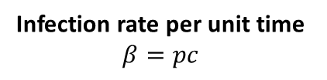
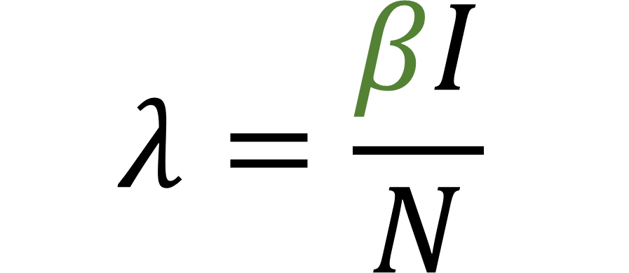
The Force of Infection (FOI) deconstructed
Infection rate per unit time
$$β=pc$$
Number infected
$$λ=\frac{βI}{N}$$
Total population

Slide 11
The Force of Infection (FOI) deconstructed
Infection rate is
a constant
I is a state variable
A small I means a small λ
FOI changes over time
We allow λ to be a function of other model variables
$$λ=\frac{βI}{N}$$

Slide 12
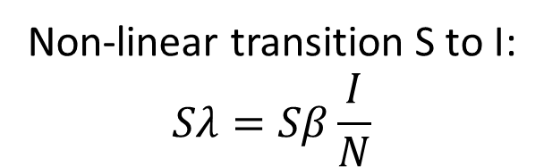
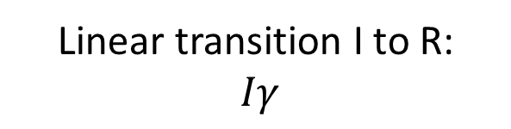
Transitions in the SIR model
Susceptible
Infected
Recovered
Linear transition I to R:
$Iγ$
S
$$λ$$
I
$$γ$$
R
$$μ$$
Non-linear transition S to I:
$$Sλ=Sβ\frac{I}{N}$$
This is the engine of the transmission model!!

Slide 13






Differential equations for the SIR
Susceptible
Infected
Recovered
S
$$λ$$
I
$$γ$$
R
Same as..
$$μ$$
$$\frac{dS}{dt}=−Sλ(t)$$
$$\frac{dS}{dt}=−Sβ\frac{I}{N}$$
$$\frac{dI}{dt}=Sλ(t)−Iμ−Iγ$$
$$\frac{dI}{dt}=Sβ\frac{I}{N}−Iμ−Iγ$$
$$\frac{dR}{dt}=Iγ$$
$$\frac{dR}{dt}=Iγ$$

Slide 14

Lessons from the SIR model
If$λ=pc\frac{I}{N}$ , then the same infection in a population with a larger c will result in a higher force of infection
Similarly, biological factors of the pathogen affecting p mean that different infections will have different FOI in the same population

Slide 15
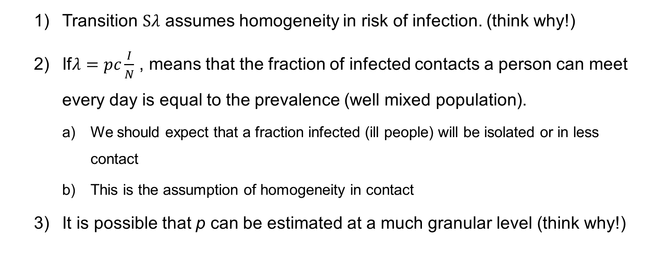
Assumptions in the SIR model
Transition $Sλ$ assumes homogeneity in risk of infection. (think why!)
If$λ=pc\frac{I}{N}$ , means that the fraction of infected contacts a person can meet every day is equal to the prevalence (well mixed population).
We should expect that a fraction infected (ill people) will be isolated or in less contact
This is the assumption of homogeneity in contact
It is possible that p can be estimated at a much granular level (think why!)

Slide 16
What we should know by now
What is an SIR model
What is the force of infection
What are the components of the force of infection
What are the main assumptions behind the SIR model

