Slide 1


Day 3 Lecture 2: Understanding the phases of an epidemic
Short course on modelling infectious disease dynamics in R
Ankara, Türkiye, June 2023
Dr Juan F Vesga

Slide 2
Aims of the session
Understand why epidemics rise
Understand why epidemics peak
Understand why epidemics fade out
Examine the concept of heard immunity
Understand R₀ and R_{eff}

Slide 3
What it takes for an epidemic to rise?
A rate of infection -> transmission!
A window of opportunity -> infectious period !
In general an epidemic starts if a pathogen is able to transmit quickly enough in that window of opportunity
Other factors play a role too, like virulence behaviours etc.

Slide 4

What it takes for an epidemic to rise?
8
New Infections
New Infections
Exponential growth
1
1
time
time
Average of 1 new case per infection
Average of 2 new cases per infection

Slide 5
R₀ (basic reproduction number)
Average number of secondary infections caused by a single infectious case in a fully susceptible population
If R₀ > 1 , an epidemic start
If R₀ < 1 , an epidemic fails

Slide 6
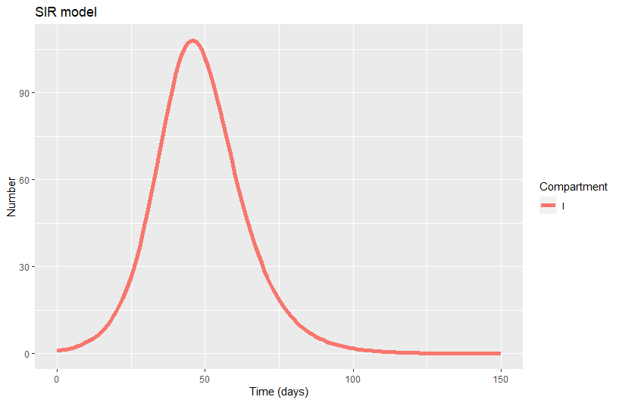
Exponential growth of an epidemic

Slide 7
What are the phases?
Why does it peaks?
Why does it declines?
R0 > 1 means an epidemic grows exponentially
Does it reach zero?

Slide 8
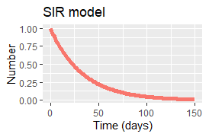
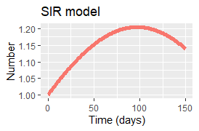
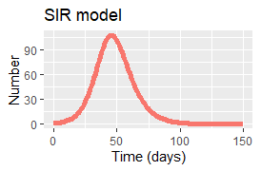
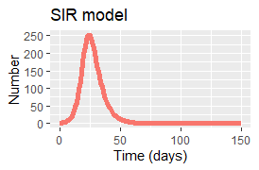
Epidemic growth and R₀
R0 = 1
R0 = 1.2
R0 = 2
R0 = 3
Behaviour of the number infected under different assumptions of R0 for an SIR model with a close population

Slide 9
Epidemic peak
Why does it peaks?

Slide 10

Epidemic peak
We know that R0 plays a role in the epidemic rise.
A second actor is immunity
10

Slide 11
Epidemic peak
We know that R0 plays a role in the epidemic rise.
A second actor is immunity
At the peak, the fraction susceptible in the population is insufficient to satisfy R0 for each infected case
11

Slide 12
Epidemic peak
Reff=1
Reff<1
R0 is defined for a fully susceptible population
When immunity plays a role, we can define R_{eff}
A depletion of Susceptible drives the epidemic down
Reff>1
R_{eff} is the average number of secondary cases arising from an infected case at a given point in time
12

Slide 13
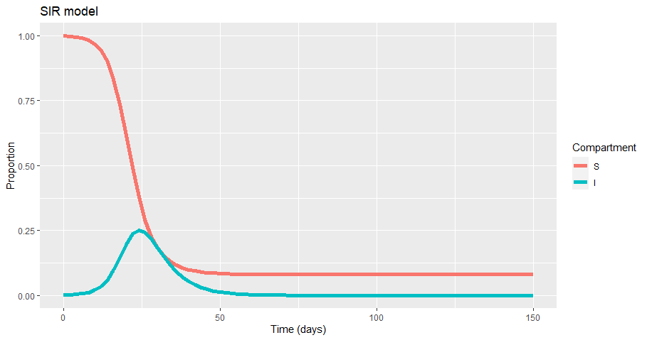
Epidemic peak
Does everybody gets infected?
No!
Insufficient susceptible to sustain Reff > 1
13

Slide 14
Herd immunity
Reff =1
Can be raised artificially with vaccination
What is the fraction immune at which an epidemic fails?

Slide 15

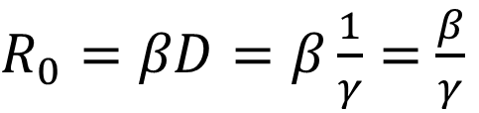



How can this be explained in terms of SIR
Susceptible
Infected
Recovered
At t=0
S
$$λ$$
I
$$γ$$
R
$R_{0}=βD=β\frac{1}{γ}=$ $\frac{β}{γ}$
$$β\frac{I}{N}$$
$$\frac{1}{D}$$
Average number of secondary infections in the total duration of the infectious period
Average secondary
infections per unit time
Number of unit times
D= duration of infectious period

Slide 16
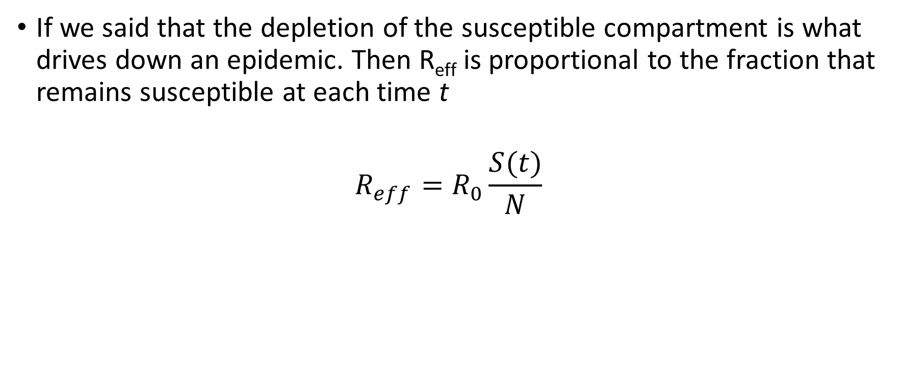
And R_{eff} ?
If we said that the depletion of the susceptible compartment is what drives down an epidemic. Then R_{eff} is proportional to the fraction that remains susceptible at each time t
$$R_{eff}=R_{0}\frac{S(t)}{N}$$

Slide 17
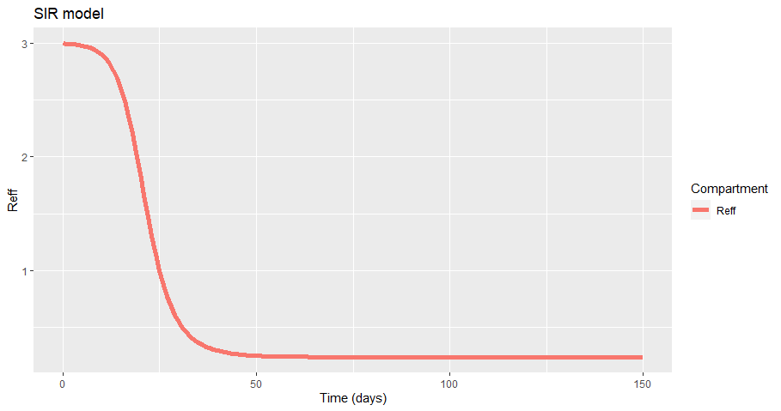






Herd immunity
Fraction immune necessary to bring epidemic down
Example for R0=3
$$R_{eff}=1$$
$$\frac{S(t)}{N}=\frac{1}{R_{0}}$$
$$R_{0}\frac{S(t)}{N}=1$$
$$\frac{S(t)}{N}=\frac{1}{3}=0.33$$
$$\frac{S(t)}{N}=\frac{1}{R_{0}}$$
HIT $=1−0.33=0.66$
Fraction susceptible below which epidemic declines
Herd immunity threshold

Slide 18
What if we have susceptible renewal?
Does it reach zero?

Slide 19
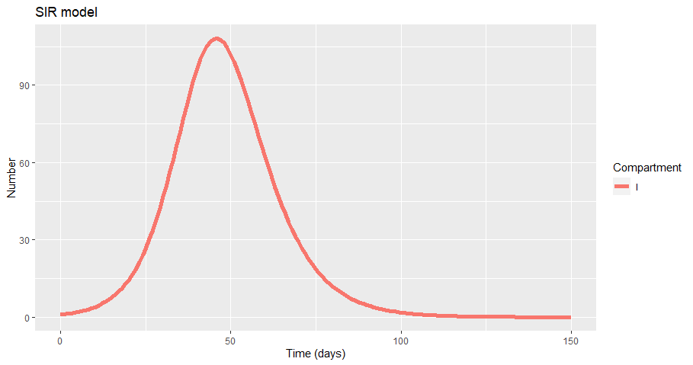
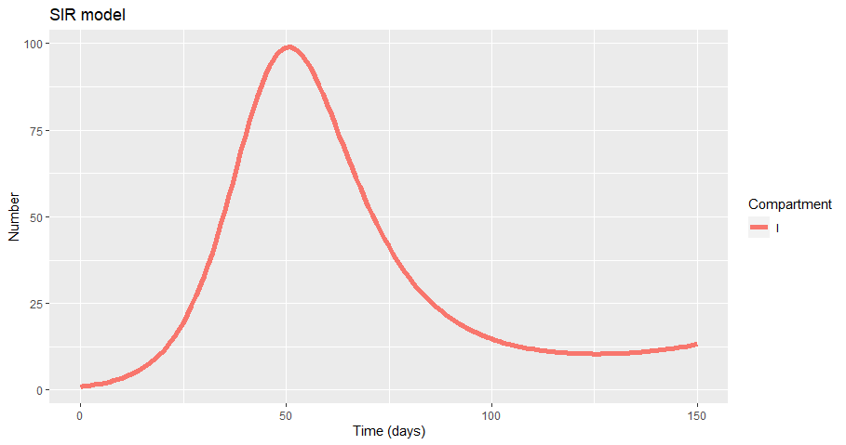
Close population
Susceptible renewal (birth rate)

Slide 20
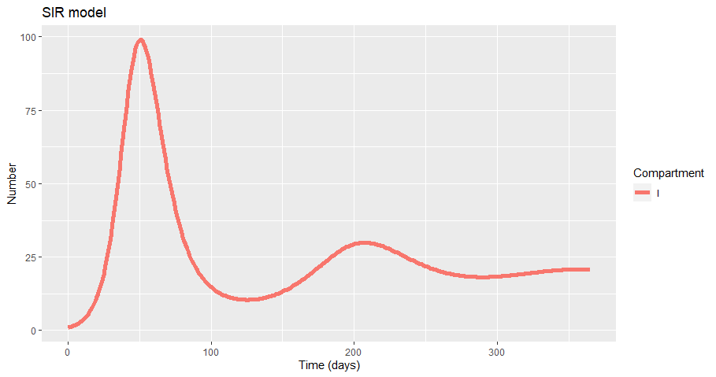
Long term dynamics
Endemicity

Slide 21
Some added complexity when understanding reproduction numbers

Slide 22
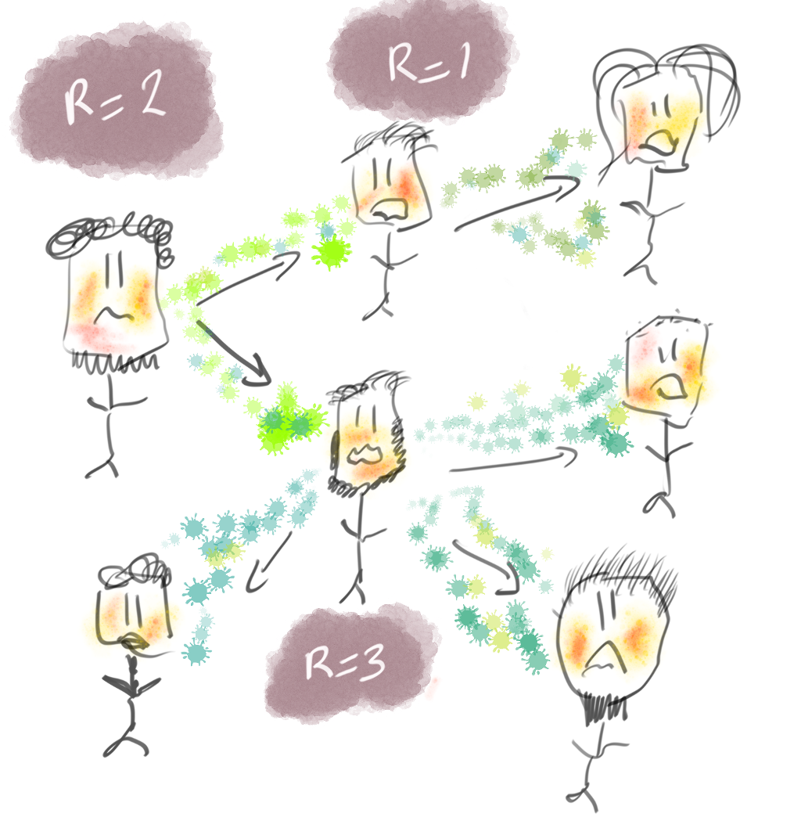
The reproduction number(s)
Generalities
number of secondary cases by infected individual
R > 1 = exponential growth
R < 1 = exponential decline
Basic reproduction number (R₀): R in a fully susceptible population
Effective / case reproduction number (R_{c}): actually realised R
Instantaneous reproduction number (R_{i}(t)): average R_{c} of infectors with symptoms at time t if transmissibility remains the same
With thanks to Thibaut Jombart

Slide 23
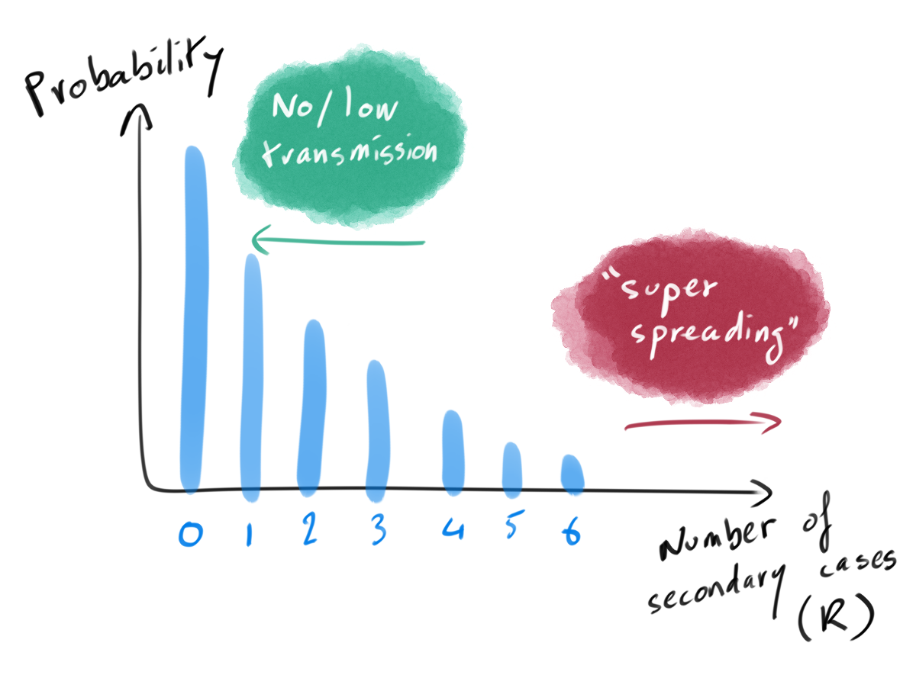
The offspring distribution
Distribution of the number of secondary cases per infected case
Its average is R
Further indications of how transmission occurs:
Do all individuals transmit?
Are there super-spreading events?
With thanks to Thibaut Jombart

Slide 24
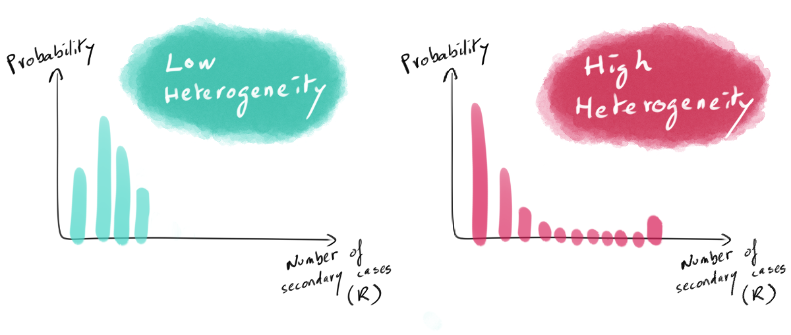
Heterogeneity in R
Heterogeneity in R reflects differences in infectiousness between cases
Higher heterogeneity
A smaller fraction of the population drives transmission
Presence of super-spreading events
Skewed offspring distribution
With thanks to Thibaut Jombart

Slide 25
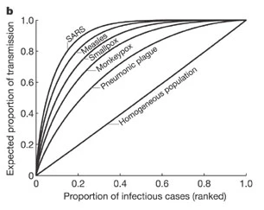
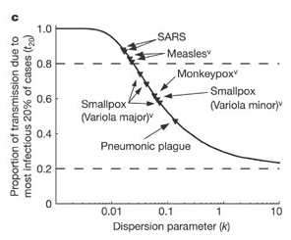
Impact of heterogeneity in R for epidemic control
Higher heterogeneity in R
Stochastic extinction more likely
Rarer, more ‘explosive’ outbreaks
Individual-based interventions better suited than population-wide
Targeted interventions require investigation of predictors of infectiousness
May need contact tracing, genetic data, etc. to reconstruct transmission chains
Source: Lloyd-Smith et al. (2005)
With thanks to Thibaut Jombart

Slide 26
What we should know by now
Why epidemics rise
What is R0 and Reff and how it relates to the SIR model
What is herd immunity
How we calculate HIT if we know R0
How introducing demographics can change the picture of the long term dynamics
In simple models we assess the population infectiousness, but in a real outbreak , estimation of R becomes more complex

