Slide 1


Day 4 Lecture 1: Introduction to Stochasticity
Short course on modelling infectious disease dynamics in R
Ankara, Türkiye, June 2023
Dr Juan F Vesga

Slide 2
Aims of the session
Understand what is stochasticity and why it is important
Learn concepts of epidemic persistence and some important consequences of stochasticity on disease dynamics, like:
Variability
Persistence and critical community size
Fade out probability

Slide 3
What is stochasticity?
Deterministic models
try to capture ‘average’ behaviour.
…but in reality transmission/demographic processes are random.
Stochasticity
Randomness.
Disease transmission really a process of discrete, random infection/recovery and other events.
Stochastic models generate ‘random’ output, so many independent runs are needed to calculate average behaviour, variances, correlations, etc.
Complicating factors
Heterogeneity (behavioural, spatial, temporal).

Slide 4
Stochastic or deterministic?
A stochastic model consists of a population and a number of event types.
The population may consist of individuals or of sub-populations in given states. E.g. susceptible, infected, ‘recovered’, etc.
Event types could be infection, recovery, death, etc.
Simple basic idea – in any time interval there is a certain probability of each type of event occurring (e.g. birth/death).
Deterministic models approximate by saying that in any time interval, the mean number of events of any particular type occur. They also assume population sizes to be real, not integer numbers.

Slide 5
A simple birth-death process (1)
Deterministically
- with solution
For ω>μ, N grows exponentially. For ω < μ, N decreases asymptotically to zero. For ω = μ, N remains constant.
Here N(t) represents the average number of individuals alive at time t. Should be careful in interpreting it as the real number of people alive – since the model in that case tells you that a fraction of an individual can be alive, and a fraction dead.
50

Slide 6
A simple birth-death process (2)
Stochastically
We need a complete description of the stochastic model so we
can simulate it. For the present case:
Population: N identical individuals.
Name | What happens to population | Rate/individual
Birth | N →N + 1 | ω
Death | N →N - 1 | m

Slide 7
A simple birth-death process (3)
Stochastically
Between time t at time t+dt a short time later, one of two events might happen:
A birth – with probability ωdt per individual
A death – with probability μdt per individual
Stochastic simulation involves picking these events randomly to generate a single realisation:

Slide 8
Population size and stochasticity
N₀=1000
N₀=100
N₀=10

Slide 9
Stochasticity and persistence

Slide 10
What is persistence?
The ability of a disease to remain endemic.
Deterministic models tell us R0>1 is only criterion for persistence.
In fact, random fluctuations often drive diseases to extinction.
Population size, N, a key issue (& space).
Stochastic effects can give fundamentally different dynamics
especially for cyclical epidemics!

Slide 11
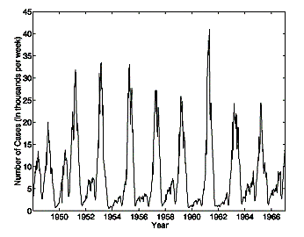
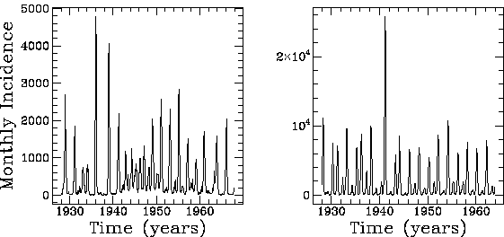
Example: Measles dynamics
UK
Copenhagen
New York
Predominantly biennial cycles, but strong annual & triennial components

Slide 12
Deterministic model of Measles
Seasonally forced model – transmission varies annually.
Equivalent of equilibrium is limit cycle - sustained incidence oscillations - not necessarily of same period as forcing.
Cycles completely regular.

Slide 13
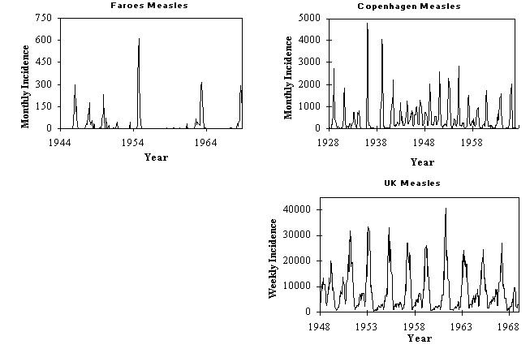
Effect of stochasticity
Disease extinction likely by random chance when number of infectives falls to very low numbers.
So extinction more frequent as population size decreases.

Slide 14
Effect of stochasticity on SEIR dynamics
Phase space plots of biennial epidemics:
Stochastic
Deterministic
Y=Infective
X=Susceptible
Notes:
Y= Infective , X=Susceptible

Slide 15
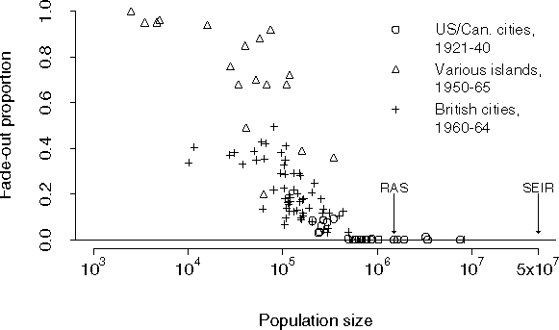
Critical Community Size
CCS = minimum population size at which fadeouts become rare.

Slide 16
Back to Persistence
Epidemic prediction/control strategy design needs to take account of stochastic effects.
Different pathogens adopt different strategies to persist.
Key requirement is to keep prevalence of infectives, Y, at level where extinction becomes unlikely by chance.
Extinction
likely
Y*
Y*

Slide 17
A simple criterion for disease persistence
Given random fluctuations are approximately Poisson, their variance is proportional to N.
i.e. fluctuations have SD ~ √N
A disease goes extinct when the number of infectives (Y) falls to 0.
A crude rule of thumb is therefore that extinction will be unlikely if E[Y]>√N.
Thus diseases have an advantage if they can maintain the highest possible numbers of infectives for a given population size.
Infectious period and immunity are therefore key.

Slide 18
Critical community size
CCS = minimum population size at which fadeouts become rare.
Data: Bolker and Grenfell Phil Trans Roy Soc 1995

Slide 19
Mechanisms for enhancing persistence
Antigenic variation (or not generating permanent host immunity) clearly gives a large advantage – which is why STDs are found in even very small communities.
SIR diseases with short infectious periods like measles, rubella etc. need very large (>500,000) populations to be able to persist – otherwise they burn out the susceptible population too quickly.
A long infectious period (or disease recrudence, like chickenpox) compared with host lifespan is also an effective strategy – it pays to be chronic.
Disease like influenza fall between the SIR/SIS camps – antigenic drift requires fairly large populations to happen, but does allow disease persistence in smaller populations than measles.
Not just an abstract issue – critical to evaluations of how realistic disease eradication programmes might be.

Slide 20
Fade out probability
infecteds
infecteds
infecteds
time
time
time
In a deterministic model, if R₀ > 1 a seeded epidemic will never fade out. In reality, an epidemic may never take off due to chance events, for example the first infected case may never contact other individuals.
Stochastic models allow epidemic fade out (i.e. I = 0).
For an epidemic (R₀ > 1) beginning with a single case in a large population, it can be shown that:

Slide 21
The importance of stochasticity during outbreaks
If the initial seeding of a new outbreak only infects very low numbers of people (1 or 2), then the probability of disease extinction by random chance in the establishment phase is significant, and the rate of early spread is quite variable.
Stochasticity also important in the tail of an epidemic

Slide 22
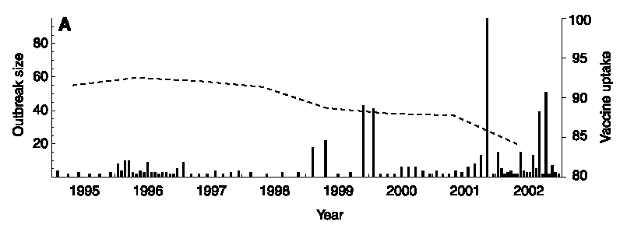
The impact of reduced MMR uptake: an example of the use of stochastic models
The current concern about MMR uptake levels makes predicting the likelihood of a large measles outbreak a priority.
Can data on the current small outbreaks seen in the last few years tell us anything?
Source:[Jansen, V.A.A. et al, Science (2002), 301:804]

Slide 23
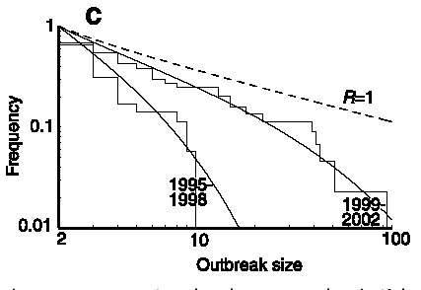
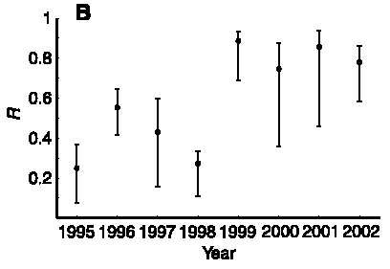
Inferring R from outbreak size distributions
For sub-critical transmission, possible to estimate R from the distribution of outbreak sizes (m=2/(1-R), where m is mean outbreak size).
This analysis shows a significantly increased level of transmission in the period 1999-2002 compared with 1995-98.
R is now dangerously close to 1 – meaning a major measles outbreak is due any time.
This is an intrinsically stochastic analysis – since outbreak size is a random variable.

Slide 24
Extra material
some maths for persistence and SIR/SIS

Slide 25
SIR/SIS persistence criteria
A lot can be inferred from just examining the relationship between prevalence and epidemiological parameters.
SIS (STDs etc)
SIR (measles etc)
Herd immunity threshold S< N/R0
Notes:
Qc=1-1/R0 ; Herd Imm threshold to brin N down to CCS

Slide 26
SIR/SIS persistence criteria
What is value of N above which Y*> √N ? ➔ N_{crit}
SIS (STDs etc)
SIR (measles etc)

