Slide 1


Day 4 Lecture 2: Formulating Stochastic models
Short course on modelling infectious disease dynamics in R
Ankara, Türkiye, June 2023
Dr Juan F Vesga

Slide 2
Aims of the session
Learn how to formulate stochastic models
Learn how stochasticity is introduced in compartmental and individual base models
Understand the methodological difference with deterministic models

Slide 3
Formulations of a stochastic model
Individual based/agent based models
Simulate each individual and events which happen to each individual
Can include much realistic detail, but can be slow to simulate
Population or compartmental based models
Only keep track of total number of individuals in each compartment
Simulate the number of events that will happen to that group of individuals
Faster to simulate

Slide 4
Hazard
The hazard is the probability per unit time of an event happening.
It is equivalent to the instantaneous per-capita rate used in a deterministic model.
E.g. If an infected person has a hazard or rate of recovery of σ:
Infected
Recovered
Probability of recovering in time dt is σdt, for small dt.

Slide 5
Hazard
If we have N individuals who are all identical (with respect to the process we’re talking about), the binomial distribution describes the distribution of the number of events in a given time.
N trials of something with probability p, number of successes is a binomially-distributed random number:
Binomial(p,N)
Infected
N
σ
Recovered
Number of recoveries in dt is from Binomial(σdt, N)

Slide 6
Competing Hazards
Consider a population of susceptible which can become infected (rate: λ) but can also die (rate: μ).
But they can’t do both at the same time!
In a time period, dt, how many die and how many become infected?
X
λ
Infected
μ
Death

Slide 7
Competing Hazards
It turns out that we can add the rates of the different events to
get the total number to which anything happened.
Then we can decide which of the two things happened to each.
X
λ
Infected
μ
Death
Total number of events:
Split into H₁ and H₂:

Slide 8
Simple infection process
A stochastic model is completely described by two things:
The state of the population. E.g. the number of individuals in susceptible, infected, recovered states, etc.
All possible events and their rates. E.g. infection rate, death rate, recovery rate, etc.
For the present case:
Population: S identical susceptible individuals,
I identical infected individuals.
Name | What happens to population | Rate/individual
Infection | S →S – 1, I→I + 1 | λ
recovery | I →I - 1 | σ

Slide 9
Individual base models
Treat every individual separately.
For synchronous update case, choose small update time-step, dt.
Only one event could happen to the individual – get infected (rate λ)
Every time-step, for each individual pick random number p (uniformly distributed between 0 and 1). If
p<λdt - the individual has become infected, so S→S-1, I → I+1.
p>λdt - nothing happens.
0
λdt
1
Infection
p
Nothing happens

Slide 10
Multiple individuals-IBM
No infection or death
Infection
0 λΔt 1-λΔt 1
Each susceptible individual is ‘identical’
Could generate a random number for each (22 random numbers) and discover if infection or death
e.g. 5 new infections, 17 no change

Slide 11
Multiple individuals-Compartment
Infection
No infection or death
0 λΔt 1-λΔt 1
22 individuals, probability of infection per individual λDt
Use Binomial to generate number of ‘successes’,
Infections = Binomial(λDt,S) = 7 infections (for example)

Slide 12
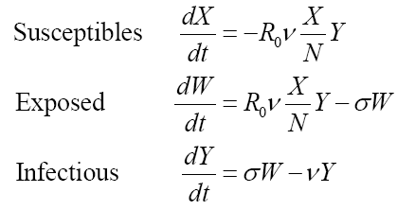
SEIR
Hollingsworth et al (2006) Nature Medicine

Slide 13
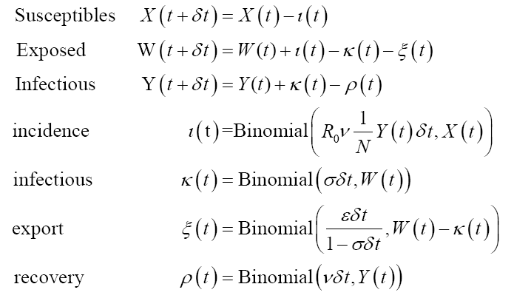
SEIR
Hollingsworth et al (2006) Nature Medicine

Slide 14
SEIR
Number moving from susceptible to exposed
Hollingsworth et al (2006) Nature Medicine

Slide 15
SEIR
Number moving from susceptible to exposed
rate
Hollingsworth et al (2006) Nature Medicine

Slide 16
Summary
Stochastic effects important when considering
persistence
dealing with small populations (start and tail of epidemics)
or spatial spread.
By chance can have outbreaks, even when R₀<1
By chance can have no outbreak when R₀>1
Stochastic models can be relatively simple to program, difficult to analyse

Slide 17
Extra materials
Further reading and something on distribution of stochastic events

Slide 18
Further reading
Books:
Renshaw, E., Modelling biological populations in space and time, Cambridge Univ. press, 1991
Bailey, N.T.J., The mathematical theory of infectious diseases and its applications, 2nd edition, Griffin, 1975
Papers:
Bartlett, M. S. (1957). "Measles periodicity and community size." J. Roy. Stat. Soc. A 120: 48-70.
Bolker, B. M. and B. T. Grenfell (1995). "Space, persistence and dynamics of measles epidemics." Proc. Roy. Soc. Lond. B 348: 308-320.
Jansen, V. A. A., N. Stollenwerk, et al. (2003). “Measles outbreaks in a population with declining vaccine uptake." Science 301(5634): 804-804.
Farrington, C. P., M. N. Kanaan, et al. (2003). "Branching process models for surveillance of infectious diseases controlled by mass vaccination." Biostatistics 4(2): 279-295.

Slide 19
Advanced: Binomial versus Poisson
Poisson distribution simulates the number of events that will happen in a small timestep = Poisson(ωΔtN(t))
Binomial formulation Binomial(ωΔt,N(t)) says there are N(t) tries, each with probability of success approximated by ωΔt, how many are successful?
Can’t have more events than there are people
For small timesteps won’t matter, since there won’t be many events
Have to calculate multinomials when there are multiple competing hazards

Slide 20
Population simulations
Individual based models can be very slow, and computing time increases as N.
If events are independent, the number of events of type i in a fixed time, Dt, can be simulated by sampling from a binomial distribution (it can also be simulated by sampling from a Poisson distribution). Hence in a population of size S, the number of events of type i, is given by
When there are multiple events competing with each other, binomial or multinomial approximations perform better than using sampling from several Poisson distributions, and allow more consistent model formulation.

Slide 21
Advanced: Synchronous versus asynchronous
Synchronous: at each timestep simulate all the events that could have occurred.
Asynchronous: simulate when the next event is, and move forward to that time point,
If there are many possible events each with a low probability of occurring, particularly in individual based simulations, its may be more efficient to have an asynchronous model

