Slide 1


Day 4 Lecture 2: Assessing model uncertainty and calibration
Short course on modelling infectious disease dynamics in R
Ankara, Türkiye, June 2023
Dr Juan F Vesga

Slide 2
Aims of the session
Understand the sources of uncertainty
Understand the importance of communicating uncertainty
Learn main methods for addressing model uncertainty

Slide 3
The nature of the problem
Data
Model
Result
Raw data: incidence,
serological data, etc.
or parameter values
from other studies.
Property or statistic of
the system (Contact rate,
R₀, etc.)
Deterministic or
stochastic

Slide 4
Uncertainty
Data
Model
Result
?
Stochastic or
deterministic model
Data error
Uncertainty in result

Slide 5
Sensitivity
Data
Model
Result
For a deterministic model, two types:
Local sensitivity: change in result for given change in parameter.
Global sensitivity: how uncertainty in result is related to that of
any input parameter.

Slide 6
Model for illustration of parameter sensitivity
Outbreak of an SIR type in finite population, e.g. influenza, measles, Rubella,
Hepatitis A.
Scenario: introduce I₀ infectives into a population of N-I₀ susceptibles.
: rate /day,
: rate μ /day

Slide 7
Model for illustration of parameter sensitivity
The model can be described by the following system of equations:
R₀ = 2
I₀ = 100

Slide 8
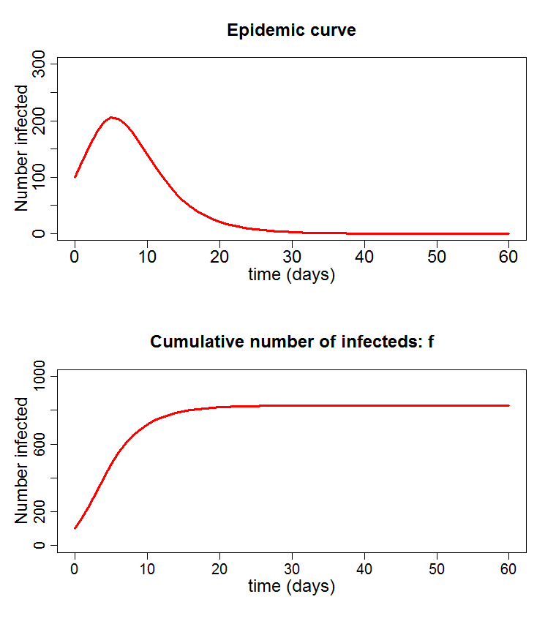
Model for illustration of parameter sensitivity
R₀ = 2
I₀ = 100

Slide 9
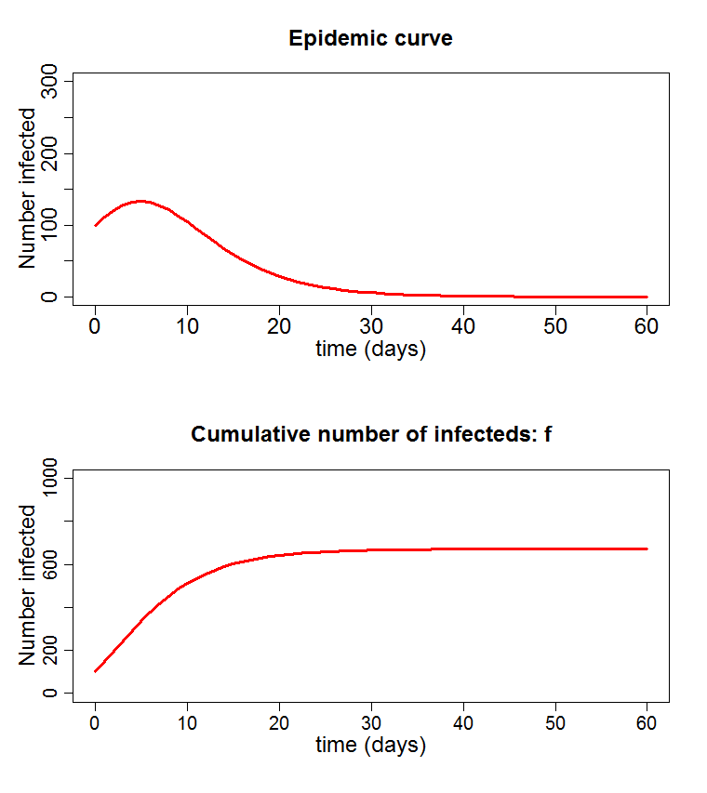
Model for illustration of parameter sensitivity
R₀ = 1.5
I₀ = 100

Slide 10
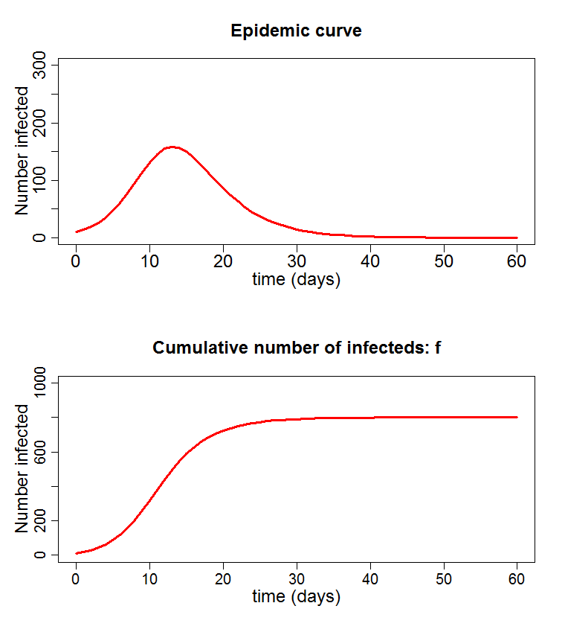
Model for illustration of parameter sensitivity
R₀ = 2
I₀ = 10

Slide 11
Model for illustration of parameter sensitivity
We are interested in the number of individuals infected over the course of the
epidemic, a.k.a. the final size, f, or attack rate, as it depends on I₀ and R₀.
For a deterministic model,

Slide 12
Model for illustration of parameter sensitivity
We are interested in the number of individuals infected over the course of the
epidemic, a.k.a. the final size, f, or attack rate, as it depends on I₀ and R₀.
For a deterministic model,
Sensitivity to variation in R₀:
I₀ | R₀ | f
100 | 1.25 | 544
100 | 1.5 | 671
100 | 2 | 828
100 | 3 | 948
100 | 4 | 982
Notes:
R0 = (-log (1 - attack_rate)) / attack_rate

Slide 13
Model for illustration of parameter sensitivity
We are interested in the number of individuals infected over the course of the
epidemic, a.k.a. the final size, f, or attack rate, as it depends on I₀ and R₀.
For a deterministic model,
Sensitivity to variation in I₀:
I₀ | R₀ | f
1 | 2 | 797
10 | 2 | 800
100 | 2 | 828
200 | 2 | 855
300 | 2 | 879

Slide 14
Local uncertainty
Local sensitivity looks at the change in the outcome of interest as params
are varied one at a time.
In our model, final size depends on reproduction number, R₀, and initial
infectives, I₀.
We can look at the sensitivity around R₀=2, I₀=100, say.
Doesn’t tell us how different parameters combine to affect the result.

Slide 15
Latin Hypercube Sampling
If evaluation expensive, don’t want to go through all values.
LHC is a method of picking a subset of points that ‘span’ the region.
From previous example:
1
X
2
X
choose an
R₀
3
X
4
X
Increasing size
I_{o}
5
X
6
X
for each
I₀
7
X
8
X
9
X
10
X
R₀₁
R₀₂
R₀₃
R₀₄
…..
10X10 cube: mean = 780, s.d. = 86
R₀
Each parameter value appears once and only once.
Can repeat the process to get further sets.

Slide 16
Monte Carlo Markov Chain
MCMC is a way of generating a sequence of parameter sets which appear to
have come from distribution.
Each new set generated from previous one, hence ‘chain’, by a rule.
Metropolis Algorithm
First, create a way of randomly picking a new set of params from the old.
(must be symmetrical. E.g. Add normal deviate to each).
From last point, (x₁,x₂), generate new point,
Calculate A, where
Get a random number, u, between [0,1].
If u<A, accept new point. Otherwise use old one again.
N.B. successive points are not independent!

Slide 17
Stochastic and probabilistic models: likelihood
Stochastic models incorporate the randomness of the processes they represent,
e.g. infection, recovery, death, etc.
Hence each run of the model will produce different results from the same parameters.
Consider an epidemic model: we want to know what values of β produce an
observed final epidemic size.
observed
Model
Many runs
final size
Questions:
What is the ‘best’ value for β?
What range of values of β are acceptable?

Slide 18
Likelihood
Likelihood of data,
given parameters
Probability that the observed data is generated by the model, given the parameters
=
observed
Model
Many runs
final size
By repeating for a range of β’s,
we can generate a graph of
likelihood against β.
The peak indicates the ‘best’ value, called
the maximum likelihood estimator (MLE).

Slide 19
Log-Likelihood and confidence intervals
The shape of the log of the likelihood curve gives us the range of values of b
that fit well.
If we measure down Q from top of the curve,
This defines the 95% confidence for the parameter values.
Q

Slide 20
Uncertainty arising from data
Consider sampling a population to estimate the proportion seropositive for a malaria antigen. Assume that:
Individuals sampled = N
Individuals seropositive = k
Need to estimate the proportion seropositive p.
We use a binomial likelihood function:

Slide 21
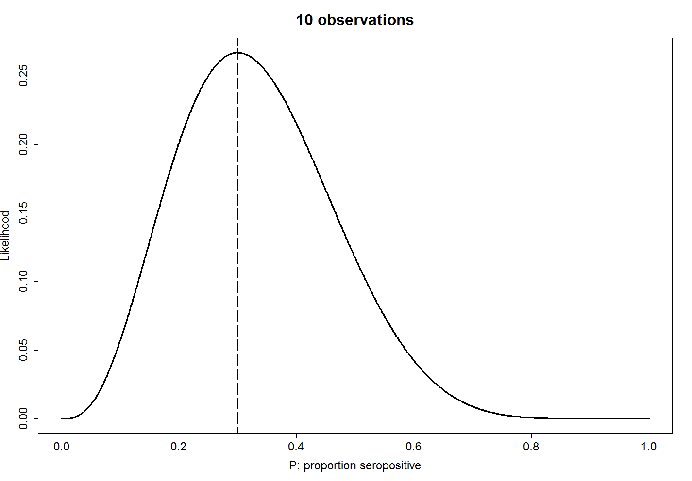
Uncertainty arising from data

Slide 22
Uncertainty arising from data
maximum
likelihood
estimate

Slide 23
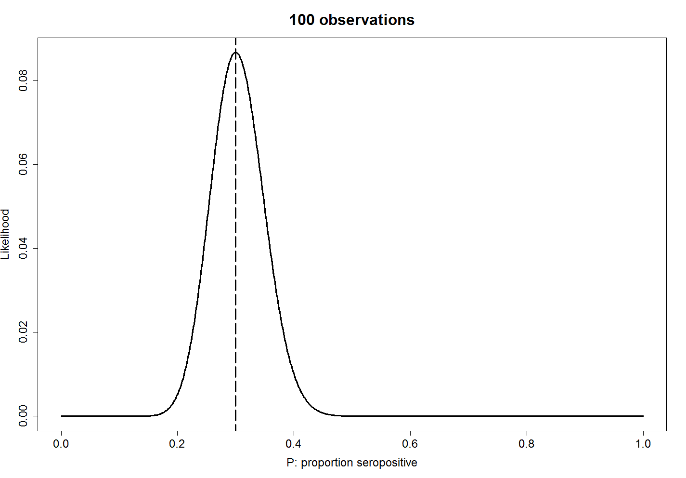
Uncertainty arising from data

Slide 24
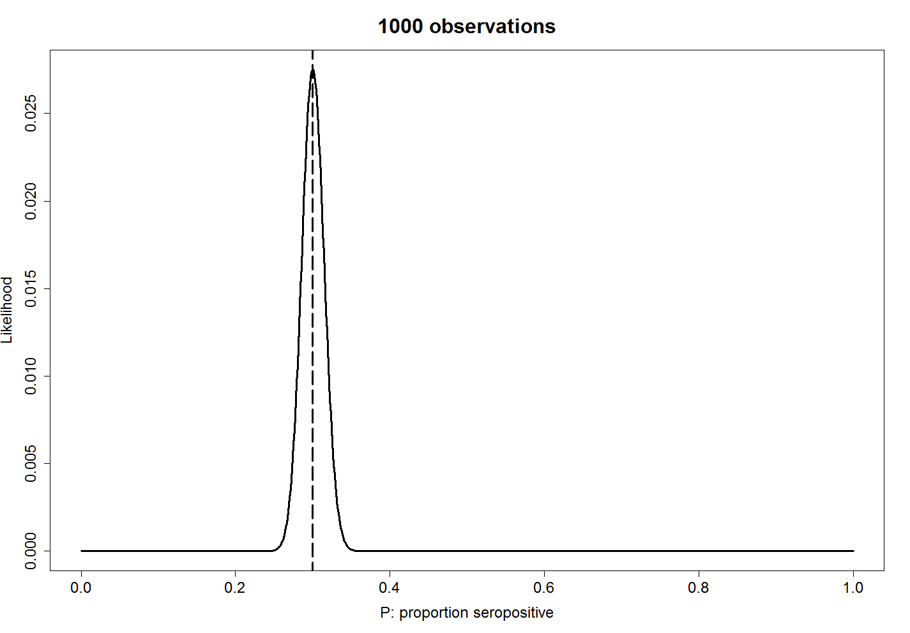
Uncertainty arising from data

Slide 25
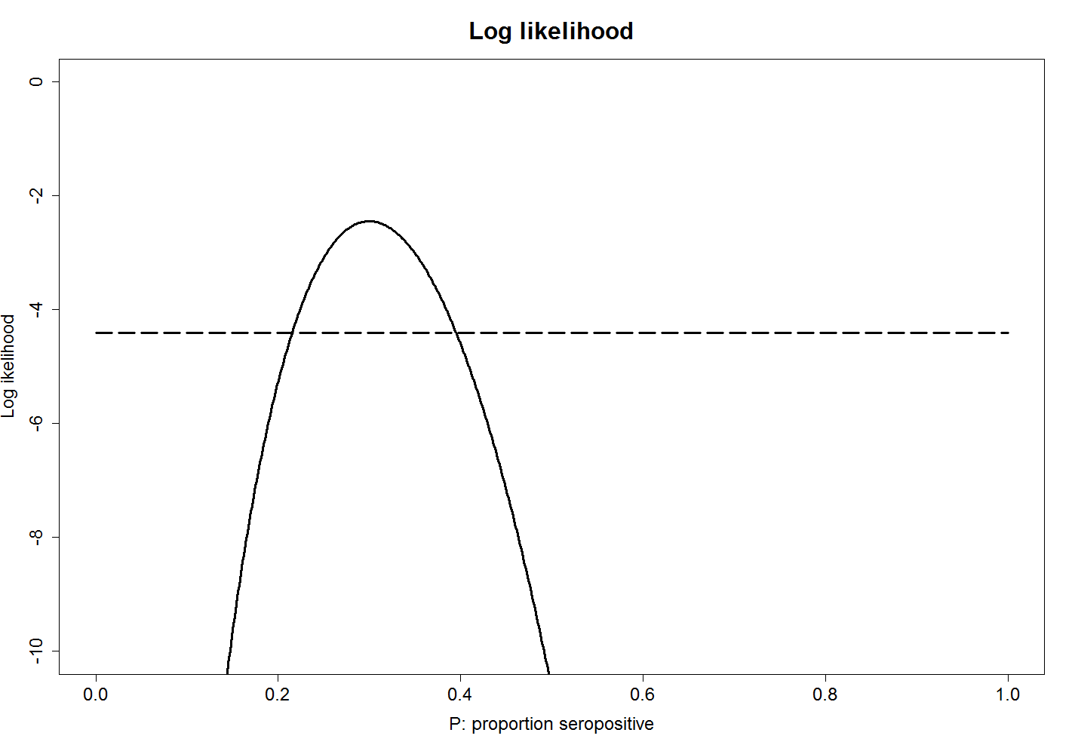
Uncertainty arising from data
maximum
likelihood
estimate

Slide 26
Uncertainty arising from data
maximum
likelihood
estimate
1.92

Slide 27
Uncertainty arising from data
maximum
likelihood
estimate
1.92
95% confidence
intervals

Slide 28
Uncertainty arising from data
In general:
more data => less uncertainty
more data => narrower confidence intervals
Can depend on the choice of model, e.g. a badly chosen model will not be helped by more data.

Slide 29
Summary
Looked at a number of ways to explore possible parameter values and
Estimate the distribution and sensitivity of outcome variables.
Another method for generating parameter set for analysis is through
Monte Carlo Markov Chain algorithms. Very simple and robust algorithm in common use.
Likelihood methods very powerful for finding parameter ranges corresponding to observed data.
Calculating the likelihood becomes more difficult with more complicated data sets, e.g. incidence curves.
The more data you have, the more accurate your parameter estimate.
If the model’s no good, you can still get a best fit, so check it’s not nonsense.

