Slide 1
TPAPI
B2B Customer & API Portal
High-Level Architecture & Solution Overview
March 2026 | SAP BTP · S/4HANA · Integration Suite · Snowflake

Slide 2






WHAT IS TPAPI?
A B2B digital commerce and API platform that automates the complete order-to-cash cycle — enabling customers to self-serve without requiring a sales rep for every transaction.
Order Placement
Invoice Automation
Fulfillment Visibility
Customers place & manage orders directly
E-invoicing, payment tracking, disputes
Real-time shipment & delivery tracking
API Integration
API Self-Service
Onboarding Automation
REST/OData APIs for ERP-to-ERP flows
Developer portal, API keys, playground
Self-registration & approval workflow
TPAPI | Solution Overview
Confidential — Architecture Overview

Slide 3
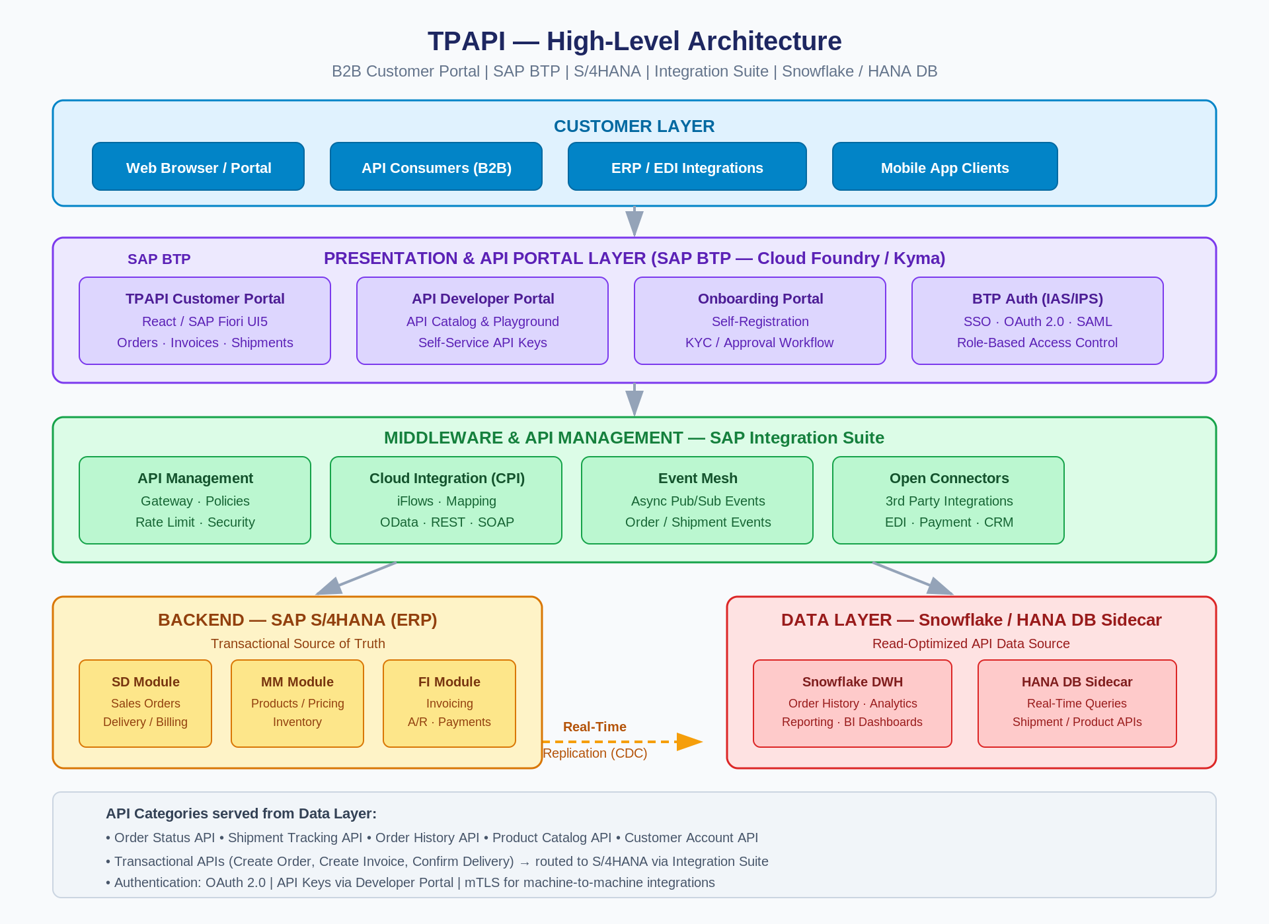
HIGH-LEVEL ARCHITECTURE
TPAPI | Architecture Diagram
Confidential — Architecture Overview

Slide 4
TECHNOLOGY STACK
Presentation Layer
SAP BTP (Cloud Foundry / Kyma) · React / SAP Fiori UI5 · SAP IAS / OAuth 2.0 · SAP BTP Workflow
Middleware & API Mgmt
SAP Integration Suite · API Management · Cloud Integration (CPI) · Event Mesh · Open Connectors
Backend ERP
SAP S/4HANA · SD / MM / FI Modules · OData V4 · BAPIs · Business Events
Data Layer
Snowflake DWH · HANA DB Sidecar · SAP Data Intelligence (CDC) · Real-Time Replication (SLT)
DevOps & Observability
GitHub / Azure DevOps · SAP CI/CD Service · Dynatrace / SAP Cloud ALM · SAP Alert Notification
TPAPI | Technology Stack
Confidential — Architecture Overview

Slide 5
CUSTOMER PORTAL FEATURES
Portal Capabilities
API Developer Portal
Personalized order & account dashboard
API catalog with OpenAPI/Swagger docs
New order placement & quick reorder
Interactive sandbox playground
Order templates for repeat purchases
Self-service API key issuance & rotation
Product catalog with real-time pricing
Usage analytics & quota dashboards
Electronic invoice download (PDF)
Webhook endpoint registration
Payment status & dispute submission
Event subscription management
Real-time shipment tracking
Code samples in multiple languages
Delivery confirmation & POD access
Sandbox & production environments
TPAPI | Portal Features
Confidential — Architecture Overview

Slide 6
ORDER-TO-CASH API FLOW
1
Browse Products
2
Place Order
3
Confirm Order
GET /products
POST /orders
GET /orders/{id}
Served from Snowflake / HANA DB
Routes to S/4HANA via CPI iFlow
Status from data layer within seconds
4
Track Shipment
5
Receive Invoice
6
Apply Payment
GET /orders/{id}/shipments
GET /invoices
POST /invoices/{id}/payment
Enriched with carrier tracking data
Electronic PDF from S/4HANA FI
Via payment gateway integration
TPAPI | Order-to-Cash Flow
Confidential — Architecture Overview

Slide 7
SAP INTEGRATION SUITE — MIDDLEWARE DESIGN
API Management
Cloud Integration (CPI)
API Gateway with OAuth, JWT, rate limiting, threat protection, transformation policies, and developer analytics. All APIs exposed through a single managed gateway endpoint.
iFlow-based integration for transactional operations: order creation, invoice posting, delivery confirmation. Handles OData/BAPI mapping, error handling, and retry logic for S/4HANA.
Event Mesh
Open Connectors
Async pub/sub for business events: Order Confirmed, Goods Issued, Invoice Posted, Payment Received. Customer systems subscribe via webhooks or AMQP — no polling required.
Pre-built adapters for payment gateways (Stripe/Adyen), logistics carriers (FedEx/UPS/DHL), CRM (Salesforce/SAP Sales Cloud), and tax engines (Vertex/Avalara).
TPAPI | Integration Design
Confidential — Architecture Overview

Slide 8
DATA ARCHITECTURE — READ / WRITE SEPARATION
WRITE PATH — S/4HANA
READ PATH — Snowflake / HANA DB
System of Record for all transactional data
Read-optimized for high-performance APIs
POST /orders → SD Sales Order
GET /orders — order history & status
POST /invoices/payment → FI Payment
GET /products — catalog & pricing
Real-Time
Replication
(CDC / SLT)
Order confirmation → SD Delivery
GET /orders/{id}/shipments — tracking
Goods issue → MM Inventory update
GET /invoices — invoice history
Invoice posting → FI Document
GET /customers/{id}/account — balance
Return / credit memo processing
Analytics & reporting queries
TPAPI | Data Architecture
Confidential — Architecture Overview

Slide 9
SECURITY ARCHITECTURE
Authentication
API Security
SAP IAS — SSO via SAML 2.0 / OIDC
JWT validation & token introspection
MFA enforced for all portal logins
Rate limiting & quota enforcement
OAuth 2.0 Client Credentials for API M2M
OWASP Top-10 threat protection
mTLS for high-security B2B integrations
API key + IP allowlisting
Data Security
Access Control
AES-256 encryption at rest
Role-Based Access Control (RBAC)
TLS 1.3 encryption in transit
Least-privilege principle enforced
PII data masking in API responses
Customer data isolation per tenant
Immutable audit trail for all access
Admin audit logging in BTP
TPAPI | Security
Confidential — Architecture Overview

Slide 10
PHASED IMPLEMENTATION ROADMAP
PHASE 1
PHASE 2
PHASE 3
PHASE 4
Foundation & Core Portal
API Portal & Onboarding
Advanced APIs & Events
Analytics, AI & Ecosystem
Months 1–4
Months 5–8
Months 9–12
Months 13–16
BTP environment setup & provisioning
API Developer Portal with Swagger playground
Full order-to-cash REST API suite
Order analytics & BI dashboards
S/4HANA OData API exposure
Self-service API key management
Event Mesh & webhook delivery
AI/ML demand forecasting on Snowflake
Customer Portal (orders, invoices, shipments)
Customer onboarding workflow automation
Payment gateway integration
Open Connectors expansion
Identity & SSO (SAP IAS)
Snowflake / HANA DB Sidecar + replication
Logistics provider tracking & EDI
Mobile app & multi-currency/language
Basic API Gateway configuration
Total estimated delivery: 12–16 months to full platform maturity
TPAPI | Roadmap
Confidential — Architecture Overview

Slide 11
NEXT STEPS
Actions required to move from plan to execution
01
Architecture Review — Formal review with SAP BTP and S/4HANA technical leads
02
S/4HANA API Assessment — Identify all required OData services and BAPIs for Phase 1
03
Data Layer Decision — Evaluate Snowflake vs HANA DB Sidecar (licensing, skills, performance)
04
UI/UX Design — Portal wireframes and customer stakeholder prototype validation
05
SAP BTP Provisioning — Enable IAS, Integration Suite, API Management, Workflow services
06
Project Kickoff — Charter, team assignments, and Sprint 1 planning for Phase 1
TPAPI — Powering B2B Commerce Through Automation and API-First Design

