Slide 1

Tmux & Gnu Parallel shaken, not stirred workshop
juan@elsotanillo.net
@juasiepo
www.elsotanillo.net
Alicante Tech Meetup (Alacant)
@AlicanteTech

Slide 2
Who is this guy?
Juan Sierra Pons
Linux administrator interested in
Automation and DevOps
juan@elsotanillo.net
@juasiepo
www.elsotanillo.net
Alicante Puppet Users Group founder

Slide 3

You might remember me from….
……. others workshops like:
Puppet Install Party
Pentaho workshop
Notes:
Are there any other puppet user in the room? Pentaho user?
All three workshops are related….
Automation
Productivity
Orchrestation
Learning new ways
Lazyness :)

Slide 4
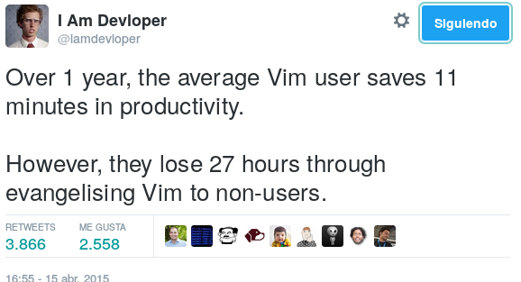
TMUX & GNU Parallel
Let's see how today's evangelising works
https://twitter.com/iamdevloper/status/588355053104267264
Notes:
Productivity is the keyword
Contact me in several weeks about how your productivity has grown :) I will be pleased to hear you

Slide 5
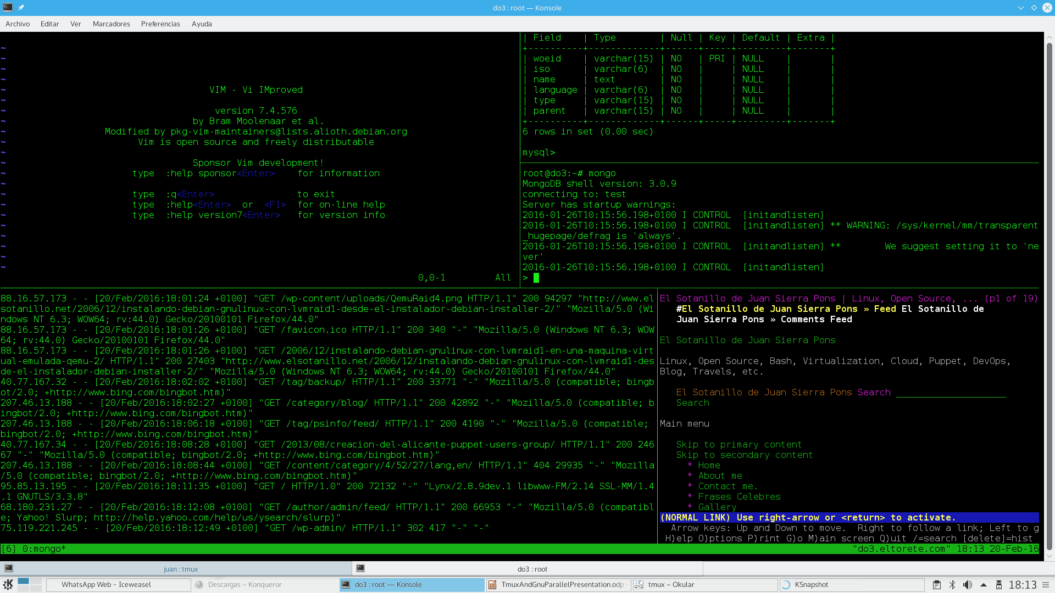
TMUX – Terminal MUltipleXer
Your mouse is slowing you down.
Notes:
tmux is a terminal multiplexer. It lets us use a single environment to launch multiple terminals
In one screen we can see:
Vim editor
Tail -f Apache Logs
Text browser
Msyql console
MongoDB console
We can switch from all of them without touching the mouse

Slide 6
TMUX – Terminal MUltipleXer
Installation:
Linux: apt-get install tmux (deb based OS)
yum install tmux (rpm based OS
Mac: brew install tmux (Homebrew)
port install tmux (Mac Ports)
Windows: Install Cygwin setup-x86.exe -B
Then install the tmux package using Cygwin's GUI
Notes:
What is Cygwin?
Using the -B allows “portable” installation so no administrative rights are needed :)
Another option is to connect to a server with the tmux already installed

Slide 7

TMUX – Terminal MUltipleXer
What can we do with TMUX:
Pair programming
Pair administering
Pair monitoring
Re-attach to running sessions
Teaching sessions
Launch commands in parallel to several sessions
Use our imagination

Slide 8
TMUX – Terminal MUltipleXer

Slide 9

TMUX & GNU Parallel
A word of caution about working in parallel:
“With great power comes great responsibility”
Uncle Ben
Notes:
Both tools allows you to work with some degree of parallelism.
With them your mistakes will run in parallel too

Slide 10
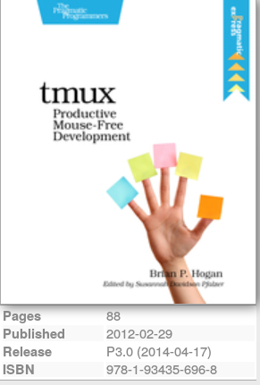
Tmux & Gnu Parallel shaken, not stirred workshop
To know more:
TMUX:
https://tmux.github.io/
https://groups.google.com/forum/#!forum/tmux-users
GNU Parallel:
http://www.gnu.org/software/parallel/
https://www.gnu.org/software/parallel/parallel_tutorial.html

Slide 11


Tmux & Gnu Parallel shaken, not stirred workshop
Questions ?
Notes:
Any question regarding the presentation?
More questions later after the workshop.

