Slide 1
Pentaho Workshop
Download Links:
Main site:
http://community.pentaho.com/
For those who didn't do their homework:
http://X.X.X.X/pentaho
Shame on you!!!

Slide 2
Pentaho workshop
Kettle for ETL
Extract Transform and Load
Alicante Tech Meetup (Alacant)
@AlicanteTech

Slide 3

Who is this guy?
Juan Sierra Pons
Linux administrator interested in
Automation and DevOps
juan@elsotanillo.net
@juasiepo
www.elsotanillo.net
Alicante Puppet Users Group founder
Notes:
Are there any other puppet user in the room?

Slide 4
Pentaho Workshop
Pentaho Suite:
Data Integration (kettle)
Report Designer
Business Analytics Platform
Notes:
Data integration to create transformations and jobs
Report Designer
Business Analytics to publish report, Dashboards and to schedule jobs
MarketPlace (Kettle and BA) has many plugins available

Slide 5
Pentaho Workshop
Pentaho installation process
mkdir pentaho && cd pentaho
Download the 3 applicattions
http://X.X.X.X/pentaho
Unzip the 3 applications in a specific folder
Reduce the java settings on the launcher scripts
Data integrator: spoon.[sh|bat]
Report Designer: report-designer.[sh|bat]
Business Analytics: start-pentaho.[sh|bat]

Slide 6
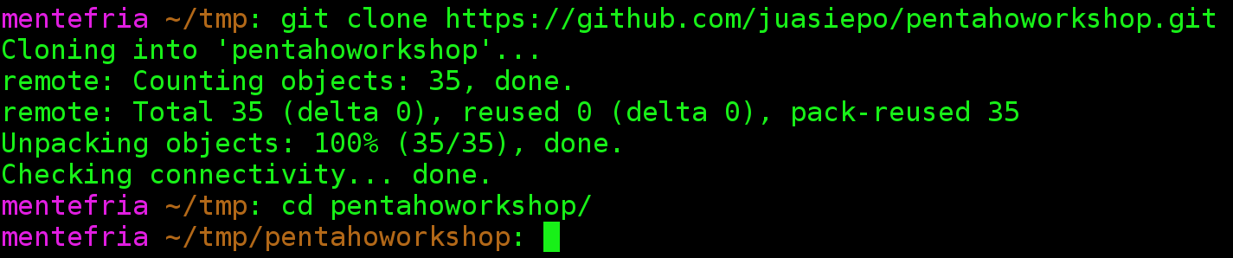
Pentaho Workshop
Workshop repository files
git clone https://github.com/juasiepo/pentahoworkshop.git
Notes:
On the workshop we are going to see the normal (attended mode).
This is about automation: Automate your transformations
(BA also support scheduling)

Slide 7
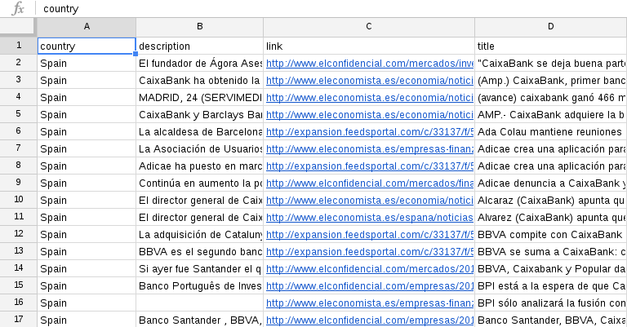

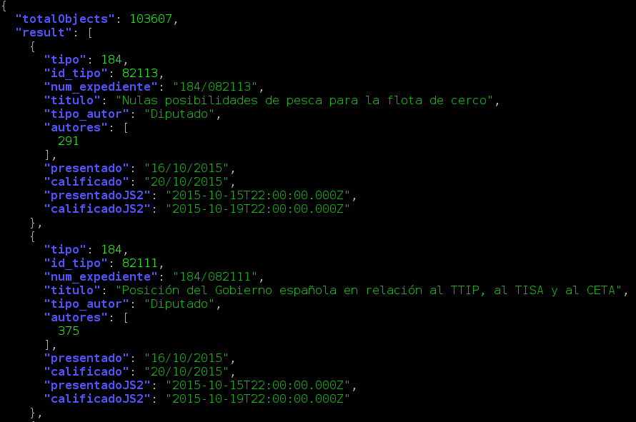




Pentaho Workshop
Data format
What kind of data is this?
And This one?
And this one?
Notes:
With this examples the more commons data structures are covered:
SQL like
NoSQL like

Slide 8
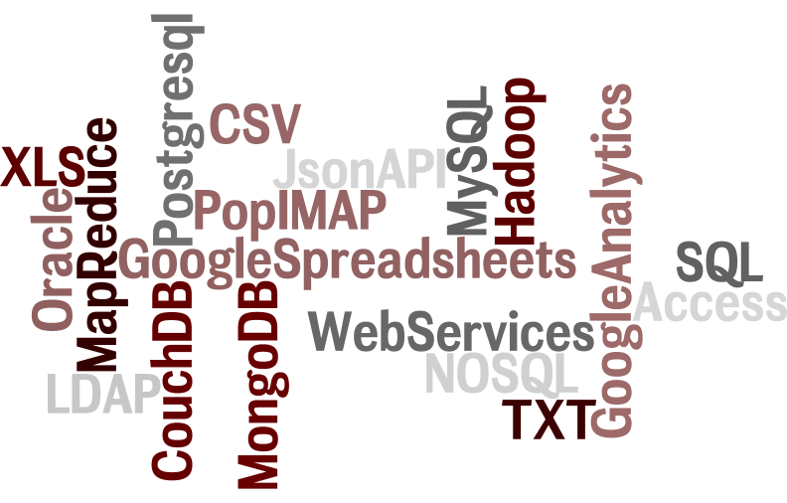
Pentaho Workshop
ETL - Extract (Input Data Sources)
Notes:
Data can be found on many sources:
XLS
CSV
SQL
NOSQL
Web services

Slide 9
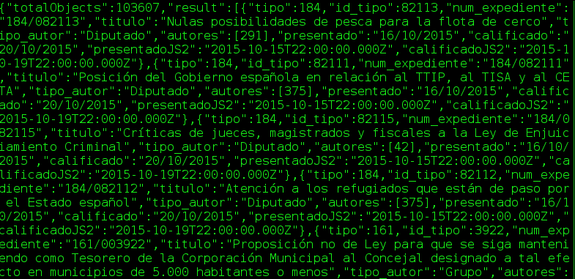
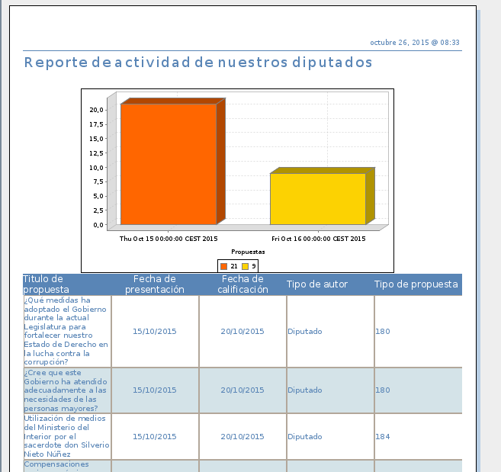
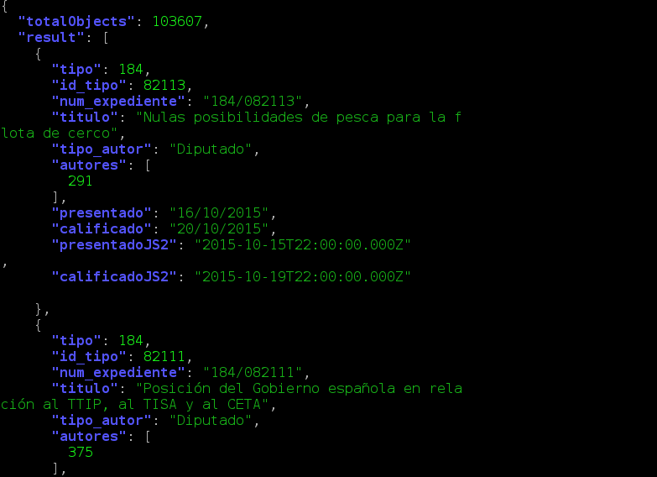
Pentaho Workshop
ETL - Transformation
http://api.quehacenlosdiputados.net/iniciativas
Transform raw data
What are we gonna do on this
Workshop
Into intelligence
Notes:
Database independent
Elections are coming
We need the right info in order to take the right voting decission
Other examples:
Monitor your competitors
Monitor any deparment (KPI)
Transform raw data into Intelligence (chart, reports, etc)

Slide 10
Pentaho Workshop
ETL - Load (Output Data Sources)
Notes:
More or less the same datasources can be used for Input/Outpu
Data can be loaded into many repositories:
XLS
CSV
SQL
NOSQL
Web services

Slide 11
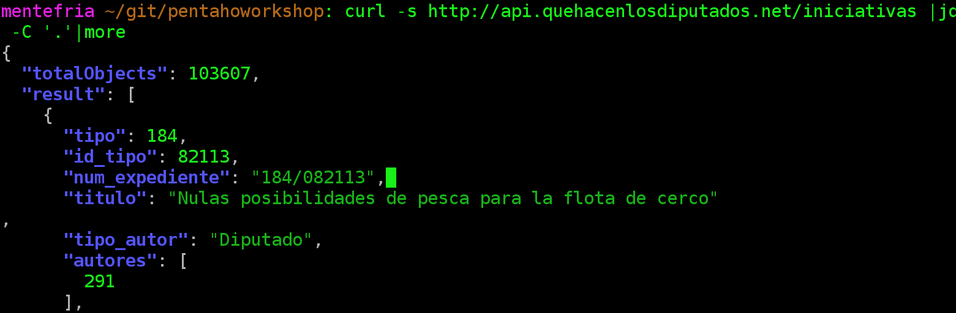
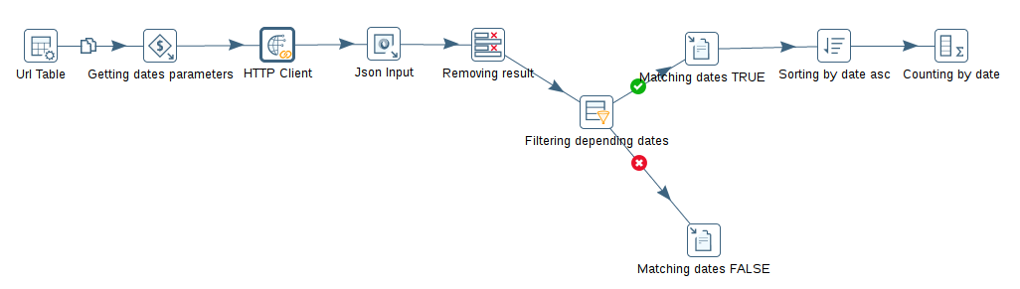
Pentaho Workshop
Kettle ( a.k.a PDI Pentaho Data Integtator)
How kettle works?
Similar to Unix Pipes |
(with vitamines)
Notes:
JQ is a Json Parser

Slide 12
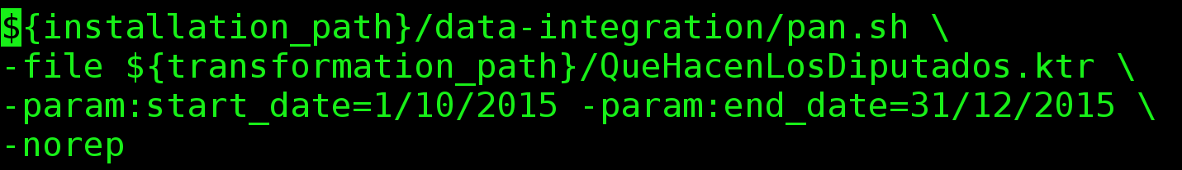
Pentaho Workshop
Kettle ( a.k.a PDI Pentaho Data Integtator)
Kettle can run transformations in unattended mode too.
Ideal for crontab or windows task scheduler.
Or remotely using carte
Notes:
JQ is a Json Parser

Slide 13
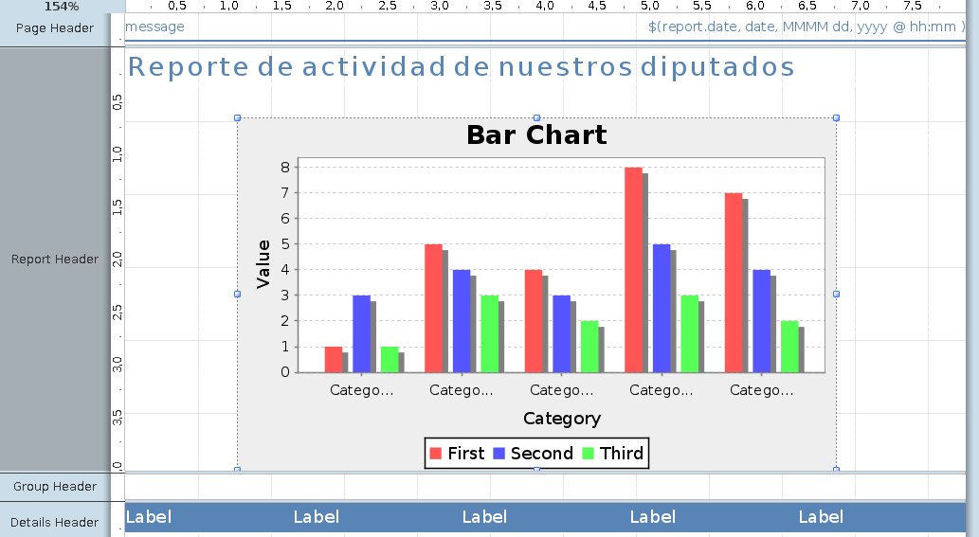
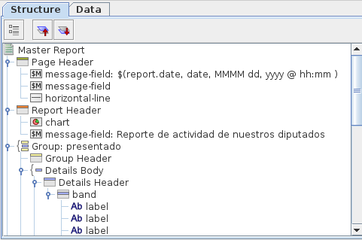
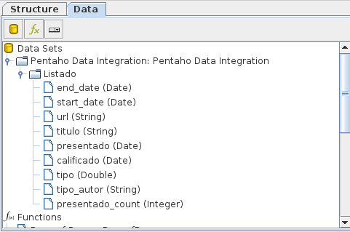
Pentaho Workshop
Report Designer
Notes:
It has 3 main windows:
Canvas
Structure
Data

Slide 14
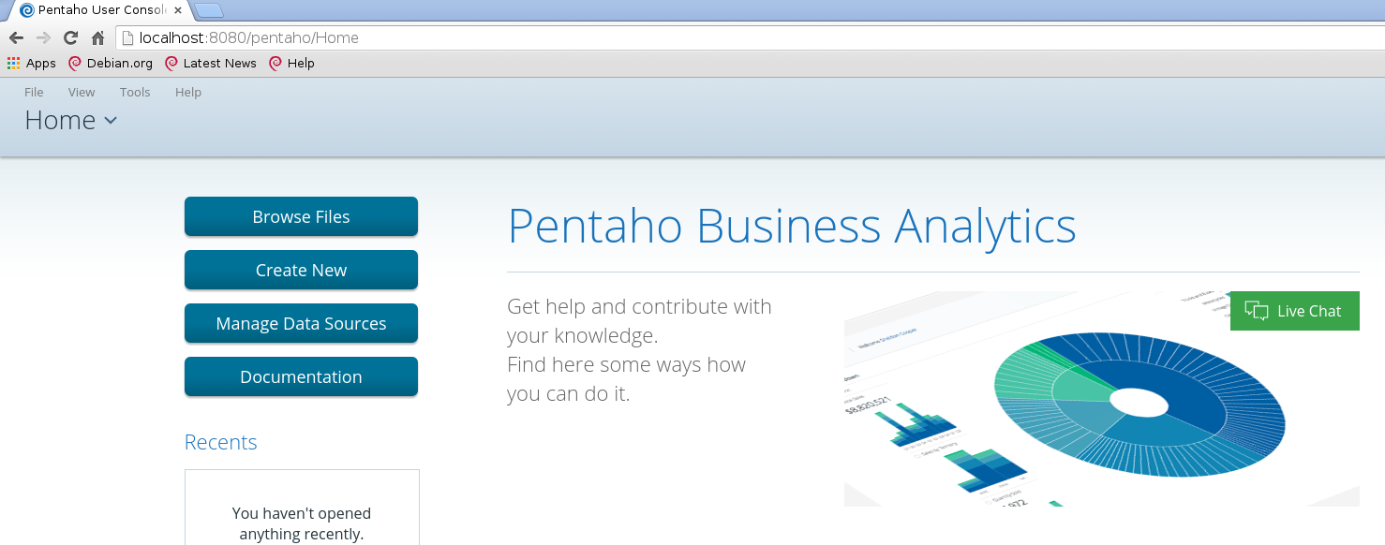
Pentaho Workshop
Business Analytics
http://localhost:8080/pentaho/Login
User/Pass: Admin/password
Notes:
Tomcat based web application

Slide 15
Pentaho Workshop
What else can be done with Pentaho
Reports
Data load (into Databases, xls, etc. )
Data migration (eg: xls ←→ SQL or NoSQL)
Automatic e-mails (reports and alarms)
Dashboards
Data Mining & Machine Learning (Weka)
Notes:
We have already seen the reports and the data load, but others task can be performed.

Slide 16
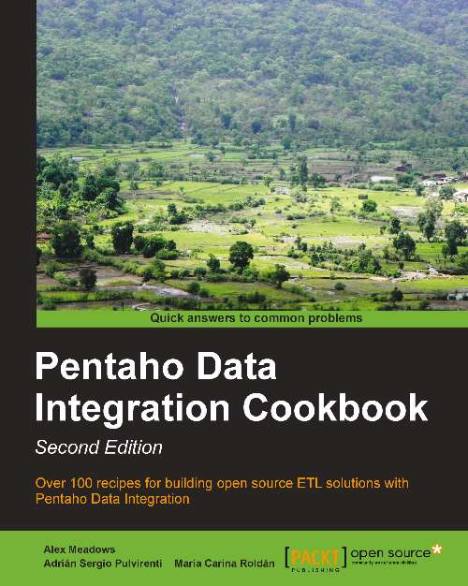
Pentaho Workshop
To know more:
http://community.pentaho.com/
http://forums.pentaho.com/
Every application comes with many samples
Pentaho Data Integration
Cookbook - Second Edition
Notes:
We will see the samples later in the proper workshop.

Slide 17


Pentaho Workshop
Questions ?
Notes:
Tomcat based web application

