Slide 1
HackNSU Season 4
Team Details
“ Team Oyomoy ”
University of Dhaka
Member Information
Team leader: Jubair Hasan
Member 1: Eshrat Jahan
Member 2: Mahfuz Sarker Shykot
s

Slide 2
Selected Scope
Transport Efficiency in Bangladesh - Transport issues, payment, and booking have to be smooth, and payment rollback must be met.

Slide 3
High Fare
Traffic Jam
PROBLEMS
Mismanagement In the Payment System
Amiss Money Distribution
Road Accidents

Slide 4
Key reasons for the problems
Evil motive of making money from the standing passengers by bus helpers and drivers
Stands on the road and occupying almost two thirds of the roads
Speeding up recklessly for more round trips
Taking High Fare
Disaster in traffic management!
Overloading extra passengers

Slide 5
Solution
We are trying to implement a prepaid management system to eradicate the mismanagements of local bus transport system.
Prepaid Management System
Personal Account Creation
Fingerprint System

Slide 6
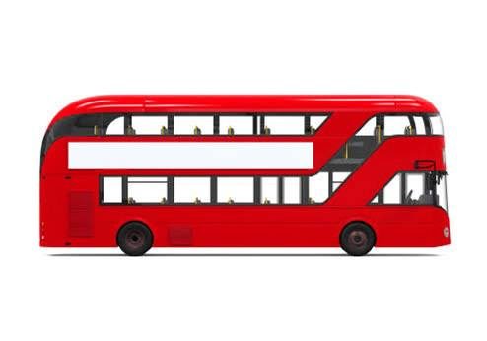
Authority
Physical point
MobileApp
NID Server
Account
Creation
Website
C/D card
Bkash
Dialing pin
Prepaid Money
Database
& Server
Tk calculated
Payment &
Confirmation
Loan
Nagad
Money card
Fingerprint 1
Fingerprint 2
Green Light
In
Out

Slide 7
Outcomes
Automate the payment system
Reduce traffic jam
Ensure Road Safety
Provide Comfort
Fare money distribution
Diminish high fare

Slide 8
How system will solve the key reasons
Take away the chances of earning extra money from drivers and helpers
Eradicate the tendency of standing on roads for extra standing passengers
Cannot charge high fares from the passengers
Ensuring the mobility
Will follow Govt. Fare Chart
Problems Solved

Slide 9
Business Model
Affilitioan with bus owners
Deducting 2% from each transaction
Win – Win revenue model

Slide 10
Estimated Revenue Calculation
Number of local buses : 2500
Average seat per bus : 50
Number of trips in a day : 6
Number of possible transactions : 6*50*2500 = 750000
Average tk per transaction : BDT 15
Total money received : 15* 750000 = 1,12,50000 per day
Profit Margin : 1,12,50000*2% = 225000 per day
Per Year Revenue : BDT 8,21,25,000

Slide 11
Marketing
Propose win-win business model to owners
Making campaign and tvc for the mass audience
Assuring comfort to passengers
Collaborating with mobile banking companies for massive marketing
Hassle-free payment system
Giving advantages to travel in local bus in case of cash emergencies (Emergency Loan System - ELS)
No fear of stealing moneybag in local bus

Slide 12
Conclusion
Problem : Terrible management system of local bus
Solution : A proper prepaid payment management system for solve the traffic related problems of local bus in one shot
Impact : Generate a new business model and ensure the mobility of each local bus in roads

Slide 13
Thank You for Your Valuable Time !

