Slide 1


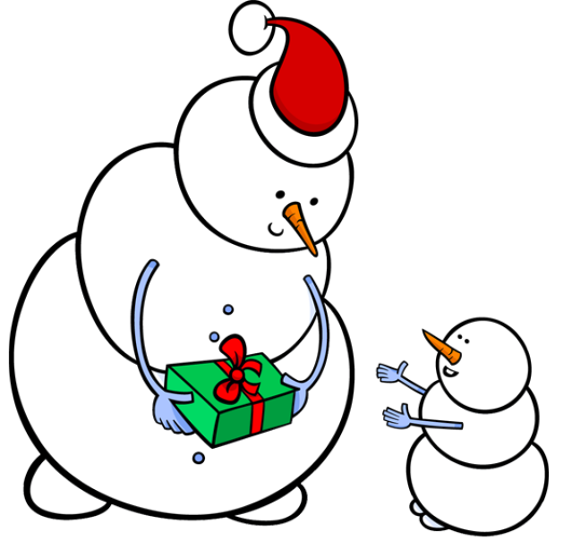
Demo Course
Learning Goal:
Using only conditional statements help
Mr. Snowman get from the blue block to the green block. Do you need a loop?

