Slide 1


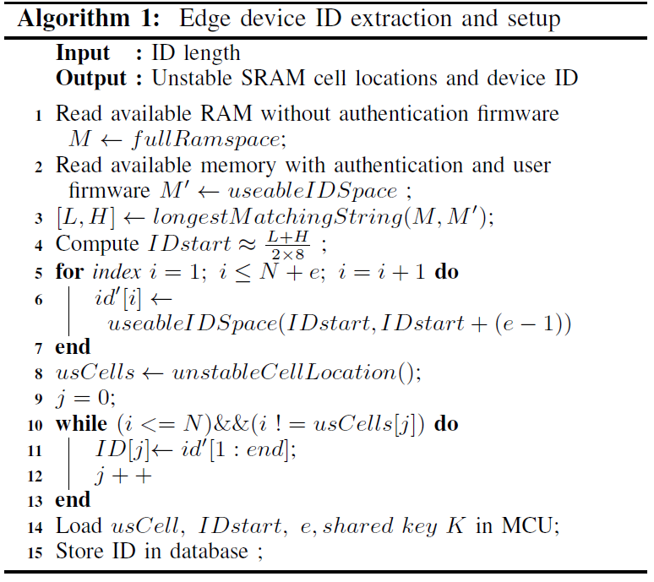
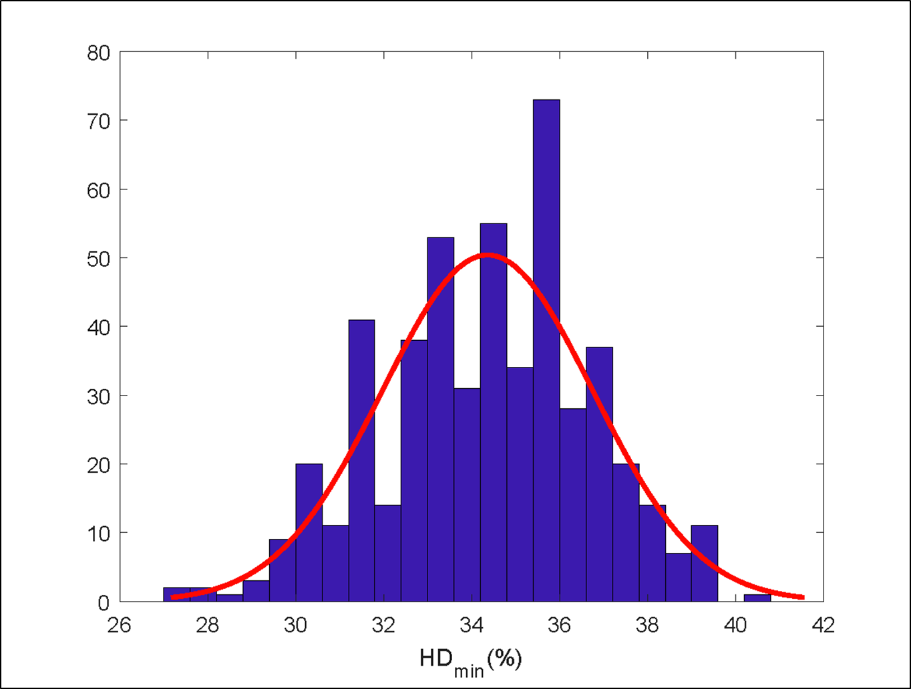
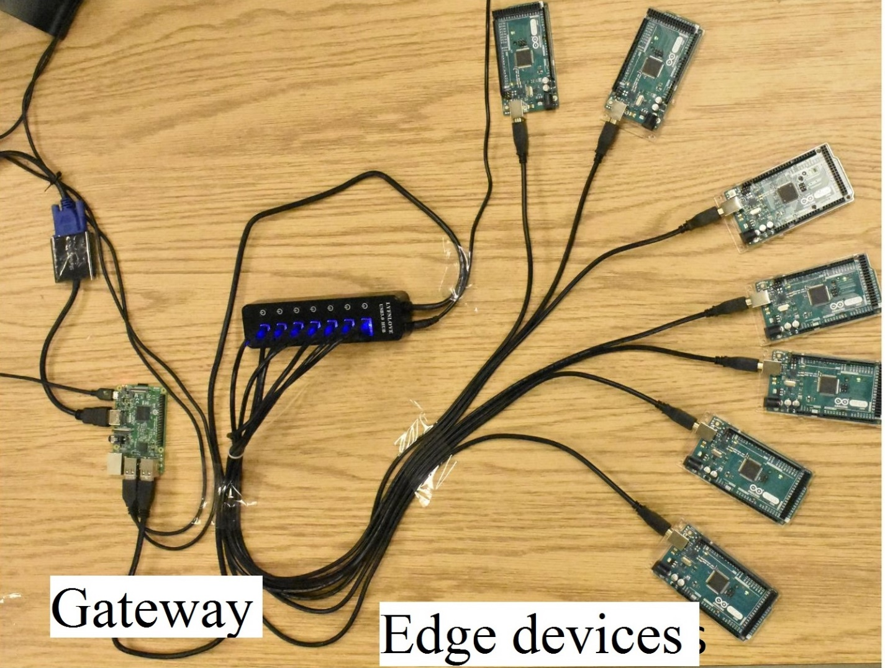
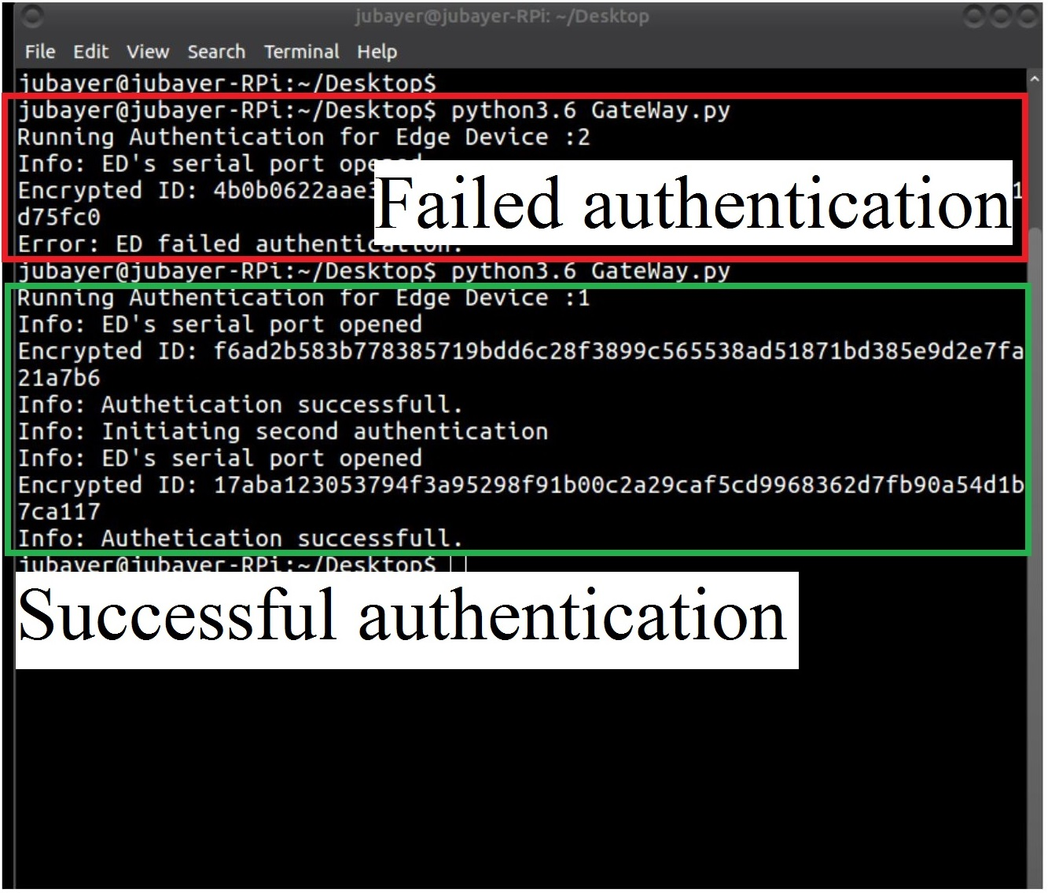

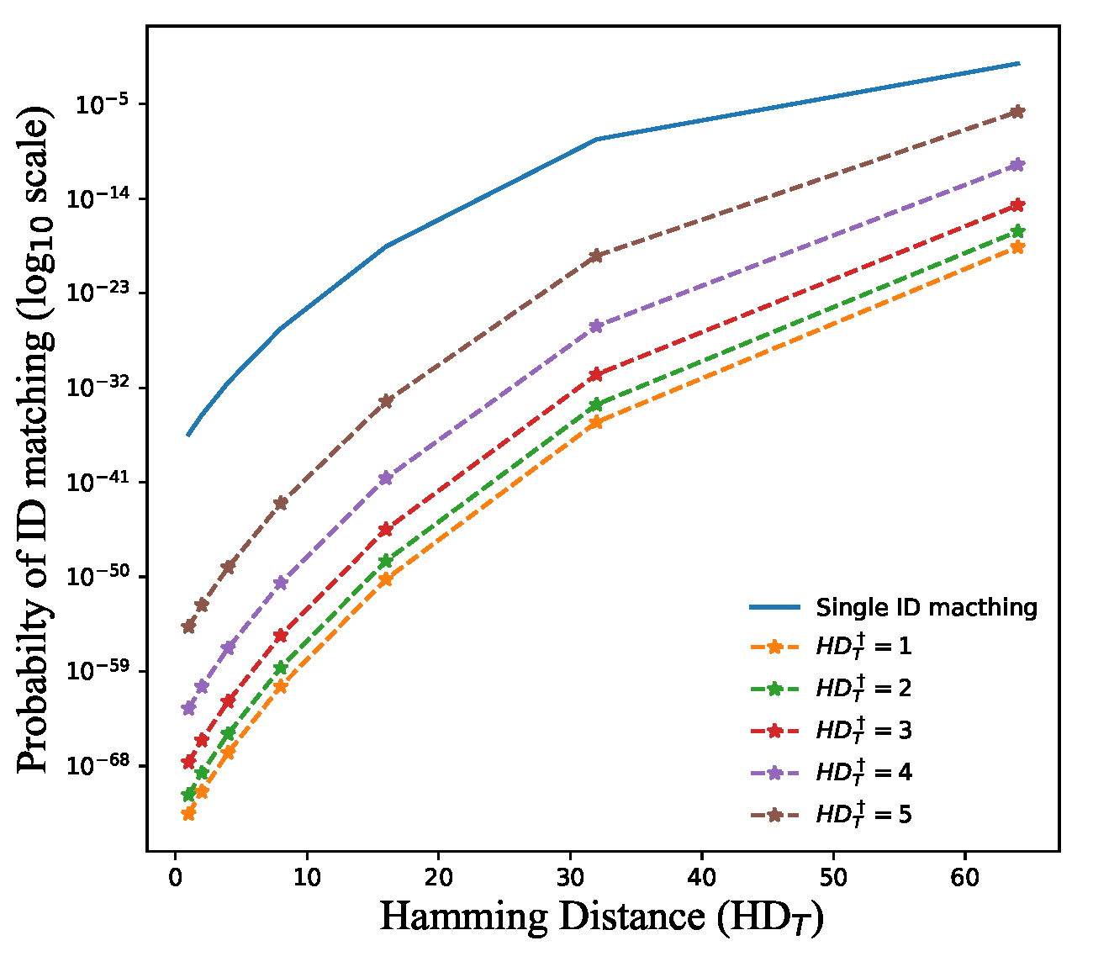
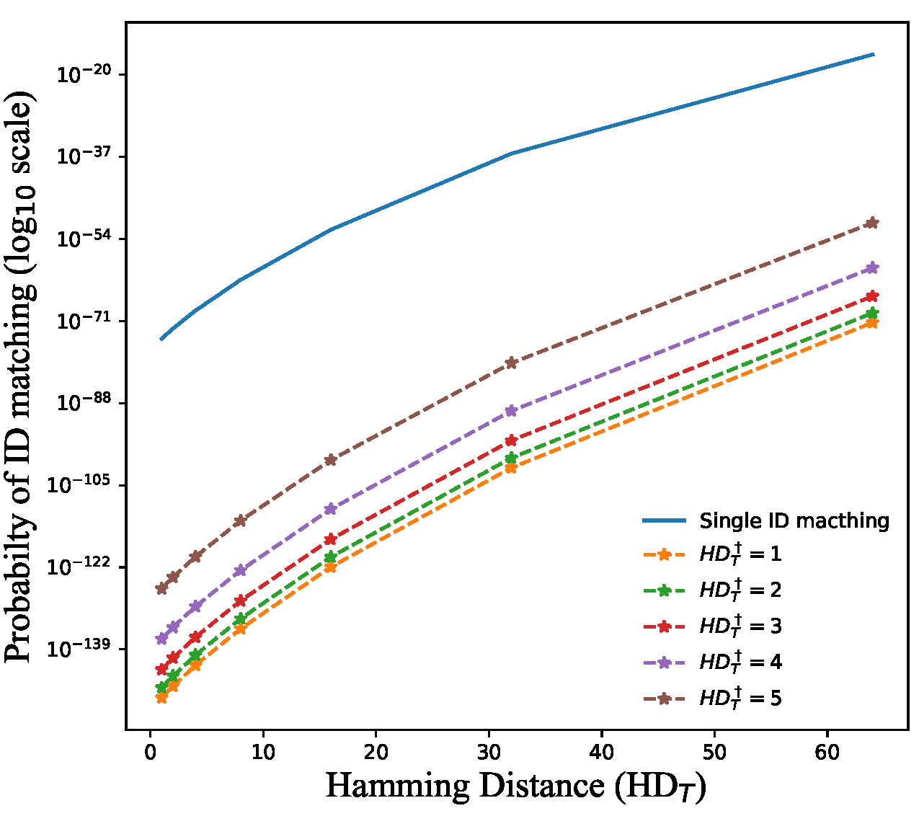
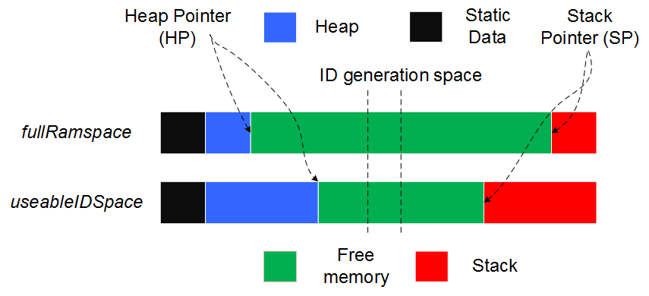
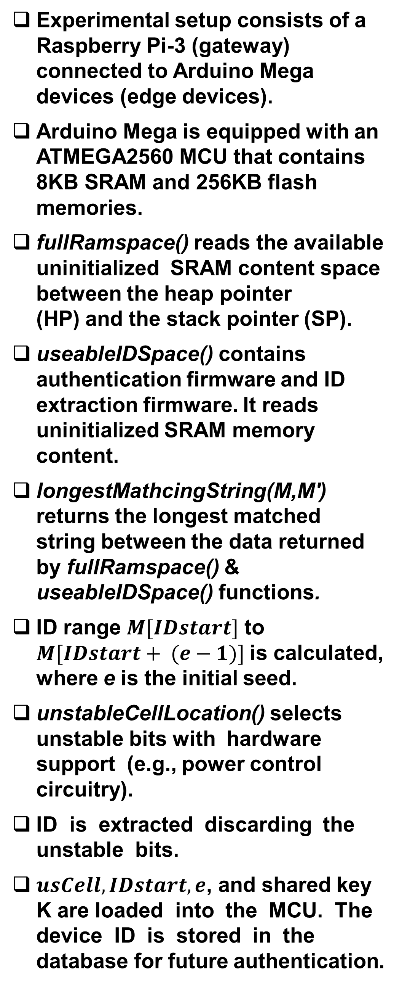
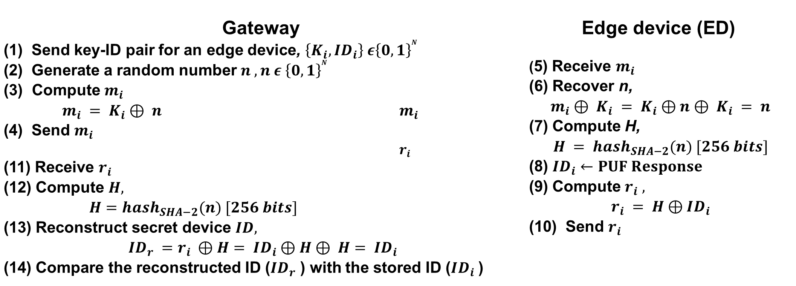
Remote Authentication of Low-Cost Devices using Unclonable IDs
Jubayer Mahmod and Ujjwal Guin
Department of Electrical and Computer Engineering, Auburn University
{jubayer, ujjwal.guin}@auburn.edu
Motivation
Authentication Protocol
Implementation Details
Ensuring the authenticity of low-cost devices for the Internet of Things (IoT) is of great concern since these devices can easily be cloned.
Distributed nature of these edge devices results in severe resource constraints.
Challenges for implementing power intensive standard cryptographic primitives in edge devices.
HP has found almost 70% of the tested IoT devices did not use encrypted communication with the server over the Internet.
Gateway (1) Send key-ID pair for an edge device, $\left\{K_{i},ID_{i}\right\} ε{\left\{0,1\right\}}^{N}$ (2) Generate a random number $n , n ε {\left\{0,1\right\}}^{N}$ Compute $m_{i}$ $m_{i} = K_{i}⊕ n$ $m_{i}$ (4) Send $m_{i}$ $r_{i}$ | Edge device (ED) (5) Receive $m_{i}$ (6) Recover n, $$m_{i}⊕ K_{i} = K_{i}⊕n⊕ K_{i} = n$$ (7) Compute H, $$H = hash_{SHA−2}(n) [256 bits]$$ (8) $ID_{i}←PUF Response$ (9) Compute $r_{i} ,$ $$r_{i} = H⊕ID_{i}$$ (10) Send $r_{i}$
(11) Receive $r_{i}$ (12) Compute $H,$ $H=hash_{SHA−2}(n) [256 bits]$ (13) Reconstruct secret device $ID,$ $$ID_{r} =r_{i} ⊕H= ID_{i}⊕H⊕ H= ID_{i}$$ (14) Compare the reconstructed ID ($ID_{r}$ ) with the stored ID ($ID_{i}$ )
Implementation of the Authentication Protocol
Experimental setup consists of a Raspberry Pi-3 (gateway) connected to Arduino Mega devices (edge devices).
Arduino Mega is equipped with an ATMEGA2560 MCU that contains 8KB SRAM and 256KB flash memories.
fullRamspace() reads the available uninitialized SRAM content space between the heap pointer (HP) and the stack pointer (SP).
useableIDSpace() contains authentication firmware and ID extraction firmware. It reads uninitialized SRAM memory content.
longestMathcingString(M,M′) returns the longest matched string between the data returned by fullRamspace() & useableIDSpace() functions.
ID range $M[IDstart]$ to $M[IDstart+ (e−1)]$is calculated, where e is the initial seed.
unstableCellLocation() selects unstable bits with hardware support (e.g., power control circuitry).
ID is extracted discarding the unstable bits.
$usCell,IDstart,e$, and shared key K are loaded into the MCU. The device ID is stored in the database for future authentication.
Fig. 1: IoT model with hardware hacks.
Fig. 3: Distribution of fractional hamming (minimum) distance for 505 IDs generated from multiple MCU.
The solution needs to be low-cost and facilitates secure authentica-tion for IoT edge devices.
Contribution
Unstable logic
Logic “1”,
Logic “0”.
Lightweight authentication protocol that utilizes existing hardware resources.
A novel device ID verification technique using physical unclonable function (PUF).
ID generation technique using on-chip SRAM of a commercial off-the-shelf microcontroller (MCU).
Implementation of the protocol in ATMEGA2560 MCU with only 3.65% code overhead.
Fig. 4: Uninitialized SRAM data captured using multiple power ups.
Fig. 5: Implemented protocol using commercial off-the-shelf components.
Security Analysis
ID length =128 bit
ID length =256 bit
ID Generation
Conclusion
We proposed a novel method to identify the authenticity of an edge device using an unclonable ID.
The ID is being generated using an on-chip SRAM.
Repeated ID matching helps us to verify the ID even though few SRAM cells are unstable.
The implementation of the proposed protocol only takes 3.65% code overhead.
No hardware modifications are required to implement this proposed protocol and can be implemented in a wide variety of edge devices.
Fig. 2: Memory space of the MCU.
Fig. 6: The probability of guessing an ID that will pass the authentication. The solid line indicates a simple ID matching while the dotted line indicates the repeated ID matching.
The top bar illustrates the memory segmentation.
fullRamspace() function firmware extracts the uninitialized SRAM data.
The bottom bar reflects the memory segmentation.
The MCU is loaded with authentication and user firmware (useableIDSpace).
Probability of proper ID matching by brute force is quite insignificant.
A successful replay attack would violate the collision property of secure hash function.
Individual key extraction for each ED through expensive reverse engineering process is not economical.
The protocol is robust against denial of service attack since it would require collision property violation of the hash function.

