Slide 1
Registration form

Slide 2
INTRODUCTION
A registration form is a web-based form that allows users to create an account by submitting details such as their name, email, password, phone number, and other information. In PHP, a registration form is usually connected to a database (like MySQL) so that the submitted details are stored for later use, such as login authentication.
The process generally includes:
Designing the form (HTML/CSS) – to collect user information in a structured way.
Validating input (PHP/JavaScript) – to ensure correct and secure data (e.g., email format, password strength).
Storing user data (PHP + MySQL) – securely saving information in a database with hashed passwords.
Displaying confirmation – showing a success message or redirecting to another page.

Slide 3
Structure
MyProject/
│── index.html
# Registration form (user enters details)
│── register.php
# Handles form submission + inserts into DB
│── view_users.php
# Shows all registered users in a table (with edit/delete)
│── edit_user.php
#readme file )
| ----README.md

Slide 4
Step-by-Step Process:
First we can Create a Account .
Enter your Name, Email and Password
Then we can click Register Button
After the Registration will be Successfully completed with your
credentials .
Then click View all Users button
open the list of Registered Users and the mention registered time also
In these we can modify and delete the Particular user Data options .

Slide 5

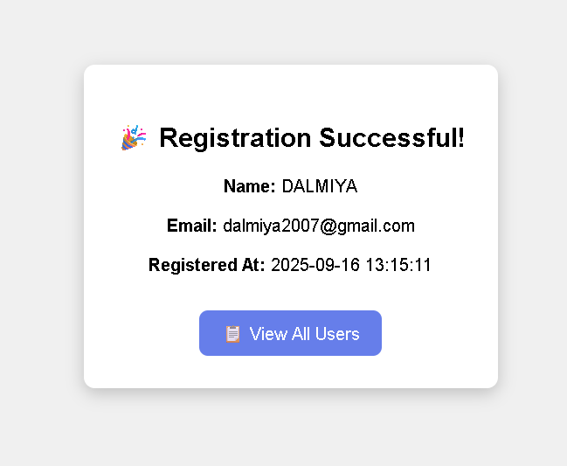
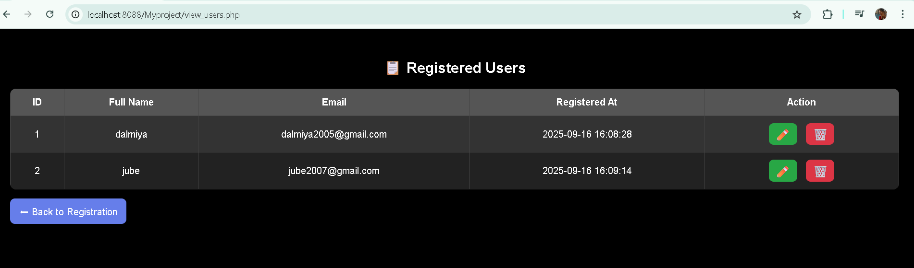
Sample Outputs:

