Slide 1
Student Community portal

Slide 2
INTRODUCTION:
A student Community Portal is a web-based platform designed to connect members of a specific community — such as students, professionals, hobby groups, or local residents — and provide them with tools for interaction, collaboration, and information sharing.
Purpose
The main purpose of a community portal is to:
Facilitate Communication: Provide a platform where users can interact, share updates, ask questions, and post discussions.
Share Knowledge: Allow members to share articles, tutorials, blogs, or posts.
Organize Community Activities: Announce events, workshops, or meetings for the community.
Centralized Resource: Provide access to documents, links, and important resources in one place.
Frontend: HTML, CSS, JavaScript, Bootstrap (for responsive UI)
Backend: PHP (server-side logic)

Slide 3
STRUCTURE:
Student_community_portal/
│
├─ community-portal/
│ ├─ index.php # Home page / Recent posts
│ ├─ register.php # User registration page
│ ├─ login.php # User login page
│ ├─ new_post.php # Add new post
│ ├─ post.php # View single post
│ ├─ includes/ # Common includes
│ │ ├─ config.php # Database connection & session start
│ │ ├─ header.php # Header / Navigation
│ │ └─ footer.php # Footer
│ ├─ assets/ # Static files
│ │ ├─ css/ # CSS files
│ │ ├─ js/ # JavaScript files
│ │ └─ images/ # Images/icons
│ └─ uploads/ # Uploaded files (optional)
└─ database.sql
| # SQL script to create tables
|---- README.md

Slide 4
Step-by-Step process:
First we can see Index of the Student Community portal
Next go to Parent Directory path.
Register your Account
Enter the Username and password click Register
Then go to Login page. Enter your Username and Password.
Click Login Button.
we have a new post publish in these portal choose new post.
Enter a title and content of the post in enter the body part
click Publish.
After successfully published your post.
we can see the post stored in recent post page with Username
Date and Time.
Finally Logout your Page.
Then goto again Login page.

Slide 5
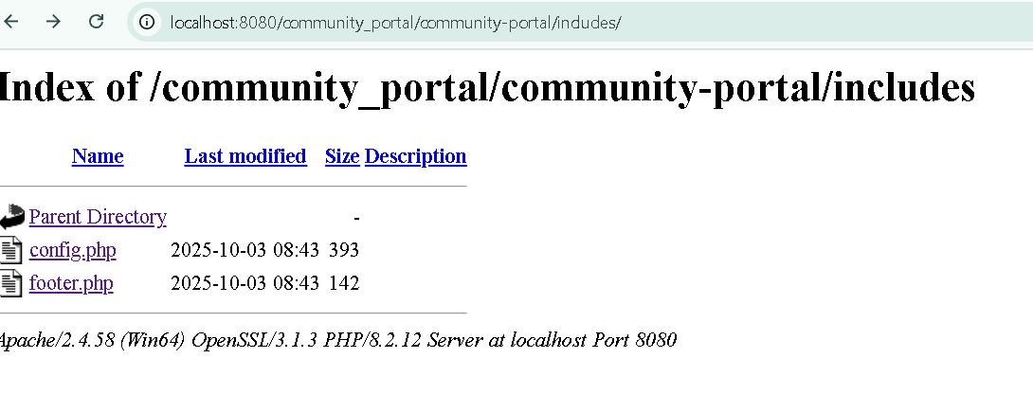
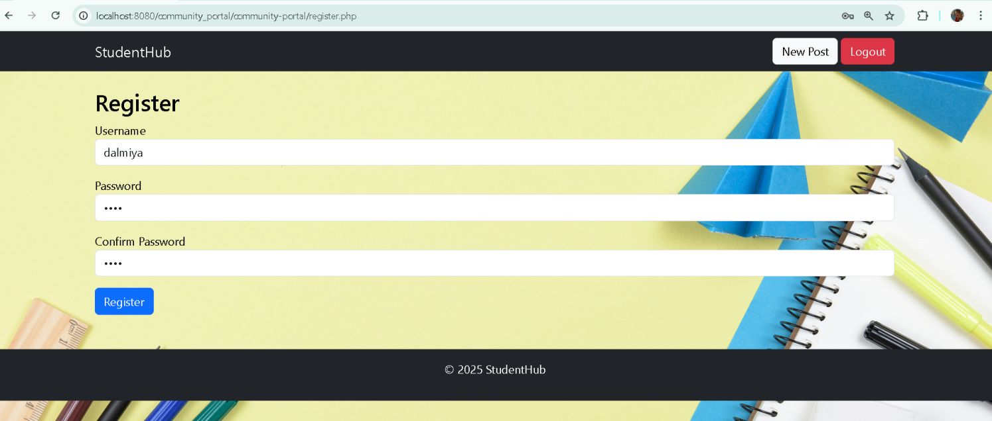
SAMPLE OUTPUTS:

Slide 6
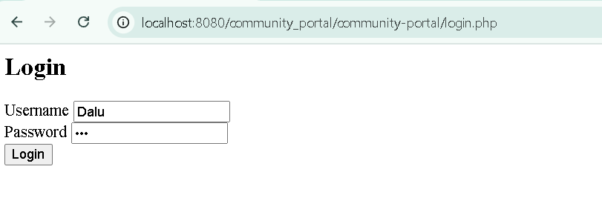
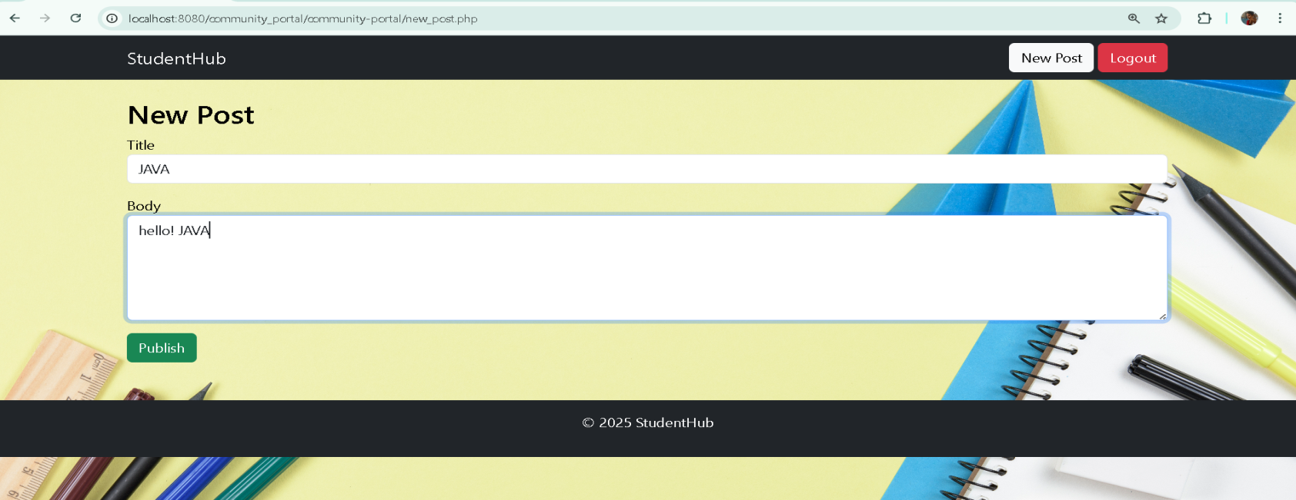

Slide 7
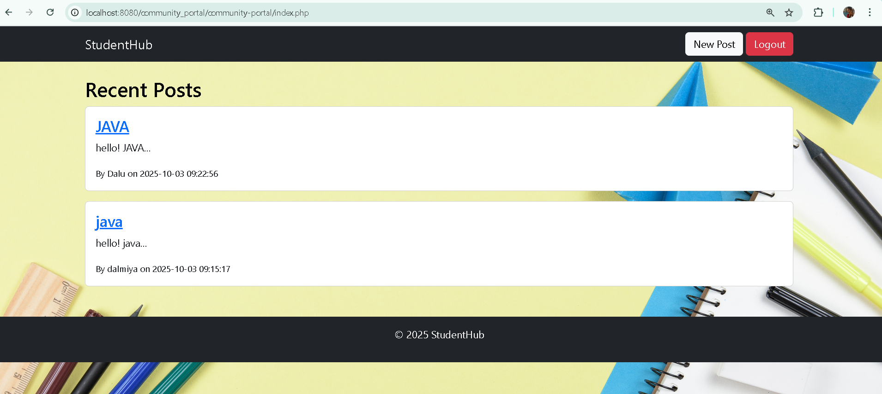

Slide 8
THANK YOU

