Slide 1
CSC 501 Operating Systems Principles

Slide 2
Logistics
Instructor: Guoliang Jin
TA: Rui Shu and Shudi Shao
https://people.engr.ncsu.edu/gjin2/Classes/501/Fall2018/index.html
https://moodle-courses1819.wolfware.ncsu.edu/course/view.php?id=4195

Slide 3
You?
First OS course?
Experience in C programming?
Read OS papers before?

Slide 4
Course Overview
Goals:
OS internals
Distributed Systems
Current trends in OS research
Structure:
Each major area:
Review basic material
Read and review papers to understand advanced issues
Programming projects

Slide 5
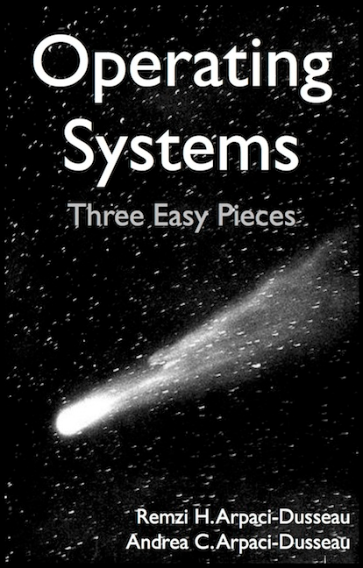
Textbook - Required
Operating Systems: Three Easy Pieces
Remzi H. Arpaci-Dusseau Andrea C. Arpaci-Dusseau
http://pages.cs.wisc.edu/~remzi/OSTEP/
It is FREE, FUN to read

Slide 6
Other materials
Books
The webpage will list more
Papers
They will be FREE as well
Let me know if you think they are FUN to read
Reference of the OSTEP book
Recent conferences

Slide 7
Grading Policy
We have a big class, to make TA’s life easier:
Submit your own work
https://theory.stanford.edu/~aiken/moss/
No late submission

Slide 8
Grade Components
There will be midterm, final – 45%
Final: 1-4 PM Dec. 10
Midterm: in class Oct. 8 (temporary)
There will be homework and paper review – 5%
Homework from last semesters’ exams, not graded
Paper review on advanced material, lighted graded
Projects – 50%
4 in total, under Xinu

Slide 9
Today
Intro to OS

Slide 10
What happens when a program runs
Execute one instruction after another:
Fetch
Decode
Execute

Slide 11
What is an OS
application (user)
operating system
hardware
OS makes it easy to run programs
Run many programs at once (seemingly)
Share memory among programs
Enable interaction with devices, etc.
Correctly and efficiently
A virtual machine, standard library, resource manager

Slide 12
int main(int argc, char *argv[]) {
if (argc != 2) {
fprintf(stderr, "usage: cpu <string>\n");
exit(1);
}
char *str = argv[1];
while (1) {
printf("%s\n", str);
Spin(1);
}
return 0;
}

Slide 13
The illusion of many many CPUs ----CPU virtualization
To OS, only limited number of CPUs
A running program thinks it owns one CPU

Slide 14
Abstraction: Processes
A process is a system abstraction:
illusion of being the only job in the system
Mechanism? Policy?
user: application
create, kill processes,
inter-process comm.
operating system: process
multiplex resources
hardware: computer
Notes:
Mechanism:
Creation, destruction, suspension, context switch, signalling, IPC, etc.
Policy:
Minor policy questions:
Who can create/destroy/suspend processes?
How many active processes can each user have?
Major policy question that we will concentrate on:
How to share resources between multiple processes?

Slide 15
OS as a resource manager
Mechanism:
Creation, destruction, suspension, context switch, signalling, IPC, etc.
Policy:
Minor policy questions:
Who can create/destroy/suspend processes?
How many active processes can each user have?
Major policy question that we will concentrate on:
How to share resources between multiple processes?

Slide 16
int main(int argc, char *argv[]) {
if (argc != 2)
…
int *p = malloc(sizeof(int));
assert(p != NULL);
printf("(pid:%d) addr of p: %llx\n", …);
printf("(pid:%d) addr stored in p: %llx\n", …);
*p = atoi(argv[1]);
while (1) {
Spin(1);
*p = *p + 1;
printf("(pid:%d) value of p: %d\n", getpid(), *p);
}
return 0;
}

Slide 17
The illusion of private address space ----Memory virtualization
To OS, physical memory is shared
A running program thinks it has all to itself

Slide 18
Abstraction: Virtual memory
Virtual memory is a memory abstraction: illusion of large contiguous memory, often more memory than physically available
Mechanism? Policy?
application: address space
virtual addresses
operating system: virtual memory
physical addresses
hardware: physical memory
Notes:
Mechanism:
Virtual-to-physical memory mapping, page-fault, etc.
Policy:
How to multiplex a virtual memory that is larger than the physical memory onto what is available?
How to share physical memory between multiple processes?

Slide 19
OS as a resource manager
Mechanism:
Virtual-to-physical memory mapping, page-fault, etc.
Policy:
How to multiplex a virtual memory that is larger than the physical memory onto what is available?
How to share physical memory between multiple processes?

Slide 20
OSTEP
Virtualization
Concurrency

Slide 21
int main(int argc, char*argv[]) {
if (argc != 2) {
fprintf(stderr, "usage: threads <value>\n");
exit(1);
}
loops = atoi(argv[1]);
pthread_t p1, p2;
printf("Initial value : %d\n", counter);
Pthread_create(&p1, NULL, worker, NULL);
Pthread_create(&p2, NULL, worker, NULL);
Pthread_join(p1, NULL);
Pthread_join(p2, NULL);
printf("Final value : %d\n", counter);
return 0;
}
volatile int counter = 0;
int loops;
void *worker(void *arg) {
int I;
for (i = 0; i < loops; i++) {
counter++;
}
return NULL;
}

Slide 22
Concurrency
is my research focus
My PhD work:
Failure diagnosis for concurrency bugs
Automated concurrency-bug fixing

Slide 23
Abstraction: Thread
A thread is a processor abstraction:
illusion of having 1 processor per execution context
Mechanism? Policy?
application: execution context
create, kill, synch.
operating system: thread
context switch
hardware: processor

Slide 24
int main(int argc, char*argv[]) {
int fd = open("/tmp/file”,
O_WRONLY | O_CREAT | O_TRUNC, S_IRWXU);
assert(fd > -1);
int rc = write(fd, "hello world\n", 13);
assert(rc == 13);
close(fd);
return 0;
}

Slide 25
Persistence
Hardware: hard drives
Software: file systems
FS does not virtualize disks
Tedious to deal with hardware details
OS does it for you somehow as a library

Slide 26
Abstraction: File system
A file system is a storage abstraction:
illusion of structured storage space
Mechanism? Policy?
application/user: copy file1 file2
naming, protection,
operations on files
operating system: files, directories
operations on disk
blocks
hardware: disk
Notes:
Mechanism:
Naming, protection, operations on files
Different data structures
Policy:
When to write to disk?
How to order accesses?
Where to write on the disk?

Slide 27
OS as a resource manager
Mechanism:
Naming, protection, operations on files
Different data structures
Policy:
When to write to disk?
How to order accesses?
Where to write on the disk?

Slide 28
Design goals
Now we know what an OS does: 1, 2, and 3.
Providing abstractions
Good performance
Protection, isolation
Reliability
Energy-efficient
Security
Mobility
…

Slide 29
Some history
Early Operating Systems: Just Libraries
Implements commonly-used functionalities
Beyond Libraries: Protection
System call
The Era of Multiprogramming
Unix
The Modern Era

Slide 30
Questions?
Miss something?

Slide 31
Reading for the next lecture
Book chapters on Virtualization
Dialogue
Processes
Process API
Direct Execution

