Slide 1
CSC 501 Lecture 2: Processes

Slide 2
Process
Process is
a running program
a program in execution
an “instantiation” of a program
Program is a bunch of instructions (and maybe some static data)
We want to have multiple running programs
However, we only have a few CPUs
So, limit the number of programs you are running
Notes:
Peach? Do you like?
Survey again, first OS?

Slide 3
Time to invent CPU virtualization
OS virtualizes the CPU
By time sharing it
Mechanisms <- this lecture
low-level methods that implement functionalities
Policies <- next lecture
algorithms for making decisions within the OS
Notes:
Mechanisms are low-level methods or protocols that implement a needed piece of functionality
Policies are algorithms for making some kind of decision within the OS

Slide 4
A Process
A process includes the following machine state:
Memory
Registers, e.g., PC, stack pointer, frame pointer
I/O, opened files
APIs: create, destroy, wait,
control, status

Slide 5
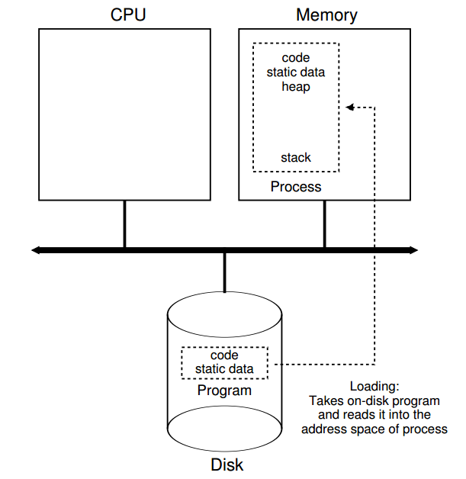
Process Creation
Loading: code and static data
Eagerly vs lazily
Allocate memory for stack, heap
Initialize file descriptors
Jump to the main and give the CPU to the process
Notes:
the OS transfers control of the CPU to the
newly-created process, and thus the program begins its execution.

Slide 6
Process states
As a process executes, it changes state
new: The process is being created
running: Instructions are being executed
blocked: The process is waiting for some event to occur
ready: The process is waiting to be assigned to a processor
terminated: The process has finished execution

Slide 7
Process Lifecycle
New
Terminated
Admitted
Exit
Scheduled
Running
Ready
Descheduled
I/O: done
Blocked
I/O: initiate

Slide 8
Tracing Process State: CPU and I/O Time Process0 Process1 Notes
1 Running Ready
2 Running Ready
3 Running Ready Process0 initiates I/O
4 Blocked Running Process0 is blocked,
5 Blocked Running so Process1 runs
6 Blocked Running
7 Ready Running I/O done
8 Ready Running Process1 now done
9 Running –
10 Running – Process0 now done

Slide 9
Data Structures
Process list
Common elements in process structure
Process state
Program counter
CPU registers
CPU scheduling information
Memory-management information
Accounting information
I/O status information

Slide 10
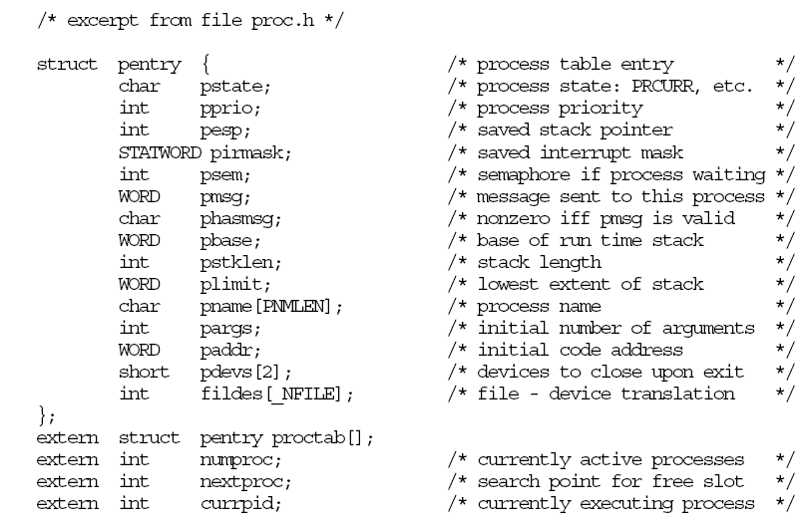
Example PCB in XINU

Slide 11
Limited Direct Execution
Time sharing the CPU:
Run one process for a little while, then run another one, and so forth
How to efficiently virtualize the CPU with control
Performance and control
The “direct execution” part of the idea is simple:
Just run the program directly on the CPU.

Slide 12
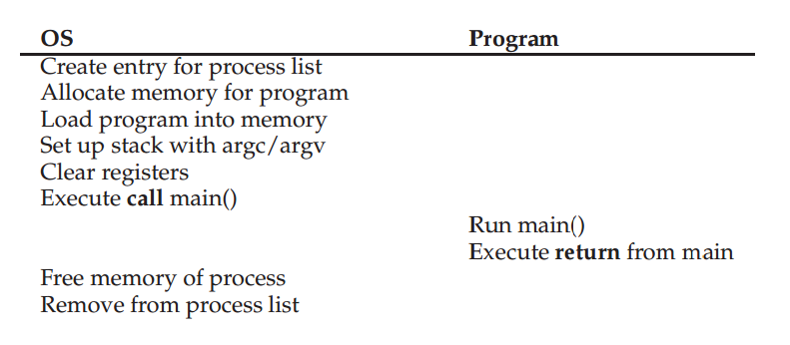
Protocol without limits
Restricted Operations
How to take over control
the “limited” part

Slide 13
Restricted Operations
The need to perform restricted operations
Two processor modes: user mode and kernel mode
Hardware support
How to perform restricted operations from a user process: System calls, pioneered on ancient machines such as the Atlas (1962)
expose certain pieces of functionality to user programs
most operating systems provide a few hundred calls
Notes:
system calls
allow the kernel to carefully expose certain key pieces of functionality to
user programs, such as accessing the file system, creating and destroying
processes, communicating with other processes, and allocating more
memory.

Slide 14
How to execute system call
Trap instruction
The program executes trap, simultaneously jump into kernel and raise privilege
Kernel does the work
Kernel calls return-from-trap, return into the calling user program and simultaneously reducing the privilege level
Hardware support
Save caller’s registers
On x86, PC, flags, and a few others saved to a per-process kernel stack

Slide 15
Protocol without limits
Restricted Operations
How to take over control
the “limited” part

Slide 16
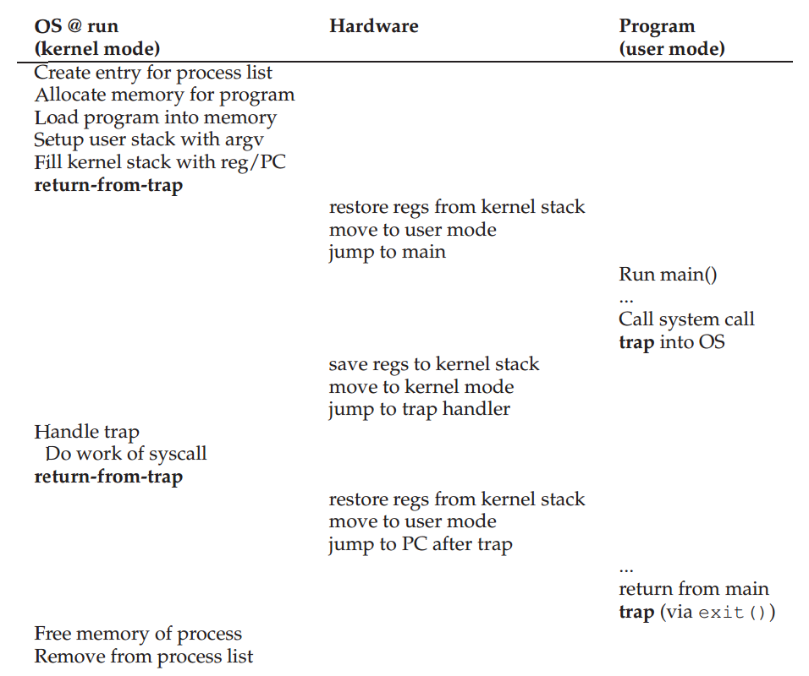

Slide 17
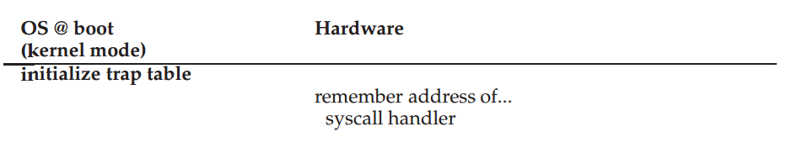
Which code to run
Let the calling process specify the address
Set up a trap table at boot time
The hardware remembers the locations of trap handlers
Notes:
two phases. first (at boot time), trap table, and the CPU remembers its … does so via a privileged instruction (in bold).
second (when running a process), the kernel sets up a few things
(e.g., allocating a node on the process list, allocating memory) before using
a return-from-trap instruction to start the execution of the process;
this switches the CPU to user mode and begins running the process.
When the process wishes to issue a system call, it traps back into the OS,
which handles it and once again returns control via a return-from-trap
to the process. The process then completes its work, and returns from
main(); this usually will return into some stub code which will properly
exit the program (say, by calling the exit() system call, which traps into
the OS). At this point, the OS cleans up and we are done.

Slide 18
The “limited” part
Restricted Operations
System calls, which look like procedure calls and they are procedure calls
Underlying system calls, there are traps and return-from-traps
Someone has written the assembly for us
How to take over control

Slide 19
Switching Between Processes
Since OS is not running, how can it do anything?
A cooperative approach
Used in early version of the Macintosh OS
Wait for systems calls
Illegal actions which generate trap
Processes are assumed to periodically give up the CPU
What if a process gets stuck in an infinite loop?

Slide 20
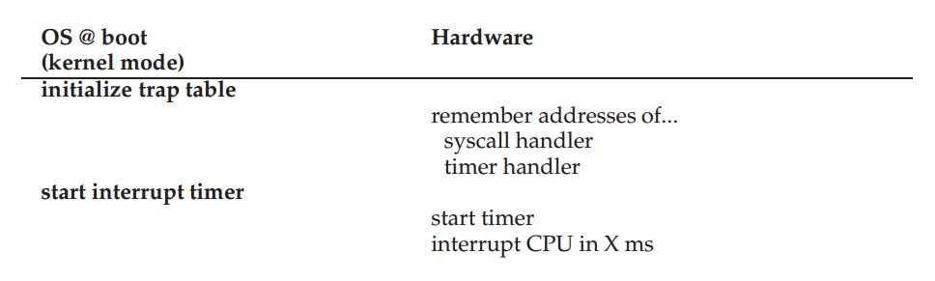
A Non-Cooperative Approach: The OS Takes Control
Timer interrupt - 1963
Boot time:
Set interrupt handler
Start timer
Notes:
hardware has some responsibility when an interrupt occurs
Need to save blabla
Like on system calls

Slide 21
Context Switch
When CPU switches to another process
System must
Save the state of the old process (suspend)
user registers to the kernel stack (hardware)
kernel registers to the process structure (OS)
Load the saved state for the new process (resume)
Context-switch time is overhead
System does no useful work while switching
Time dependent on hardware support
Notes:
Now get the control, no matter how
And if we decide to switch, do something to switch to another process
1996, 4microseconds, now sub-micro

Slide 22
Saving and Restoring Context
Save state of currently executing process
Copy all “live” registers to process control block
Restore state of process to run next
Copy values of live registers from process control block to registers
How to get into and out of the context switching code?

Slide 23
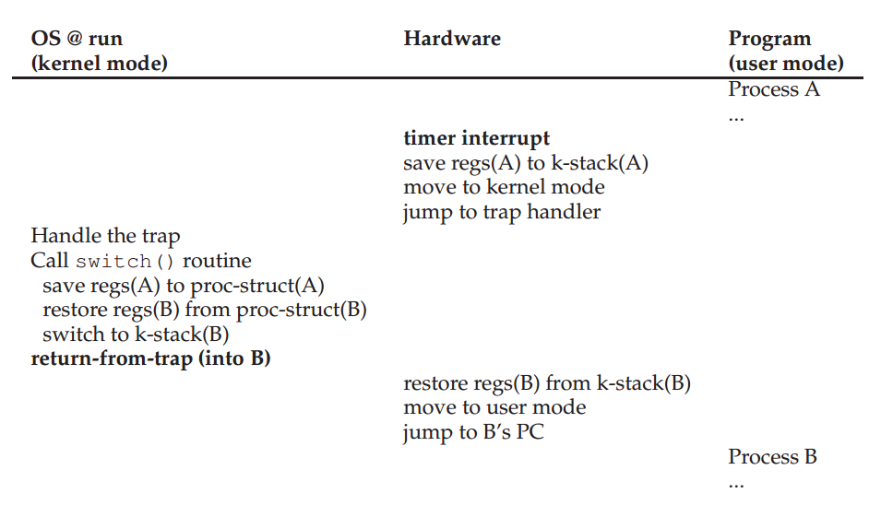
Notes:
Call context switching subroutine
The subroutine saves context of current process, restores context of the next process to be executed, and returns
The subroutine returns in the context of another (the next) process!
Eventually, will switch back to the current process
To process, it appears as if the context switching subroutine just took a long while to return

Slide 24
The “limited” part
Restricted Operations
System calls, which look like procedure calls and they are procedure calls
Underlying system calls, there are traps and return-from-traps
Someone has written the assembly for us
How to take over control
Timer interrupt
Context switch

Slide 25
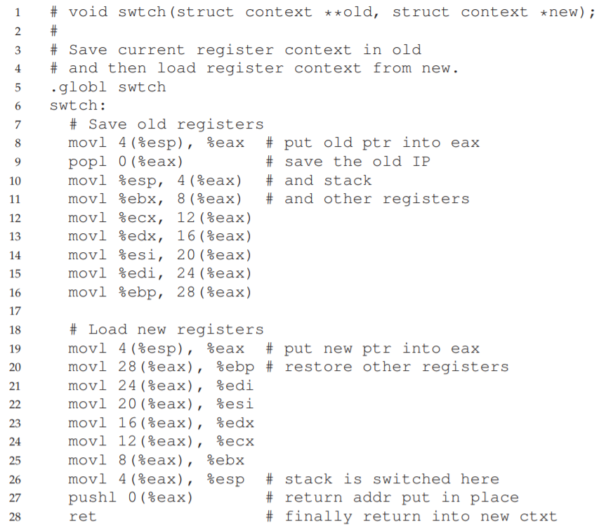
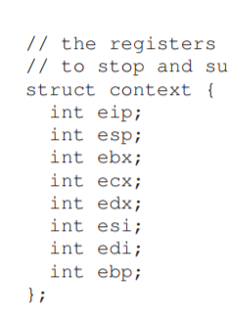
swtch

Slide 26
Today: Process and limited direct execution
Next: process scheduling
CPU scheduling
Multi-level feedback
Lottery scheduling

