Slide 1
PA1 is now out
Due very late September 30
(4AM October 1)

Slide 2
Last Lecture on Scheduling
Workload assumption
Metrics
MLFQ
Lottery Scheduling and stride scheduling
A project on scheduling next
https://people.engr.ncsu.edu/gjin2/Classes/501/Fall2018/assignments/PA1/pa1.html

Slide 3
XINU Scheduling
Each process has a priority (in the pprio field)
Non-negative integer value
Initialized when process created
Can be changed
Scheduler chooses process with the highest priority
Processes with the same priority are scheduled in a round-robin fashion
Function resched makes the selection

Slide 4
Implementation
To avoid searching process table
Keep ready processes on a linked list called a ready list
Order ready list by priority
Selection in constant time
The current process does not appear on the ready list
Global integer currpid
Suggested background
The default scheduler in resched.c
When is the scheduler invoked
Process management code

Slide 5
int resched()
{
register struct pentry *optr; /* pointer to old process entry */
register struct pentry *nptr; /* pointer to new process entry */
/* no switch needed if current process priority higher than next*/
if ( ( (optr= &proctab[currpid])->pstate == PRCURR) &&
(lastkey(rdytail)<optr->pprio)) {
return(OK);
}
/* force context switch */
if (optr->pstate == PRCURR) {
optr->pstate = PRREADY;
insert(currpid,rdyhead,optr->pprio);
}
/* remove highest priority process at end of ready list */
nptr = &proctab[ (currpid = getlast(rdytail)) ];
nptr->pstate = PRCURR; /* mark it currently running */
#ifdef RTCLOCK
preempt = QUANTUM; /* reset preemption counter */
#endif
ctxsw((int)&optr->pesp, (int)optr->pirmask, (int)&nptr->pesp, (int)nptr->pirmask);
/* The OLD process returns here when resumed. */
return OK;
}

Slide 6
What if all processes are idle?
OS needs an extra process
Called NULL process with ID zero and priority zero
Never terminates
Cannot make a system call that takes it out of ready or current state
An infinite loop

Slide 7
PA1: Process Scheduling
The default scheduling policy has a limitation, namely process starvation
You are asked to implement two different policies
An exponential distribution scheduler
Linux-like Scheduler (based loosely on the 2.2 Linux kernel)
A pdf file on these two policies will be uploaded in moodle, please read it after you finish reading the project description, and you may find it useful

Slide 8
XINU Code to Read
Read relevant source code in Xinu
Process queue management
h/q.h sys/queue.c sys/insert.c, …
Proc. creation/suspension/resumption/termination:
sys/create.c, sys/suspend.c sys/resume.c, sys/kill.c, sys/ctxsw.S
Priority change
sys/chprio.c, sys/getprio.c
Process scheduling
sys/resched.c, h/proc.h
Other code
sys/initialize.c, sys/ready.c, sys/clkint.S

Slide 9
Lecture 5 Memory Virtualization: Segmentation

Slide 10
Space Sharing Memory
Operating System
(code, data, etc.)
(free)
Process C
(code, data, etc.)
Process B
(code, data, etc.)
(free)
Process A
(code, data, etc.)
(free)

Slide 11
The Abstraction
The process address space
Process’s view of memory in the system
a set of addresses that map to RAM cell
private
0KB
1KB
2KB
15KB
16KB
Code
Data
Heap
(free)
Stack
int x;
int main(int argc, char *argv[]) {
int y;
int *z = malloc(1);
}

Slide 12
What is the virtualization?
Every address generated by a user program is a virtual address

Slide 13
Goals and Mechanism
Transparency
Efficiency
Protection and isolation
Hardware-based address translation

Slide 14
Memory Accesses
_main:
0000000000000000 pushq %rbp
…
0000000000000010 movl -0x14(%rbp), %r8d
0000000000000014 addl $0x1, %r8d
0000000000000017 movl %r8d, -0x14(%rbp)
…
…
x = x + 1;
…

Slide 15
Memory Accesses
%rip starts with 0x10
%rbp starts with 0x200
0x10 movl -0x14(%rbp), %r8d
0x14 addl $0x1, %r8d
0x17 movl %r8d, -0x14(%rbp)
Fetch inst at 0x10
Exec inst, load from 0x186
Fetch inst at 0x14
Exec inst, no memory access
Fetch inst at 0x17
Exec inst, store to 0x186

Slide 16
How to Run Multiple Processes
Time Sharing
Static Relocation
Base
Base+Bounds
Segmentation

Slide 17
Static Relocation
Rewrite each program before loading it as a process
0x1010 movl -0x14(%rbp), %r8d
0x1014 addl $0x1, %r8d
0x1017 movl %r8d, -0x14(%rbp)
0x10 movl -0x14(%rbp), %r8d
0x14 addl $0x1, %r8d
0x17 movl %r8d, -0x14(%rbp)
0x3010 movl -0x14(%rbp), %r8d
0x3014 addl $0x1, %r8d
0x3017 movl %r8d, -0x14(%rbp)

Slide 18
0KB
4KB
8KB
12KB
16KB
(free)
code, data
heap
(free)
stack
(free)
code, data
heap
(free)
stack
(free)
0x1010 movl -0x14(%rbp), %r8d
0x1014 addl $0x1, %r8d
0x1017 movl %r8d, -0x14(%rbp)
0x3010 movl -0x14(%rbp), %r8d
0x3014 addl $0x1, %r8d
0x3017 movl %r8d, -0x14(%rbp)

Slide 19
How to Run Multiple Processes
Time Sharing
Static Relocation
Base
Base+Bounds
Segmentation

Slide 20
Base
Idea: translate virtual addresses to physical by adding a fixed offset each time.
Store offset in a base register.
Each process has a different value in the base register when running.
This is a “dynamic relocation” technique

Slide 21
0KB
1KB
P1
2KB
4KB
P2
5KB
(free)
code, data
heap
(free)
stack
(free)
code, data
heap
(free)
stack
(free)
physical address =
virtual address + base
P1: load 100, R1 -> load 1124, R1
P2: load 100, R1 -> load 4196, R1
P2: load 1000, R1 -> load 5096, R1

Slide 22
Memory Accesses
%rip starts with 0x10
%rbp starts with 0x200
0x10 movl -0x14(%rbp), %r8d
0x14 addl $0x1, %r8d
0x17 movl %r8d, -0x14(%rbp)
Fetch inst at 0x10
Exec inst, load from 0x186
Fetch inst at 0x14
Exec inst, no memory access
Fetch inst at 0x17
Exec inst, store to 0x186

Slide 23
0KB
1KB
P1
2KB
4KB
P2
5KB
(free)
code, data
heap
(free)
stack
(free)
code, data
heap
(free)
stack
(free)
physical address =
virtual address + base
P1: load 100, R1 -> load 1124, R1
P2: load 100, R1 -> load 4196, R1
P2: load 1000, R1 -> load 5096, R1
P1: store R1, 3072 -> store R1, 4096

Slide 24
Base+Bounds
Memory Management Unit (MMU)
Now with base and bounds registers
Will add more into it
Who should do translation with base register?
(1) process, (2) OS, or (3) HW
Who should modify the base register?
(1) process, (2) OS, or (3) HW

Slide 25
0KB
1KB
P1
2KB
4KB
P2
5KB
(free)
code, data
heap
(free)
stack
(free)
code, data
heap
(free)
stack
(free)
P1: load 100, R1 -> load 1124, R1
P2: load 100, R1 -> load 4196, R1
P2: load 1000, R1 -> load 5096, R1
P1: store R1, 3072 -> store R1, 4096
an exception, interrupt OS!

Slide 26
Hardware Requirements
Privileged mode
Base/bounds registers
Ability to translate virtual addresses and check if within bounds
Privileged instruction(s) to update base/bounds
Privileged instruction(s) to register exception handlers
Ability to raise exceptions

Slide 27
Operating System Issues
Memory management
Generally manage memory via free list
Base/bounds management
Exception handling

Slide 28
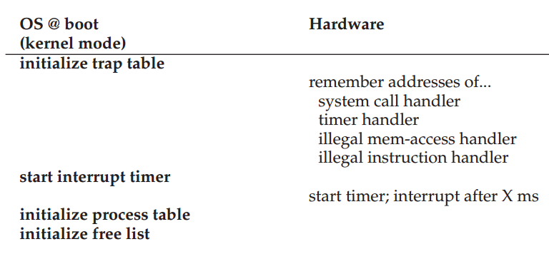

Slide 29
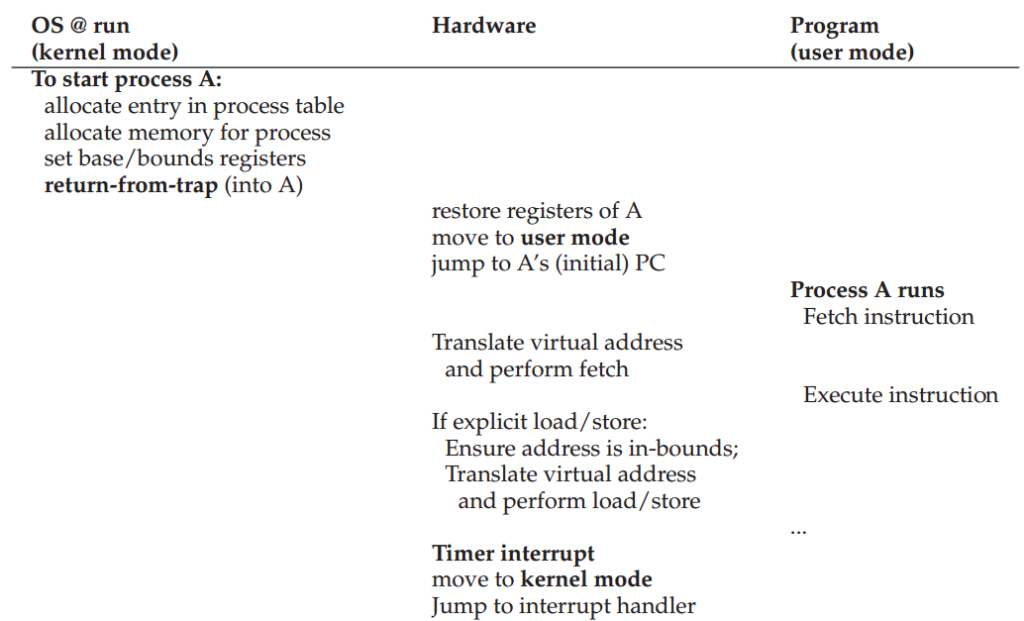

Slide 30
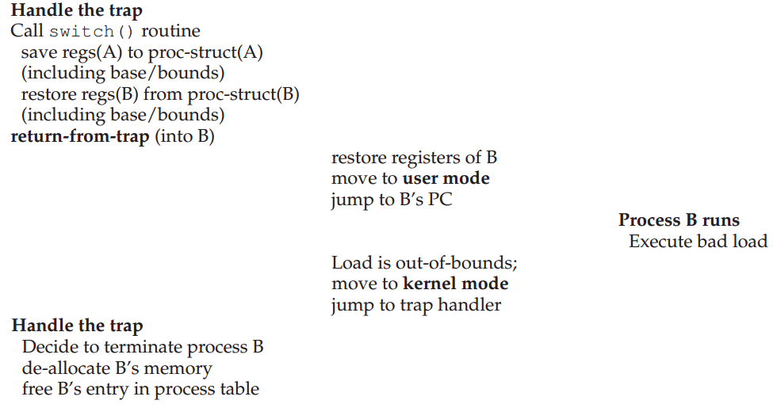

Slide 31
0KB
1KB
P1
2KB
4KB
P2
5KB
(free)
code, data
heap
(free)
stack
(free)
code, data
heap
(free)
stack
(free)
P1: load 100, R1 -> load 1124, R1
P2: load 100, R1 -> load 4196, R1
P2: load 1000, R1 -> load 5096, R1
P1: store R1, 3072 -> store R1, 4096
an exception, interrupt OS!
Problems?
Internal fragmentation
Virtual space size constraint

Slide 32
How to Run Multiple Processes
Time Sharing
Static Relocation
Base
Base+Bounds
Segmentation

Slide 33
Segmentation
Idea: generalize base+bounds
One base+bounds pair for each segment
Requires more registers!
Resize segments as needed

Slide 34
0KB
1KB
2KB
3KB
4KB
5KB
(free)
heap
(free)
stack
(free)
Segment Base Size
Code
Heap 1KB 1KB
Stack
Virtual
0x1010
0x1100
0x1400
Physical
1KB+16
1kB+256
Interrupt OS

Slide 35
Virtual Address
Break virtual addresses into two parts
one part indicates segment
one part indicates offset within segment
If an address has 14 bits, 2 for segment, 12 for offset
0: code+data
1: heap
2: stack
What virtual addresses could be valid for each segment?

Slide 36
1 // get top 2 bits of 14-bit VA
2 Segment = (VirtualAddress & SEG_MASK) >> SEG_SHIFT
3 // now get offset
4 Offset = VirtualAddress & OFFSET_MASK
5 if (Offset >= Bounds[Segment])
6 RaiseException(PROTECTION_FAULT)
7 else
8 PhysAddr = Base[Segment] + Offset
9 Register = AccessMemory(PhysAddr)

Slide 37
0KB
1KB
2KB
3KB
4KB
5KB
(free)
heap
(free)
stack
(free)
Segment Base Size Positive?
Code 1
Heap 1KB 1KB 1
Stack 5KB 1KB 0
Virtual
0x2C00
Physical
4KB

Slide 38
Code
?
Heap
?
Stack
?
VirtA
0KB
4KB
8KB
12KB
16KB
PhysA
16KB
20KB
24KB
26KB
28KB
32KB
Segment | Base | Size | Positive?
Code 0 | 16KB | 4KB | 1
Heap 1 | 22KB | 4KB | 1
Stack 2 | 28KB | 2KB | 0
Segments:
0=>code
1=>heap
2=>stack

