Slide 1
Lecture 6 Memory Management Segmentation & Paging

Slide 2
OSTEP
Virtualization
CPU: illusion of private CPU
RAM: illusion of private memory
Concurrency
Persistence

Slide 3
Goals and Mechanism
Transparency
Efficiency
Protection and isolation
Hardware-based address translation

Slide 4
Hardware-based address translation
Every address generated by a user program is a virtual address
Translate every virtual address into physical address
On each and every memory reference
For efficiency: need hardware support
For flexibility: need OS support

Slide 5
Hardware Requirements
Privileged mode
Base/bounds registers
Ability to translate virtual addresses and check if within bounds
Privileged instruction(s) to update base/bounds
Privileged instruction(s) to register exception handlers
Ability to raise exceptions

Slide 6
Operating System Issues
Memory management
Need to allocate memory for new processes;
Reclaim memory from terminated processes;
Generally manage memory via free list
Base/bounds management
Must set base/bounds properly upon context switch
Exception handling
Code to run when exceptions arise; likely action is to terminate offending process

Slide 7
How to Run Multiple Processes
Time Sharing
Static Relocation
Base+Bounds
Segmentation
Paging

Slide 8
Segmentation
Idea: generalize base+bounds
One base+bounds pair for each segment
Requires more registers!
Resize segments as needed

Slide 9
1 // get top 2 bits of 14-bit VA
2 Segment = (VirtualAddress & SEG_MASK) >> SEG_SHIFT
3 // now get offset
4 Offset = VirtualAddress & OFFSET_MASK
5 if (Offset >= Bounds[Segment])
6 RaiseException(PROTECTION_FAULT)
7 else
8 PhysAddr = Base[Segment] + Offset
9 Register = AccessMemory(PhysAddr)

Slide 10
Virtual Address
Break virtual addresses into two parts
one part indicates segment
one part indicates offset within segment
If an address has 14 bits, 2 for segment, 12 for offset
0: code+data
1: heap
2: stack
What virtual addresses could be valid for each segment?

Slide 11
0KB
1KB
2KB
3KB
4KB
5KB
(free)
heap
(free)
stack
(free)
Segment Base Size
Code
Heap 1KB 1KB
Stack
Virtual
0x1010
0x1100
0x1400
Physical
1KB+16
1kB+256
Interrupt OS

Slide 12
0KB
1KB
2KB
3KB
4KB
5KB
(free)
heap
(free)
stack
(free)
Segment Base Size Positive?
Code 1
Heap 1KB 1KB 1
Stack 5KB 1KB 0
Virtual
0x2C00
Physical
4KB

Slide 13
Memory Accesses
Fetch instruction at 0x4010
Exec, load from 0x5900
Fetch instruction at 0x4014
Fetch instruction at 0x4017
Exec, store to 0x5900
0x0010 movl 0x1100, %r8d
0x0014 addl $0x3, %r8d
0x0017 movl %r8d, 0x1100
Segment | Base | Size | Positive?
Code 0 | 16KB (0x4000) | 4KB (0x1000) | 1
Heap 1 | 22KB (0x5800) | 4KB (0x1000) | 1
Stack 2 | 28KB (0x7000) | 2KB (0x0800) | 0

Slide 14
More Memory Accesses
Fetch instruction at 0x4010
Exec, load from 0x6100
Fetch instruction at 0x4014
Fetch instruction at 0x4017
Exec, store to 0x6100
0x0010 movl 0x2100, %r8d
0x0014 addl $0x3, %r8d
0x0017 movl %r8d, 0x2100
Segment | Base | Size | Positive?
Code 0 | 16KB (0x4000) | 4KB (0x1000) | 1
Heap 1 | 22KB (0x5800) | 4KB (0x1000) | 1
Stack 2 | 28KB (0x7000) | 2KB (0x0800) | 0

Slide 15
Code
Heap
Stack
VirtA
0KB
4KB
8KB
12KB
16KB
PhysA
16KB
20KB
24KB
26KB
28KB
32KB
Segment | Base | Size | Positive?
Code 0 | 16KB | 4KB | 1
Heap 1 | 22KB | 4KB | 1
Stack 2 | 28KB | 2KB | 0
Segments:
0=>code
1=>heap
2=>stack
Segment | Base | Size | Positive?
Code 0 | 16KB | 4KB | 1
Heap 1 | 22KB | 4KB | 1
Stack 2 | 30KB | 4KB | 0

Slide 16
More Memory Accesses Get Right
Fetch instruction at 0x4010
Exec, load from 0x6900
Fetch instruction at 0x4014
Fetch instruction at 0x4017
Exec, store to 0x6900
0x0010 movl 0x2100, %r8d
0x0014 addl $0x3, %r8d
0x0017 movl %r8d, 0x2100
Segment | Base | Size | Positive?
Code 0 | 16KB (0x4000) | 4KB (0x1000) | 1
Heap 1 | 22KB (0x5800) | 4KB (0x1000) | 1
Stack 2 | 30KB (0x7800) | 4KB (0x1000) | 0

Slide 17
Support for Code Sharing
Idea: make base/bounds for the code of several processes point to the same physical mem
Careful: need extra protection!
Adding protection bits
Segment | Base | Size | Positive? | Protection
Code 0 | 16KB (0x4000) | 4KB (0x1000) | 1 | Read-Execute
Heap 1 | 22KB (0x5800) | 4KB (0x1000) | 1 | Read-Write
Stack 2 | 30KB (0x7800) | 4KB (0x1000) | 0 | Read-Write

Slide 18
Free-Space Management
Many systems need to manage/allocate space
physical space for process segments
virtual space for malloc calls
disk blocks for files
Memory Allocation APIs:
void *malloc(size_t size);
void free(void *ptr);
etc.

Slide 19
OS-support: Space Management
Allocation without Fixed-Size
Free chunks are scattered throughout memory
Allocate memory from a chunk able to accommodate it
Maintains information about allocated and free regions

Slide 20
Splitting and Coalescing
What is the free list
If malloc(1) returns 28
What is the free list
What is the free list after free(28)
free
used
free
0 10 20 30

Slide 21
free() does not ask for size
hptr
size: 20
The header used by malloc library
magic: 1234567
ptr
The 20 bytes returned to caller
(suppose malloc(20) is called)

Slide 22
Embedding A Free List
head
Let’s try some malloc/free calls
size: 4088
next: 0

Slide 23
Space Management
Generally manage memory via free list
Free chunks are scattered throughout memory
Allocate memory from a chunk able to accommodate it
Maintains information about allocated and free regions
Policies:
First-fit: Allocate the first chunk that is big enough
Best-fit: Allocate the smallest chunk that is big enough
Worst-fit: Allocate the largest chunk; must also search entire list
Next-fit: Allocate the second chunk that is big enough
Segregated Lists, Buddy Allocation

Slide 24
Fragmentation
External Fragmentation – total memory space exists to satisfy a request, but it is not contiguous
Internal Fragmentation – allocated memory may be slightly larger than requested memory; this size difference is memory internal to a partition, but not being used
Reduce external fragmentation by compaction
Shuffle memory contents to place all free memory together in one large block
Compaction is possible only if relocation is dynamic, and is done at execution time

Slide 25
Paging
Segmentation is too coarse-grained
Paging is a fine-grained alternative
Divide mem into small, fix-sized units (aka page frames)
Map each virtual page independently
Grow memory segments however we please

Slide 26
Page Mapping
P1
P2
P3
VirtMem
PhysMem
0 1 2 3 4 5 6 7 8 9 10 11
P1
P2
P3
3
0
8
Page Tables
1
4
5
7
2
9
10
6
11

Slide 27
Addressing
For segmentation
High bits => segment
Low bits => offset
Segment number vs. number of high bits
Segment size vs. number of low bits
For paging
High bits => page
Low bits => offset
Page number vs. number of high bits
Page size vs. number of low bits

Slide 28
Address Examples
How many low bits do we need, for page size 16 bytes, 1KB, 1MB, 512 bytes, and 4KB?
4, 10, 20, 9, 12
How may page we can have for virtual address， with width 10, 20, 32, 16, and 32 bits correspondingly?
64, 1K, 4K, 128, 1MB

Slide 29
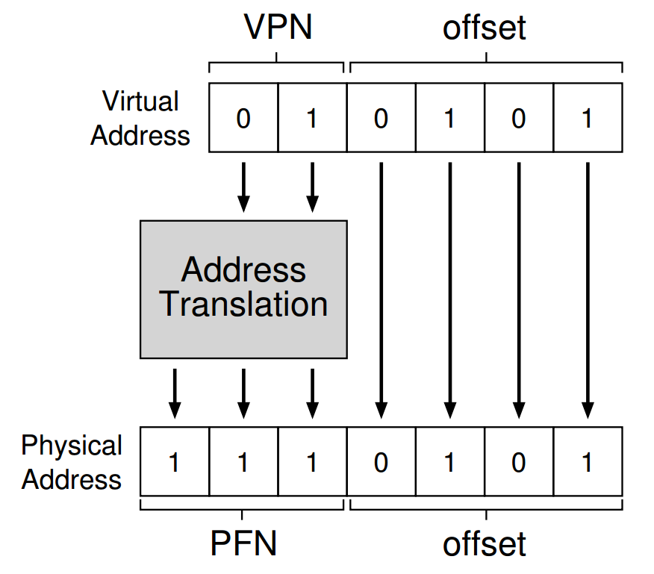

Slide 30
Translation Steps
H/W: for each mem reference:
1. extract VPN (virt page num) from VA (virt addr)
2. calculate addr of PTE (page table entry)
3. fetch PTE
4. extract PFN (page frame num)
5. build PA (phys addr)
6. fetch PA to register

Slide 31
offset = VirtualAddress & OFFSET_MASK
PhysAddr = (PFN << SHIFT) | offset
1 // Extract the VPN from the virtual address
2 VPN = (VirtualAddress & VPN_MASK) >> SHIFT
3
4 // Form the address of the page-table entry (PTE)
5 PTEAddr = PTBR + (VPN * sizeof(PTE))
6
7 // Fetch the PTE
8 PTE = AccessMemory(PTEAddr)
9
10 // Check if process can access the page
11 if (PTE.Valid == False)
12 RaiseException(SEGMENTATION_FAULT)
13 else if (CanAccess(PTE.ProtectBits) == False)
14 RaiseException(PROTECTION_FAULT)
15 else
16 // Access is OK: form physical address and fetch it
17 offset = VirtualAddress & OFFSET_MASK
18 PhysAddr = (PTE.PFN << PFN_SHIFT) | offset
19 Register = AccessMemory(PhysAddr)

Slide 32
Virt => Phys Mapping
For segmentation, we used a formula, e.g., phys = virt_offset + base_reg
Now, we need a more general mapping mechanism.
What data structure is good?
Big array, called a page table

Slide 33
Memory Accesses
PT, load from 0x5000
Fetch instruction at 0x2010
PT, load from 0x5004
Exec, load from 0x0100
…
0x0010 movl 0x1100, %r8d
0x0014 addl $0x3, %r8d
0x0017 movl %r8d, 0x1100
PT
2
Assume PT is at 0x5000
Assume PTE’s are 4 bytes
Assume 4KB pages
0
80
99

Slide 34
Where are Page Tables Stored?
The size of a typical page table?
assume 32-bit address space
assume 4 KB pages
assume 4 byte entries (or this could be less)
2 ^ (32 - log(4KB)) * 4 = 4 MB
Store in memory, and CPU finds it via registers

Slide 35
Other Information in Page Table
What other data should go in page table entries besides translation?
valid bit
protection bits
present bit
reference bit
dirty bit

Slide 36
Summary
Flexible Addr Space
don’t need to find contiguous RAM
doesn’t waste whole data pages (valid bit)
Easy to manage
fixed size pages
simple free list for unused pages
no external fragmentation, no need to coalesce
Too slow -> TLB: the next topic
Too big

