Slide 1
Lecture 7: TLB

Slide 2
How to Run Multiple Processes
Time Sharing: one process uses RAM at a time
Static Relocation: statically rewrite code before run
Base: add a base to virtual address to get physical
Base+Bounds: also check physical addr is in range
Segmentation: many base+bounds pairs
Paging

Slide 3
Page Mapping
P1
P2
P3
VirtMem
PhysMem
0 1 2 3 4 5 6 7 8 9 10 11
P1
P2
P3
3
0
8
Page Tables
1
4
5
7
2
9
10
6
11

Slide 4
Addressing
For segmentation
High bits => segment
Low bits => offset
Segment number vs. number of high bits
Segment size vs. number of low bits
For paging
High bits => page
Low bits => offset
Page number vs. number of high bits
Page size vs. number of low bits

Slide 5
Address Examples
How many low bits do we need, for page size 16 bytes, 1KB, 1MB, 512 bytes, and 4KB?
4, 10, 20, 9, 12
How may page we can have for virtual address， with width 10, 20, 32, 16, and 32 bits correspondingly?
64, 1K, 4K, 128, 1MB

Slide 6
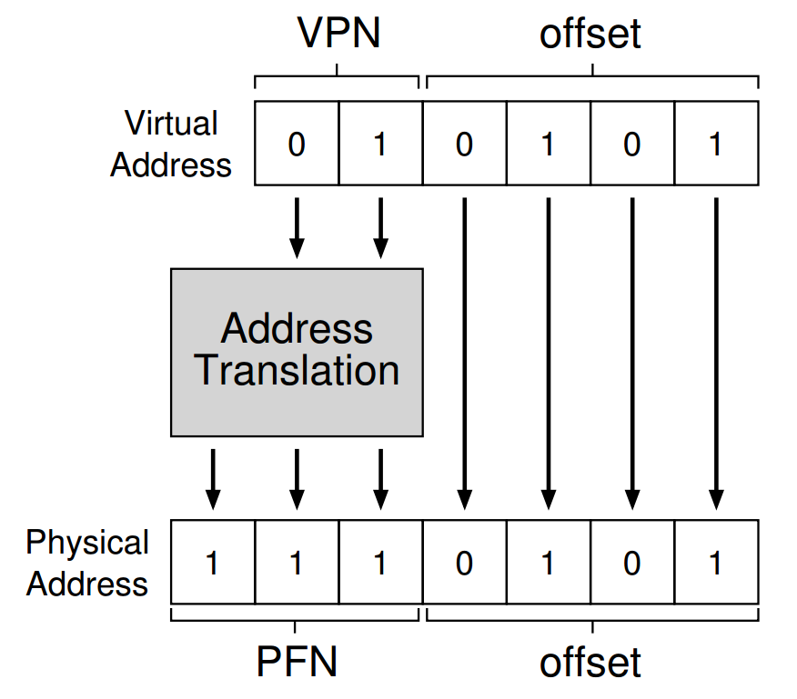

Slide 7
Translation Steps
H/W: for each mem reference:
1. extract VPN (virt page num) from VA (virt addr)
2. calculate addr of PTE (page table entry)
3. fetch PTE
4. extract PFN (page frame num)
5. build PA (phys addr)
6. fetch PA to register

Slide 8
Memory Accesses with Paging
PT, load from 0x5000
Fetch instruction at 0x2010
PT, load from 0x5004
Exec, load from 0x0100
…
0x0010 movl 0x1100, %r8d
0x0014 addl $0x3, %r8d
0x0017 movl %r8d, 0x1100
PT
2
Assume PT is at 0x5000
Assume PTE’s are 4 bytes
Assume 4KB pages
0
80
99

Slide 9
Other Information in Page Table
What other data should go in page table entries besides translation?
valid bit
protection bits
present bit
reference bit
dirty bit

Slide 10
offset = VirtualAddress & OFFSET_MASK
PhysAddr = (PFN << SHIFT) | offset
1 // Extract the VPN from the virtual address
2 VPN = (VirtualAddress & VPN_MASK) >> SHIFT
3
4 // Form the address of the page-table entry (PTE)
5 PTEAddr = PTBR + (VPN * sizeof(PTE))
6
7 // Fetch the PTE
8 PTE = AccessMemory(PTEAddr)
9
10 // Check if process can access the page
11 if (PTE.Valid == False)
12 RaiseException(SEGMENTATION_FAULT)
13 else if (CanAccess(PTE.ProtectBits) == False)
14 RaiseException(PROTECTION_FAULT)
15 else
16 // Access is OK: form physical address and fetch it
17 offset = VirtualAddress & OFFSET_MASK
18 PhysAddr = (PTE.PFN << PFN_SHIFT) | offset
19 Register = AccessMemory(PhysAddr)

Slide 11
Memory Accesses Again
PT, load from 0x5000
Fetch instruction at 0x2010
PT, load from 0x5004
Exec, load from 0x0100
…
0x0010 movl 0x1100, %r8d
0x0014 addl $0x3, %r8d
0x0017 movl %r8d, 0x1100
PT
2
Assume PT is at 0x5000
Assume PTE’s are 4 bytes
Assume 4KB pages
0
TOO SLOW
80
99

Slide 12
A Memory Trace
int array[1000];
...
for (i = 0; i < 1000; i++)
array[i] = 0;
0x1024 movl $0x0,(%edi,%eax,4)
0x1028 incl %eax
0x102c cmpl $0x03e8,%eax
0x1030 jne 0x1024

Slide 13
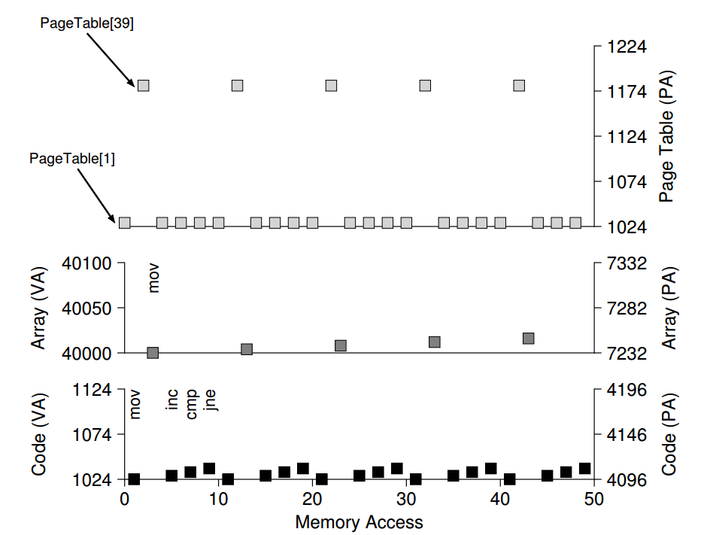

Slide 14
TLB: Basic strategy
Take advantage of repetition.
Use a CPU cache.
CPU
TLB
RAM
PT
Notes:
ATC?

Slide 15
TLB Cache Type
Fully-Associative: entries can go anywhere
most common for TLBs
must store whole key/value in cache
search all in parallel
There are other general cache types

Slide 16
TLB Contents
VPN | PFN | other bits
TLB valid bit
whether the entry has a valid translation
TLB protection bits
rwx
Address Space Identifier
TLB dirty bit

Slide 17
1 VPN = (VirtualAddress & VPN_MASK) >> SHIFT
2 (Success, TlbEntry) = TLB_Lookup(VPN)
3 if (Success == True) // TLB Hit
4 if (CanAccess(TlbEntry.ProtectBits) == True)
5 Offset = VirtualAddress & OFFSET_MASK
6 PhysAddr = (TlbEntry.PFN << SHIFT) | Offset
7 AccessMemory(PhysAddr)
8 else
9 RaiseException(PROTECTION_FAULT)
10 else // TLB Miss
11 PTEAddr = PTBR + (VPN * sizeof(PTE))
12 PTE = AccessMemory(PTEAddr)
13 if (PTE.Valid == False)
14 RaiseException(SEGMENTATION_FAULT)
15 else if (CanAccess(PTE.ProtectBits) == False)
16 RaiseException(PROTECTION_FAULT)
17 else
18 TLB_Insert(VPN, PTE.PFN, PTE.ProtectBits)
19 RetryInstruction()

Slide 18
Reasoning about TLB
Workload: series of loads/stores to accesses
Metric: performance (i.e., hit rate)

Slide 19
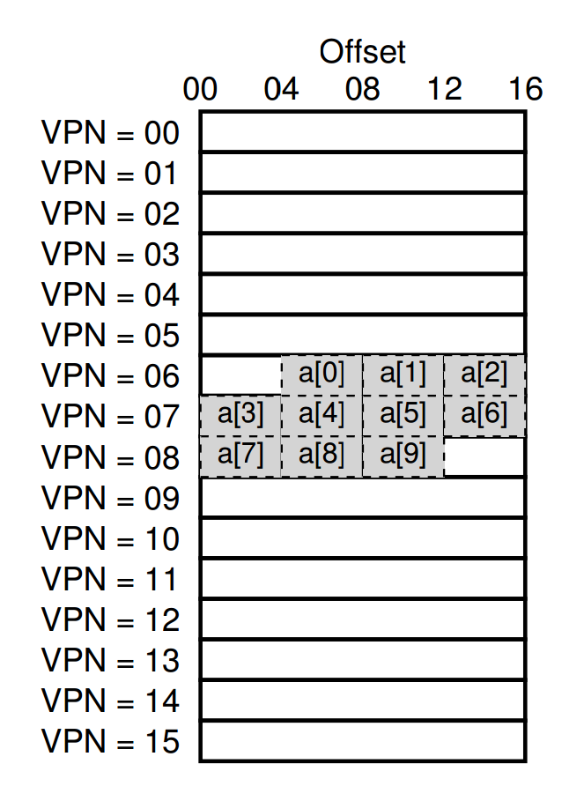
Array Iterator with TLB
int sum = 0;
for (i = 0; i < 10; i++) {
sum += a[i];
}
How many TLB hits?
How many TLB misses?
Hit rate?
Miss rate?
Notes:
TLB
Valid VPN PFN
0
0
0
0
What’s the virtual address for a[0]
0x604, and the following?
PTBR+24, 0xA04
PTBR+24, 0xA08
PTBR+24, 0xA12

Slide 20
TLB Workloads
Spatial locality
Sequential array accesses can almost always hit in the TLB, and so are very fast!
Temporal locality
What pattern would be slow?
highly random, with no repeat accesses

Slide 21
Who Handles The TLB Miss?
H/W or OS?
H/W: CPU must know where page tables are
CR3 on x86
Page table structure not flexible
OS: CPU traps into OS upon TLB miss

Slide 22
1 VPN = (VirtualAddress & VPN_MASK) >> SHIFT
2 (Success, TlbEntry) = TLB_Lookup(VPN)
3 if (Success == True) // TLB Hit
4 if (CanAccess(TlbEntry.ProtectBits) == True)
5 Offset = VirtualAddress & OFFSET_MASK
6 PhysAddr = (TlbEntry.PFN << SHIFT) | Offset
7 AccessMemory(PhysAddr)
8 else
9 RaiseException(PROTECTION_FAULT)
10 else // TLB Miss
11 PTEAddr = PTBR + (VPN * sizeof(PTE))
12 PTE = AccessMemory(PTEAddr)
13 if (PTE.Valid == False)
14 RaiseException(SEGMENTATION_FAULT)
15 else if (CanAccess(PTE.ProtectBits) == False)
16 RaiseException(PROTECTION_FAULT)
17 else
18 TLB_Insert(VPN, PTE.PFN, PTE.ProtectBits)
19 RetryInstruction()

Slide 23
1 VPN = (VirtualAddress & VPN_MASK) >> SHIFT
2 (Success, TlbEntry) = TLB_Lookup(VPN)
3 if (Success == True) // TLB Hit
4 if (CanAccess(TlbEntry.ProtectBits) == True)
5 Offset = VirtualAddress & OFFSET_MASK
6 PhysAddr = (TlbEntry.PFN << SHIFT) | Offset
7 AccessMemory(PhysAddr)
8 else
9 RaiseException(PROTECTION_FAULT)
10 else // TLB Miss
11 RaiseException(TLB_MISS)

Slide 24
OS TLB Miss Handler
OS: CPU traps into OS upon TLB miss
check page table for page table entry
if valid, extract PFN and update TLB w a special inst
return from trap
Where to resume execution?
The instruction that caused the trap
How to avoid double traps?
keep TLB miss handlers in physical memory
reserve some entries in the TLB for permanently-valid translations
Modifying TLB entries is privileged

Slide 25
TLB Contents
VPN | PFN | other bits
TLB valid bit
whether the entry has a valid translation
Different from page table valid bit
TLB protection bits
rwx
Address Space Identifier
TLB dirty bit

