Slide 1
Lecture 8: TLB and MLPT

Slide 2
TLB: Basic strategy
Take advantage of repetition.
Use a CPU cache.
CPU
TLB
RAM
PT
Notes:
ATC?

Slide 3
1 VPN = (VirtualAddress & VPN_MASK) >> SHIFT
2 (Success, TlbEntry) = TLB_Lookup(VPN)
3 if (Success == True) // TLB Hit
4 if (CanAccess(TlbEntry.ProtectBits) == True)
5 Offset = VirtualAddress & OFFSET_MASK
6 PhysAddr = (TlbEntry.PFN << SHIFT) | Offset
7 AccessMemory(PhysAddr)
8 else
9 RaiseException(PROTECTION_FAULT)
10 else // TLB Miss
11 PTEAddr = PTBR + (VPN * sizeof(PTE))
12 PTE = AccessMemory(PTEAddr)
13 if (PTE.Valid == False)
14 RaiseException(SEGMENTATION_FAULT)
15 else if (CanAccess(PTE.ProtectBits) == False)
16 RaiseException(PROTECTION_FAULT)
17 else
18 TLB_Insert(VPN, PTE.PFN, PTE.ProtectBits)
19 RetryInstruction()

Slide 4
Who Handles The TLB Miss?
H/W or OS?
H/W: CPU must know where page tables are
CR3 on x86
Page table structure not flexible
OS: CPU traps into OS upon TLB miss

Slide 5
1 VPN = (VirtualAddress & VPN_MASK) >> SHIFT
2 (Success, TlbEntry) = TLB_Lookup(VPN)
3 if (Success == True) // TLB Hit
4 if (CanAccess(TlbEntry.ProtectBits) == True)
5 Offset = VirtualAddress & OFFSET_MASK
6 PhysAddr = (TlbEntry.PFN << SHIFT) | Offset
7 AccessMemory(PhysAddr)
8 else
9 RaiseException(PROTECTION_FAULT)
10 else // TLB Miss
11 RaiseException(TLB_MISS)

Slide 6
OS TLB Miss Handler
OS: CPU traps into OS upon TLB miss
check page table for page table entry
if valid, extract PFN and update TLB w a special inst
return from trap
Where to resume execution?
The instruction that caused the trap
How to avoid double traps?
keep TLB miss handlers in physical memory
reserve some entries in the TLB for permanently-valid translations
Modifying TLB entries is privileged

Slide 7
TLB Contents
VPN | PFN | other bits
TLB valid bit
whether the entry has a valid translation
Different from page table valid bit
TLB protection bits
rwx
Address Space Identifier
TLB dirty bit

Slide 8
A MIPS TLB Entry
Notes:
19 bits for the
VPN; as it turns out, user addresses will only come from half the address
space (the rest reserved for the kernel)
(PFN), and hence can support systems with up to 64GB of (physical) main
memory (2^24 4KB pages).
a global
bit (G), which is used for pages that are globally-shared among processes.
Thus, if the global bit is set, the ASID is ignored
Too much memory to store page tables
assume 32-bit address space
assume 4 KB pages
assume 4 byte entries (or this could be less)
2 ^ (32 - log(4KB)) * 4 = 4 MB

Slide 9
Context Switches
What happens if a process uses the cached TLB entries from another process?
Solutions?
Flush TLB on each switch
Remember which entries are for each process
Address Space Identifier

Slide 10
Address Space Identifier
You can think of the ASID as a process identifier (PID), but usually it has fewer bits
P1
(ASID 11)
P2
(ASID 12)
valid | VPN | PFN | ASID
0 | - | - | -
1 | 1 | 1 | ?
1 | 1 | 4 | ?
1 | 0 | 3 | ?
3
0
1
4
7
2
10
6

Slide 11
TLB Replacement Policies
LRU: evict least-recently used a TLB slot is needed
Random: randomly choose entries to evict
When is each better?
Sometimes random is better than a “smart” policy!

Slide 12
Where are Page Tables Stored?
The size of a typical page table?
assume 32-bit address space
assume 4 KB pages
assume 4 byte entries (or this could be less)
2 ^ (32 - log(4KB)) * 4 = 4 MB
Store in memory, and CPU finds it via registers

Slide 13
Now let’s solve the too big problem

Slide 14
Change Sizes
Make virtual address space smaller
Make pages bigger
PT size 512 bytes. PTE’s 4 bytes. Virtual addrs 16 bits
PT size 1 KB. PTE’s 4 bytes. Virtual addrs 16 bits
PT size 4 KB. PTE’s 4 bytes. Virtual addrs 32 bits
Why are 4 MB pages bad?
Internal fragmentation.
Some systems support multiple page sizes
Reduce TLB misses
Notes:
32 bits AS
With 512 byte pages 32MB
With 4KB pages 4MB
Why do we want large virtual AS? Easy to program
(a) Goal PT size is 512 bytes. PTE’s are 4 bytes. Virtual addrs are 16 bits
(b) Goal PT size is 1 KB. PTE’s are 4 bytes. Virtual addrs are 16 bits
(c) Goal PT size is 4 KB. PTE’s are 4 bytes. Virtual addrs are 32 bits
.

Slide 15
Abandon Simple Linear Page Tables
Use more complex PTs, instead of just a big array
Look at the problem more closely ..

Slide 16
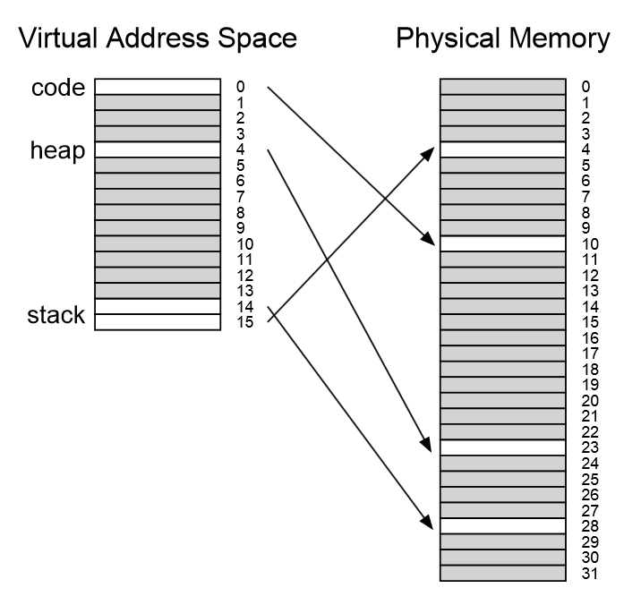
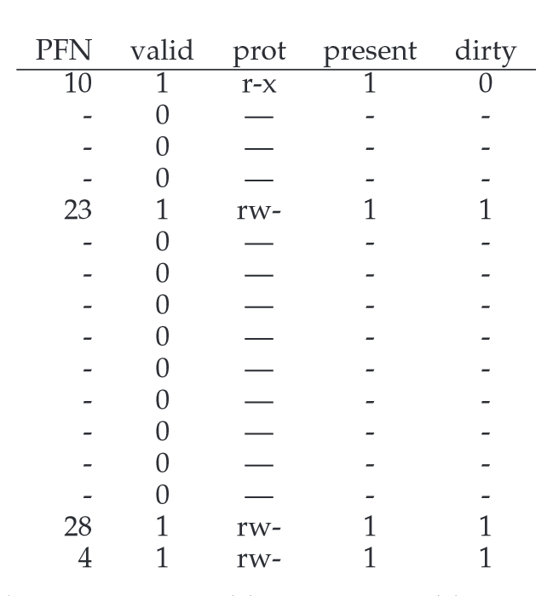

Slide 17
Many invalid PT entries
There is a big “hole” in our page table
Invalid entries are clustered.
How did we fix holes in physical memory before?
Segmentation
Paging

Slide 18
Approaches
Change sizes
Segments over PTs
PTs over PTs
PTs over PTs over PTs over PTs

Slide 19
Segmentation/Paging Hybrid
Idea: use different page tables for heap, stack, etc
Each PT can have a different size
Each PT has a base/bounds (where?)
Virtual address
Before: PT_Index + OFFSET
Now: SEG + PT_Index + OFFSET, VPN is SEG + PT_Index
Notes:
SN = (VirtualAddress & SEG_MASK) >> SN_SHIFT
VPN = (VirtualAddress & VPN_MASK) >> VPN_SHIFT
AddressOfPTE = Base[SN] + (VPN * sizeof(PTE))

Slide 20
Segment 00: code Segment 01: heap
(a) 0x12FFF =>
(b) 0x10FFF =>
(c) 0x01ABC =>
(d) 0x11111 =>
PFN | valid | Prot
0x10 | 1 | r-x
0x15 | 1 | r-x
0x12 | 1 | r-x
 | …
PFN | valid | Prot
0x22 | 1 | rw-
0x02 | 1 | rw-
0x04 | 1 | rw-
 | …
18-bit addresses
2-bit segment index
6-bit VPN

Slide 21
Multi-Level Page Tables
Idea: break PT itself into pages
A page directory refers to pieces
Only have pieces with >0 valid entries
Used by x86
Virtual address
Basic paging: PT_Index + OFFSET
Segmentation/Paging: SEG + PT_Index + OFFSET
Multi-level page tables: PD_Index + PT_Index + OFFSET
Notes:
SN = (VirtualAddress & SEG_MASK) >> SN_SHIFT
VPN = (VirtualAddress & VPN_MASK) >> VPN_SHIFT
AddressOfPTE = Base[SN] + (VPN * sizeof(PTE))
proportion to the amount of address space you are using
constructed, each portion of the page table fits neatly within a page,

Slide 23
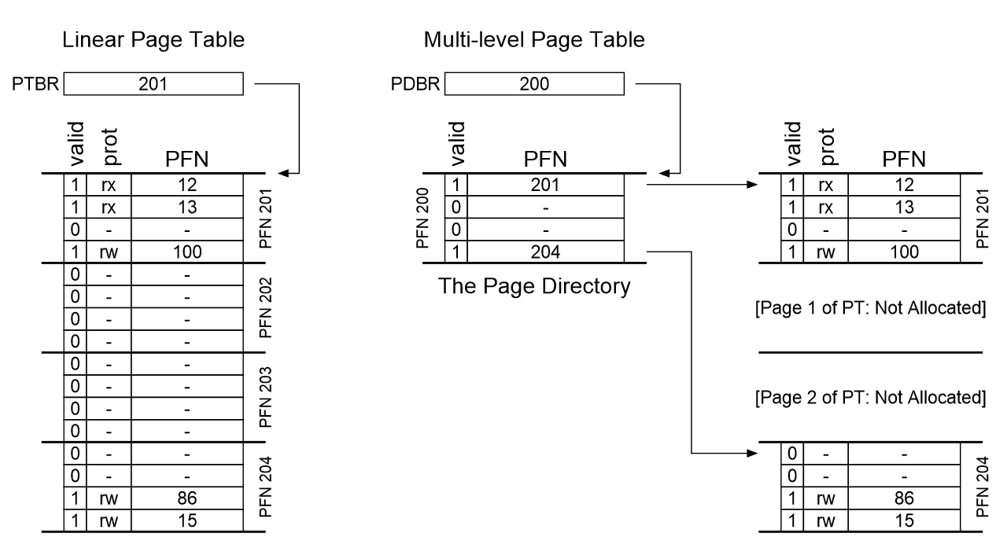
Notes:
proportion to the amount of address space you are using
constructed, each portion of the page table fits neatly within a page,

Slide 24
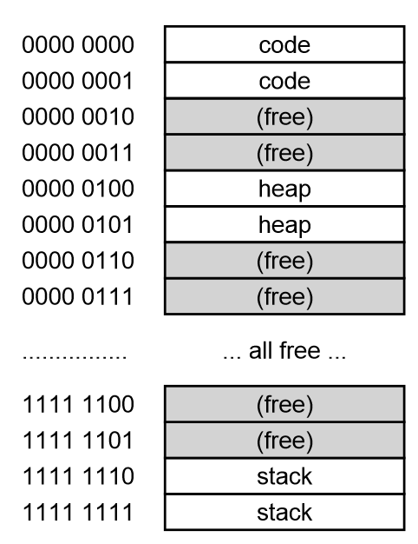
Assume
64-KB address space
256-byte pages
16-byte PTE
Construct the multi-level page table

Slide 25
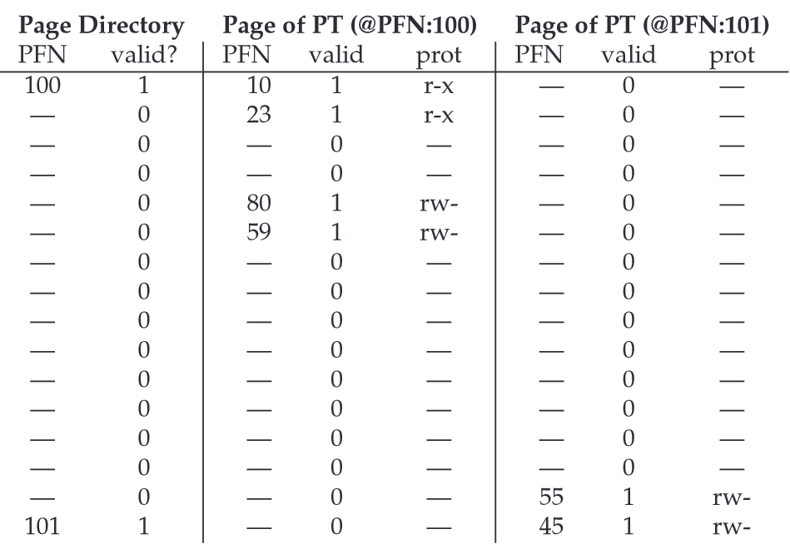
Notes:
(a) how many PT pages would have been needed if we instead had a simple, linear array?
(b) how many bits of a virt addr are used for the page-directory index?
(b) how many virtual pages are there?
(c) translate 0x01AB
(d) translate 0x0000
(e) translate 0xFEED
(f) translate 0x1000?

Slide 26
Questions
(a) how many PT pages would have been needed if we instead had a simple, linear array?
(b) how many bits of a virt addr are used for the page-directory index?
(b) how many virtual pages are there?
(c) translate 0x01AB
(d) translate 0x0000
(e) translate 0xFEED
(f) translate 0x1000?

Slide 27
What about TLBs?
Lookups in multiple levels more expensive.
How much does a miss cost?
Time/Space tradeoffs

