Slide 1
Lecture 9: Swapping

Slide 2
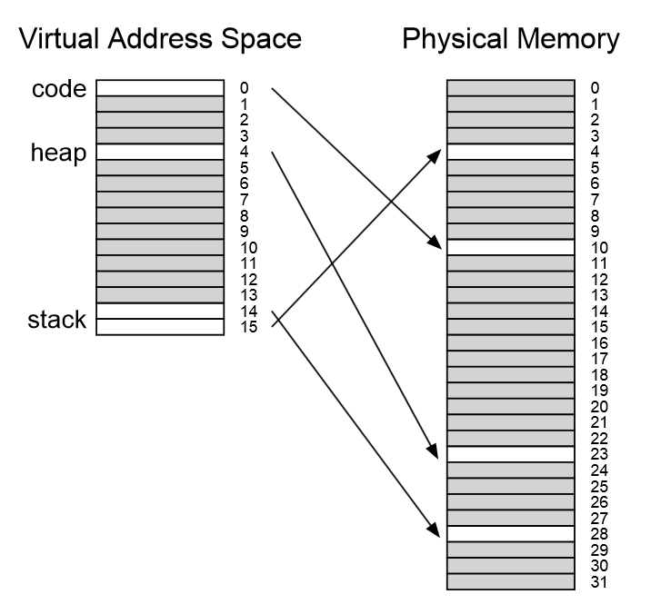
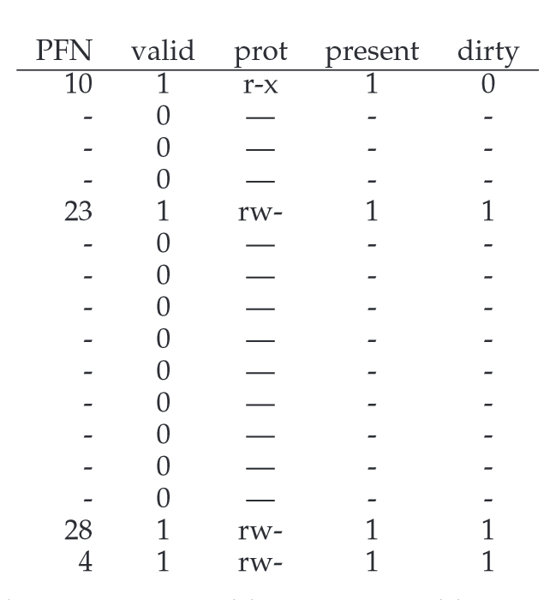

Slide 3
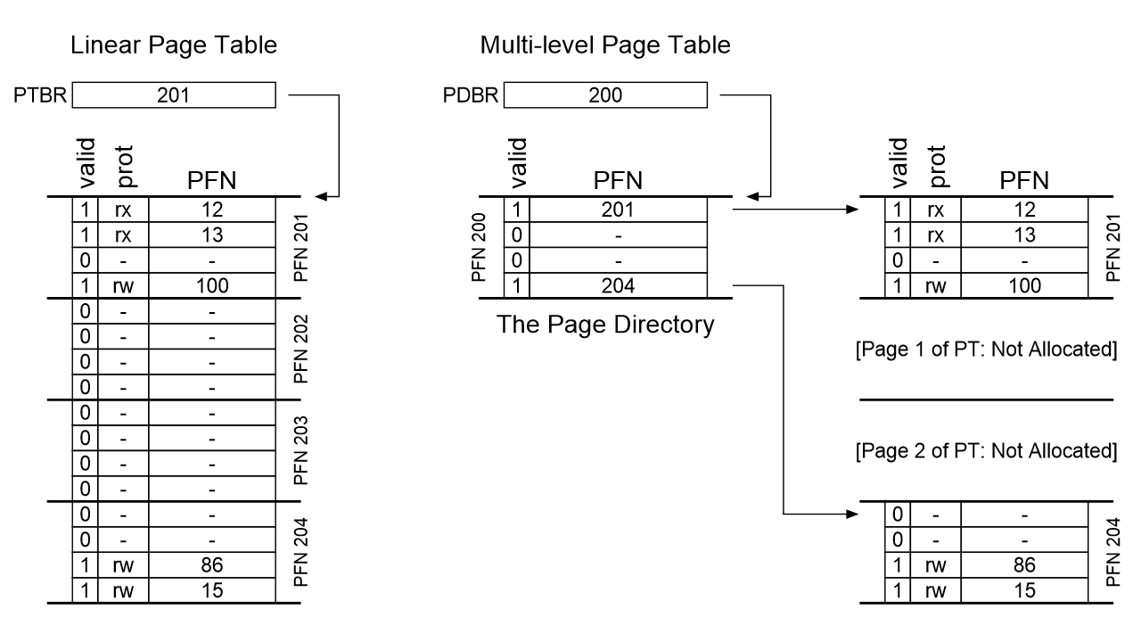
Notes:
proportion to the amount of address space you are using
constructed, each portion of the page table fits neatly within a page,

Slide 4
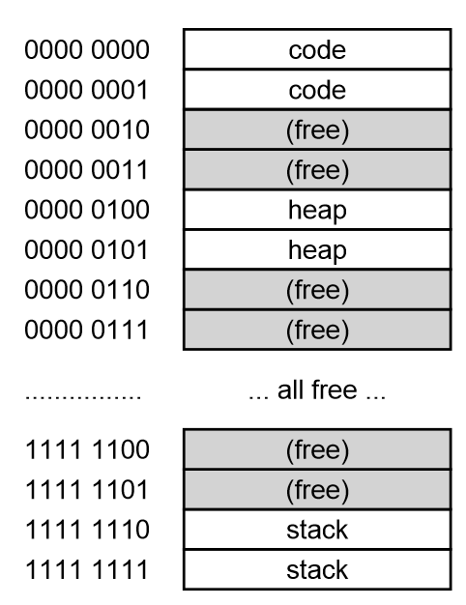
Assume
64-KB address space
256-byte pages
16-byte PTE
Construct the multi-level page table

Slide 5
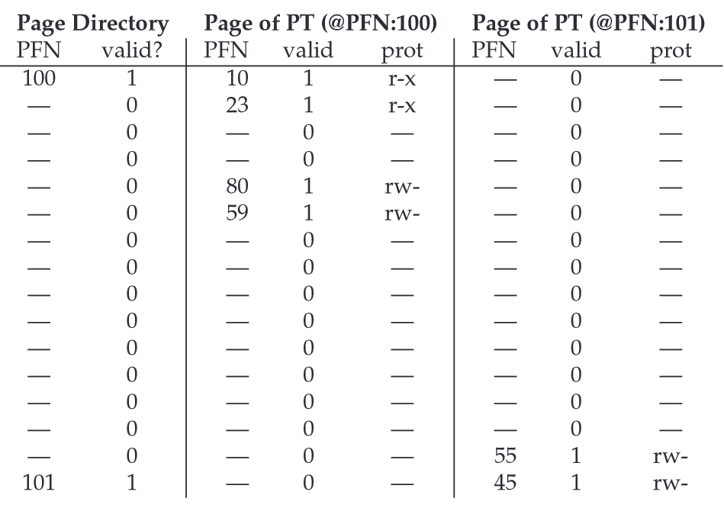
Notes:
(a) how many PT pages would have been needed if we instead had a simple, linear array?
(b) how many bits of a virt addr are used for the page-directory index?
(b) how many virtual pages are there?
(c) translate 0x01AB
(d) translate 0x0000
(e) translate 0xFEED
(f) translate 0x1000?

Slide 6
Questions
(a) how many PT pages would have been needed if we instead had a simple, linear array?
(b) how many bits of a virt addr are used for the page-directory index?
(b) how many virtual pages are there?
(c) translate 0x01AB
(d) translate 0x0000
(e) translate 0xFEED
(f) translate 0x1000?

Slide 7
What about TLBs?
Lookups in multiple levels more expensive.
How much does a miss cost?
Time/Space tradeoffs

Slide 8
Swapping

Slide 9
The Memory Hierarchy
Secondary Storage
Main Memory
Cache
Registers
Notes:
why do we want to support a single large address space for a process
Ease one program
Ease multi program

Slide 10
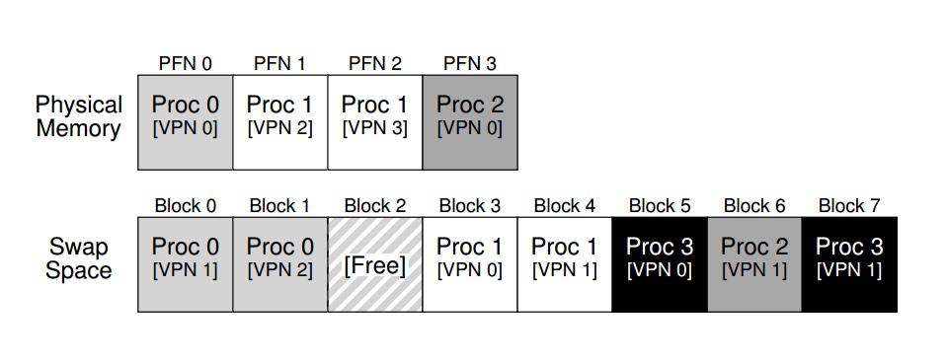
Swap Space
Reserved disk space for moving pages back and forth

Slide 11
How to know where a page lives? The Present Bit
Now Proc 1 accesses VPN 0, …
Notes:
We had PFN valid prot
Now present bit
What is the bit for proc 1?

Slide 12
Translation Steps
H/W: for each mem reference:
extract VPN from VA
check TLB for VPN
TLB hit:
build PA from PFN and offset
fetch PA from memory
TLB miss:
fetch PTE
if (!valid): exception [segfault]
else if (!present): exception [page fault, or page miss]
else: extract PFN, insert in TLB, retry

Slide 13
The Page Fault
OS handles the page fault
Regardless of hardware-managed or OS-managed TLB
Page faults to disk are slow, so no need to use hardware
Page faults are complicated to handler, so easier for OS
Where is the page on disk?
Store the disk address in the PTE

Slide 14
Page-Fault Handler (OS)
PFN = FindFreePage()
if (PFN == -1)
PFN = EvictPage()
DiskRead(PTE.DiskAddr, PFN)
PTE.present = 1
PTE.PFN = PFN
retry instruction
<- policy
<- blocking

Slide 15
When Replacements Really Occur
High watermark (HW) and low watermark (LW)
A background thread (swap daemon/page daemon)
Frees pages when there are fewer than LW
Clusters or groups a number of pages
The page fault handler leverages this

Slide 16
Average Memory Access Time (AMAT)
Hit% = portion of accesses that go straight to RAM
Miss% = portion of accesses that go to disk first
Tm = time for memory access
Td = time for disk access
AMAT = (Hit% * Tm) + (Miss% * Td)
Mem-access time is 100 nanoseconds, disk-access time is 10 milliseconds, what is AMAT when hit rate is (a) 50% (b) 98% (c) 99% (d) 100%

Slide 17
The Optimal Replacement Policy
Replace the page that will be accessed furthest in the future
Given 0, 1, 2, 0, 1, 3, 0, 3, 1, 2, 1, hit rate?
Assume cache for three pages
Three C’s: types of cache misses
compulsory miss
capacity miss
conflict miss

Slide 18
FIFO
Given 0, 1, 2, 0, 1, 3, 0, 3, 1, 2, 1, hit rate?
Assume cache for three pages
Belady’s Anomaly
1, 2, 3, 4, 1, 2, 5, 1, 2, 3, 4, 5, hit rate if 3-page cache
1, 2, 3, 4, 1, 2, 5, 1, 2, 3, 4, 5, hit rate if 4-page cache
Random
Notes:
Good bad?

Slide 19
Let’s Consider History
Principle of locality: spatial and temporal
LRU evicts least-recently used
LFU evicts least-frequently used
Given 0, 1, 2, 0, 1, 3, 0, 3, 1, 2, 1, LRU hit rate?
Assume cache for three pages
MRU, MFU
Notes:
More workload example in the book

Slide 20
Implementing Historical Algorithms
Need to track every page access
Accurate implementation is expensive
Approximating LRU
Adding reference bit: set upon access, cleared by OS
Clock algorithm
Notes:
More workload example in the book

Slide 21
Other factors
Assume page is both in RAM and on disk
Do we have to write to disk for eviction?
not if page is clean
track with dirty bit

Slide 22
Other VM Policies
Demand paging
Don’t even load pages into memory until they are first used
Less I/O needed
Less memory needed
Faster response
More users
Prefetching

Slide 23
Thrashing
A machine is thrashing when there is not enough RAM, and we constantly swap in/out pages
Solutions?
admission control (like scheduler project)
buy more memory
Linux out-of-memory killer!

