Slide 1
Lecture 10: Swapping Threads & Lock

Slide 2
Page-Fault Handler (OS)
PFN = FindFreePage()
if (PFN == -1)
PFN = EvictPage()
DiskRead(PTE.DiskAddr, PFN)
PTE.present = 1
PTE.PFN = PFN
retry instruction
<- policy
<- blocking

Slide 3
When Replacements Really Occur
High watermark (HW) and low watermark (LW)
A background thread (swap daemon/page daemon)
Frees pages when there are fewer than LW
Clusters or groups a number of pages
The page fault handler leverages this

Slide 4
Replacement Polices
The optimal policy
FIFO
Random
LRU/LFU
MRU/MFU
Approximating LRU: clock algorithm
Considering dirty pages

Slide 5
Thrashing
A machine is thrashing when there is not enough RAM, and we constantly swap in/out pages
Solutions?
admission control (like scheduler project)
buy more memory
Linux out-of-memory killer!

Slide 6
Other VM Policies
Demand paging
Don’t even load pages into memory until they are first used
Less I/O needed
Less memory needed
Faster response
More users
Prefetching

Slide 7
More VM Policies
Demand zeroing
COW

Slide 8
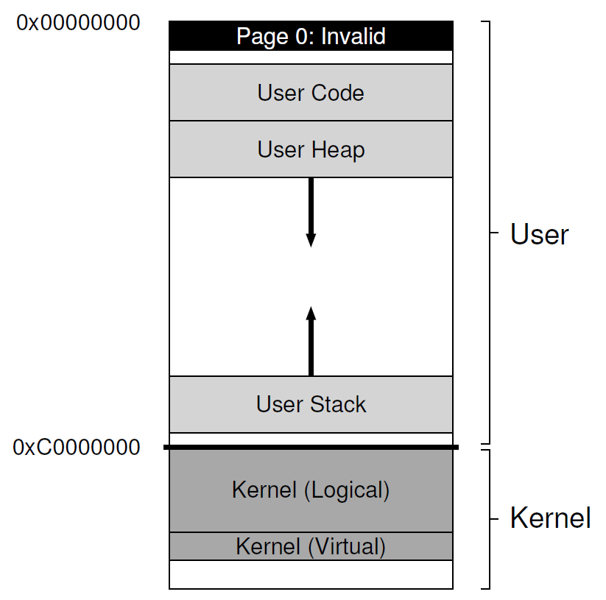
The Linux Virtual Memory System

Slide 9
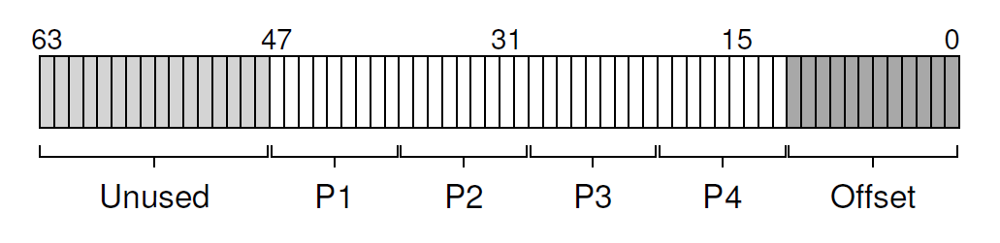
Page Table Structure
x86 provides a hardware-managed, multi-level page table structure

Slide 10
Large Page Support
Recent designs support 2-MB and even 1-GB pages
Benefits:
A smaller page table
Less TLB misses
A shorter TLB-miss path
Recently, Linux developers added transparent huge page support

Slide 11
The Page Cache
The Linux page cache is unified for
memory-mapped files
file data and metadata from devices
heap and stack pages
A 2Q replacement policy, and each Q uses the clock replacement policy

Slide 12
Security And Buffer Overflows
Buffer overflow attacks and address space layout randomization (ASLR)
Meltdown And Spectre

Slide 13
Concurrency

Slide 14
CPU Trends
The future:
same speed
more cores
Faster programs => concurrent execution
Write applications that fully utilize many CPUs …
Notes:
Thus far, we have seen the development of the basic abstractions that the OS performs. We have seen how to take a single physical CPU and turn it into multiple virtual CPUs, thus enabling the illusion of multiple programs running at the same time. We have also seen how to create the illusion of a large, private virtual memory for each process; this abstraction of the address space enables each program to behave as if it has its own memory when indeed the OS is secretly multiplexing address spaces across physical memory (and sometimes, disk).

Slide 15
Strategy 1
Build applications from many communicating processes
like Chrome (process per tab)
communicate via pipe() or similar
Pros/cons?
don’t need new abstractions
cumbersome programming
copying overheads
expensive context switching

Slide 16
Strategy 2
New abstraction: the thread.
Threads are just like processes, but they share the address space
Same page table
Same code segment, but different PC
Same heap
Thread control block
Different stacks, also used for thread-local storage
Different registers

Slide 17
Threads vs. Processes
Advantages of multi-threading over multi-processes
Far less time to create/terminate thread than process
Context switch is quicker between threads of the same process
Communication between threads of the same process is more efficient
Through shared memory

Slide 18
Shared and Not-Shared
All threads of a process share resources
Memory address space: global data, code, heap …
Open files, network sockets, other I/O resources
User-id
IPC facilities
Private state of each thread:
Execution state: running, ready, blocked, etc..
Execution context: Program Counter, Stack Pointer, other user-level registers
Per-thread stack

Slide 19
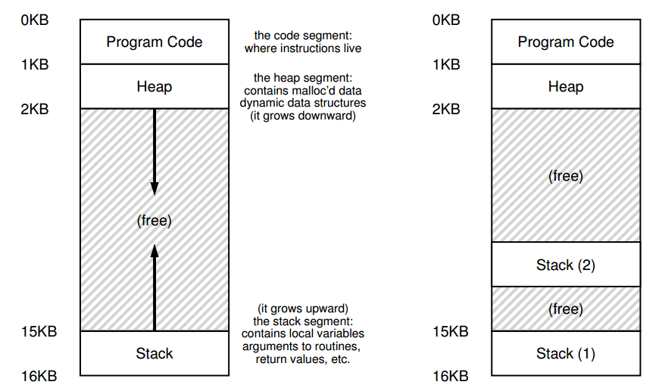
Process Address Space

Slide 20
Thread
In single threaded systems, a process is:
Resource owner: memory address space, files, I/O resources
Scheduling/execution unit: execution state/context, dispatch unit
Multithreaded systems
Separation of resource ownership & execution unit
A thread is unit of execution, scheduling and dispatching
A process is a container of resources, and a collection of threads

Slide 21
When to, and not to use threads?
Use threads for parallelism and concurrency
Applications
Multiprocessor machines
Handle slow devices
Background operations
Windowing systems
Server applications to handle multiple requests
No threads cases
When each unit of execution require different authentication/user-id
E.g., secure shell server

Slide 22
#include <stdio.h>
#include "mythreads.h"
#include <stdlib.h>
#include <pthread.h>
void *mythread(void *arg) {
printf("%s\n", (char *) arg);
return NULL;
}
Int main(int argc, char *argv[]){
if (argc != 1) {
fprintf(stderr, "usage: main\n");
exit(1);
}
pthread_t p1, p2;
printf("main: begin\n");
Pthread_create(&p1, NULL, mythread, "A");
Pthread_create(&p2, NULL, mythread, "B");
// join waits for the threads to finish
Pthread_join(p1, NULL);
Pthread_join(p2, NULL);
printf("main: end\n");
return 0;
}

Slide 23
#include <stdio.h>
#include "mythreads.h"
#include <stdlib.h>
#include <pthread.h>
int max;
// shared global variable
volatile int counter = 0;
void * mythread(void *arg)
{
char *letter = arg;
int i; // stack
printf("%s: begin\n", letter);
for (i = 0; i < max; i++) {
counter = counter + 1;
}
printf("%s: done\n", letter);
return NULL;
}
int main(int argc, char *argv[]) {
if (argc != 2) {
fprintf(stderr, "usage: ...\n");
exit(1);
}
max = atoi(argv[1]);
pthread_t p1, p2;
printf("main: begin [counter = %d] [%x]\n",
counter, (unsigned int) &counter);
Pthread_create(&p1, NULL, mythread, "A");
Pthread_create(&p2, NULL, mythread, "B");
// join waits for the threads to finish
Pthread_join(p1, NULL);
Pthread_join(p2, NULL);
printf("main: done\n [counter: %d]\n
[should: %d]\n", counter, max*2);
return 0;
}

Slide 24
Scheduling Control: Mutex
Basic
Others
pthread_mutex_t lock = PTHREAD_MUTEX_INITIALIZER;
pthread_mutex_lock(&lock);
x = x + 1; // or whatever your critical section is
pthread_mutex_unlock(&lock);
int pthread_mutex_trylock(pthread_mutex_t *mutex);
int pthread_mutex_timedlock(pthread_mutex_t *mutex,
struct timespec *abs_timeout);

Slide 25
typedef struct __lock_t { int flag; } lock_t;
void init(lock_t *mutex) {
// 0 -> lock is available, 1 -> held
mutex->flag = 0;
}
void lock(lock_t *mutex) {
while (mutex->flag == 1) // TEST the flag
; // spin-wait (do nothing)
mutex->flag = 1; // now SET it!
}
void unlock(lock_t *mutex) {
mutex->flag = 0;
}

Slide 26
Scheduling Control: Condition Variable
pthread_mutex_t lock = PTHREAD_MUTEX_INITIALIZER;
pthread_cond_t init = PTHREAD_COND_INITIALIZER;
Pthread_mutex_lock(&lock);
while (initialized == 0)
Pthread_cond_wait(&init, &lock);
Pthread_mutex_unlock(&lock);
Pthread_mutex_lock(&lock);
initialized = 1;
Pthread_cond_signal(&init);
Pthread_mutex_unlock(&lock);
Initilization
Wait side
Signal side

Slide 27
Debugging
Concurrency leads to non-deterministic bugs
Whether bug manifests depends on CPU schedule!
Passing tests means little
How to program: imagine scheduler is malicious

Slide 28
Thread API Guidelines
Keep it simple
Minimize thread interactions
Initialize locks and condition variables
Check your return codes
Be careful with how you pass arguments to, and return values from, threads
Each thread has its own stack
Always use condition variables to signal between threads. Avoid simple flags!
Use the manual pages

Slide 29

Reading for the next lecture
OSTEP chapters on Virtualization
26, 27, and 28
http://pages.cs.wisc.edu/~remzi/OSTEP/
You can now also find the schedule and other information https://people.engr.ncsu.edu/gjin2/Classes/501/Fall2017/index.html

