Slide 1
Lecture 14 Lock-based Data Structures Concurrency Bugs

Slide 2



Concurrency bugs in history

Slide 3
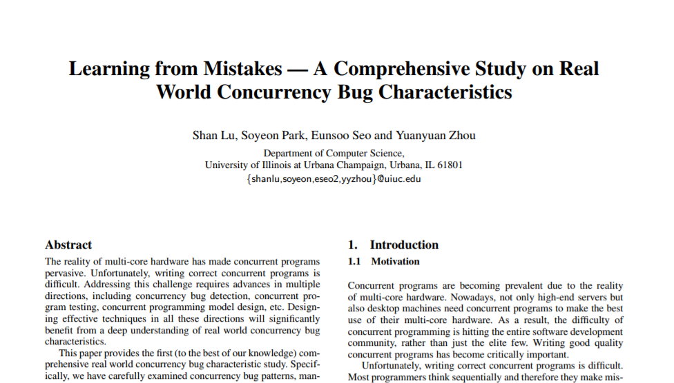
Concurrency Bugs are Common and Diverse
Application | Atomicity | Order | Deadlock | other
MySQL | 12 | 1 | 9 | 1
Apache | 7 | 6 | 4 | 0
Mozilla | 29 | 15 | 16 | 0
OpenOffice | 3 | 2 | 2 | 1

Slide 4
Atomicity: MySQL
Thread 1:
pthread_mutex_lock(&lock);
if (thd->proc_info) {
…
fputs(thd->proc_info, …);
…
}
pthread_mutex_unlock(&lock);
Thread 2:
pthread_mutex_lock(&lock);
thd->proc_info = NULL;
pthread_mutex_unlock(&lock);

Slide 5
Ordering: Mozilla
Thread 1:
void init() {
…
mThread
= PR_CreateThread(mMain, …);
pthread_mutex_lock(&mtLock);
mtInit = 1;
pthread_cond_signal(&mtCond);
pthread_mutex_unlock(&mtLock);
…
}
Thread 2:
void mMain(…) {
…
Mutex_lock(&mtLock);
while(mtInit == 0)
Cond_wait(&mtCond, &mtLock);
Mutex_unlock(&mtLock);
mState = mThread->State;
…
}
Notes:
The actual fix

Slide 6
Data Race
A data race occurs when 2 instructions from different threads access the same memory location, at least one of these accesses is a write and there is no synchronization that is mandating any particular order among these accesses.

Slide 7
Race: MySQL
Thread 1:
if (thd->proc_info) {
…
fputs(thd->proc_info, …);
…
}
Thread 2:
thd->proc_info = NULL;

Slide 8
Race: Mozilla
Thread 1:
void init() {
…
mThread
= PR_CreateThread(mMain, …);
…
}
Thread 2:
void mMain(…) {
…
mState = mThread->State;
…
}

Slide 9
Data Race Free DOES not mean Concurrency Bug Free

Slide 10
A Simple Deadlock Example
Thread 1 Thread 2
lock(&A); lock(&B);
lock(&B); lock(&A);

Slide 11
What’s Wrong?
set_t *set_union (set_t *s1, set_t *s2) {
set_t *rv = Malloc(sizeof(*rv));
Mutex_lock(&s1->lock);
Mutex_lock(&s2->lock);
for(int i=0; i<s1->len; i++) {
if(set_contains(s2, s1->items[i])
set_add(rv, s1->items[i]);
Mutex_unlock(&s2->lock);
Mutex_unlock(&s1->lock);
}

Slide 12
Encapsulation
Modularity can make it harder to see deadlocks.
Thread 1 Thread 2
rv = set_union(setA, setB); rv = set_union(setB, setA);

Slide 13
Deadlock Theory
Deadlocks can only happen with these four conditions:
mutual exclusion
hold-and-wait
no preemption
circular wait
Eliminate deadlock by eliminating one condition.

Slide 14
Mutual Exclusion
Def: Threads claim exclusive control of resources that they require (e.g., thread grabs a lock).

Slide 15
Wait-Free Algorithms
Strategy: eliminate lock use.
Assume we have:
int CompAndSwap(int *addr, int expected, int new)
0: fail, 1: success
void add_v1(int *val,
int amt) {
Mutex_lock(&m);
*val += amt;
Mutex_unlock(&m);
}
void add_v2(int *val,
int amt) {
do {
int old = *value;
}
while(!CompAndSwap(val,
old, old+amt);
}

Slide 16
Wait-Free Insert
void insert(int val) {
node_t *n = Malloc(sizeof(*n));
n->val = val;
lock(&m);
n->next = head;
head = n;
unlock(&m);
}
void insert(int val) {
node_t *n = Malloc(sizeof(*n));
n->val = val;
do {
n->next = head;
} while (!CompAndSwap(&head,
n->next, n));
}

Slide 17
Deadlock Theory
Deadlocks can only happen with these four conditions:
mutual exclusion
hold-and-wait
no preemption
circular wait
Eliminate deadlock by eliminating one condition.

Slide 18
Hold-and-Wait
Def: Threads hold resources allocated to them (e.g., locks they have already acquired) while waiting for additional resources (e.g., locks they wish to acquire).

Slide 19
Eliminate Hold-and-Wait
Strategy: acquire all locks atomically once (cannot acquire again until all have been released).
For this, use a meta lock, like this:
lock(&meta);
lock(&L1);
lock(&L2);
…
unlock(&meta);
disadvantages?

Slide 20
Deadlock Theory
Deadlocks can only happen with these four conditions:
mutual exclusion
hold-and-wait
no preemption
circular wait
Eliminate deadlock by eliminating one condition.

Slide 21
No preemption
Def: Resources (e.g., locks) cannot be forcibly removed from threads that are holding them

Slide 22
Support Preemption
Strategy: if we can’t get what we want, release what we have.
top:
lock(A);
if (trylock(B) == -1) {
unlock(A);
goto top;
}
…

Slide 23
Deadlock Theory
Deadlocks can only happen with these four conditions:
mutual exclusion
hold-and-wait
no preemption
circular wait
Eliminate deadlock by eliminating one condition.

Slide 24
Circular Wait
Def: There exists a circular chain of threads such that each thread holds a resource (e.g., lock) being requested by next thread in the chain.

Slide 25
Eliminating Circular Wait
Strategy:
decide which locks should be acquired before others
if A before B, never acquire A if B is already held!
document this, and write code accordingly

Slide 26
Other approaches
Deadlock avoidance vis scheduling
Detect and recover

Slide 27
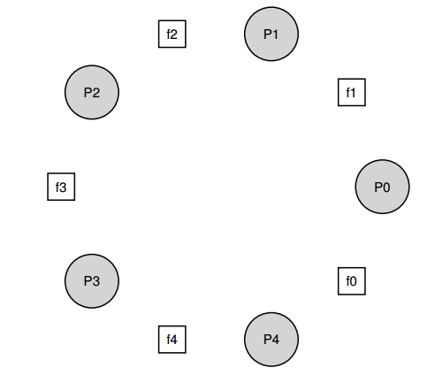
The Dining Philosophers

Slide 28
A broken solution
while (1) { void getforks() {
think(); sem_wait(forks[left(p)]);
getforks(); sem_wait(forks[right(p)]);
eat(); }
putforks(); void putforks() {
} sem_post(forks[left(p)]);
sem_post(forks[right(p)]); }
int left(int p) { return p; }
int right(int p) { return (p + 1) % 5; }

Slide 29
A Solution: Breaking The Dependency
void getforks() {
if (p == 4) {
sem_wait(forks[right(p)]);
sem_wait(forks[left(p)]);
} else {
sem_wait(forks[left(p)]);
sem_wait(forks[right(p)]);
}
}

Slide 30
Concurrent Counters
typedef struct __counter_t {
int value;
} counter_t;
void init(counter_t *c) {
c->value = 0;
}
void increment(counter_t *c) {
c->value++;
}
void decrement(counter_t *c) {
c->value--;
}
int get(counter_t *c) {
return c->value;
}

Slide 31
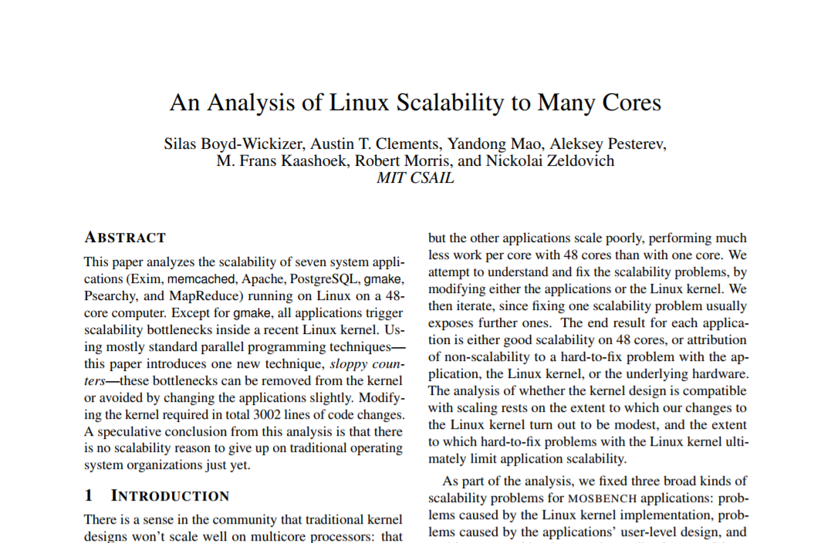
Concurrent Counters
typedef struct __counter_t {
int value;
} counter_t;
void init(counter_t *c) {
c->value = 0;
}
void increment(counter_t *c) {
c->value++;
}
void decrement(counter_t *c) {
c->value--;
}
int get(counter_t *c) {
return c->value;
}

Slide 32
typedef struct __counter_t {
int global; // global count
pthread_mutex_t glock; // global lock
int local[NUMCPUS]; // local count (per cpu)
pthread_mutex_t llock[NUMCPUS]; // ... and locks
int threshold; // update frequency
} counter_t;
void init(counter_t *c, int threshold) {
c->threshold = threshold; c->global = 0;
pthread_mutex_init(&c->glock, NULL);
int i;
for (i = 0; i < NUMCPUS; i++) {
c->local[i] = 0;
pthread_mutex_init(&c->llock[i], NULL);
}
}

Slide 33
void update(counter_t *c, int threadID, int amt) {
pthread_mutex_lock(&c->llock[threadID]);
c->local[threadID] += amt; // assumes amt > 0
if (c->local[threadID] >= c->threshold) {
pthread_mutex_lock(&c->glock);
c->global += c->local[threadID];
pthread_mutex_unlock(&c->glock);
c->local[threadID] = 0;
}
pthread_mutex_unlock(&c->llock[threadID]);
}
int get(counter_t *c) {
pthread_mutex_lock(&c->glock);
int val = c->global;
pthread_mutex_unlock(&c->glock);
return val; // only approximate!
}

Slide 34
Concurrent Linked Lists
typedef struct __node_t {
int key;
struct __node_t *next;
} node_t;
typedef struct __list_t {
node_t *head;
pthread_mutex_t lock;
} list_t;
void List_Init(list_t *L) {
L->head = NULL;
pthread_mutex_init(&L->lock, NULL);
}

Slide 35
int List_Insert(list_t *L, int key) {
pthread_mutex_lock(&L->lock);
node_t *new = malloc(sizeof(node_t));
if (new == NULL) {
perror("malloc");
pthread_mutex_unlock(&L->lock);
return -1; // fail
}
new->key = key;
new->next = L->head;
L->head = new;
pthread_mutex_unlock(&L->lock);
return 0; // success
}

Slide 36
int List_Lookup(list_t *L, int key) {
pthread_mutex_lock(&L->lock);
node_t *curr = L->head;
while (curr) {
if (curr->key == key) {
pthread_mutex_unlock(&L->lock);
return 0; // success
}
curr = curr->next;
}
pthread_mutex_unlock(&L->lock);
return -1; // failure
}

Slide 37
int List_Insert(list_t *L, int key) {
// synchronization not needed
node_t *new = malloc(sizeof(node_t));
if (new == NULL) {
perror("malloc");
return;
}
new->key = key;
// just lock critical section
pthread_mutex_lock(&L->lock);
new->next = L->head;
L->head = new;
pthread_mutex_unlock(&L->lock);
}

Slide 38
int List_Lookup(list_t *L, int key) {
int rv = -1;
pthread_mutex_lock(&L->lock);
node_t *curr = L->head;
while (curr) {
if (curr->key == key) {
rv = 0;
break;
}
curr = curr->next;
}
pthread_mutex_unlock(&L->lock);
return rv; // now both success and failure
}

Slide 39
Also in OSTEP
Concurrent Queues
Concurrent Hash Table

Slide 40
Thread API Guidelines
Keep it simple
Minimize thread interactions
Initialize locks and condition variables
Check your return codes
Be careful with how you pass arguments to, and return values from, threads
Each thread has its own stack
Always use condition variables to signal between threads. Avoid simple flags!
Use the manual pages

Slide 41
Debugging
Concurrency leads to non-deterministic bugs
Whether bug manifests depends on CPU schedule!
Passing tests means little
How to program: imagine scheduler is malicious

