Slide 1
Lecture 16 I/O Devices & Hard Disk Drives

Slide 2
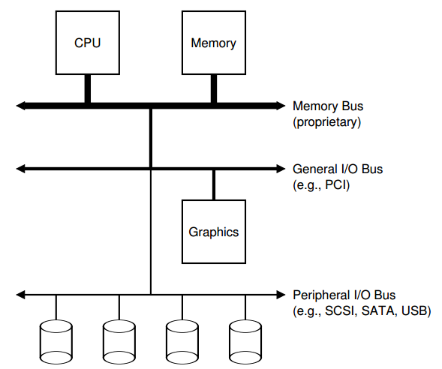
We need I/O devices

Slide 3
The Canonical Device
The interface for OS to interact
Device Registers
Hidden Internals
Micro-controller (CPU)
Memory (DRAM or SRAM or both)
Other Hardware-specific Chips
Status
Command
Data

Slide 4
The Canonical Protocol
While (STATUS == BUSY) // 1
; // wait until device is not busy
Write data to DATA register // 2
Write command to COMMAND register // 3
(To start the device & executes the command)
While (STATUS == BUSY) // 4
; // wait until device is done with your request

Slide 5
A trace
3
1 2 4
CPU:
Disk:
A
B
C
A

Slide 6
Using interrupts to avoid spinning
1 3,4
2
CPU:
Disk:
B
B
A A A
B
C
A

Slide 7
Interrupts vs. Polling
Discussion: could interrupt be worse under some cases?
Techniques:
Hybrid approach
Interrupt coalescing

Slide 8
What else can we optimize?
1 3,4
2
CPU:
Disk:
B
B
A A A
B
C
A

Slide 9
Programmed I/O vs. Direct Memory Access
PIO (Programmed I/O):
CPU directly tells device what data is
DMA (Direct Memory Access):
CPU leaves data in memory
Device reads it directly

Slide 10
Using DMA
1 3,4
CPU:
Disk:
B
B
A A
B
C
A

Slide 11
How does OS access registers?
Special instructions
each device has a port
in/out instructions (x86) communicate with device
Memory-Mapped I/O
H/W maps registers into address space
loads/stores sent to device
Doesn’t matter much (both are used).

Slide 12
Protocol Variants
Status checks: polling vs. interrupts
Data: PIO vs. DMA
Control: special instructions vs. memory-mapped I/O

Slide 13
Variety is a Challenge
Problem:
many, many devices
each has its own protocol
How can we avoid writing a slightly different OS for each H/W combination?
Encapsulation!
Write driver for each device.
Drivers are 70% of Linux source code.

Slide 14
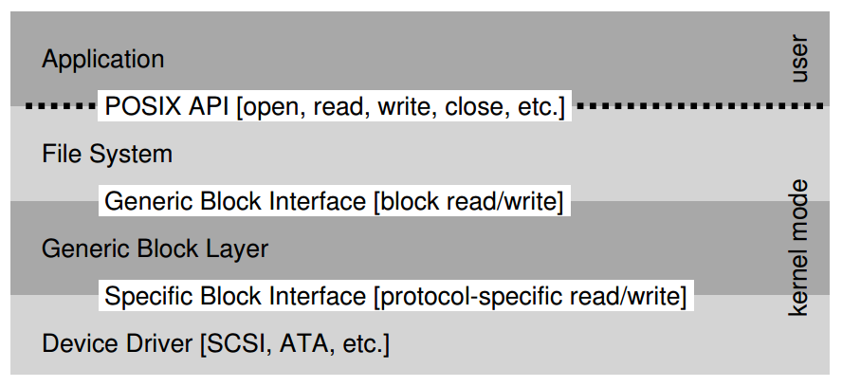
The File System Stack

Slide 15
Hard Disk Basic Interface
Disk has a sector-addressable address space (so a disk is like an array of sectors).
Sectors are typically 512 bytes or 4096 bytes.
By the end of 2007, Samsung and Toshiba began shipments of 1.8-inch hard disk drives with 4096 byte sectors. In 2010, the International Disk Drive Equipment and Materials Association (IDEMA) completed the Advanced Format standard for 4096 sector drives, setting the date for the transition from 512 to 4096 byte sectors as January 2011 for all manufacturers, and Advanced Format drives soon became prevalent. [wiki]
Main operations: reads + writes to sectors.

Slide 16
Disk Internals
Platter: covered with a magnetic film.
Surface: each platter has two surfaces
Spindle: many platters may be bound to the spindle.
Track: each surface is divided into rings, each track is further divided into numbers sectors
Cylinder: a stack of tracks across platters
Heads on a moving arm can read from each surface.

Slide 17
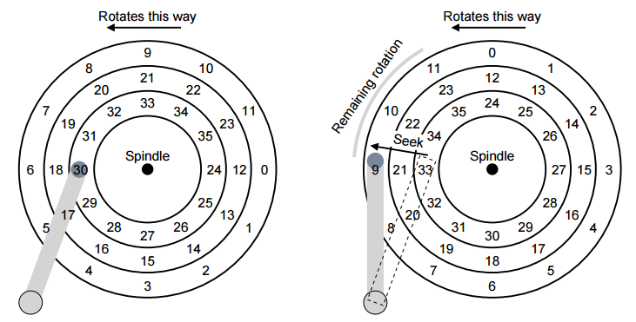
Three Tracks Plus A Head

Slide 18
https://www.youtube.com/watch?v=9eMWG3fwiEU

Slide 19
Seek, Rotate, Transfer
Must accelerate, coast, decelerate, settle
Seeks often take several milliseconds!
Settling alone can take 0.5 - 2 ms.
Entire seek often takes 4 - 10 ms.

Slide 20
Seek, Rotate, Transfer
Depends on rotations per minute (RPM).
7200 RPM is common, 15000 RPM is high end.
1 / 7200 RPM = 1 minute / 7200 rotations = 1 second / 120 rotations = 8.3 ms / rotation
so it may take 4.2 ms on avg to rotate to target (0.5 * 8.3 ms)

Slide 21
Seek, Rotate, Transfer
Pretty fast — depends on RPM and sector density.
100+ MB/s is typical.
1s / 100 MB = 10 ms / MB = 4.9 us / sector (assuming 512-byte sector)

Slide 22
Workload
So…
seeks are slow
rotations are slow
transfers are fast
What kind of workload is fastest for disks?
Sequential: access sectors in order (transfer dominated)
Random: access sectors arbitrarily (seek+rotation dominated)

Slide 23
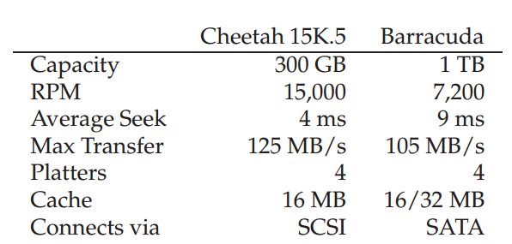
Disk Spec
Sequential workload: what is throughput for each?
Close to max transfer rate if workload large enough
Random workload: what is throughput for each?
Assume 4KB reads: 0.66MB/s and 0.31MB/s
Assume 16KB reads: 2.5 MB/s and 1.2MB/s
Notes:
avg rotation =1/2 x 1 min/15000 x 60 sec/1 min x 1000 ms/1 sec= 2 ms
transfer =1 sec/125 MB x 16 KB x 1,000,000 us/1 sec= 125 us
Cheetah time = 4ms + 2ms + 125us = 6.1ms
throughput =16 KB/6.1ms x 1 MB/1024 KB x 100 ms/1 sec =2.5 MB/s
avg rotation =1/2 x 1 min/7200 x 60 sec/1 min x 1000 ms/1 sec= 4.1 ms
transfer =1 sec/105 MB x 16 KB x 1,000,000 us/1 sec= 149 us
Cheetah time = 9ms + 4.1ms + 149us = 13.2ms
throughput =16 KB/13.2ms x 1 MB/1024 KB x 100 ms/1 sec =1.2 MB/s

Slide 24
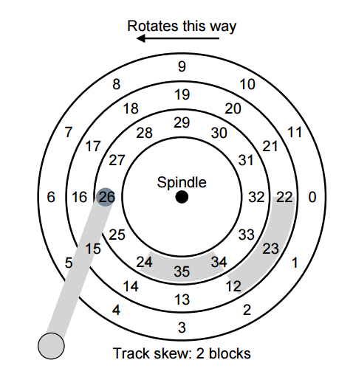
Track Skew

Slide 25
Zones

Slide 26
Other Improvements
Track Skew
Zones
Cache
Drives may cache both reads and writes.

Slide 27
Schedulers
Given a stream of requests, in what order should they be served?
FCFS
Try to follow SJF (shortest job first)
SSTF: Shortest Seek Time First
Difficult for OS, OS can do nearest-block-first (NBF)
Starvation
Elevator (a.k.a. SCAN or C-SCAN)
Still ignore rotation time

Slide 28
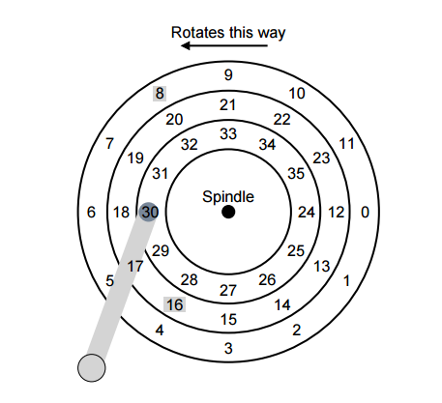
SPTF: Shortest Positioning Time First

Slide 29
Other Issues
Both OS and disk do some scheduling
I/O merging
Work Conservation

Slide 30
Next: File System Implementation

Slide 31
The File System Stack

Slide 32
File and File Name
What is a File?
Array of bytes.
Ranges of bytes can be read/written.
File system consists of many files, and files need names so programs can choose the right one.
inode
path
file descriptor

Slide 33
inodes
Each file has exactly one inode number.
inodes are unique (at a given time) within a FS.
Different file system may use the same number, numbers may be recycled after deletes
Show inodes via stat.

Slide 34
Paths
String names are friendlier than number names.
Store path-to-inode mapping in many files. Call these special files directories.
Reads for getting final inode called “traversal”.

Slide 35
File Descriptor (fd)
Idea: do traversal once, and store inode number in descriptor object. Do reads/writes via descriptor. Also remember offset.
A file-descriptor table contains pointers to file descriptors.
The integers you’re used to using for file I/O are indexes into this table.

Slide 36
Code Snippet
int fd1 = open(“file.txt”); // returns 3
read(fd1, buf, 12);
int fd2 = open(“file.txt”); // returns 4
int fd3 = dup(fd2); // returns 5
fd table
0
1
2
3
4
5
fds
offset = 12
inode =
offset = 0
inode =
inode
location = 0
size =
offset = 0
inode =

