Slide 1
Lecture 17 FS APIs and vsfs

Slide 2
I/O Protocol Variants
Status checks: polling vs. interrupts
Data: PIO vs. DMA
Control: special instructions vs. memory-mapped I/O

Slide 3
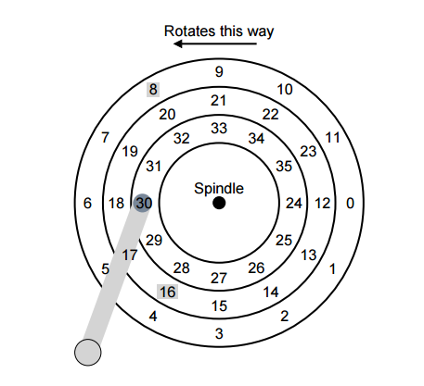
Disk
Scheduling

Slide 4
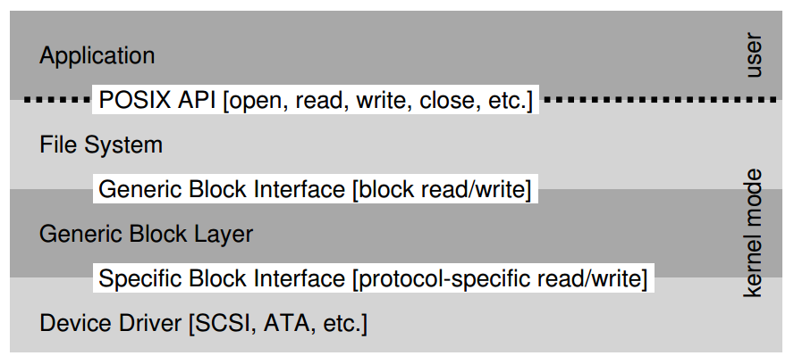
The File System Stack

Slide 5
File and File Name
What is a File?
Array of bytes.
Ranges of bytes can be read/written.
File system consists of many files, and files need names so programs can choose the right one.
inode
path
file descriptor

Slide 6
inodes
Each file has exactly one inode number.
inodes are unique (at a given time) within a FS.
Different file system may use the same number, numbers may be recycled after deletes
Show inodes via stat.

Slide 7
Paths
String names are friendlier than number names.
Store path-to-inode mapping in many files. Call these special files directories.
Reads for getting final inode called “traversal”.

Slide 8
File Descriptor (fd)
Idea: do traversal once, and store inode number in descriptor object. Do reads/writes via descriptor. Also remember offset.
A file-descriptor table contains pointers to file descriptors.
The integers you’re used to using for file I/O are indexes into this table.

Slide 9
Code Snippet
int fd1 = open(“file.txt”); // returns 3
read(fd1, buf, 12);
int fd2 = open(“file.txt”); // returns 4
int fd3 = dup(fd2); // returns 5
fd table
0
1
2
3
4
5
fds
offset = 12
inode =
offset = 0
inode =
inode
location = 0
size =
offset = 0
inode =

Slide 10
File API
int fd = open(char *path, int flag, mode_t mode)
read(int fd, void *buf, size_t nbyte)
write(int fd, void *buf, size_t nbyte)
close(int fd)
advantages:
string names
hierarchical
traverse once
different offsets

Slide 11
Directories
Making Directories: mkdir()
Reading Directories: opendir(), readdir(), and closedir()
Deleting Directories
Directories can also be unlinked with unlink(). But only if empty!
Be careful on using ““rm –rf *”

Slide 12
Special Calls
lseek
fsync
rename
Say we want to update file.txt.
write new data to new file.txt.tmp file
fsync file.txt.tmp
rename file.txt.tmp over file.txt, replacing it
Hard link
Symbolic link or soft link

Slide 13
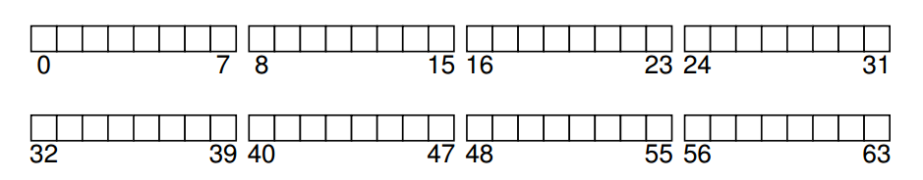
Implementation
On-disk structures
how do we represent files, directories?
Access methods
what steps must reads/writes take?

Slide 14
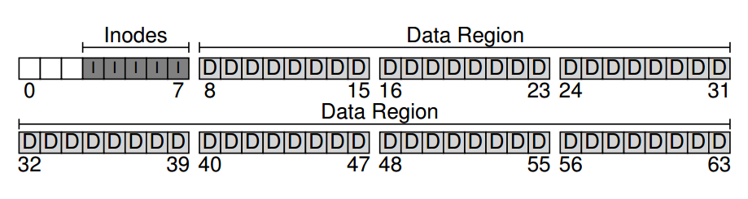
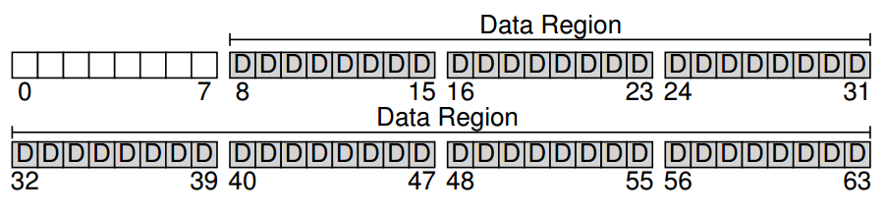
Structures
What data is likely to be read frequently?
data block
inode table
Notes:
Size of block: 4kB
Size of inode: 256B

Slide 15
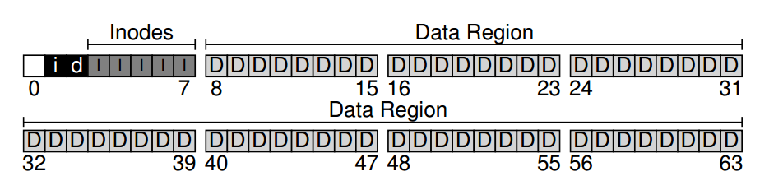
Allocation Structures
inode bitmap
data bitmap

Slide 16
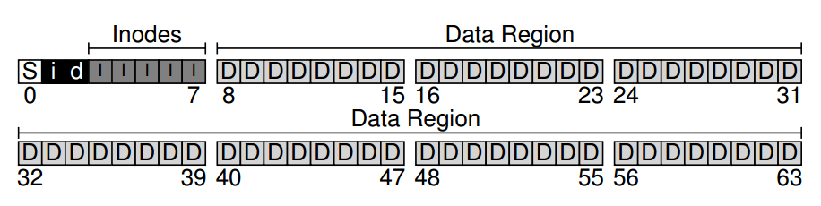
Superblock
The superblock contains information including:
how many inodes and data blocks are in the file system (80 and 56, respectively in this instance)
where the inode table begins (block 3)
a magic number to identify the file system type

Slide 17
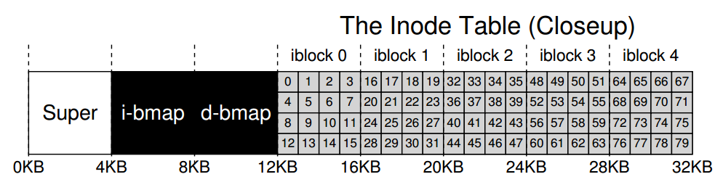
The inode Table
The sector address of an inode block can be calculated with some formula

Slide 18
What’s in an inode
Metadata for a given file
Type: file or directory?
uid: user
rwx: permission
size: size in bytes
blocks: size in blocks
time: access time
ctime: create time
links_count: how many paths
addrs[N]: N data blocks

Slide 19
The Multi-Level Index
An inode may have
some fixed number of direct pointers (e.g., 12)
a single indirect pointer
a double indirect pointer
…
Why direct pointers are kept?
Most files are small
Some systems use extents (ext4), linked list (FAT)

Slide 20
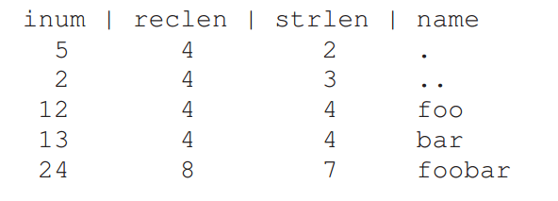
Directory Organization
File systems vary
Common design: just store directory entries in files
Simple list example
More advanced data structure is possible

Slide 21
Free Space Management
How do we find free data blocks or free inodes?
Free list
Bitmaps
B-tree

Slide 22
Operations
FS
mkfs
mount
File
open
Read
create
write
close

Slide 23
mkfs
Different version for each file system (e.g., mkfs.ext4, mkfs.xfs, mkfs.btrfs, etc)
Initialize metadata (bitmaps, inode table).
Create empty root directory.

Slide 24
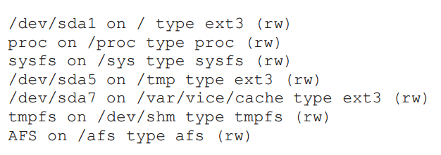
mount
Add the file system to the FS tree.

Slide 25
Operations
FS
mkfs
mount
File
open
Read
create
write
close

Slide 26
Open /foo/bar
Read root inode
Read root data
Read foo inode
Read foo data
Read bar inode

Slide 27
Read /foo/bar
Read bar inode
Read bar data
Write bar inode

Slide 28
