Slide 1
Lecture 18 FFS

Slide 2
File-System Case Studies
Local
VSFS: Very Simple File System
FFS: Fast File System
LFS: Log-Structured File System
Network
NFS: Network File System
AFS: Andrew File System

Slide 3
File Names
Three types of names:
inode number
unique name
remember file size, permissions, etc.
Path
easy to remember
hierarchical
File descriptor
avoid frequent traversal
remember multiple offsets

Slide 4
File API
int fd = open(char *path, int flag, mode_t mode)
read(int fd, void *buf, size_t nbyte)
write(int fd, void *buf, size_t nbyte)
close(int fd)
fsync(int fd)
rename(char *oldpath, char *newpath)
link(const char *oldpath, const char *newpath)

Slide 5
Delete?
Only unlink
rmdir vs. unlink on directories

Slide 6
What’s in an inode
Metadata for a given file
Type: file or directory?
uid: user
rwx: permission
size: size in bytes
blocks: size in blocks
time: access time
ctime: create time
links_count: how many paths
addrs[N]: N data blocks

Slide 7
Hard link
When you create a file
Make a structure: the inode
Link a human-readable name to that file, and put that link into a directory
When you call link()
link(const char *oldpath, const char *newpath)
To remove a file, just call unlink
The reference count will be decreased
If the reference count reaches zero, the file inode and related data blocks are removed

Slide 8
Deleting Files
There is no system call “delete” for deleting files!
inode (and associated file) is garbage collected when there are no references
FDs are deleted when:
close(), or process quits

Slide 9
Structures
What data is likely to be read frequently?
data block
inode table
indirect block
directories
data bitmap
inode bitmap
superblock

Slide 10
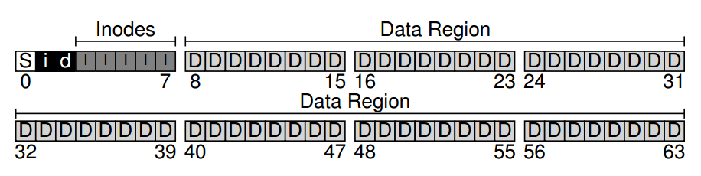
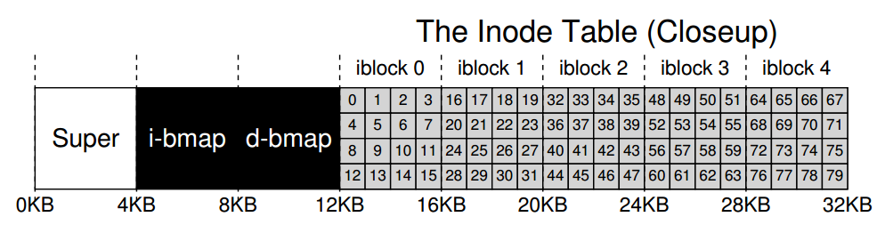

Slide 11
Operations
FS
mkfs
mount
File
create
write
open
read
close

Slide 12
create /foo/bar
Read root inode
Read root data
Read foo inode
Read foo data
Read inode bitmap
Write inode bitmap
Write foo data
Read bar inode
Write bar inode
Write foo inode

Slide 13
Write to /foo/bar
Read bar inode
Read data bitmap
Write data bitmap
Write bar data
Write bar inode

Slide 14
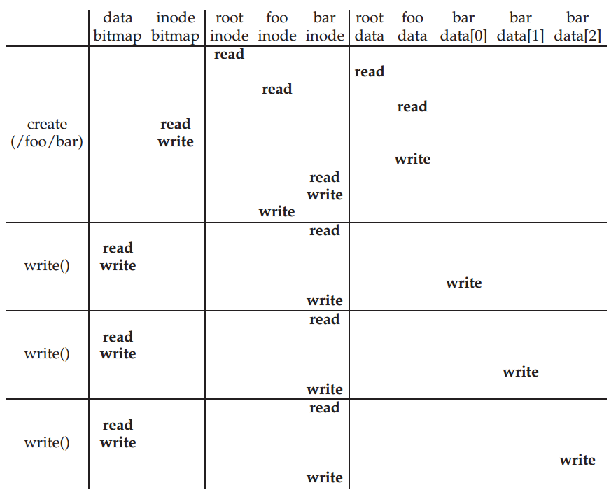

Slide 15
Open /foo/bar
Read root inode
Read root data
Read foo inode
Read foo data
Read bar indoe

Slide 16
Read /foo/bar
Read bar inode
Read bar data
Write bar inode

Slide 17
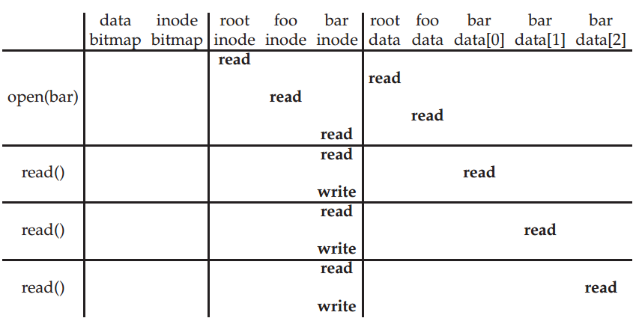

Slide 18
Close /foo/bar
Deallocate the file descriptor
No disk I/Os take place

Slide 19
How to avoid excessive I/O?
Fixed-size cache
Unified page cache for read and write buffering
Instead of a dedicated file-system cache, draw pages from a common pool for FS and processes.
Cache benefits read traffic more than write traffic
For write: batch, schedule, and avoid
A trade-off between performance and reliability
We decide: how much to buffer, how long to buffer…

Slide 20
Operations
FS
mkfs
mount
File
create
write
open
read
close

Slide 21
Policy: Choose inode, Data Blocks
S
i
d
I
I
I
I
I
D
D
D
D
D
D
D
D
D
D
D
D
D
D
D
D
D
D
D
D
D
D
D
D
Layout
3, 8, 31, 14, 22
3, 8, 9, 10, 11
A better one?

Slide 22
System Building Approach
Identify state of the art
Measure it, identify problems
Get idea
Build it!

Slide 23
Layout for the Original UNIX FS
S
I
D
Only super block, inode blocks, and data blocks
Free lists are embedded in inodes, data blocks
Data blocks are 512 bytes

Slide 24
Old FS
State of the art: original UNIX file system.
Measure throughput for file reads/writes.
Compare to theoretical max, which is…
disk bandwidth
Old UNIX file system: only 2% of potential. Why?

Slide 25
Measurement 1
What is performance before/after aging?
New FS: 17.5% of disk bandwidth
Few weeks old: 3% of disk bandwidth
FS is probably becoming fragmented over time.
Free list makes contiguous chunks hard to find.

Slide 26
Measurement 2
How does block size affect performance?
Try doubling it!
Performance more than doubled.
Logically adjacent blocks are probably not physically adjacent.
Smaller blocks cause more indirect I/O.

Slide 27
Old FS Observations:
long distance between inodes/data
inodes in single dir not close to one another
small blocks (512 bytes)
blocks laid out poorly
free list becomes scrambled, causes random alloc

Slide 28
Problem: old FS treats disk like RAM!
Solution: a disk-aware FS
The difference of RAM and disk?

Slide 29
Design Questions
How to use big blocks without wasting space
How to place data on disk

Slide 30
Technique 1: Bitmaps
S
I
D
S
B
I
D
Use bitmaps instead of free list.
Provides more flexibility, with more global view.

Slide 31
Technique 2: Groups
S
B
I
D
How would the distance between inode block and data block affect performance?
strategy: allocate inodes and data blocks in same group.
S
B
I
D
S
B
I
D
S
B
I
D

Slide 32
Groups
In FFS, groups were ranges of cylinders
called cylinder group
In ext2-4, groups are ranges of blocks
called block group

Slide 33
Technique 3: Super Rotation
S
B
I
D
S
B
I
D
S
B
I
D
Is it useful to have multiple super blocks?
Yes, if some (but not all) fail.
Problem: All super-block copies are on the top platter. What if it dies?
For each group, store super-block at different offset.

Slide 34
Technique 4: Large blocks
Doubling the block size for the old FS over doubled performance.
Strategy: choose block size so we never have to read more than two indirect blocks to find a data block (2 levels of indirection max). Want 4GB files.
How large is this?
Why not make blocks huge?
Most files are small
Problem: space waste for small files

Slide 35
Solution: Fragments
Hybrid!
Introduce “fragment” for files that use parts of blocks.
Only tail of file uses fragments
Block size = 4096
Fragment size = 1024
bits: 0000 0000 1111 0010
blk1 blk2 blk3 blk4

Slide 36
How to Decide
Whether addr refers to block or fragment is inferred by the file size.
What about when files grow?

Slide 37
Smart Policy
S
B
I
D
S
B
I
D
S
B
I
D
Where should new inodes and data blocks go?
Put related pieces of data near each other.
Rules:
Put directory entries near directory inodes.
Put inodes near directory entries.
Put data blocks near inodes.

Slide 38
Challenge
The file system is one big tree.
All directories and files have a common root.
In some sense, all data in the same FS is related.
Trying to put everything near everything else will leave us with the same mess we started with.

Slide 39
Revised Strategy
Put more-related pieces of data near each other.
Put less-related pieces of data far from each other.
FFS developers used their best judgement.

Slide 40
Preferences
File inodes: allocate in same group with dir
Dir inodes: allocate in new group with more free inodes than the average group
First data block: allocate near inode
Other data blocks: allocate near previous block

Slide 41
Problem: Large Files
A single large file can use nearly all of a group.
This displaces data for many small files.
It’s better to do one seek for the large file than one seek for each of many small files.
Define “large” as requiring an indirect.
Starting at indirect (e.g., after 48 KB), put blocks in a new block group.

Slide 42
Preferences
File inodes: allocate in same group with dir
Dir inodes: allocate in new group with fewer inodes than the average group
First data block: allocate near inode
Other data blocks: allocate near previous block
Large file data blocks: after 48KB, go to new group. Move to another group (w/ fewer than avg blocks) every subsequent 1MB.

Slide 43
Several New Features:
long file names
atomic rename
symbolic links
you can’t create hard link to a directory
you can’t hard link to files in other disk partitions
actually a file itself, which holds the pathname of the linked-to file as the data
dangling reference is possible

Slide 44
FFS
First disk-aware file system.
FFS inspired modern files systems, including ext2 and ext3.
FFS also introduced several new features:
long file names
atomic rename
symbolic links
All hardware is unique: treat disk like disk!

Slide 45
Next: Journaling and FSCK

