Slide 1
Lecture 19 FSCK & Journaling

Slide 2
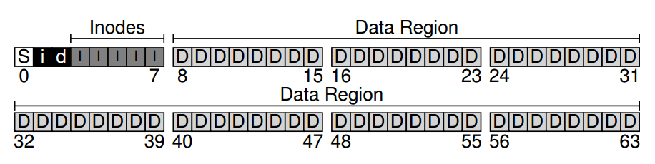
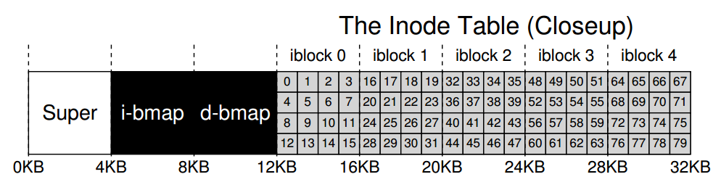

Slide 3
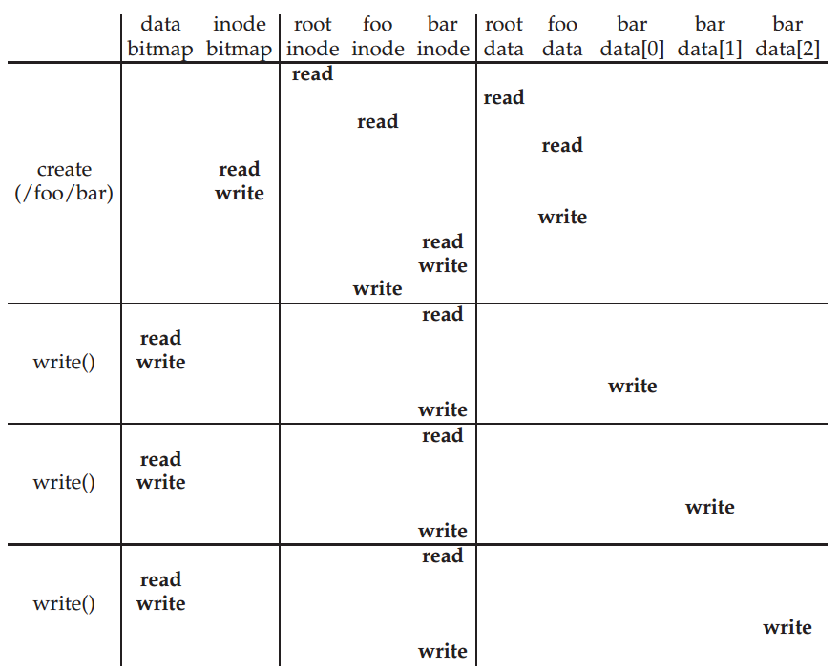

Slide 4
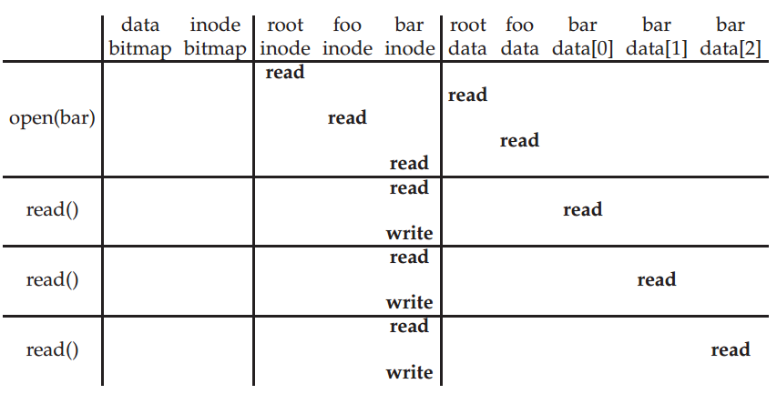

Slide 5
FFS Review
A few contributions:
hybrid block size
groups
smart allocation

Slide 6
Hybrid Block Size: Blocks + Fragments
Big blocks: fast
Small blocks: space efficient
FFS split regular blocks into fragments when less than a block is needed.

Slide 7
Groups and Allocation
B
With groups, each inode has data blocks near it
File inodes: allocate in same group with dir
Dir inodes: allocate in new group with fewer inodes than the average group
First data block: allocate near inode
Other data blocks: allocate near previous block
Large file data blocks: after 48KB, go to new group. Move to another group (w/ fewer than avg blocks) every subsequent 1MB.
S
I
D
S
B
I
D
S
B
I
D

Slide 8
Redundancy?
Definition: if A and B are two pieces of data, and knowing A eliminates some or all the values B could B, there is redundancy between A and B.
Superblock: field contains total blocks in FS.
Inode: field contains pointer to data block.
Is there redundancy between these fields? Why?
Yes. If total block number is N, pointers to block N or after are invalid.

Slide 9
Redundancy in FFS
Dir entries AND inode table.
Dir entries AND inode link count.
Data bitmap AND inode pointers.
Inode file size AND inode/indirect pointers.

Slide 10
Redundancy Uses
Redundancy may improve:
Performance
Reliability
Redundancy hurts:
Capacity
Redundancy implies:
Certain combinations of values are illegal.
Inconsistencies

Slide 11
Consistency Challenge
We may need to do several disk writes to redundant blocks.
We don’t want to be interrupted between writes.
Things that interrupt us:
power loss
kernel panic, reboot
user hard reset

Slide 12
Partial Update
Suppose we are appending to a file, and must update the following:
data block, inode, and data bitmap
What if crash after only updating some of these?
data: nothing bad
inode: point to garbage, somebody else may use
bitmap: lost block, space leak
bitmap and inode: point to garbage
bitmap and data: lost block
data and inode: somebody else may use

Slide 13
fsck
FSCK = file system checker.
Strategy: after a crash, scan whole disk for contradictions.
For example, is a bitmap block correct?
Read every valid inode+indirect. If an inode points to a block, the corresponding bit should be 1

Slide 14
fsck
Other checks:
Do superblocks match?
Do number of dir entries equal inode link counts?
Do different inodes ever point to same block?
Do directories contain “.” and “..”?
…
How to solve problems?

Slide 15
Exmaples
Dir Entry -> inode link_count = 1 <- Dir Entry
make the link_count 2
inode link_count = 1 with no Dir Entry points to it
link it under lost+found/
Data and inode are written, but not bitmap
change bitmap
Two inodes point to the same block
duplicate the block
inode points to a block N or more
remove the link

Slide 16
fsck
It’s not always obvious how to patch the file system back together.
We don’t know the “correct” state, just a consistent one.
Too slow.

Slide 17
Regaining Consistency After Crash
Solution 1: reformat disk
Solution 2: guess (fsck)
Solution 3: do fancy bookkeeping before crash

Slide 18
Journaling Goals
It’s ok to do some recovery work after crash, but not to read entire disk.
Don’t just get to a consistent state, get to a “correct” state.
Known as write-ahead logging is database systems.

Slide 19
Atomicity
Concurrency definition:
operations in critical sections are not interrupted by operations on other critical sections.
Persistence definition:
collections of writes are not interrupted by crashes. Get all new or all old data.

Slide 20
Basic Idea
Before overwriting the disk, write down a little note
Upon a crash, check the note
Ext3 file system with a journal
Journal
Group 1
Group 2
…
Group N

Slide 21
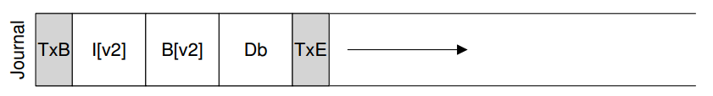
Data Journaling
Before writing inode (I[v2]), bitmap (B[v2]), and data block (Db) to disk, write to the log/journal
TxB (transaction begin): information about the pending updates, e.g., the final addresses for the blocks, transaction ID, checksum.
Middle three blocks: physical logging
TxE (transaction end): mark the end, also contains the transaction ID, checksum.

Slide 22
Sequence of Operations (V1)
1. Journal write: Write the transaction, including a transaction-begin block, all pending data and metadata updates, and a transaction-end block, to the log; wait for these writes to complete.
2. Checkpoint: Write the pending metadata and data updates to their final locations in the file system.

Slide 23
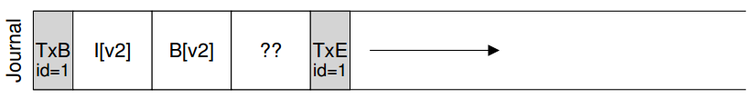
How to write the journal?
Write set of blocks: e.g., TxB, I[v2], B[v2], Db, TxE
Issue one block by one block: too slow
Issue five blocks at one: unsafe

Slide 24
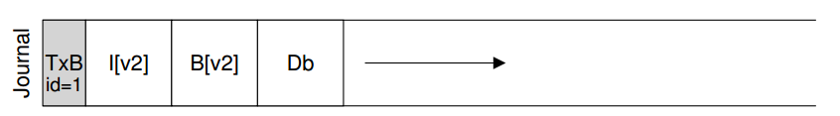
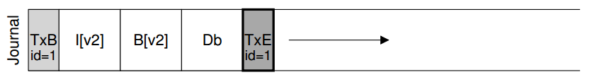
Write in two steps
To make the write of TxE atomic, make it a single 512-byte block

Slide 25
Sequence of Operations (V2)
1. Journal write: Write the contents of the transaction (including TxB, metadata, and data) to the log; wait for these writes to complete.
2. Journal commit: Write the transaction commit block (containing TxE) to the log; wait for write to complete; transaction is said to be committed.
3. Checkpoint: Write the contents of the update (metadata and data) to their final on-disk locations.

Slide 26
Recovery
A crash could happen at any time.
If crash before step 2 completes
Skip the pending update
If crash after step 2 completes
Transactions are replayed
What if crash during checkpointing?

Slide 27
Batching Log Updates
Basic protocol could add a lot of extra disk traffic
Suppose we create two files
Going to write the same inode block over and over to the log
Buffer all updates into a global transaction

Slide 28
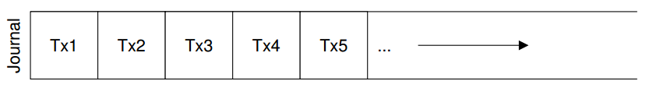
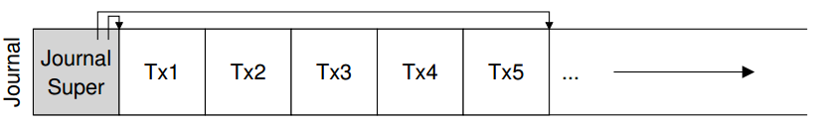
Making The Log Finite
What if the log is full?
Recovery takes longer to replay everything in the log
No further transactions can happen
Make the journal circular
Free the space after a transaction is checkpointed

Slide 29
Sequence of Operations (V3)
1. Journal write: Write the contents of the transaction (containing TxB and the contents of the update) to the log; wait for these writes to complete.
2. Journal commit: Write the transaction commit block (containing TxE) to the log; wait for the write to complete; the transaction is now committed.
3. Checkpoint: Write the contents of the update to their final locations within the file system.
4. Free: Some time later, mark the transaction free in the journal by updating the journal superblock.

Slide 30
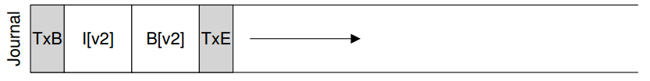
Metadata Journaling
For each write, we write twice.
Other than data journaling, there is also ordered journaling (metadata journaling)
User data is not written to the journal
When to write Db to disk?

Slide 31
Sequence of Operations (V4)
1/2. Data write: Write data to final location; wait for completion (the wait is optional).
1/2. Journal metadata write: Write the begin block and metadata to the log; wait for writes to complete.
3. Journal commit: Write the transaction commit block (containing TxE) to the log; wait for the write to complete; the transaction (including data) is now committed.
4. Checkpoint metadata: Write the contents of the metadata update to their final locations within the file system.
5. Free: Later, mark the transaction free in journal superblock

Slide 32
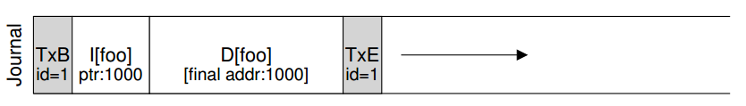
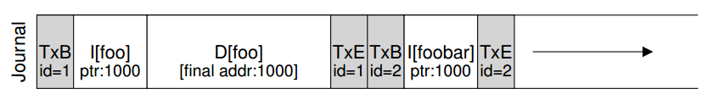
Tricky Case: Block Reuse
The Db of foobar will be overwritten
Solutions:
Never reuse blocks until the delete of said blocks is checkpointed out of the journal
add a new type of record to the journal, a revoke record

Slide 33
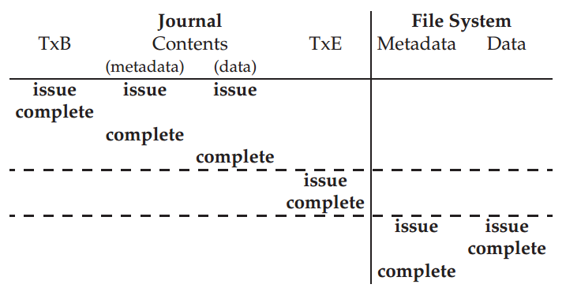
Data Journaling Timeline

Slide 34
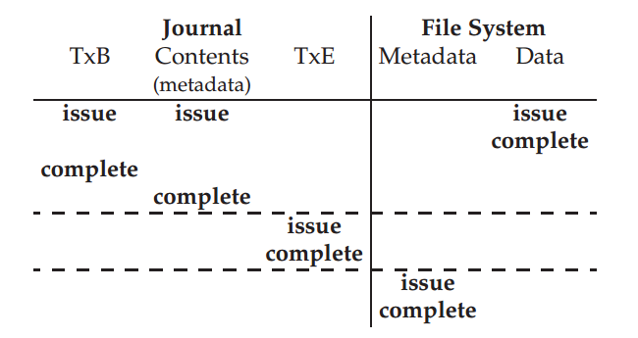
Metadata Journaling Timeline

Slide 35
Other Approaches
Soft Update
COW: copy-on-write
BBC: backpointer-based consistency
Optimistic crash consistency

Slide 36
Journaling
Reduces recovery time from O(size-of-the-disk-volume) to O(size-of-the-log)

Slide 37
Next
Networking and distributed systems

