Slide 1
Lecture 20 RAID

Slide 2
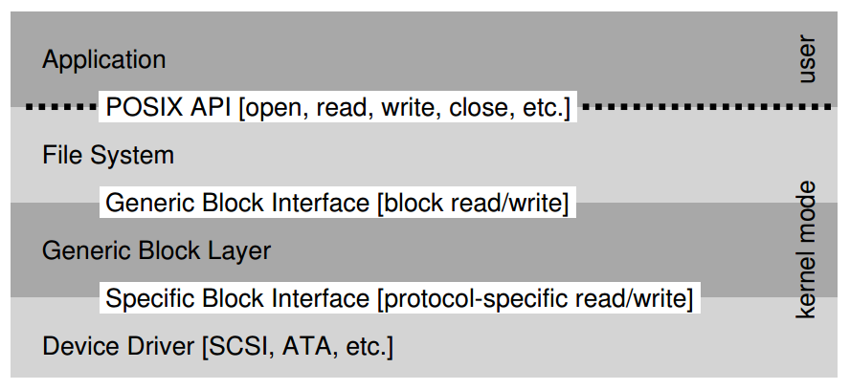
The File System Stack

Slide 3
Workload
So…
seeks are slow
rotations are slow
transfers are fast
What kind of workload is fastest for disks?
Sequential: access sectors in order (transfer dominated)
Random: access sectors arbitrarily (seek+rotation dominated)

Slide 4
Only One Disk?
Sometimes we want many disks — why?
capacity
performance
reliability

Slide 5
Solution 1: JBOD
JBOD: Just a Bunch Of Disks
Application/user is smart, stores different files on different file systems.
Application
FS
FS
FS
FS

Slide 6
Solution 2: RAID
RAID: Redundant Array of Inexpensive Disks
Transparent and deployable
Capacity, performance, and reliability
Application
FS
Fake Disk

Slide 7
Why Inexpensive Disks?
Economies of scale! Cheap disks are popular.
You can often get many commodity H/W components for the same price as a few expensive components.
Strategy: develop S/W or H/W to build high-quality logical devices from many cheap devices.
Alternative to RAID: buy an expensive, high-end disk.

Slide 8
General Strategy
Build fast, large disk from smaller ones.
Add even more disks for reliability.
0 100 200
RAID
Disk
Disk
Disk
Disk
0 100 0 100
0 100 0 100

Slide 9
Mapping
How should we map logical to physical addresses?
How is this problem similar to virtual memory?
Dynamic mapping: use data structure (hash table, tree)
paging
Static mapping: use math
RAID

Slide 10
Redundancy
Redundancy: how many copies?
System engineers are always trying to increase or decrease redundancy.
Increase: replication (e.g., RAID)
Decrease: deduplication (e.g., code sharing)
One strategy: reduce redundancy as much is possible. Then add back just the right amount.

Slide 11
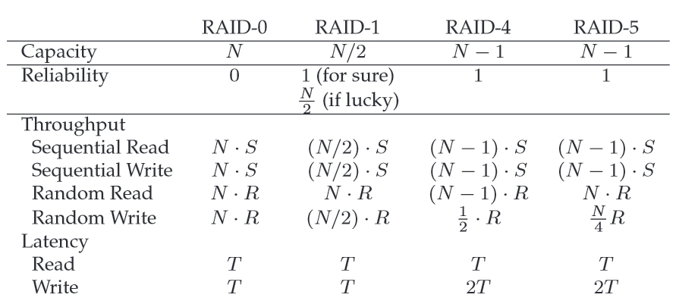

Slide 12
Reasoning About RAID
Workload: types of reads/writes issued by app
Reads and writes
One operation and steady I/O
Sequential and random
RAID: system for mapping logical to physical addrs
Which logical blocks map to which physical blocks?
How do we use extra physical blocks (if any)?
Metrics
Capacity: how much space can apps use?
Reliability: how many disks can we safely lose?
Performance: how long does each workload take?

Slide 13
RAID-0: Striping
Optimized for capacity.
No redundancy.
Logical Blocks
Disk 0 Disk 1

Slide 14
RAID-0 with 4 disks
Disk 0 Disk 1 Disk 2 Disk 3
0 1 2 3
4 5 6 7
8 9 10 11
12 13 14 15
stripe
How to map a given logical address A:
Disk = A % disk_count
Offset = A / disk_count

Slide 15
Chunk Size
Disk 0 Disk 1 Disk 2 Disk 3
0 2 4 6
1 3 5 7
8 10 12 14
9 11 13 15
stripe
When are small chunks better?
When are big ones better?
Notes:
How to map given logical address with chunk size K?

Slide 16
RAID-0: Analysis
What is capacity?
N * C
How many disks can fail?
0
Throughput?
?
Latency for one-op performance
T

Slide 17
Single Disk Throughput
Average seek time 7 ms
Average rotational delay 3 ms
Transfer rate of disk 50 MB/s
Sequential workload (S)
Assuming 10 MB transfer: 47.62 MB/s
Random workload (R)
Assuming 10 KB transfer: 0.981 MB/s

Slide 18
RAID-0: Analysis
Performance: what is steady-state throughput for
sequential reads
sequential writes
random reads
random writes
A sequential workload means that requests to the array come in large contiguous chunks
A random workload means that each request is rather small, and that each request is to a different random location on disk
N * S
N * S
N * R
N * R

Slide 19
RAID-1: Mirroring
Keep two copies of all data.
Logical Blocks
Disk 0 Disk 1

Slide 20
4 disks (RAID 1+0)
Disk 0 Disk 1 Disk 2 Disk 3
0 0 1 1
2 2 3 3
4 4 5 5
6 6 7 7
How many disks can fail?

Slide 21
Assumptions
Assume disks are fail-stop.
they work or they don’t
we know when they don’t
Tougher Errors:
latent sector errors
silent data corruption

Slide 22
RAID-1: Analysis
What is capacity?
N / 2 * C
How many disks can fail?
1 (or maybe N / 2)
Throughput?
???
Latency for one-op performance
T for read, T+ for write

Slide 23
RAID-1: Throughput
Performance: what is steady-state throughput for
sequential reads
sequential writes
random reads
random writes
N/2 * S
N/2 * S
N * R
N/2 * R

Slide 24
Crashes
Operations: write (A) to 2 disks
What if crash in between the writes to two disks?
Logical Blocks
Disk 0 Disk 1
Consistent-update problem

Slide 25
Consistent-update problem
Write-ahead log
Run recovery procedure upon a system failure
H/W Solution:
Use non-volatile RAM in RAID controller.

Slide 26
RAID-4 with 5 disks
parity
Disk 0 Disk 1 Disk 2 Disk 3 Disk 4
0 1 2 3 PA0
4 5 6 7 PA1
8 9 10 11 PA2
12 13 14 15 PA3
How to calculate parity
XOR is a good one, and it is performed bitwisely

Slide 27
RAID-4: Analysis
What is capacity?
(N-1) * C
How many disks can fail? How to recovery?
1
Throughput?
???
Latency for one-op performance
T for read, ? for write

Slide 28
RAID-4 Write Operations
Sequential writes
A full-stripe write
Random writes
additive parity
subtractive parity

Slide 29
RAID-4: Throughput
Performance: what is steady-state throughput for
sequential reads
sequential writes
random reads
random writes
Knows as small writes
Latency for one-op performance
T for read, 2T+ for write
(N-1) * S
(N-1) * S
(N-1) * R
R/2 under subtractive parity
How to avoid parity bottleneck?

Slide 30
RAID-5
Disk 0 Disk 1 Disk 2 Disk 3 Disk 4
0 1 2 3 PA0
5 6 7 PA1 4
10 11 PA2 8 9
15 PA3 12 13 14
PA4 16 17 18 19

Slide 31
RAID-5: Analysis
What is capacity?
(N-1) * C
How many disks can fail?
1
Throughput?
???
Latency for one-op performance
T for read, 2T+ for write

Slide 32
RAID-5: Throughput
Performance: what is steady-state throughput for
sequential reads
sequential writes
random reads
random writes
(N-1) * S
(N-1) * S
N * R
N/4 * R

Slide 33
All RAID
 | Reliability | Capacity
RAID-0 | 0 | N
RAID-1 | 1 | N / 2
RAID-4 | 1 | N - 1
RAID-5 | 1 | N - 1

Slide 34
All RAID
 | Read Latency | Write Latency
RAID-0 | T | T
RAID-1 | T | T
RAID-4 | T | 2T
RAID-5 | T | 2T
RAID-5 can do more in parallel

Slide 35
All RAID
 | Seq R | Seq W | Rand R | Rand W
RAID-0 | N*S | N*S | N*R | N*R
RAID-1 | N/2 * S | N/2 * S | N*R | N/2 * R
RAID-4 | (N-1)*S | (N-1)*S | (N-1)*R | R/2
RAID-5 | (N-1)*S | (N-1)*S | N*R | N/4 * R
RAID-5 is strictly better than RAID-4
RAID-0 is always the fastest and has best capacity.
RAID-5 better than RAID-1 for sequential.
RAID-1 better than RAID-5 for random write.

Slide 37
Other Issues
RAID-2 and RAID-3
How to handle disk failures?
How to handle latent sector errors and block corruption?
Software RAID

Slide 38
Under RAID-4 with five disks:
Assume we must read blocks 0, 5, 10, and 15 as fast as we can. What is the flow of these blocks?
Assume we must read blocks 100, 109, 126, and 85 as fast as we can. What is the flow of these blocks?
Assume we must read blocks 0, 4, 8, and 12. What is the flow of these blocks?
Now assume we will be writing. Assume we must write block 5. What is the I/O flow?
Assume we must write blocks 5 and 10. What is the I/O flow?
Now assume that we changed from a RAID-4 to a RAID-5 system with rotating parity. How can we arrange the data and parity blocks across the disks so as to make the writes to 5 and 10 go as fast as possible? (draw a picture)
Notes:
(r0 r5 r10 r15)
(r100 r109 r126), (r85)
r0, r4, r8, r12 (or all at once in one big read)
(r5 rp1), (w5 wp1)
(r5 rp1), (r10 rp2), (w5 wp1), (w10 wp2)
5* 6 7 P1 4
11 10* P2* 8 9
15 P3 12 13 14
... (and so forth) ...
Allows the most parallelism across p0, 5, p2, and 10.

