Slide 1
Lecture 21 RAID Data Integrity and Protection LFS

Slide 2
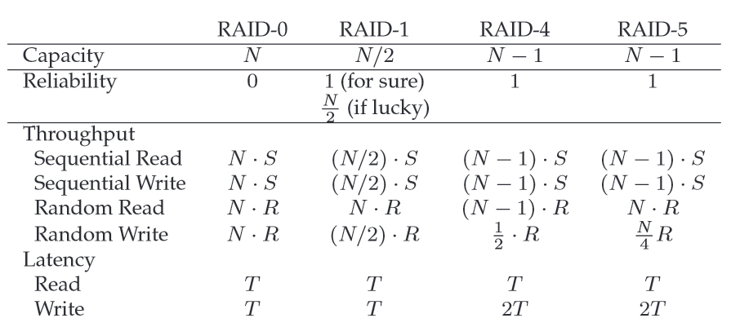

Slide 3
RAID-4: Analysis
What is capacity?
(N-1) * C
How many disks can fail? How to recovery?
1
Throughput?
???
Latency for one-op performance
T for read, ? for write

Slide 4
RAID-4 Write Operations
Sequential writes
A full-stripe write
Random writes
additive parity
subtractive parity

Slide 5
RAID-4: Throughput
Performance: what is steady-state throughput for
sequential reads
sequential writes
random reads
random writes
Knows as small writes
Latency for one-op performance
T for read, 2T+ for write
(N-1) * S
(N-1) * S
(N-1) * R
R/2 under subtractive parity
How to avoid parity bottleneck?

Slide 6
RAID-5
Disk 0 Disk 1 Disk 2 Disk 3 Disk 4
0 1 2 3 PA0
5 6 7 PA1 4
10 11 PA2 8 9
15 PA3 12 13 14
PA4 16 17 18 19

Slide 7
RAID-5: Analysis
What is capacity?
(N-1) * C
How many disks can fail?
1
Throughput?
???
Latency for one-op performance
T for read, 2T+ for write

Slide 8
RAID-5: Throughput
Performance: what is steady-state throughput for
sequential reads
sequential writes
random reads
random writes
(N-1) * S
(N-1) * S
N * R
N/4 * R

Slide 9
All RAID
 | Reliability | Capacity
RAID-0 | 0 | N
RAID-1 | 1 | N / 2
RAID-4 | 1 | N - 1
RAID-5 | 1 | N - 1

Slide 10
All RAID
 | Read Latency | Write Latency
RAID-0 | T | T
RAID-1 | T | T
RAID-4 | T | 2T
RAID-5 | T | 2T
RAID-5 can do more in parallel

Slide 11
All RAID
 | Seq R | Seq W | Rand R | Rand W
RAID-0 | N*S | N*S | N*R | N*R
RAID-1 | N/2 * S | N/2 * S | N*R | N/2 * R
RAID-4 | (N-1)*S | (N-1)*S | (N-1)*R | R/2
RAID-5 | (N-1)*S | (N-1)*S | N*R | N/4 * R
RAID-5 is strictly better than RAID-4
RAID-0 is always the fastest and has best capacity.
RAID-5 better than RAID-1 for sequential.
RAID-1 better than RAID-5 for random write.

Slide 13
Other Issues
RAID-2 and RAID-3
How to handle disk failures?
How to handle latent sector errors and block corruption?
Software RAID

Slide 14
Under RAID-4 with five disks:
Assume we must read blocks 0, 5, 10, and 15 as fast as we can. What is the flow of these blocks?
Assume we must read blocks 100, 109, 126, and 85 as fast as we can. What is the flow of these blocks?
Assume we must read blocks 0, 4, 8, and 12. What is the flow of these blocks?
Now assume we will be writing. Assume we must write block 5. What is the I/O flow?
Assume we must write blocks 5 and 10. What is the I/O flow?
Now assume that we changed from a RAID-4 to a RAID-5 system with rotating parity. How can we arrange the data and parity blocks across the disks so as to make the writes to 5 and 10 go as fast as possible? (draw a picture)
Notes:
(r0 r5 r10 r15)
(r100 r109 r126), (r85)
r0, r4, r8, r12 (or all at once in one big read)
(r5 rp1), (w5 wp1)
(r5 rp1), (r10 rp2), (w5 wp1), (w10 wp2)
5* 6 7 P1 4
11 10* P2* 8 9
15 P3 12 13 14
... (and so forth) ...
Allows the most parallelism across p0, 5, p2, and 10.

Slide 15
Data Integrity and Protection

Slide 16
Disk Failure Modes
Fail-stop as assumed by RAID
Silent faults:
Latent-sector errors (LSEs): a disk sector (or group of sectors) has been damaged in some way
Block corruption

Slide 17
Handling Latent Sector Errors
How to detect:
A storage system tries to access a block, and the disk returns an error
How to fix:
Use whatever redundancy mechanism it has to return the correct data

Slide 18
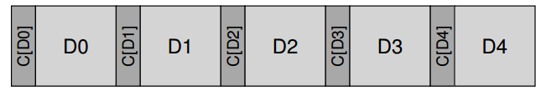
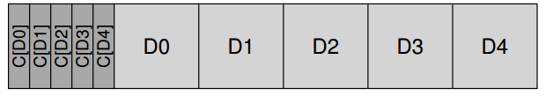
Detecting Corruption: The Checksum
Common Checksum Functions
XOR
Fletcher checksum
Cyclic redundancy check (CRC)
Collision is possible

Slide 19
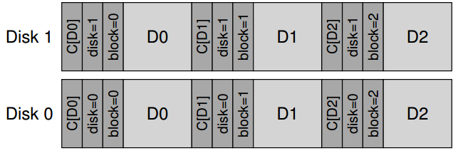
Misdirected Writes
Arises in disk and RAID controllers which write the data to disk correctly, except in the wrong location
Physical identifier (physical ID)

Slide 20
Lost Writes
Occur when the device informs the upper layer that a write has completed but in fact it never is persisted。
Do any of our strategies from above (e.g., basic checksums, or physical ID) help to detect lost writes?
Solutions:
Perform a write verify or read-after-write
Some systems add a checksum elsewhere in the system to detect lost writes.
ZFS includes a checksum in each file system inode and indirect block for every block included within a file

Slide 21
Scrubbing
When do these checksums actually get checked?
Many systems utilize disk scrubbing:
Periodically read through every block of the system
Check whether checksums are still valid
Schedule scans on a nightly or weekly basis

Slide 22
Overhead of Checksumming
Space
Small
Time
Noticeable
CPU overhead
I/O overhead

Slide 23
Next: LFS

Slide 24
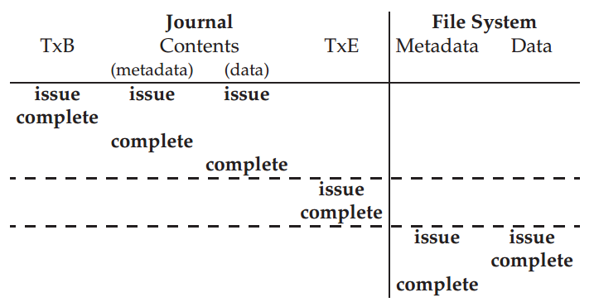
Data Journaling Timeline

Slide 25
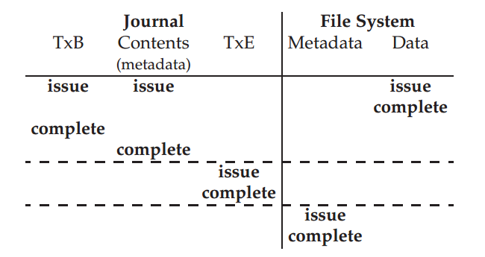
Metadata Journaling Timeline

Slide 26
Observations
Memory sizes are growing (so cache more reads).
Growing gap between sequential and random I/O performance.
Processor speeds increase at an exponential rate
Main memory sizes increase at an exponential rate
Disk capacities are improving rapidly
Disk access times have evolved much more slowly

Slide 27
Consequences
Larger memory sizes mean larger caches
Caches will capture most read accesses
Disk traffic will be dominated by writes
Caches can act as write buffers replacing many small writes by fewer bigger writes
Key issue is to increase disk write performance by eliminating seeks
Applications tend to become I/O bound, especially for workload dominated by small file accesses

Slide 28
Existing File System Problems
They spread information around the disk
I-nodes stored apart from data blocks
less than 5% of disk bandwidth is used to access new data
Use synchronous writes to update directories and i-nodes
Required for consistency
Less efficient than asynchronous writes
Metadata is written synchronously
Small file workload make synchronously metadata writes dominating

Slide 29
Performance Goal
Ideal: use disk purely sequentially.
Hard for reads -- why?
user might read files X and Y not near each other
Easy for writes -- why?
can do all writes near each other to empty space

Slide 30
LFS Strategy
Just write all data sequentially to new segments.
Never overwrite, even if that means we leave behind old copies.
Buffer writes until we have enough data.

Slide 31
Main advantages
Faster recovery after a crash
All blocks that were recently written are at the tail end of log
No need to check whole file system for inconsistencies
Small file performance can be improved
Just write everything together to the disk sequentially in a single disk write operation
Log structured file system converts many small synchronous random writes into large asynchronous sequential transfers.

Slide 32
Big Picture
Segments: S0, S1, S2, and S3
Buffer:
Disk:
S0
S1
S2
S3
S0
S1
S2
S3

Slide 33

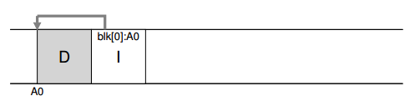
Writing To Disk Sequentially
Write both data blocks and metadata

Slide 34
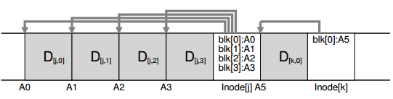
Writing To Disk Effectively
Batch writes into a segment

