Slide 1
Lecture 23 SSD

Slide 2
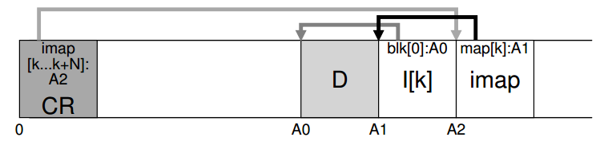
LFS review
Good for …?
Bad for …?
How to write in LFS?
How to read in LFS?

Slide 3
Garbage Collection in LFS
General operation: pick M segments, compact into N
Mechanism: how do we know whether data in segments is valid?
Is an inode the latest version?
Is a data block the latest version?
Policy: when and which segments to compact?

Slide 4
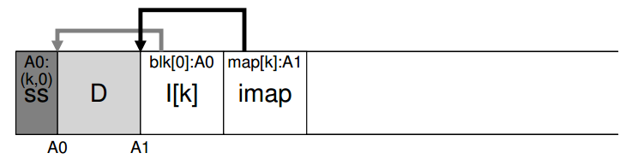
Determining Data Block Liveness

Slide 5
Crash Recovery
Start from the checkpoint
Checkpoint often: random I/O
Checkpoint rarely: recovery takes longer
LFS checkpoints every 30s
Crash on log writing
Crash on checkpoint region update

Slide 6
Metadata Journaling
1/2. Data write: Write data to final location; wait for completion (the wait is optional; see below for details).
1/2. Journal metadata write: Write the begin block and metadata to the log; wait for writes to complete.
3. Journal commit: Write the transaction commit block (containing TxE) to the log; wait for the write to complete; the transaction (including data) is now committed.
4. Checkpoint metadata: Write the contents of the metadata update to their final locations within the file system.
5. Free: Later, mark the transaction free in journal superblock

Slide 7
Checkpoint
In journaling
Write the contents of the update to their final locations within the file system.
In LFS
Checkpoint regions locate on a special fixed position on disk.
Checkpoint region contains the addresses of all imap blocks, current time, the address of the last segment written, etc.

Slide 8
Checkpoint Strategy
Have two checkpoints.
Only overwrite one at a time.
it first writes out a header (with timestamp)
then the body of the CR
finally one last block (also with a timestamp)
Use timestamps to identify the newest consistent one.
If the system crashes during a CR update, LFS can detect this by seeing an inconsistent pair of timestamps

Slide 9
Roll-forward
Scanning BEYOND the last checkpoint to recover max data
Use information from segment summary blocks for recovery
If found new inode in Segment Summary block -> update the inode map (read from checkpoint) -> new data block on the FS
Data blocks without new copy of inode => incomplete version on disk => ignored by FS
Adjusting utilization in the segment usage table to incorporate live data after roll-forward (utilization after checkpoint = 0 initially)
Adjusting utilization of deleted & overwritten segments
Restoring consistency between directory entries & inodes

Slide 10
Major Data Structures
Superblock: Holds static configuration information such as number of segments and segment size. - Fixed
inode: Locates blocks of file, holds protection bits, modify time, etc. Log
Indirect block: Locates blocks of large files. - Log
Inode map: Locates position of inode in log, holds time of last access plus version number version number. - Log
Segment summary: Identifies contents of segment (file number and offset for each block). - Log
Directory change log: Records directory operations to maintain consistency of reference counts in inodes. - Log
Segment usage table: Counts live bytes still left in segments, stores last write time for data in segments. - Log
Checkpoint region: Locates blocks of inode map and segment usage table, identifies last checkpoint in log. - Fixed

Slide 11
SSD

Slide 12
Flash-based Solid-state Storage Disk
A new form of persistent storage device
Unlike hard drives, it has no mechanical or moving parts
Unlike typical random-access memory, it retains information despite power loss
Unlike hard drives and like memory, random-access device
Basics:
To write a flash page, the flash block first needs to be erased
Wear out
…

Slide 13
Storing a Single Bit
Store one or more bits in a single transistor
single-level cell (SLC) flash, 1 or 0
multi-level cell (MLC) flash, 00, 01, 10, and 11
triple-level cell (TLC) flash, which encodes 3 bits per cell
SLC chips achieve higher performance and are more expensive

Slide 14
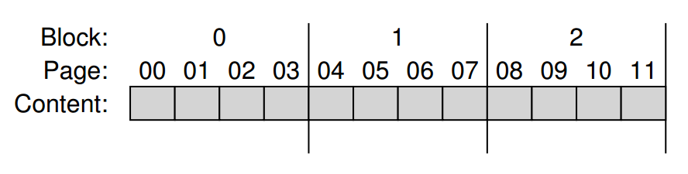
From Bits to Blocks and Pages
Flash chips are organized into banks or planes.
A bank is accessed in two different sized units:
Blocks (erase blocks): 128 KB or 256 KB
Pages: 4KB

Slide 15
Basic Flash Operations
Read (a page): a random access device.
Erase (a block):
Set each bit to the value 1
Quite expensive, taking a few milliseconds to complete
Program (a page):
Only if the block has been erased
Around 100s of microseconds - less expensive than erasing a block, but more costly than reading a page
Write is expensive, and frequent erase/program lead to wear out

Slide 16
4-page Block Status
Erase()
Program(0)
Program(0)
Program(1)
Erase()
iiii Initial: pages in block are invalid (i)
→ EEEE State of pages in block set to erased (E)
→ VEEE Program page 0; state set to valid (V)
→ error Cannot re-program page after programming
→ VVEE Program page 1
→ EEEE Contents erased; all pages programmable

Slide 17
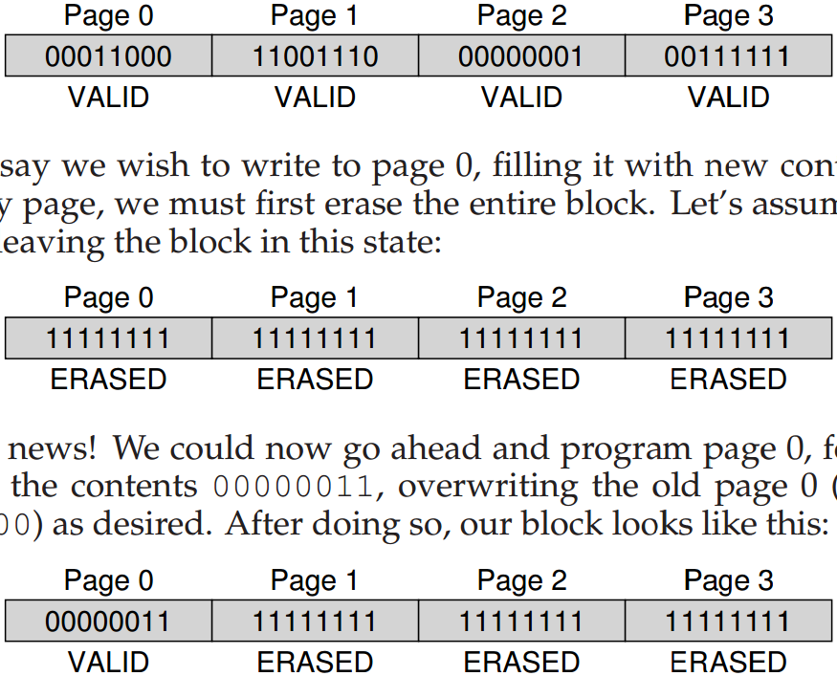
A Detailed Example

Slide 18
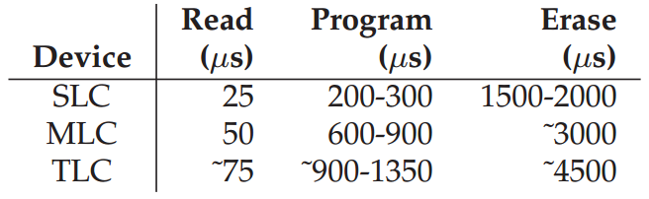
Flash Performance And Reliability
Raw Flash Performance Characteristics
The primary concern is wear out, as a little bit of extra charge is slowly accrued
Disturbance: when accessing (read/program) a particular page within a flash, it is possible that some bits get flipped in neighboring pages

Slide 19
Raw Flash → Flash-Based SSDs
The standard storage interface: lots of sectors
Inside SSD: flash chips, RAM for cache, and
flash translation layer (FTL) – control logic to turn client reads and writes into flash operations
FTL needs to reduce write amplification:
bytes issued to the flash chips by the FTL
divided by
bytes issued by the client to the SSD
FTL takes care of wear out - do wear leveling
FTL takes care of disturbance - access in order

Slide 20
A Bad Approach: Direct Mapped
logical page N is mapped directly to physical page N
Performance is bad
Uneven wear out
What might be a good approach?
Trying to improve write performance
Use the device circularly

Slide 21
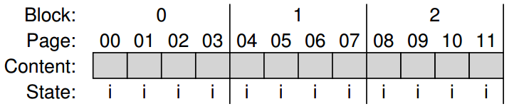
A Log-Structured FTL
Need to add a mapping table
Operations:
Write(100) with contents a1
Write(101) with contents a2
Write(2000) with contents b1
Write(2001) with contents b2

Slide 22
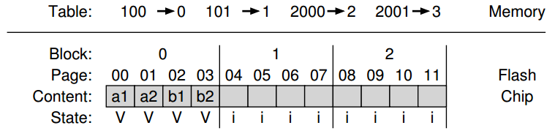
The resulting SSD
How to read?
Wear leveling: FTL now spreads writes across all pages

Slide 23
Keep FTL Mapping Persistent
Record some mapping information with each page
called an out-of-band (OOB) area
When the device looses power and is restarted
Scan OOB areas and reconstruct the mapping table is memory
Logging and checkpointing

Slide 24
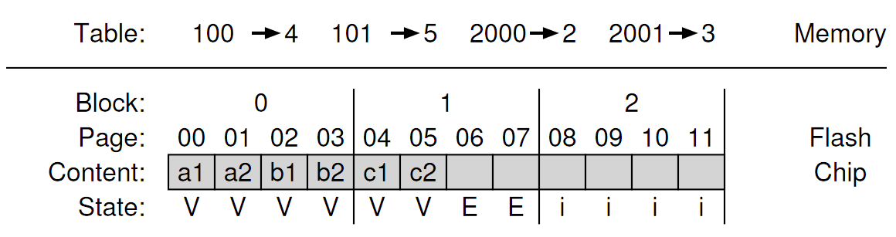
Garbage Collection
Garbage example
Determine liveness:
Within each block, store information about which logical blocks are stored within each page
Checking the mapping table for the logical block

Slide 25
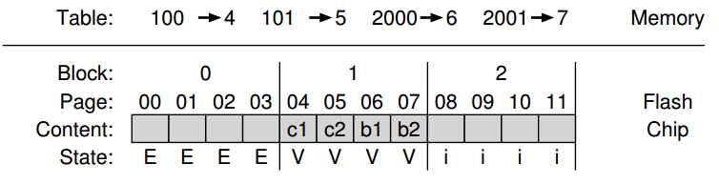
Garbage Collection Steps
Read live data (pages 2 and 3) from block 0
Write live data to end of the log
Erase block 0 (freeing it for later usage)

Slide 26
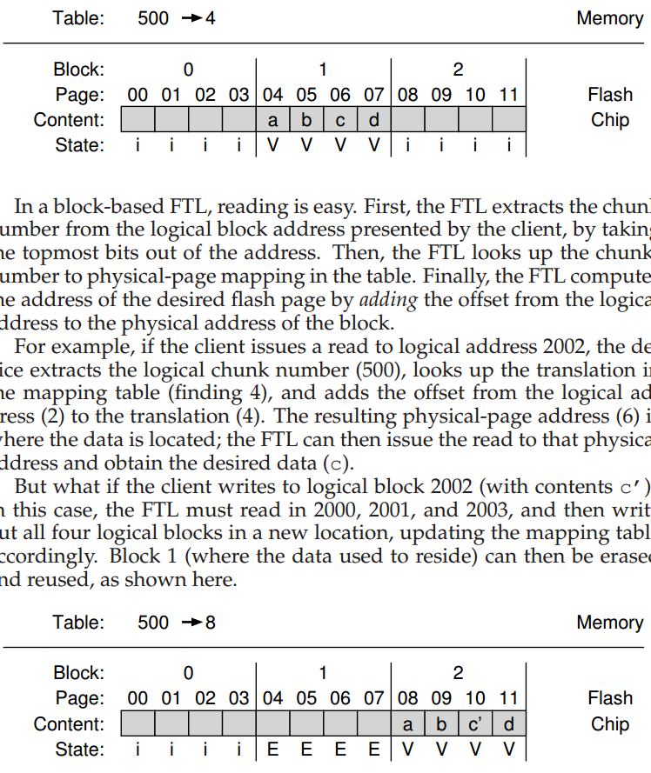
Block-Based Mapping to Reduce Mapping Table Size
Logical address: the least significant two bits as offset
Page mapping: 2000→4, 2001→5, 2002→6, 2003→7
Before
After

Slide 27
Problem with Block-Based Mapping
Small write
The FTL must read a large amount of live data from the old block and copy it into a new one
What might be a good solution?
Page-based mapping is good at …, but bad at …
Block-based mapping is bad at …, but good at …

Slide 28
Hybrid Mapping
Log blocks: a few blocks that are per-page mapped
Call the per-page mapping log table
Data blocks: blocks that are per-block mapped
Call the per-block mapping data table
How to read and write?
How to switch between per-page mapping and per-block mapping?

Slide 29
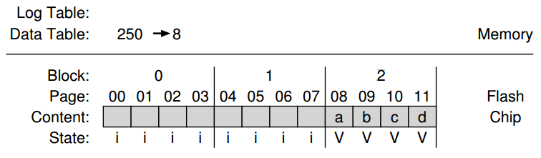
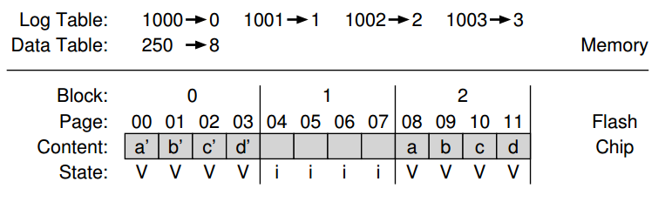
Hybrid Mapping Exmaple
Overwrite each page

Slide 30
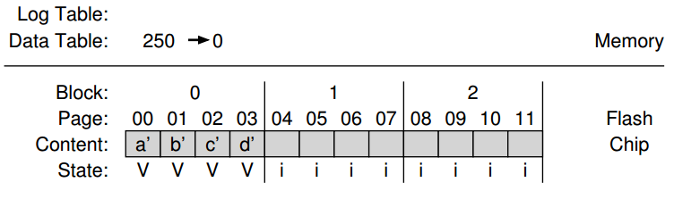
Switch Merge
Before and After

Slide 31
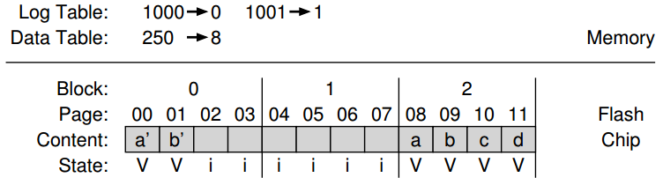
Partial Merge
Before and After

Slide 32
Full Merge
The FTL must pull together pages from many other blocks to perform cleaning
Imagine that pages 0, 4, 8, and 12 are written to log block A

Slide 33
Wear Leveling
The FTL should try its best to spread that work across all the blocks of the device evenly
The log-structuring approach does a good initial job
What if a block is filled with long-lived data that does not get over-written?
Periodically read all the live data out of such blocks and re-write it elsewhere

Slide 34
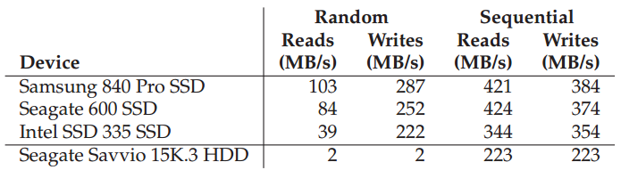
SSD Performance
Fast but expensive
An SSD costs 60 cents per GB
A typical hard drive costs 5 cents per GB

Slide 35
Next
RPC
NFS

