Slide 1
Lecture 24 Distributed Systems NFS

Slide 2
OSTEP Definition
Def: more than 1 machine
Examples:
client/server: web server and web client
cluster: page rank computation
Other courses
Networking
Distributed Systems

Slide 3
Why Go Distributed?
More compute power
More storage capacity
Fault tolerance
Data sharing

Slide 4
New Challenges
System failure: need to worry about partial failure.
Communication failure: links unreliable
Performance
Security

Slide 5
Communication
All communication is inherently unreliable.
Need to worry about:
bit errors
packet loss
node/link failure

Slide 6
Overview
Raw messages: UDP
Reliable messages: TCP
OS abstractions
virtual memory
global file system
Programming-languages abstractions
remote procedure call

Slide 7
Virtual Memory
Inspiration: threads share memory
Idea: processes on different machines share mem
Strategy:
a bit like swapping we saw before
instead of swap to disk, swap to other machine
sometimes multiple copies may be in memory on different machines

Slide 8
Virtual Memory Problems
What if a machine crashes?
mapping disappears in other machines
how to handle?
Performance?
when to prefetch?
loads/stores expected to be fast
DSM (distributed shared memory) not used today.

Slide 9
Global File System
Advantages
file access is already expected to be slow
use common API
no need to modify applications (sorta true)

Slide 10
RPC: Remote Procedure Call
What could be easier than calling a function?
Strategy: create wrappers so calling a function on another machine feels just like calling a local function.
This abstraction is very common in industry.

Slide 11
RPC
Machine A
int main(...) {
int x = foo();
}
// client wrapper
int foo(char *msg) {
send msg to B
recv msg from B
}
Machine B
int foo(char *msg) {
...
}
// server wrapper
void foo_listener() {
while(1) {
recv, call foo
}
}

Slide 12
RPC Tools
RPC packages help with this with two components.
(1) Stub generation
create wrappers automatically
(2) Runtime library
thread pool
socket listeners call functions on server

Slide 13
Conclusion
Many communication abstraction possible:
Raw messages (UDP)
Reliable messages (TCP)
Virtual memory (OS)
Global file system (OS)
Function calls (RPC)

Slide 14
Sun’s Network File System

Slide 15
NFS Architecture
client
client
RPC
RPC
File
Server
client
client
RPC
Local FS
RPC

Slide 16
Primary Goal
Local FS: processes on same machine access shared files.
Network FS: processes on different machines access shared files in same way.
sharing
centralized administration
security

Slide 17
Subgoals
Fast+simple crash recovery
both clients and file server may crash
Transparent access
can’t tell it’s over the network
normal UNIX semantics
Reasonable performance

Slide 18
Overview
Architecture
API
Write Buffering
Cache

Slide 19
NFS Architecture
client
client
RPC
RPC
File
Server
client
client
RPC
Local FS
RPC

Slide 20
Main Design Decisions
What functions to expose via RPC?
Think of NFS as more of a protocol than a particular file system.
Many companies have implemented NFS: Oracle/Sun, NetApp, EMC, IBM, etc

Slide 21
Today’s Lecture
We’re looking at NFSv2.
There is now an NFSv4 with many changes.
Why look at an old protocol?
To compare and contrast NFS with AFS.

Slide 22
General Strategy: Export FS
mount
Client
Server
read
read
Local FS
NFS
Local FS

Slide 23
Overview
Architecture
API
Write Buffering
Cache

Slide 24
Strategy 1
Wrap regular UNIX system calls using RPC.
open() on client calls open() on server.
open() on server returns fd back to client.
read(fd) on client calls read(fd) on server.
read(fd) on server returns data back to client.

Slide 25
Strategy 1 Problems
What about crashes?
int fd = open(“foo”, O_RDONLY);
read(fd, buf, MAX);
read(fd, buf, MAX);
…
read(fd, buf, MAX);
Imagine server crashes and reboots during reads…

Slide 26
Subgoals
Fast+simple crash recovery
both clients and file server may crash
Transparent access
can’t tell it’s over the network
normal UNIX semantics
Reasonable performance

Slide 27
Potential Solutions
Run some crash recovery protocol upon reboot.
complex
Persist fds on server disk.
what if client crashes instead?

Slide 28
Subgoals
Fast+simple crash recovery
both clients and file server may crash
Transparent access
can’t tell it’s over the network
normal UNIX semantics
Reasonable performance

Slide 29
Strategy 2: put all info in requests
Use “stateless” protocol!
server maintains no state about clients
server still keeps other state, of course
Need API change. One possibility: pread(char *path, buf, size, offset); pwrite(char *path, buf, size, offset);
Specify path and offset each time. Server need not remember. Pros/cons?
Too many path lookups.

Slide 30
Strategy 3: inode requests
inode = open(char *path);
pread(inode, buf, size, offset);
pwrite(inode, buf, size, offset);
This is pretty good! Any correctness problems?
What if file is deleted, and inode is reused?

Slide 31
Strategy 4: file handles
fh = open(char *path);
pread(fh, buf, size, offset);
pwrite(fh, buf, size, offset);
File Handle = <volume ID, inode #, generation #>

Slide 32
NFS Protocol Examples
NFSPROC_GETATTR expects: file handle; returns: attributes
NFSPROC_SETATTR expects: file handle, attributes; returns: nothing
NFSPROC_LOOKUP expects: directory file handle, name of file/directory to look up; returns: file handle
NFSPROC_READ expects: file handle, offset, count; returns: data, attributes
NFSPROC_WRITE expects: file handle, offset, count, data; returns: attributes

Slide 33
NFS Protocol Examples
NFSPROC_CREATE expects: directory file handle, name of file, attributes; returns: nothing
NFSPROC_REMOVE expects: directory file handle, name of file to be removed; returns: nothing
NFSPROC_MKDIR expects: directory file handle, name of directory, attributes; returns: file handle
NFSPROC_RMDIR expects: directory file handle, name of directory to be removed; returns: nothing
NFSPROC_READDIR expects: directory handle, count of bytes to read, cookie; returns: directory entries, cookie (to get more entries)

Slide 34
Client Logic
Build normal UNIX API on client side on top of the RPC-based API we have described.
Client open() creates a local fd object. It contains:
file handle
offset
Client tracks the state for file access
Mapping from fd to fh
Current file offset

Slide 35
File Descriptors
read(5,1024)
pread(fh, 123, 1024)
fd 5
fh=<…>
Off=123
local
RPC
local FS
local

Slide 36
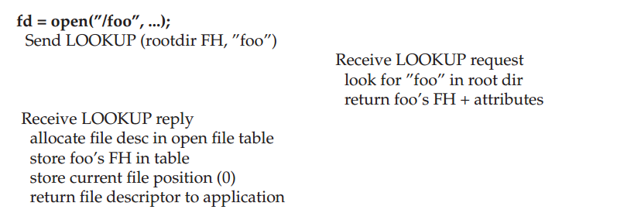
Reading A File: Client-side And File Server Actions

Slide 37
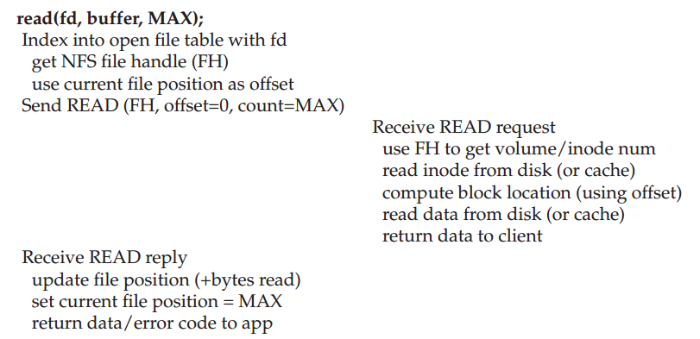
Reading A File: Client-side And File Server Actions

Slide 38
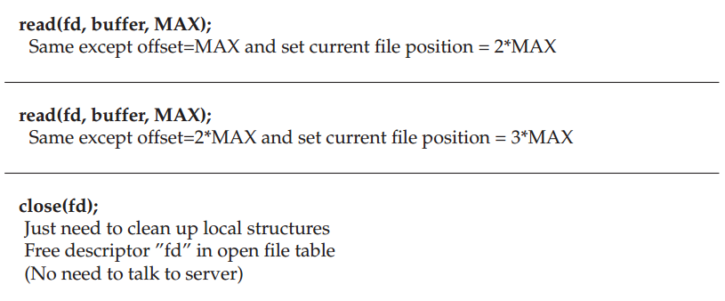
Reading A File: Client-side And File Server Actions

Slide 39
NFS Server Failure Handling
When a client does not receive a reply within a certain amount of time
Just retry

Slide 40
Append
fh = open(char *path);
pread(fh, buf, size, offset);
pwrite(fh, buf, size, offset);
append(fh, buf, size);
Would append() be a good idea?
Problem: if our client retries if no ACK or return, what happens when append is retried?

Slide 41
Idempotence
Idempotent
any sort of read
pwrite?
Not idempotent
append
What about these?
mkdir
creat

Slide 42
Subgoals
Fast+simple crash recovery
both clients and file server may crash
Transparent access
can’t tell it’s over the network
normal UNIX semantics
Reasonable performance

Slide 43
Overview
Architecture
Network API
Write Buffering
Cache

