Slide 1
Lecture 25 NFS & AFS

Slide 2
Communication Abstractions
Raw messages: UDP
Reliable messages: TCP
PL: RPC call
Make it close to normal local procedural call semantic
OS: global FS

Slide 3
NFS Architecture
client
client
RPC
RPC
File
Server
client
client
RPC
Local FS
RPC

Slide 4
Client Logic
Build normal UNIX API on client side on top of the RPC-based API we have described.
Client open() creates a local fd object. It contains:
file handle
offset
Client tracks the state for file access
Mapping from fd to fh
Current file offset

Slide 5
File Descriptors
read(5,1024)
pread(fh, 123, 1024)
fd 5
fh=<…>
Off=123
local
RPC
local FS
local

Slide 6
NFS Protocol Examples
NFSPROC_GETATTR expects: file handle; returns: attributes
NFSPROC_SETATTR expects: file handle, attributes; returns: nothing
NFSPROC_LOOKUP expects: directory file handle, name of file/directory to look up; returns: file handle
NFSPROC_READ expects: file handle, offset, count; returns: data, attributes
NFSPROC_WRITE expects: file handle, offset, count, data; returns: attributes

Slide 7
NFS Protocol Examples
NFSPROC_CREATE expects: directory file handle, name of file, attributes; returns: nothing
NFSPROC_REMOVE expects: directory file handle, name of file to be removed; returns: nothing
NFSPROC_MKDIR expects: directory file handle, name of directory, attributes; returns: file handle
NFSPROC_RMDIR expects: directory file handle, name of directory to be removed; returns: nothing
NFSPROC_READDIR expects: directory handle, count of bytes to read, cookie; returns: directory entries, cookie (to get more entries)

Slide 8
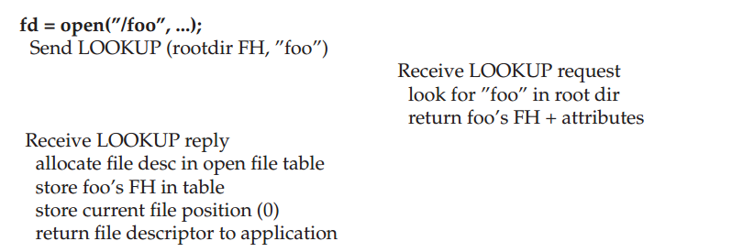
Reading A File: Client-side And File Server Actions

Slide 9
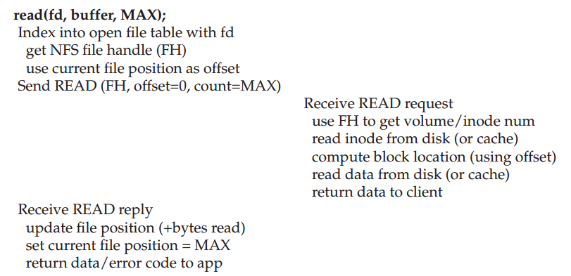
Reading A File: Client-side And File Server Actions

Slide 10
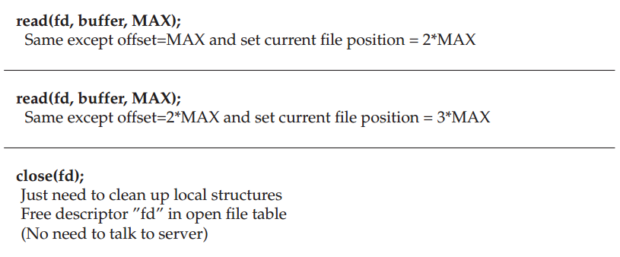
Reading A File: Client-side And File Server Actions

Slide 11
NFS Server Failure Handling
When a client does not receive a reply within a certain amount of time
Just retry if the operation is idempotent
Programmers need to be aware of non-idempotent ones

Slide 12
Write Buffers
Client
Server
write
NFS
write buffer
Local FS
write buffer
Local FS

Slide 13
What if server crashes?
Server Write Buffer Lost
client:
write A to 0
write B to 1 server mem
write C to 2
write X to 0 server disk
write Y to 1
write Z to 2
Can we get XBZ on the server?

Slide 14
Write Buffers on the Server Side
use server write buffer and return success on a WRITE until the write has been forced to disk
don’t use server write buffer
use persistent write buffer

Slide 15
Cache
We can cache data in different places, e.g.:
server memory
server disk
client memory
How to make sure all versions are in sync?

Slide 16
“Update Visibility” problem
server doesn’t have latest
Client
Server
Client
Local FS
Cache: A
NFS
Cache: A
Local FS
Cache: B
NFS
Cache: A
NFS
Cache: B
flush

Slide 17
Update Visibility Solution
A client may buffer a write.
How can server and other clients see it?
NFS solution: flush on fd close (not quite like UNIX)
Performance implication for short-lived files?

Slide 18
“Stale Cache” problem
client doesn’t have latest
Client
Server
Client
Local FS
Cache: B
NFS
Cache: A
NFS
Cache: B
NFS
Cache: B
read

Slide 19
Stale Cache Solution
A client may have a cached copy that is obsolete.
How can we get the latest?
If we weren’t trying to be stateless, server could push out update.
NFS solution: clients recheck if cache is current before using it.
Cache metadata records when data was fetched.
Before it is used, client does a GETATTR request to server: get’s last modified timestamp, compare to cache, and refetch if necessary

Slide 20
Measure then Build
NFS developers found stat accounted for 90% of server requests.
Why? Because clients frequently recheck cache.
Solution: cache results of GETATTR calls.
Why is this a terrible solution?
Also make the attribute cache entries expire after a given time (say 3 seconds).

Slide 21
Misc
VFS interface is introduced
Defines the operations that can be done on a file within a file system

Slide 22
Summary
Robust APIs are often:
stateless: servers don’t remember clients states
idempotent: doing things twice never hurts
Supporting existing specs is a lot harder than building from scratch!
Caching and write buffering is harder in distributed systems, especially with crashes.

Slide 23
Andrew File System
Main goal: scalability!
Many clients per server
Large number of clients
Client performance not as important
Central store for shared data, not diskless workstations
Consistency
Some model you can program against
Reliability
Need to handle client & server failures
Naming
Want global name space, not per-machine name space

Slide 24
AFS Design
NFS: export local FS
AFS: present big file tree, store across many machines
There are clear boundary between servers and clients (different from NFS)
Require local disk! No kernel modification

Slide 25
Prefetching
AFS paper notes: “the study by Ousterhout et al. has shown that most files in a 4.2BSD environment are read in their entirety.”
What are the implications for prefetching policy?
Aggressively prefetch whole files.

Slide 26
Whole-File Caching
Upon open, AFS fetches whole file (even if it’s huge), storing it in local memory or disk.
Upon close, whole file is flushed (if it was written).
Convenient:
AFS only needs to do work for open/close
reads/writes are local

Slide 27
AFS V1
open:
The client-side code intercepts open-system-call; decide it is local or remote
contact a server (through the full path string in AFS-1) in case of remote files
Server side: locate the file; send the whole file to client
Client side: take the whole file, put it in local disk, return a file-descriptor to user-level
read/write: on the client side copy if the file has not been modified
close: send the entire file and pathname to the server if the file has been modified

Slide 28
Measure then re-build
Evaluation performance: Andrew Benchmark used by many others
Make dir – create directory tree: stresses metadata
Copy – copy in files – stresses file writes / creates
Scan Dir (like ls –R) – stresses metadata reads
ReadAll – find . | wc – stresses whole file reads
Make – may be CPU bound, does lots of reads + fewer writes

Slide 29
Measure then re-build
Low scalability: performance got a lot worse (on clients) when # of clients goes up
QUESTION: what was bottleneck?
Server disk? Seek time? disk BW?
Server CPU?
Network?
Client CPU/Disk?
Main problems for AFSv1
The client issues too many TestAuth protocol messages
Path-traversal costs are too high
Too many processes
Load was not balanced

Slide 30
Outline
Cache management
Name resolution
Process structure
Volume management

Slide 31
Cache Consistency
Update visibility
Stale cache

Slide 32
“Update Visibility” problem
server doesn’t have latest
Client
Server
Client
Local FS
Cache: A
NFS
Cache: A
Local FS
Cache: B
NFS
Cache: A
NFS
Cache: B
flush

Slide 33
Update Visibility Solution
Clients updates not seen on servers yet.
NFS solution is flush blocks:
on close()
when low on memory
Problems
flushes not atomic (one block at a time)
two clients flush at once: mixed data

Slide 34
Update Visibility Solution
Clients updates not seen on servers yet.
AFS solution:
flush on close
buffer whole files on local disk
Concurrent writes? Last writer (i.e., closer) wins.
Never get mixed data.

Slide 35
“Stale Cache” problem
client doesn’t have latest
Client
Server
Client
Local FS
Cache: B
NFS
Cache: A
NFS
Cache: B
NFS
Cache: B
read

Slide 36
Stale Cache Solution
Clients have old version
NFS rechecks cache entries before using them, assuming a check hasn’t been done “recently”.
“Recent” is too long:
you read old data
“Recent” is too short:
server overloaded with stats

Slide 37
Stale Cache Solution
AFS solution: tell clients when data is overwritten.
When clients cache data, ask for “callback” from server.
No longer stateless!
Relaxed but well-defined consistency semantics
Get latest value on open
Changes visible on close
Read/write purely local – get local unix semantics

Slide 38
Why is this Inefficient?
Requests to server: fd1 = open(“/a/b/c/d/e/1.txt”) fd2 = open(“/a/b/c/d/e/2.txt”) fd3 = open(“/a/b/c/d/e/3.txt”)
Same inodes and dir entries repeatedly read.
Too much CPU, though.

Slide 39
Solution
Server returns dir entries to client.
Client caches entries, inodes.
Pro: partial traversal is the common case.
Con: first lookup requires many round trips.

Slide 40
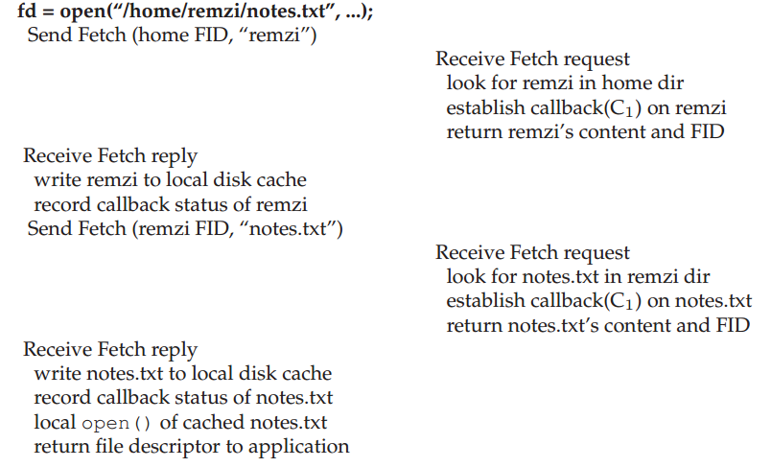
AFSv2 Reading a File

Slide 41
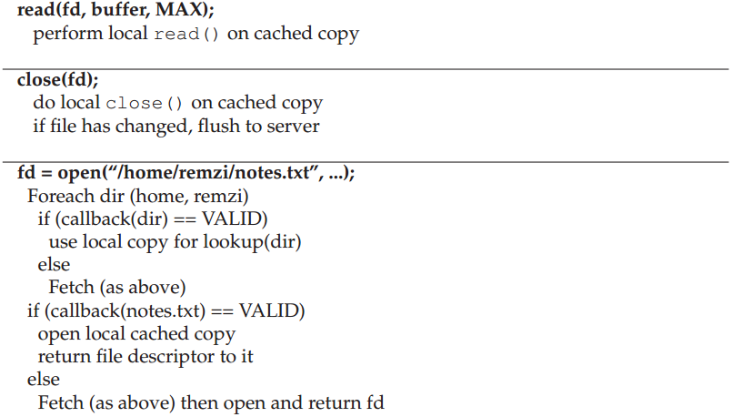
AFSv2 Reading a File

Slide 42
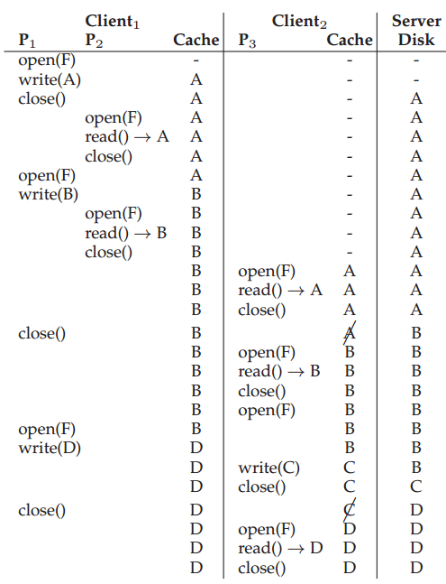

Slide 43
Callbacks
What if client crashes?
What if server runs out of memory?
What if server crashes?

Slide 44
Client Crash
What should client do after reboot?
Option 1:
evict everything from cache
Option 2:
recheck before using

Slide 45
Low Server Memory
Strategy: tell clients you are dropping their callback.
What should client do?
Mark entry for recheck.
How does server choose which entry to bump?
Sadly, it doesn’t know which is most useful.

Slide 46
Server Crashes
What if server crashes?
Option: tell everybody to recheck everything before next read.
Clients need to be aware of server crash
Option: persist callbacks.

Slide 47
Outline
Cache management
Name resolution
Process structure
Volume management

Slide 48
Process Structure
For each client, a different process ran on the server.
Context switching costs were high.
Solution:
use threads.

Slide 49
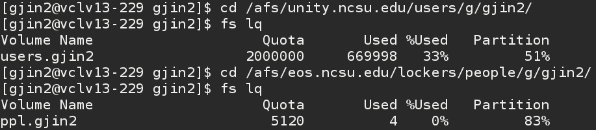
Volumes
AFS: presents big file tree, store across many machines
Break tree into “volumes.” i.e., partial sub trees.

Slide 50
Arch
A collection of servers store different volumes that together make up file tree.
Volumes may be moved by an administrator.
Client library gives seamless view of file tree by automatically finding write volumes.
Communication via RPC. Servers store data in local file systems.
Server
V1, V2
client
Server
V3, V4

Slide 51
Volume Glue
Volumes should be glued together into a seamless file tree.
Volume is a partial subtree.
Volume leaves may point to other volumes.

Slide 52
Volume Database
Given a volume name, how do we know what machine stores it?
Maintain volume database mapping volume name to locations.
Replicate to every server.
clients can ask any server they please

Slide 53
Volume Movement
What if we want to migrate a volume to another machine?
Steps:
copy data over
update volume database
AFS handles updates during movement

Slide 54
Other improvement
A true global namespace
Security
Flexible user-managed access control
System management tools

Slide 55
Scale And Performance Of AFSv2
AFSv2 was measured and found to be much more scalable that the original version
Client-side performance often came quite close to local performance

Slide 56
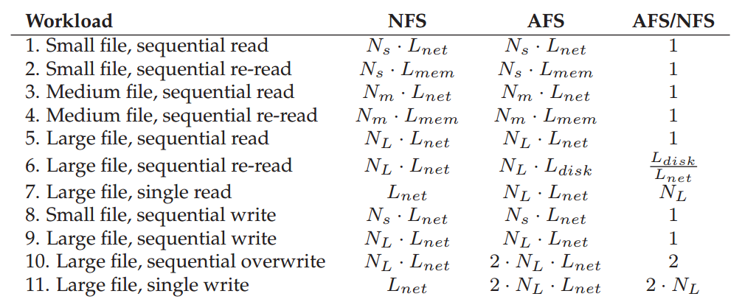
Comparison: AFS vs. NFS

Slide 57
Summary
Workload drives design: whole-file caching.
State is useful for scalability, but makes consistency hard.
Multi-step copy and forwarding make volume migration fast and consistent.

