Slide 1
BIOM 7110/8110 BIOSTATISTICS
Erno Lindner, Ph.D.
(elindner@memphis.edu)
Amber Jennings, Ph.D. (jjnnings@memphis.edu)
M,W: 8:40-10:05

Slide 2
Random sample
Simple random sample
Stratified random sample – divide into groups
Two goals: Obtain descriptive information about the population from which a sample was drawn
Test a hypothesis about the population
Bias:
systematic difference between the characteristics of members of the sample and the population (purposeful/accidental)
inappropriate groups (comp. conventional and new therapy)
erroneous measuring device
- investigator (blinded tests) /patient (placebo)/double blinded test

Slide 3
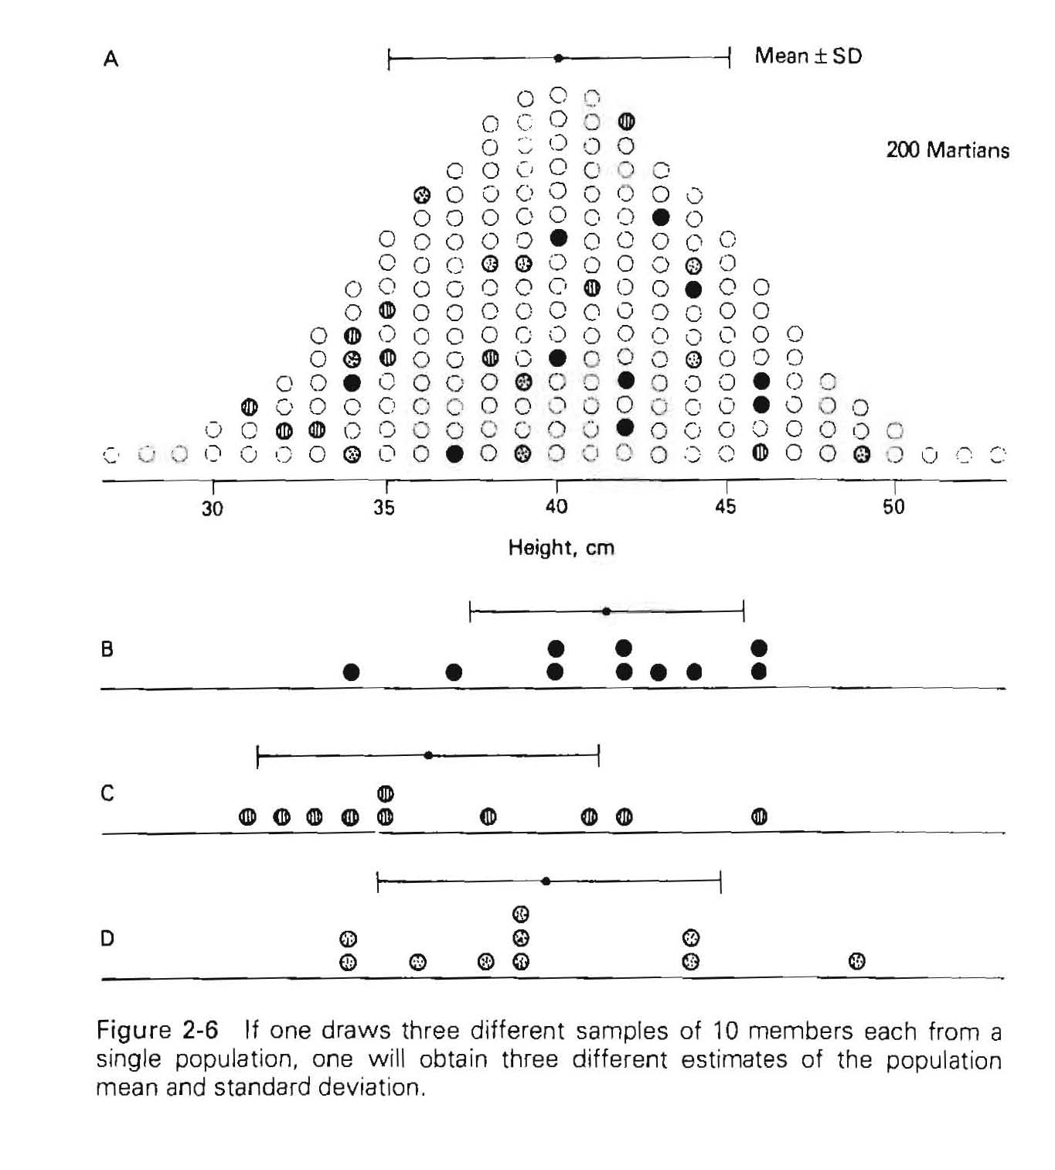
How good are our estimates?
The standard error of the mean
The certainty of the computed mean from the random samples
How accurate are these estimates
Mean±S.D.
μ=40; σ=5
x=41.5; s=3.8
x=36.0; s=5.0
x=40.0; s=5.0
What are the all possible sample means of 10 Martians?

Slide 4
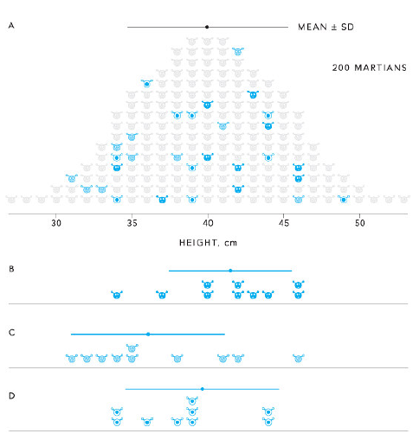


μ=40
1- Roughly bell shaped
2- Appears to be normally distributed
σ=5
When the variable of interest is the sum of many independent variables, its distribution tends to be normal, regardless of the distributions of the variables used to form the sum
If the sample were drown from a normally distributed population the distribution of the sample means will be normal regardless of the sample size.
i.e., it makes sense to describe the population of the means with their mean and standard deviation
25 random samples of 10
From 10¹⁶ possibilities
${\overline{x}}_{\overline{x}}$=40 cm and $σ_{\overline{x}}$=1.6 cm

Slide 5
25 random samples of 10
From 10¹⁶ possibilities
The distribution of means are ~ normal
The mean of the means ≡ population mean
The s.d. of the means (the standard error of the mean) is a function of the population s.d. and the size of the sample (n)
Quite remarkable agreement between
But
variability of the mean
measure of the sample means
Standard Error of the Mean (SEM)

Slide 6
Test for differences between groups Test of a scientific hypothesis The statistical technique to perform such test: TEST OF SIGNIFICANCE – THE P VALUE Test the hypothesis that different treatments all affect some variable identically, e.g., diet has no effect on cardiac output – null hypothesis Generalized to data collected in any number of treatments – ANALYSIS OF VARIANCE

Slide 7
EXAMPLE:
Population of 200 healthy adults Randomly select four groups with seven people
Sign informed consent
Group I (Control) eat normal
Group II eat only spaghetti
Group III eat only steak
Group IV eat only fruits and nuts
After one months: measure cardiac output
Assumption:
All treatment has the same effect
With control group Ξ treatment has no effect

Slide 8
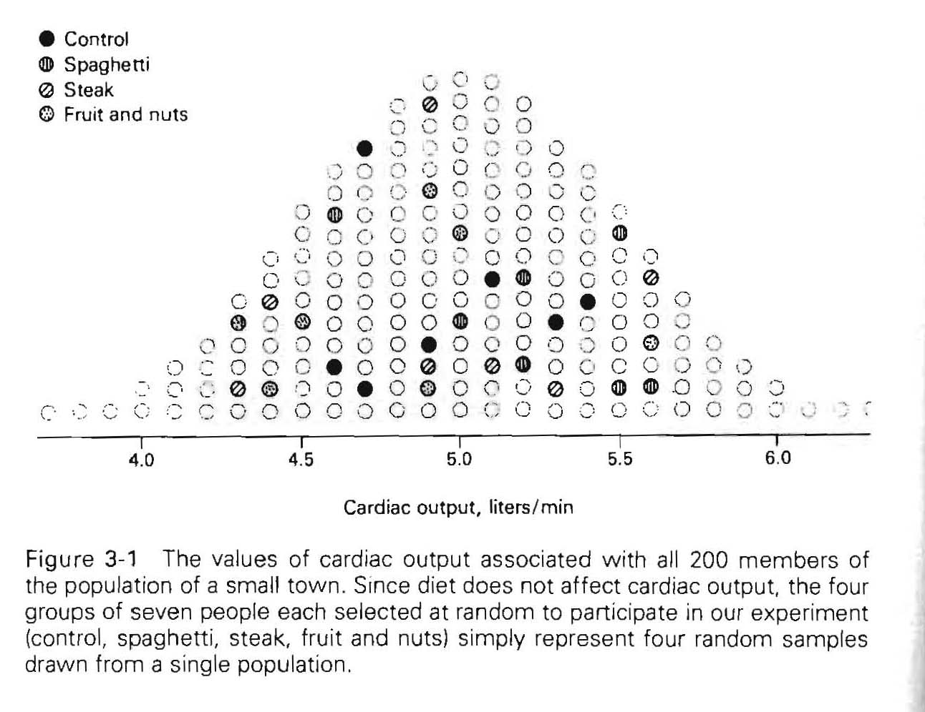
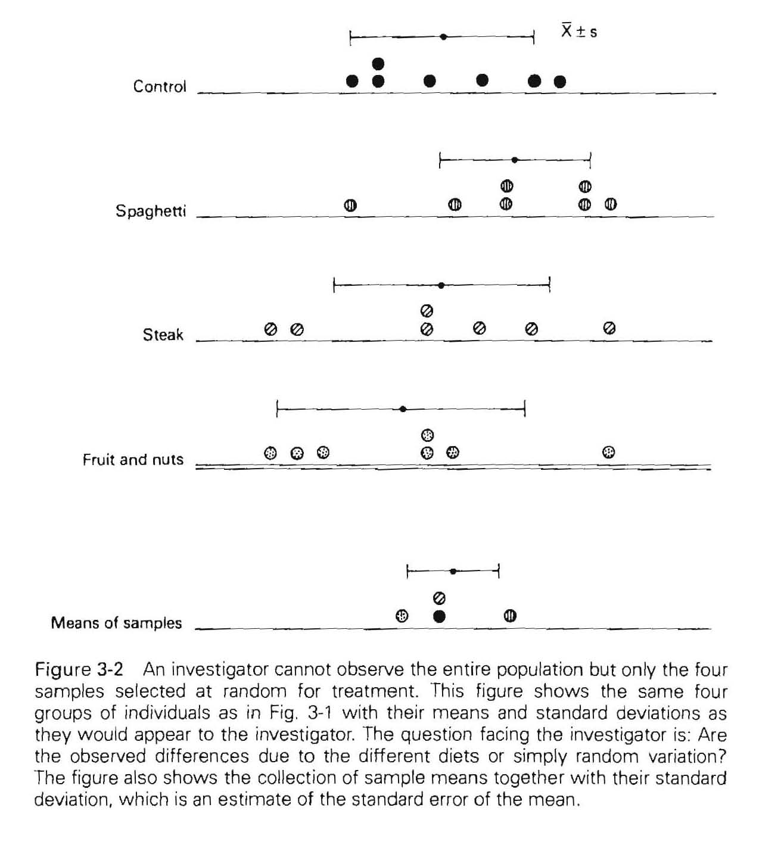
Are these differences reflections to random variations in cardiac output?

Slide 9
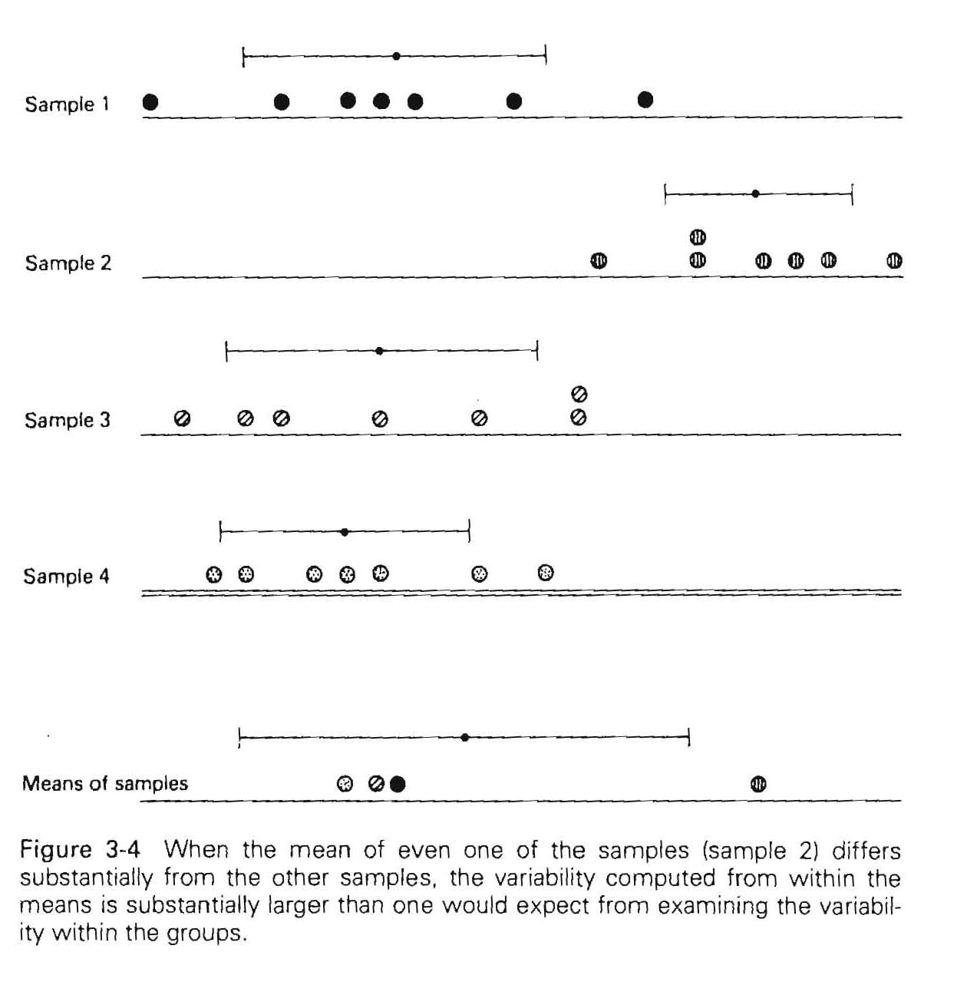
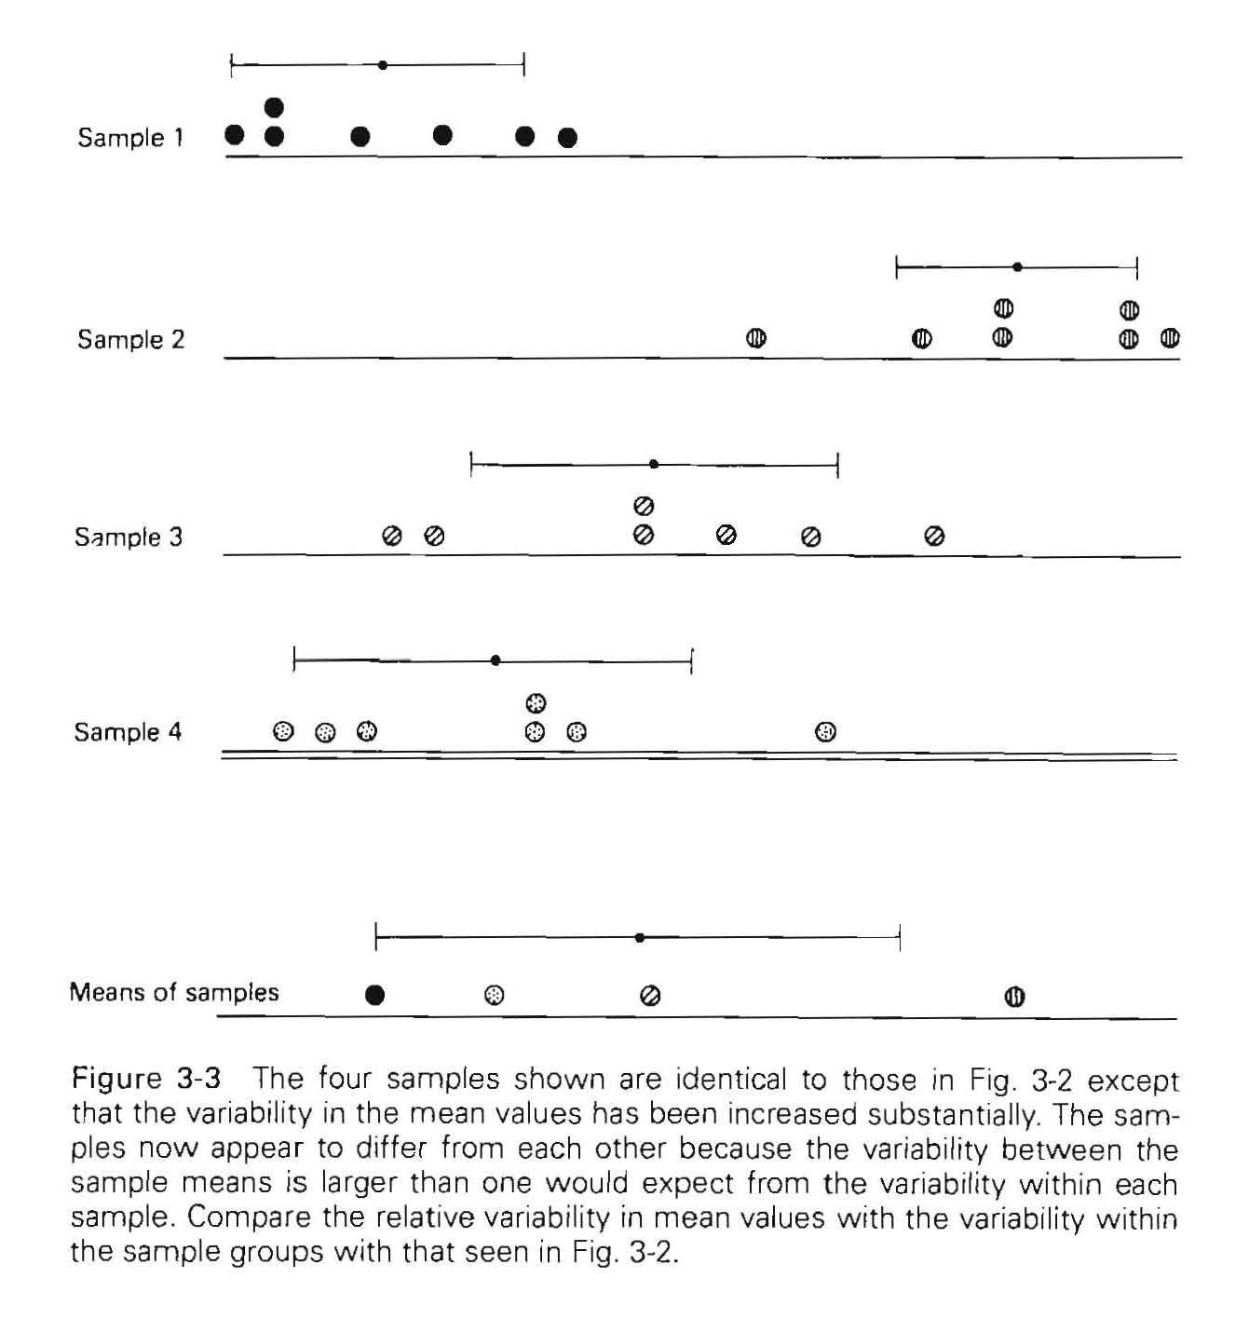
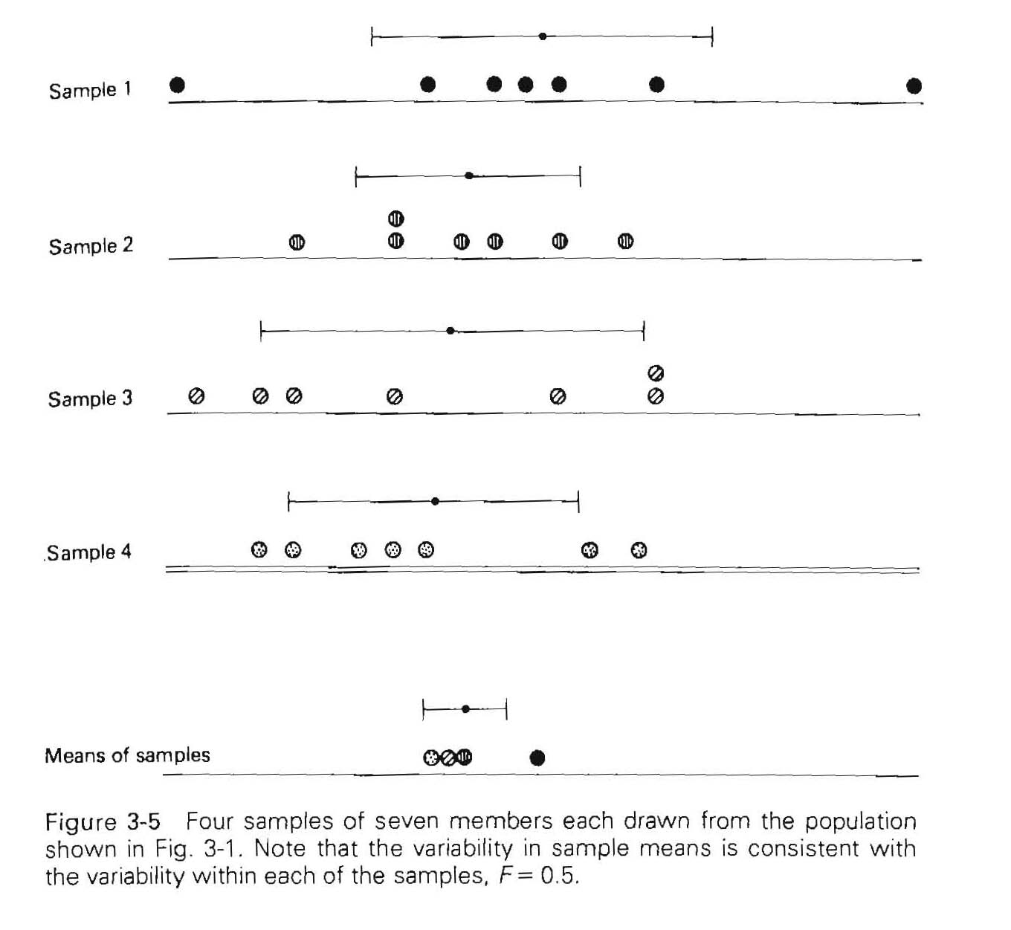
Variability
s.d. or
variance
What makes us believe that the different samples drawn from the same or different populations?
The variability within the samples are similar
The variability of the means are consistent

Slide 10
Variability
s.d. or
variance
The variability of the means is much larger than one would expect from the variability in each sample!
Independent whether all or only one appear to differ from the others

Slide 11
Parametric statistical method: mean and s.d. is adequate to describe the distribution of a population – use these parameters instead of the raw data
Test our hypothesis based on the variability within individual samples and the variability between the means
s.d. or (s.d.)² variance is a good measure of the variability
Non-parametric methods are used when the data do not follow normal distribution. Based on frequencies, ranks, percentiles.
Do not require the normality assumption.

Slide 12
Analysis of variance
Estimate the population variance in two ways:
Computed from the variance of each sample group as an estimate for the entire population (not effected by the means)
Computed from the variance of the means of the individual groups (differences in the means will obviously effect)
If the hypothesis is correct (diet had no effect) these two variances should be very similar .
If the two variances are very similar we conclude that samples were from the same population – hypothesis correct
If the variances are very different we reject the hypothesis and conclude that the samples were from different populations

Slide 13
Two different estimates of the population variance
1: average of variances (within treatment groups)
not effected by the means, i.e., whether diet has or has not effect
2: from the sample means (between treatment groups)
if from the same population the standard deviation of the means will approximate the standard error of the mean

Slide 14
If the hypothesis is correct these two variances should be very similar We calculate the ratio of the two:

Slide 15

For this example F ≈ 1.4
4.5
5.0
5.5
This finding is NOT inconsistent with the null hypothesis, i.e., that diet has NO effect on cardiac output
(s.d._{with})²≈0.35²=0.12
$$s_{bet}^{2}=ns_{\overline{x}}^{2}$$
(s.d._{betw})²≈7 x 0.15²=0.17
F≈0.17/0.12 = 1.4

Slide 16
Rule:
If F is a big number, the variability between the sample means is larger than expected from the variability within the samples, so reject the null hypothesis that the samples were drawn from the same population

Slide 17
This is the logic in claiming that samples in Fig. 3.3 and Fig. 3.4 were drawn from different populations
F≈1.4
F≈0.5

Slide 18
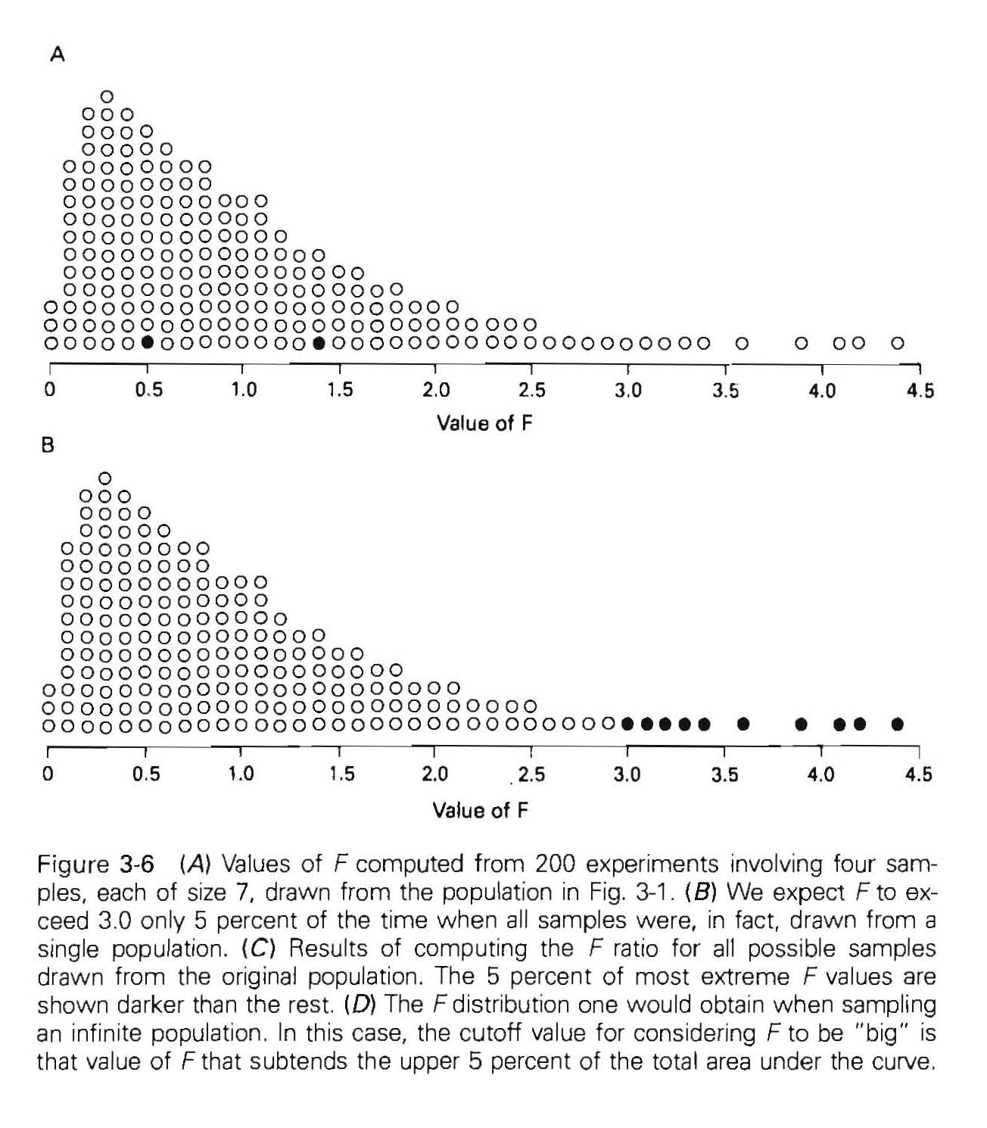
What is a big F ?
Experiment performed 200 times
Fig. 3.5
Fig. 3.2
Bad luck (only 10 are larger than 3)
F=0.5
F is big if larger than 3 (5%)
Each time different F
F is big when > 3
10 from 200 or 5%
Most F’s around 1 (between 0 and 2)

Slide 19
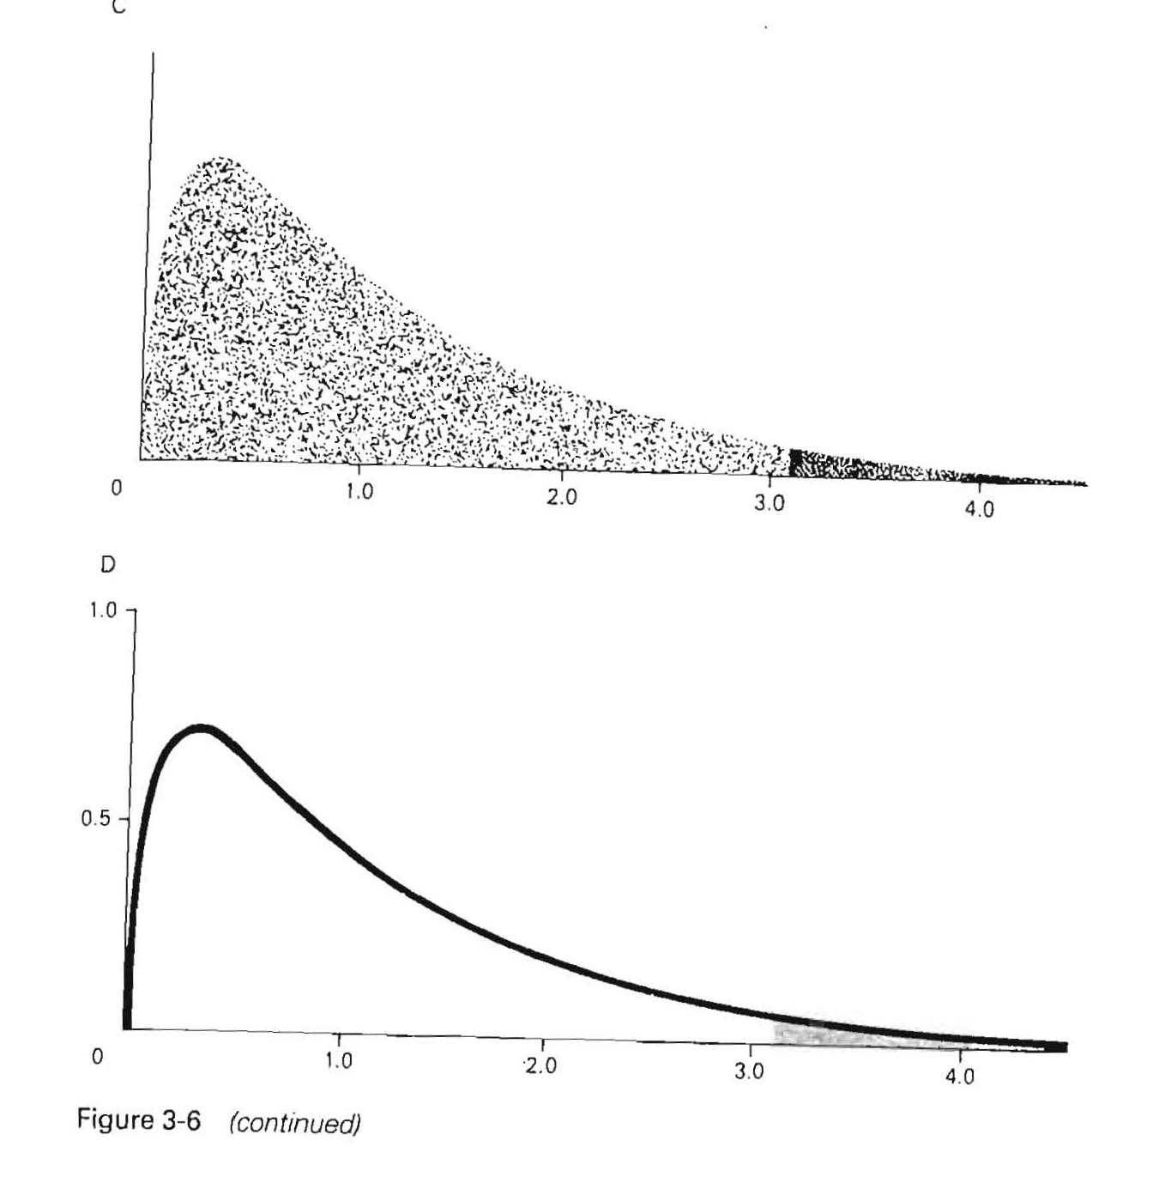
F is big if larger than 3 (5%)
Reject the null hypothesis that all means are the same and report P<0.05:
there is less than 5 % chance of getting a value as big or bigger if the original hypothesis were true
Distribution of F values
From a population of 200 - 10⁴² possibilities
5 %
Populations larger than 200 much more than 10⁴² possibilities

Slide 20
This is the logic in claiming that samples in Fig. 3.3 and Fig. 3.4 were drawn from different populations
F≈68
F≈24.5

Slide 21
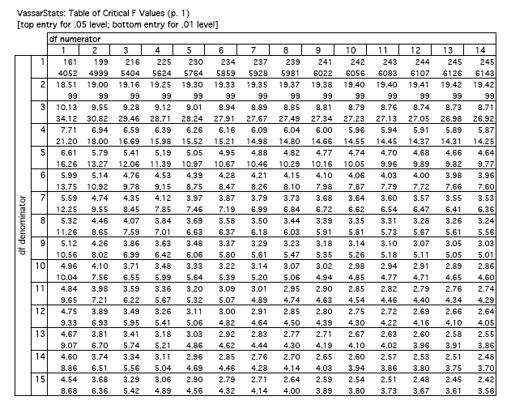
Cutoff values for F different numbers of groups and sample sizes
Table 3.1.
p. 54
d.f. (ν )
(ν_{num.})=m-1
ν_{num}=4-1=3
(ν_{den})=m(n-1)
ν_{den}=4(7-1)=24
m: number of
groups
n: number of
samples

Slide 22
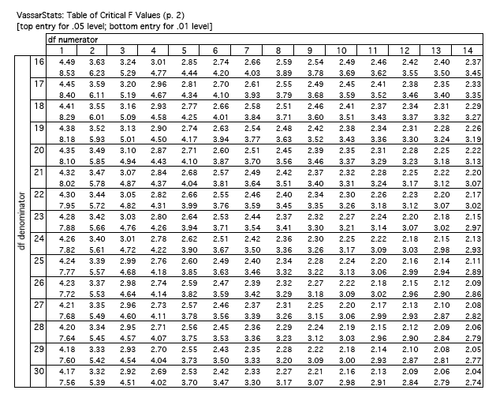
d.f. (ν )
(ν_{num.})=m-1
ν_{num}=4-1=3
(ν_{den})=m(n-1)
ν_{den}=4(7-1)=24

Slide 23
Assumptions to construct the table:
Each sample independent
Each is randomly selected from the population studied
The populations were normally distributed
The variances of each population are the same even when the means are different
If the assumptions do not apply should not be used
Single factor or one way of analysis of variance – ANOVA (one experimental factor, diet)

Slide 24
The distribution of F function and its 5 % cutoff depends on
# of samples (m) – 4
size of the sample (n) – 7
This dependence enters into the mathematical formulas used to calculate the critical value of F (when it gets “big”) as parameters known as
Degrees of freedom (ν )
Between groups (ν_{numerator}) ν_{n}=m-1
Within groups (ν_{denominator}) ν_{d}=m(n-1)

Slide 25
ν_{n}=m-1=4-1=3
ν_{d}=m(n-1)=4(7-1)=24

Slide 26
ANOVA assumes
same number of members in each group
same standard deviations/variances in each population, i.e., before using the test you must test for the equal variances

Slide 27
Example-1 – observational study: DIABETES RUNS IN FAMILIES (Type I and Type II): - Type I: Insulin dependent (Children, young adults) - Type II: Insulin independent (Over 40) – elevated glucose levels Can we detect abnormalities in carbohydrate metabolism non-diabetic young adults whose parents had a history of type II diabetes? Identified parents in Louisiana with history of diabetes from survey of school children - recruited children (cases) Control – offspring of similarly aged parents without history of diabetes Measured several physiologically important parameters that might be related to diabetes carbohydrate tolerance (fasting glucose, insulin….) blood pressure, cholesterol etc.

Slide 28
Observational studies (Observing without controlling): Advantages:
- relatively inexpensive – data available
- does not require intervention
- ethical issues
Potential problems:
- confounding variables - bias (e.g., the selected groups vary in ways which were neglected,
patient recall, investigator’s assessment, and selection of treatment and control groups, etc.)
Classification criteria is critical (explicitly specify subject and control)!
- Parental history (verified by physician) – to exclude type I diabetes - No children were included when both parents were diabetics
- Cases and control were similar ages (15.3±4.5; 15.1±5.7)
- All white parents
- Control ages matched, no grandparents, uncles, ants with diabetes

Slide 29
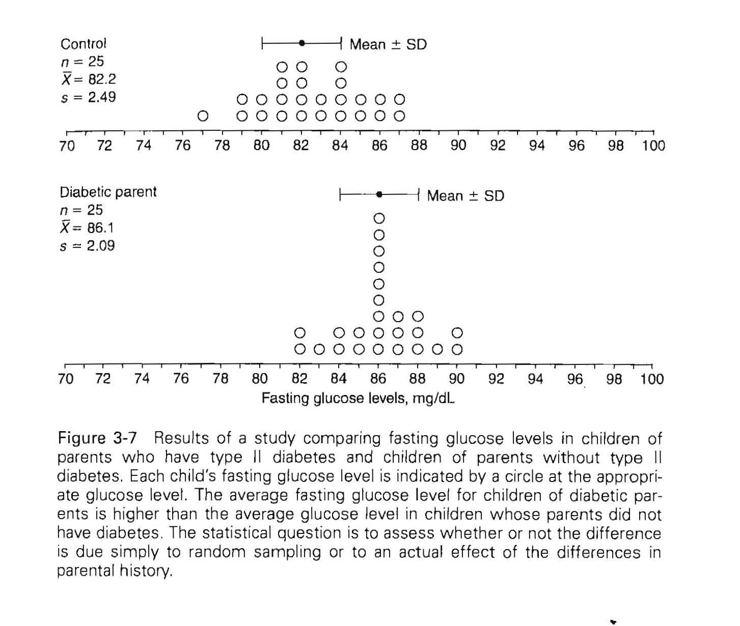
Example-1: same number of members in each group (confounding parameters similar: e.g., smoking, drinking, oral contraceptives etc.)
Fasting glucose levels:
H_{o}: no difference
(The fasting glucose levels are the same in children with parents having diabetes II compared to children with parents without diabetes)
How likely is that the experimental difference is related only to random sampling?
To answer:
ANOVA
Control: 82.2 ±2.49
Cases: 86.1±2.09 mg/L

Slide 30
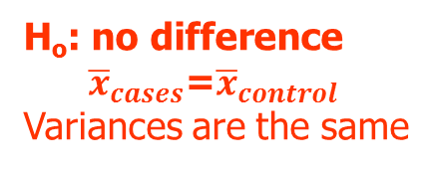
Example-1: same number of members in each group (confounding parameters similar: e.g., smoking, drinking, oral contraceptives etc.)
Fasting glucose levels:
Assumption:
H_{o}: no difference
${\overline{x}}_{cases}$=${\overline{x}}_{control}$
Variances are the same
Control: 82.2 ±2.49
Cases: 86.1±2.09 mg/L
F_{crit}(0.05)=4.04
F_{crit}(0.01)=7.19

Slide 31
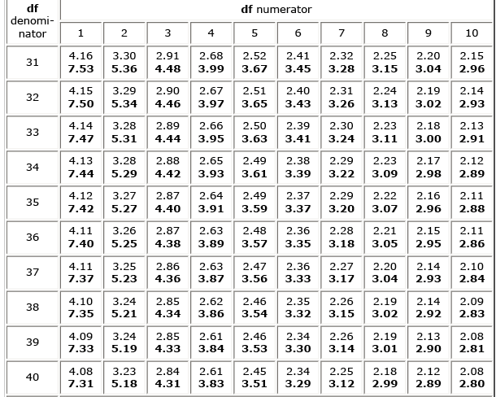
Table 3-1 Rritical F values at 0.05 and 0.01 (bold) leves
F_{calc} = 36.01

Slide 32

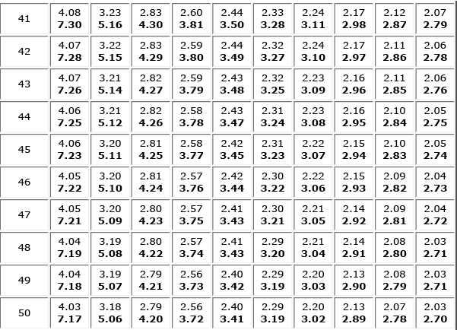
F_{calc} = 36.01
F is BIG
Excel:
F_{crit}=
FINV(0.05,1,48)=
4.04
F.INV.RT(0.05,1,48)=4.0426
P_{F=36.01}= FDIST(X,df1,df2)=
FDIST(36.01,1,48)=
2.5x10⁻⁷
F.DIST.RT(36.01,1,48)=
2.5x10⁻⁷
Reject the
Hypothesis that there is NO difference or NO effect
There is higher fasting glucose levels in children with parental history of type II diabetes

Slide 33
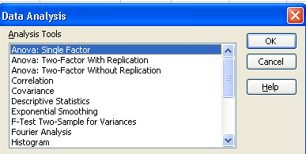
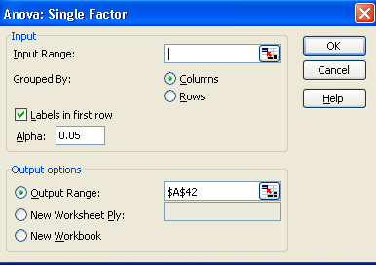
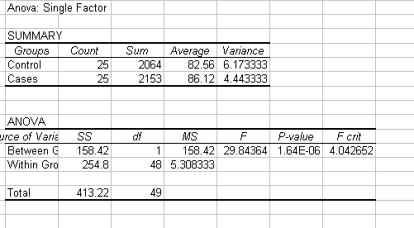
Control | Cases
77 | 82
79 | 82
79 | 83
80 | 84
80 | 84
81 | 85
81 | 85
81 | 86
81 | 86
82 | 86
82 | 86
82 | 86
82 | 86
83 | 86
83 | 86
84 | 86
84 | 87
84 | 87
84 | 87
85 | 88
85 | 88
86 | 88
86 | 89
87 | 90
87 | 90
Data analysis in Excel
P value:
FDIST(29.84,1,48)=
1.64∙10⁻⁶
F.DIST.RT(29.84,1,48)
F crit:
FINV(0.05,1,48)=
4.0426
F.INV.RT(0.05,1,48)=4.0426
82.6 | 86.12 | average
2.6 | 2.1 | SD

Slide 34
Example-2: HALOTHANE VS MORPHINE FOR OPEN HEART SURGERY HALOTHANE: Popular drug for general anesthesia (potent, non-flammable, safe, can be used with the same equipment to ventilate the patient) but lessens the heart ability to pump blood – depressing the myocardium – increasing the peripheral venous capacity It was believed to contribute to complications in people with cardiac problems, and the use of morphine was suggested – it has little effect on cardiac performance Compared during heart valve surgery Selected the used anesthesia random who was suitable During the operation they recorded a number of hemodynamic variables e.g., blood pressure before anesthesia, after anesthesia but before incision and during the operation and other parameters (recovery time, death, etc.) Evaluated the representative pressure: lowest mean arterial blood pressure between start of anesthesia and incision – measure of depression

Slide 35
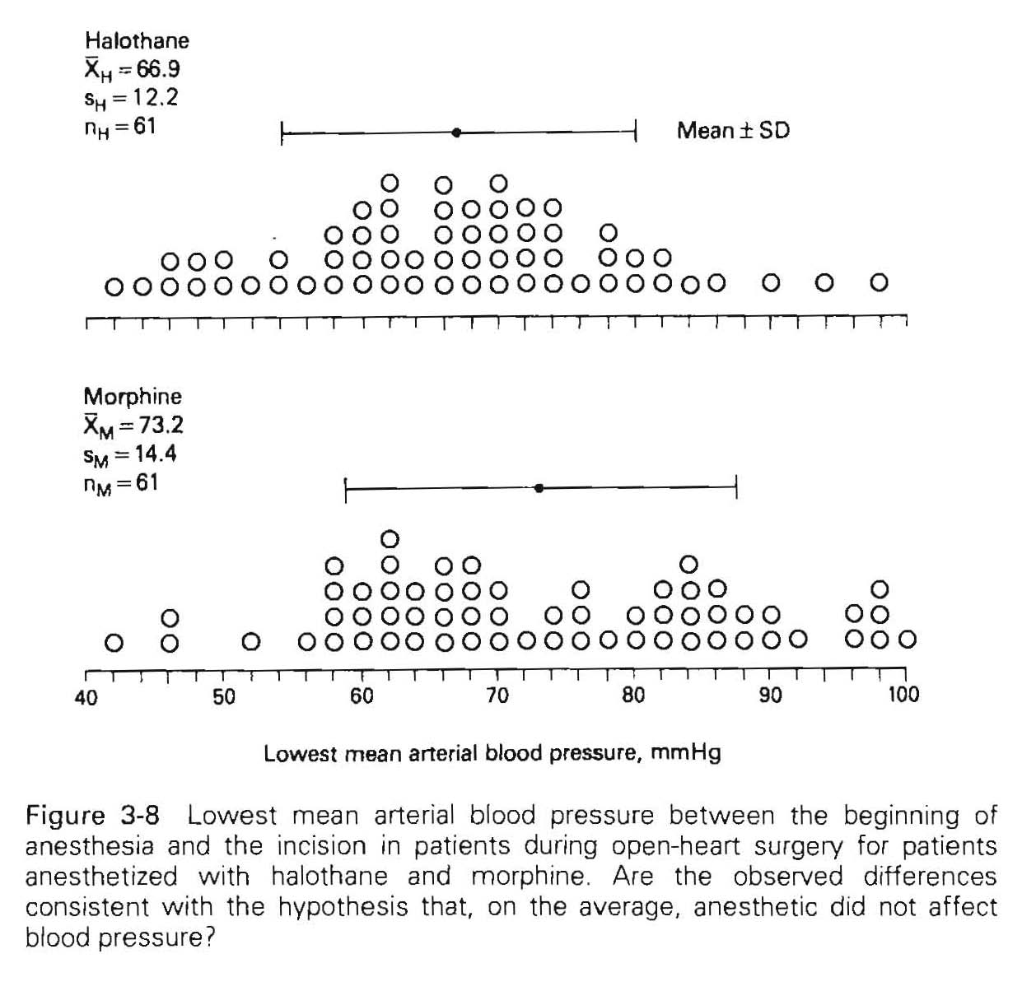


Example-2:
Is a pressure difference of Δ=6.3 mmHg
related to the difference in the anesthetic agents or related to random sampling with standard deviations ranging between 12.2 and 14.4?
Assumption:${ s}_{H}^{2}=s_{M}^{2}$
Quite big overlap between the results
Null hypothesis: There is NO difference between the lowest mean arterial blood pressure, a measure of the hearts ability to pump blood if the anesthesia is made by Halothane or morphine
n=61
Halothane: 66.9 ±12.2 mmHg
n=61
Morphine: 73.2 ±14.4 mmHg
F_{crit}(0.05)=4.04
F_{crit}(0.01)=7.19
F_{crit}(0.05)=3.92
F_{crit}(0.01)=6.85

Slide 36
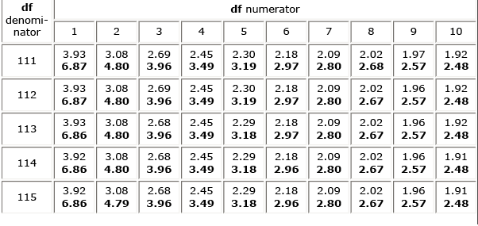
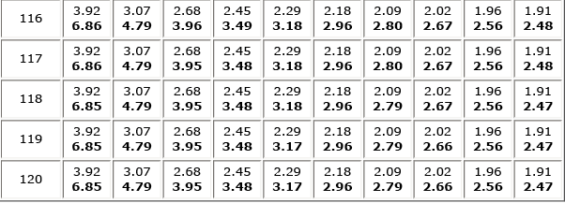
EXCEL:
FDIST(x,df₁,df₂)= FDIST(6.81,1,60)= 0.0114 (1.14 %)
F_{calc} = 6.81
F is BIG
Reject the
Null hypothesis that there is NO difference
Halothane produced lower lowest mean arterial pressure than morphine on average
Is this statistically significant difference clinically significant?

Slide 37
Example-3: MENSTRUAL DYSFUNCTION IN DISTANT RUNNERS Infrequent, suspended menstruation can be symptom of metabolic disorders, e.g., anorexia, or tumors frustrate woman who wish to be pregnant side effect of birth control pills How to diagnose/treat? Is it related to heavy exercises/body fat? Study the frequency of menstruation by joggers, runners (effect on weight, body fat, concentration of hormones etc.) Observational study with three groups: Joggers (5-30 miles/week) Runners (More than 30 miles/week CONTROL: woman who did not run The three groups were similar in all other aspects, e.g., ages, heights, occupation, birth control, other physical activity

Slide 38
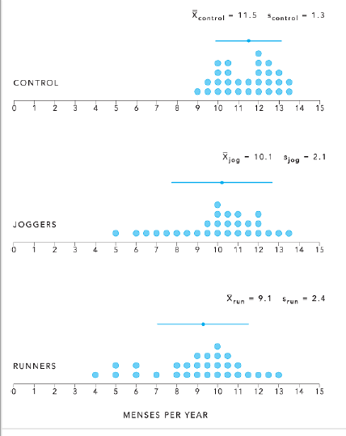
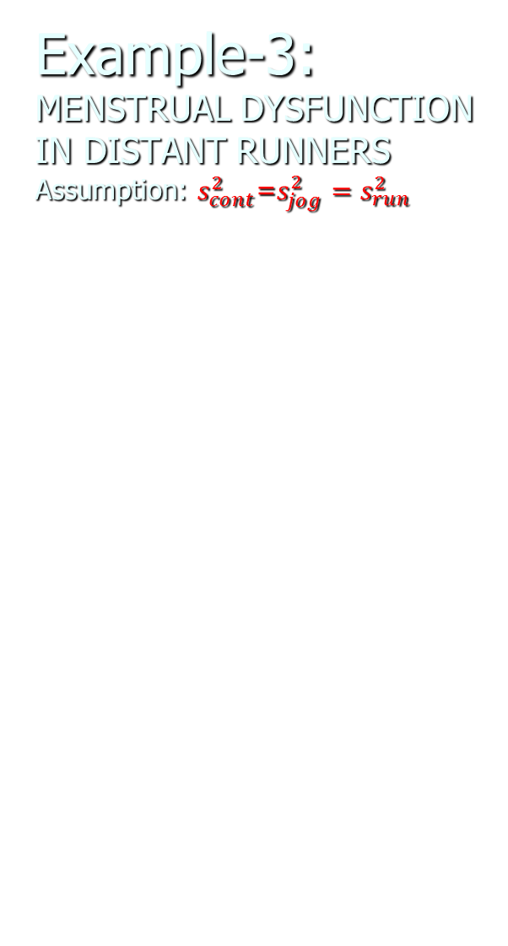
Example-3: MENSTRUAL DYSFUNCTION IN DISTANT RUNNERS
Assumption: $s_{cont}^{2}$=$s_{jog}^{2}=s_{run}^{2}$
26 Women in each group
F_{crit} ν_{n}(2) ν_{d}(70) 3.13 (4.92)
ν_{d}(80) 3.11 (4.88)
Excel:
FINV(0.01,2,75)=4.899

Slide 39
F_{calc} = 9.5
F is BIG
Reject the Null hypothesis that there is NO difference between the number of menstrual cycles of woman
When reported physicians should ask also for physical activities!
Question remains which group differed from the others.
Excel:
FDIST(9.5,2,25)=0.000853

Slide 40
In a study of factors thought to be responsible for the adverse effect of smoking on human reproduction, cadmium level determinations (ng/g) were made on placenta tissue of a sample of 14 mothers who were smokers and an independent sample of nonsmoking mothers. The results were as follows:
Nonsmokers ng/g | Smokers ng/g
10 | 30
8.4 | 30.1
12.8 | 15
25 | 24.1
11.8 | 30.5
9.8 | 17.8
12.5 | 16.8
15.4 | 14.8
23.5 | 13.4
9.4 | 28.5
25.1 | 17.5
19.5 | 14.4
25.5 | 12.5
9.8 | 20.4
7.5
11.8
12.2
15
Based on these data can one claim that the mean cadmium level is higher among smokers than non smokers?
How do you proceed?

Slide 41
Nonsmokers ng/g | Smokers ng/g
10 | 30
8.4 | 30.1
12.8 | 15
25 | 24.1
11.8 | 30.5
9.8 | 17.8
12.5 | 16.8
15.4 | 14.8
23.5 | 13.4
9.4 | 28.5
25.1 | 17.5
19.5 | 14.4
25.5 | 12.5
9.8 | 20.4
7.5
11.8
12.2
15
Two goals: Obtain descriptive information about the population from which a sample was drawn
Test a hypothesis about the population
 | Nonsmokers | Smokers
n | 18 | 14
average | 14.7 | 20.4
stdev | 6.2 | 6.8
Variance | 38.4 | 46.4
Median | 12.4 | 17.7
Min | 7.5 | 12.5
Max | 25.5 | 30.5

Slide 42
Two goals: Obtain descriptive information about the population from which a sample was drawn
Test a hypothesis about the population Ho:
Bin | Frequency Non-smoker | Bin | Frequency Smoker
8 | 1 | 8 | 0
14 | 10 | 14 | 2
20 | 3 | 20 | 6
26 | 4 | 26 | 2
More | 0 | More | 4
No outliers

Slide 43
Assumptions to test a hypothesis about the population with ANOVA:
Each sample independent
Each is randomly selected from the population studied
The populations were normally distributed
The variances of each population are the same even when the means are different
If the assumptions do not apply should not be used
The investigators believe the populations are normally distributed but they do not know whether the population variances are equal. How to test for equal variances?

Slide 44
 | Nonsmokers | Smokers
n | 18 | 14
average | 14.7 | 20.4
stdev | 6.2 | 6.8
Variance | 38.4 | 46.4
Median | 12.4 | 17.7
Min | 7.5 | 12.5
Max | 25.5 | 30.5
Using α=0.05 determine whether the equality of the variances is a reasonable assumption.
H₀: Variance ratio (VR) is = 1
Reject H₀ if VR>F_{crit}
F_{crit}
FINV (0.05) | =2.35
FINV (0.01) | =3.40
FDIST(1.21,13,17) | =0.351
Degrees of freedom:
P
Since VR< than the test statistics (F=2.35) DO NOT REJECT THE NULL HYPOTHESIS; the assumption of equal variances is reasonable; the difference in variances is most likely a consequence of random sampling

Slide 45
Nonsmokers ng/g | Smokers ng/g
10 | 30
8.4 | 30.1
12.8 | 15
25 | 24.1
11.8 | 30.5
9.8 | 17.8
12.5 | 16.8
15.4 | 14.8
23.5 | 13.4
9.4 | 28.5
25.1 | 17.5
19.5 | 14.4
25.5 | 12.5
9.8 | 20.4
7.5
11.8
12.2
15
ANOVA between groups with different number of members
n_{i} number of cases in group i
k number of groups
mean of group i
mean of all groups (i through k)

Slide 46
Summary of data
 | Nonsmokers | Smokers
n | 18 | 14
average | 14.7 | 20.4
stdev | 6.2 | 6.8
variance | 38.4 | 46.4
Median | 12.4 | 17.7
Min | 7.5 | 12.5
Max | 25.5 | 30.5
F_{crit}
FINV (α=0.05) | =4.17
FINV (α=0.01) | =7.56
FDIST(6.09,1,30) | =0.0195
Degrees of freedom:
P
Since F is larger than F_{crit} (α=0.05) we reject the null hypothesis of NO difference

