Slide 1
Handwritten digit recognition using a learning based agent EECE 8720: Artificial Intelligence Course Project
Md Sabbir Bin Zaman
Md Juber Rahman

Slide 2
Presentation Outline
Project objective and deliverables.
Structure of the system.
Learning
- Dataset
- Feature extraction and learning model
- Training the model
- Cross validation & Performance evaluation
Decision making
Implementation to test real world examples.
Demonstration

Slide 3
Project Objective & Deliverables
Objective:
The proposed AI enabled system is intended to be used in automated letter sorting in a post office or automated cheque clearing in a clearing house.
Deliverables:
We have aimed to deliver the data set, algorithm for data loading, visualization, training and testing , front end for demonstration, final report etc.

Slide 4
System Structure
Performance Standard
(Accuracy, Se, Sp)
Environment
Cross Validation
image
Camera
Letters
Sensor
Feedback
image
Classifier
Performing
element
Learning element
Conveyor Belt
Letter Boxes
Agent
Actuator
Fig. 1 : Automated letter sorting system with Agent and Environment

Slide 5
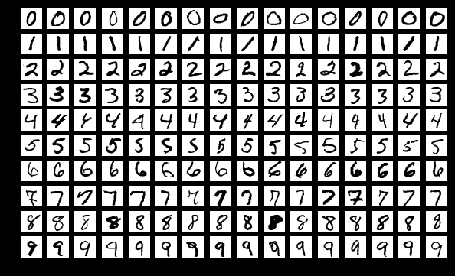
Dataset
The MNIST database of handwritten digits publicly available at http://yann.lecun.com/exdb/mnist/.
The database has a training set of 60,000 examples and a test set of 10,000 examples.
The data was collected by taking black and white pictures from handwritten documents and saved as 28x28 pixel image.
Fig. 2: Sample images from MNIST dataset

Slide 6
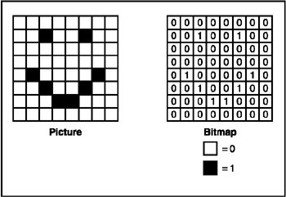
Feature Extraction & Learning
Each image has been converted into a
28 X 28 pixel bitmap array.
Then converted into a 1 X 784 array.
Learning Options:
- Supervised learning.
- Learning from probabilistic models.
- Reinforcement learning.
We have used supervised learning.
Learning Model: Support Vector Machine
No. of attributes: 784
Fig.3 : A Bitmap image in 8 x 8 binary

Slide 7
Support Vector Machine
Effective in high dimensional spaces.
Less overfitting, robust to noise.
Uses a subset of training points in the decision function (called support vectors), so it is also memory efficient.
Versatile: different Kernel functions can be specified for the decision function.
Computationally expensive, thus runs slow.

Slide 8
Training & Cross-validation
21,000 examples has been used for training the decision tree.
Training time is only 6.67 second.
Five fold cross validation has been used for performance evaluation.
Tried with pruning to reduce overfitting and improve accuracy.
Cross-validation accuracy of 96% has been achieved with SVM.

Slide 9
Testing
An accuracy of 96% has been achieved in test set.
For testing with real-world data paint software has been used.
Hand written digit has been saved as PNG image.
Saved image has been resized in 28 X 28 pixel.
Images has been formatted with white foreground and black background.
Trained model has been tested for these images and were predicted accurately by the agent in most of the cases.
Fig. 5: Image drawn on paint

Slide 10
Performance Comparison with other Supervised Learning Model
Classifier | Precision | Recall | F-1 Score
Decision Tree | 0.83 | 0.84 | 0.83
Support Vector Machine | 0.96 | 0.96 | 0.96
Logistic Regression | 0.91 | 0.91 | 0.91

Slide 11
Decision Making
Input
Prediction
Box1
Box2
Box3
Box4
Prediction | P(Box1)
0-2 | 1.0
Prediction | P(Box2)
3-5 | 1.0
Prediction | P(Box3)
6-7 | 1.0
Prediction | P(Box4)
8-9 | 1.0

Slide 12
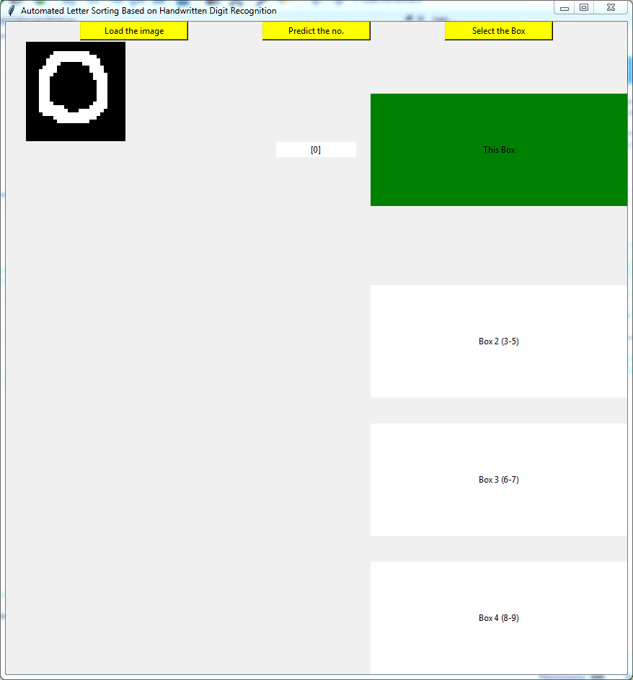
Graphical User Interface
Python tkinter module.
Buttons.
Labels.
Function binding with button clicks.
Canvas for displaying image
etc.

Slide 13
References
Y. Lecun, L. Bottou, Y. Bengio and P. Haffner, "Gradient-based learning applied to document recognition," in Proceedings of the IEEE, vol. 86, no. 11, pp. 2278-2324, Nov 1998.
J. Pradeep, E. Srinivasan and S. Himavathi, "Diagonal based feature extraction for handwritten character recognition system using neural network," 2011 3rd International Conference on Electronics Computer Technology, Kanyakumari, 2011, pp. 364-368
Documentation of scikit-learn 0.19.1
Documentation for python graphical user interface.

