Slide 1
Housing Price Prediction using Crime Rate Data
Save Neighbourhood
By making the neighbourhood safe!
Predicting future housing price using the correlations between crime rate and housing price.
https://github.com/jubileepower/SaveNeighbourhood

Slide 2
What is it? Demo

Slide 3
What open dataset did we use?
Housing Price: Kijiji (2020 June - today)
Crime Rate: Winnipeg police services (2018 September – 2019 November)
Neighborhood Map: Winnipeg R Package

Slide 4
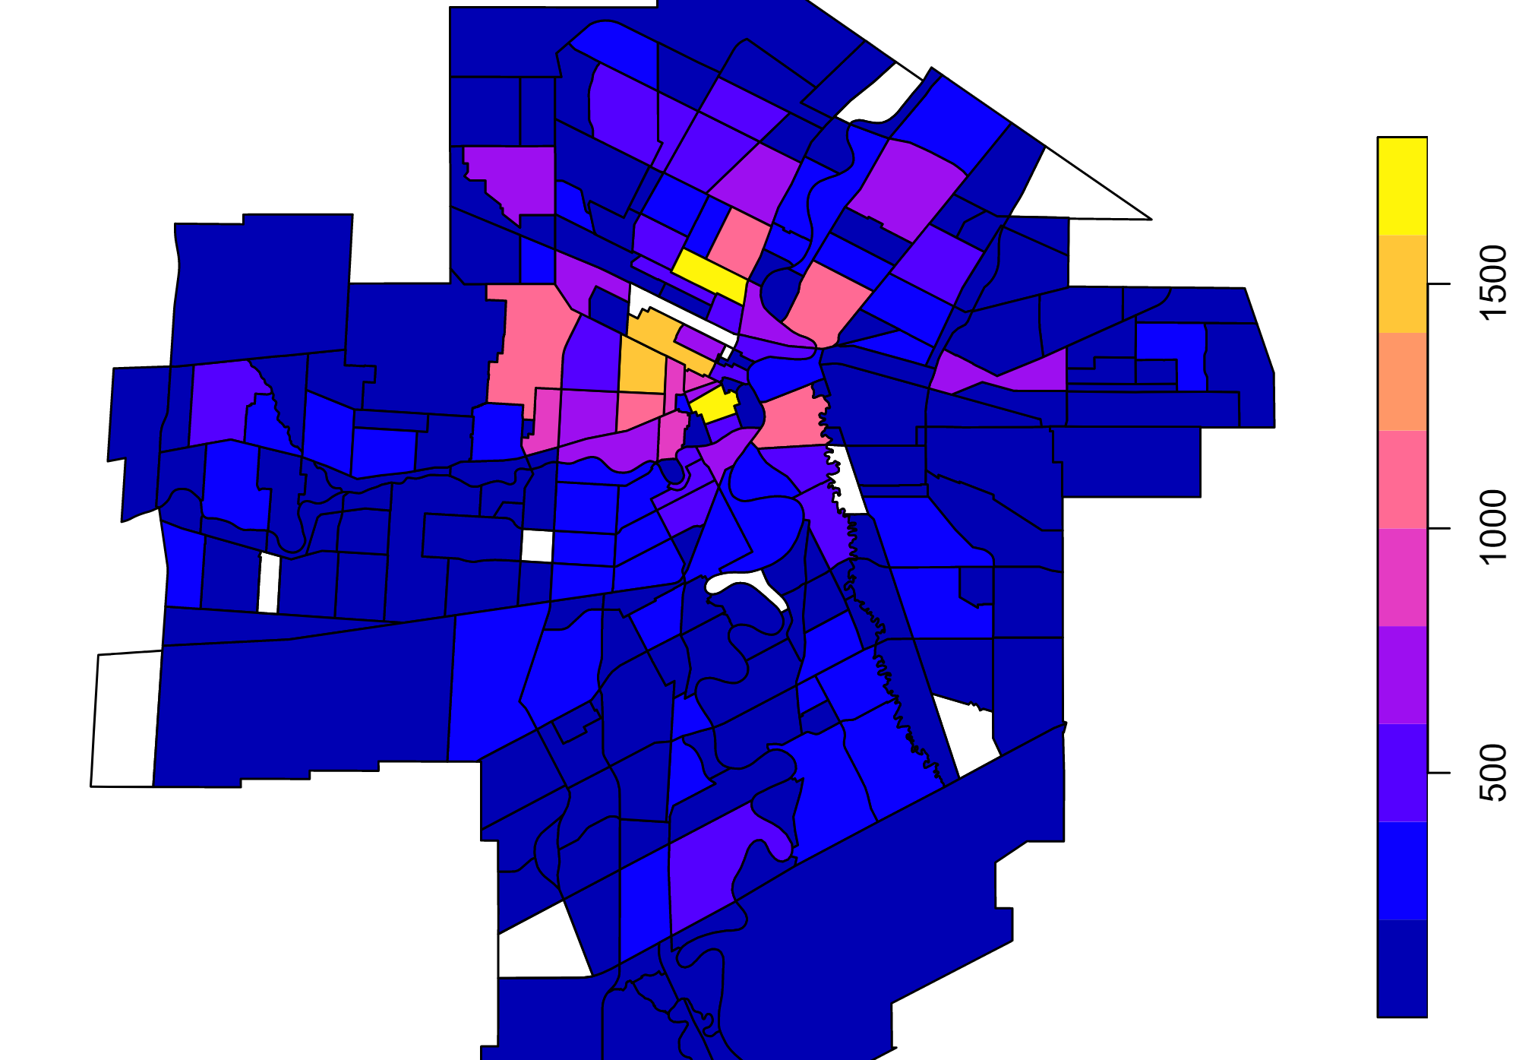
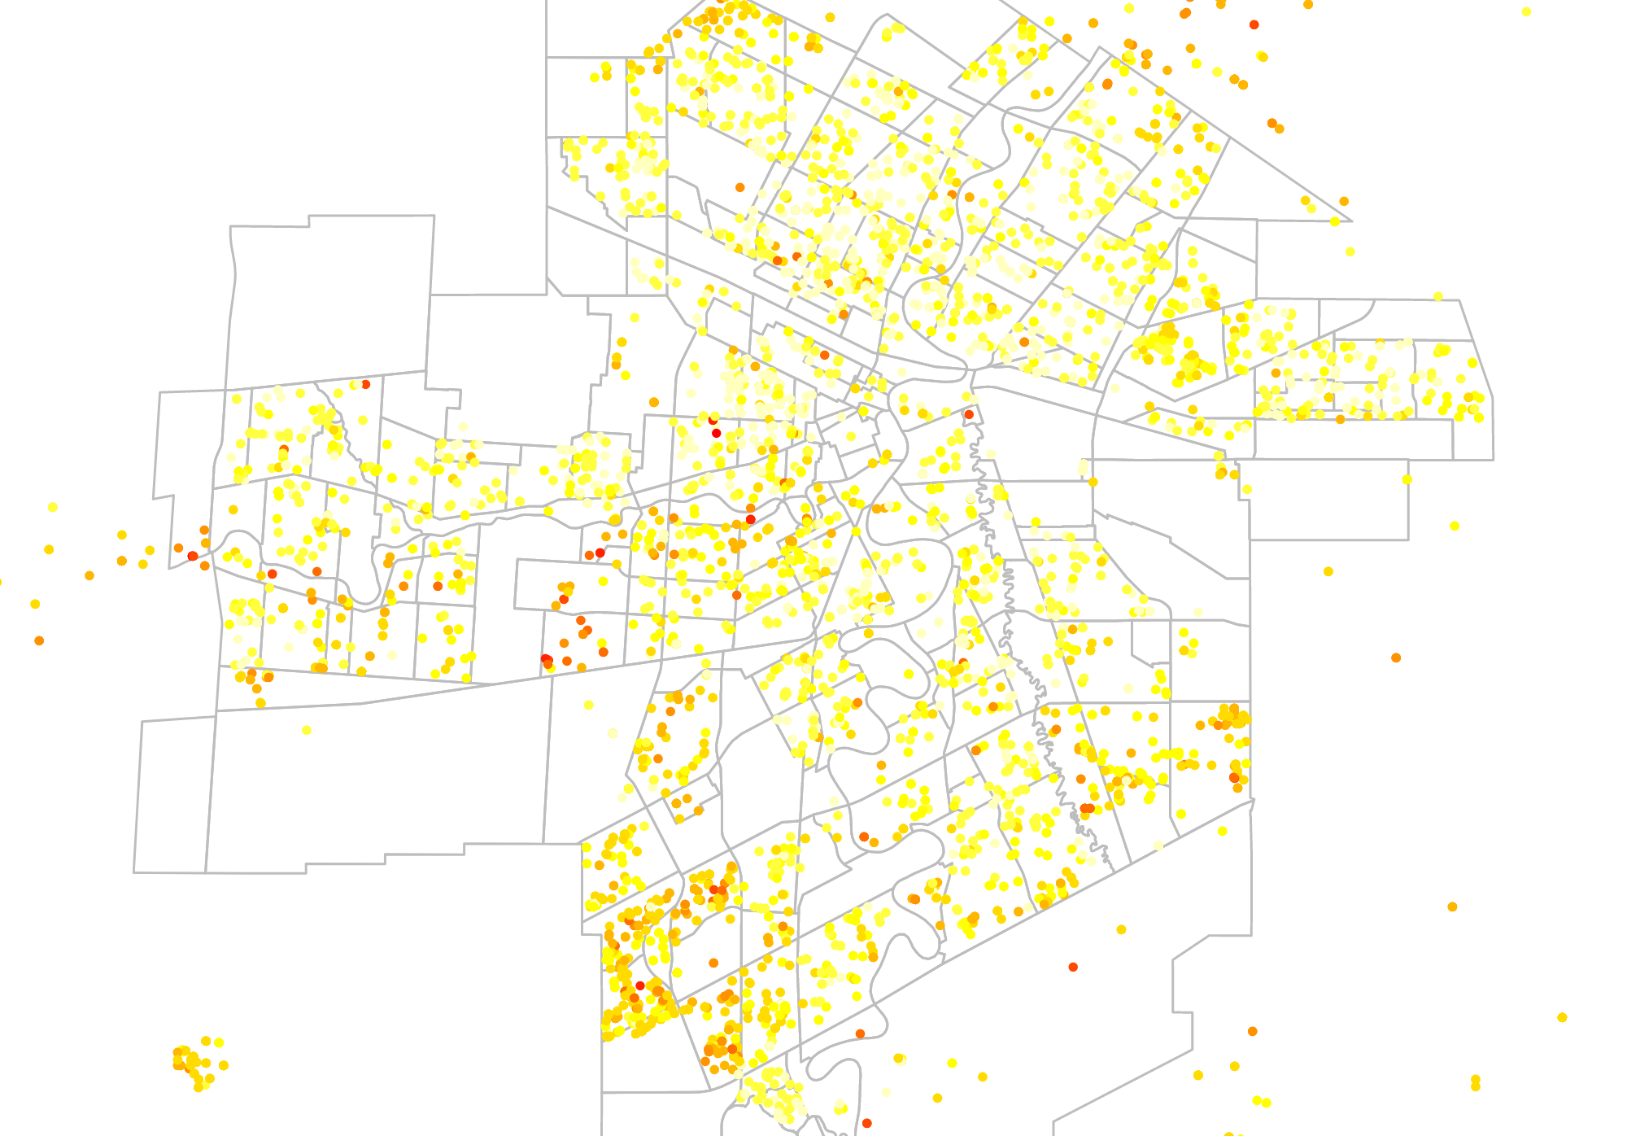
Community Crime rate

Slide 5
Why? - Benefits
Rise and falls in crime rate will suggest decrease and increase in future housing price.
Housing market affects neighbourhood economy & decision making of policies and plans

Slide 6
Who is going to get benefits? What else can we do?
TAXPAYERS: Home owners / Home buyers
Predicting their property tax
City (Government): Winnipeg Housing, Land Development, Infrastructure Development, School
Third Party: Insurance company, Land development & Real estate

Slide 7
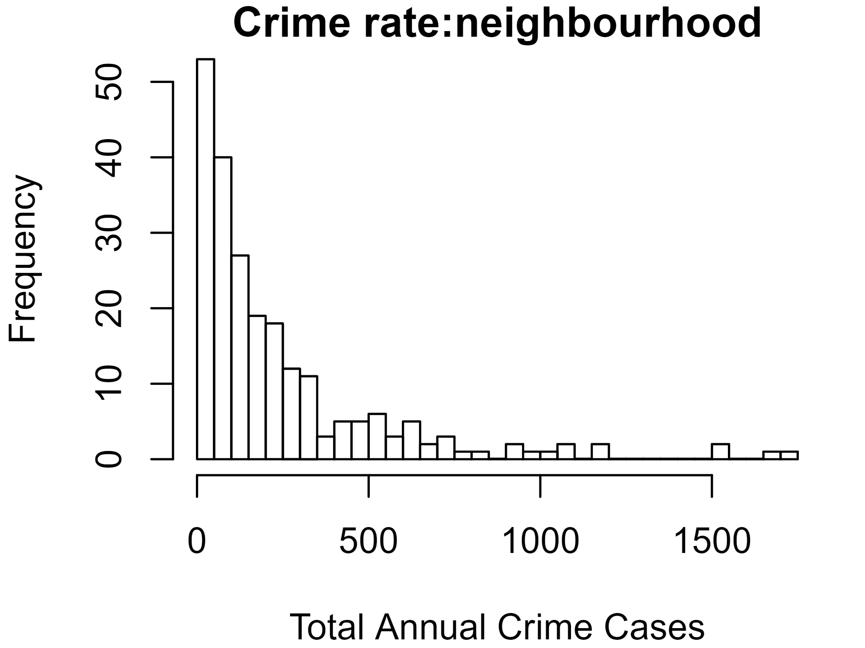
Crime Rate
Less crime rate -0.09846..
Total number of crime (2018 September – 2019 November) : 55252

Slide 8
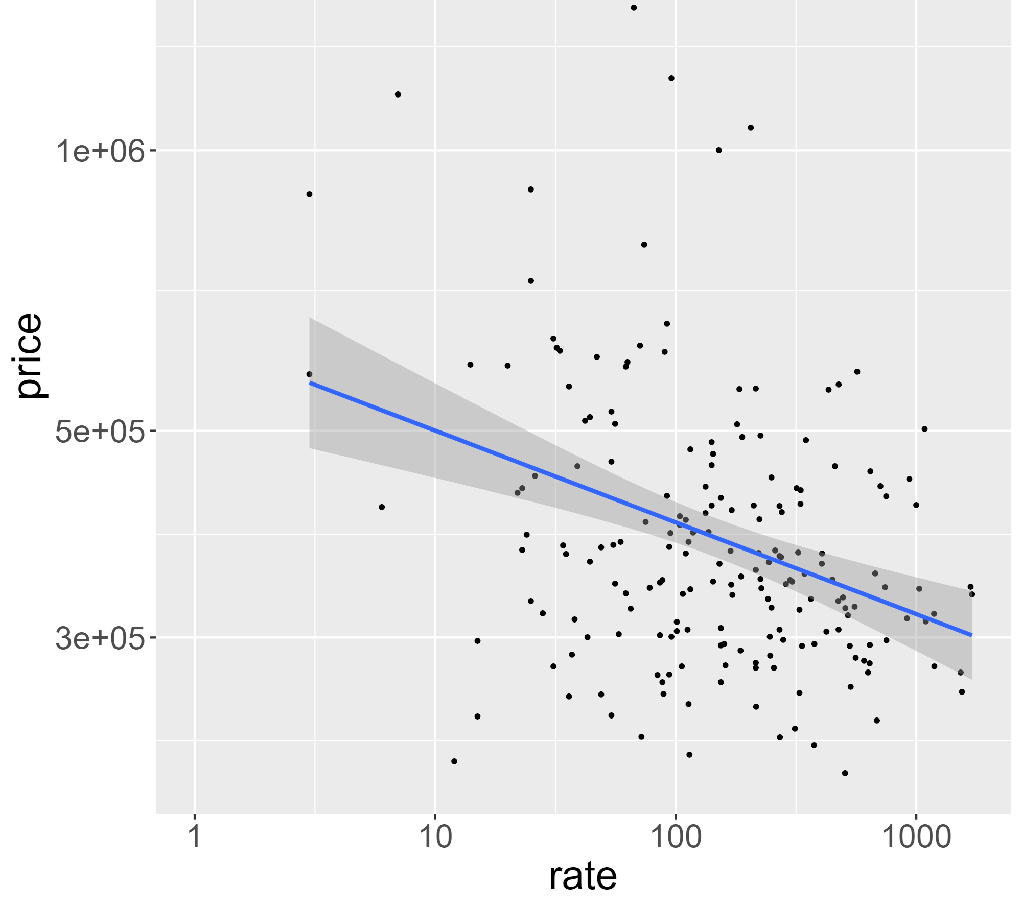
Motivation to raise property values
Correlation : -0.33
Data was collected from crime rate, housing price and population density per neighborhood.
Annual Crime Count | Average housing price
1000 | $ 318k
100 | $ 399k
10 | $ 500k
0 | $ 628k
Scatterplot crime rate

