Slide 1
Housing Price Prediction using Crime Rate Data
Save Neighborhood
By making the neighborhood safe!
Predicting future housing price using the correlations between crime rate and housing price.

Slide 2
What is it? Demo

Slide 3
What open dataset did we use?
Housing Price: Kijiji (2020 June - today)
Crime Rate: Winnipeg police services (2018 September – 2019 November)
Neighborhood Map: Winnipeg R Package

Slide 4
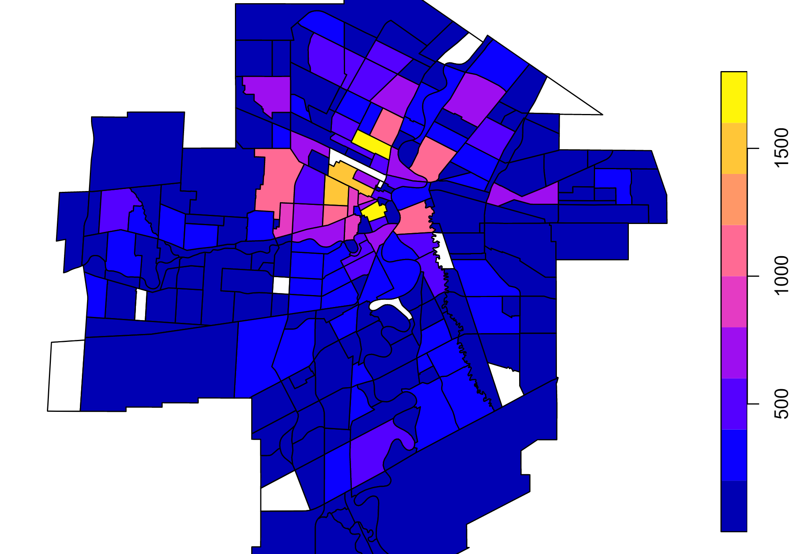
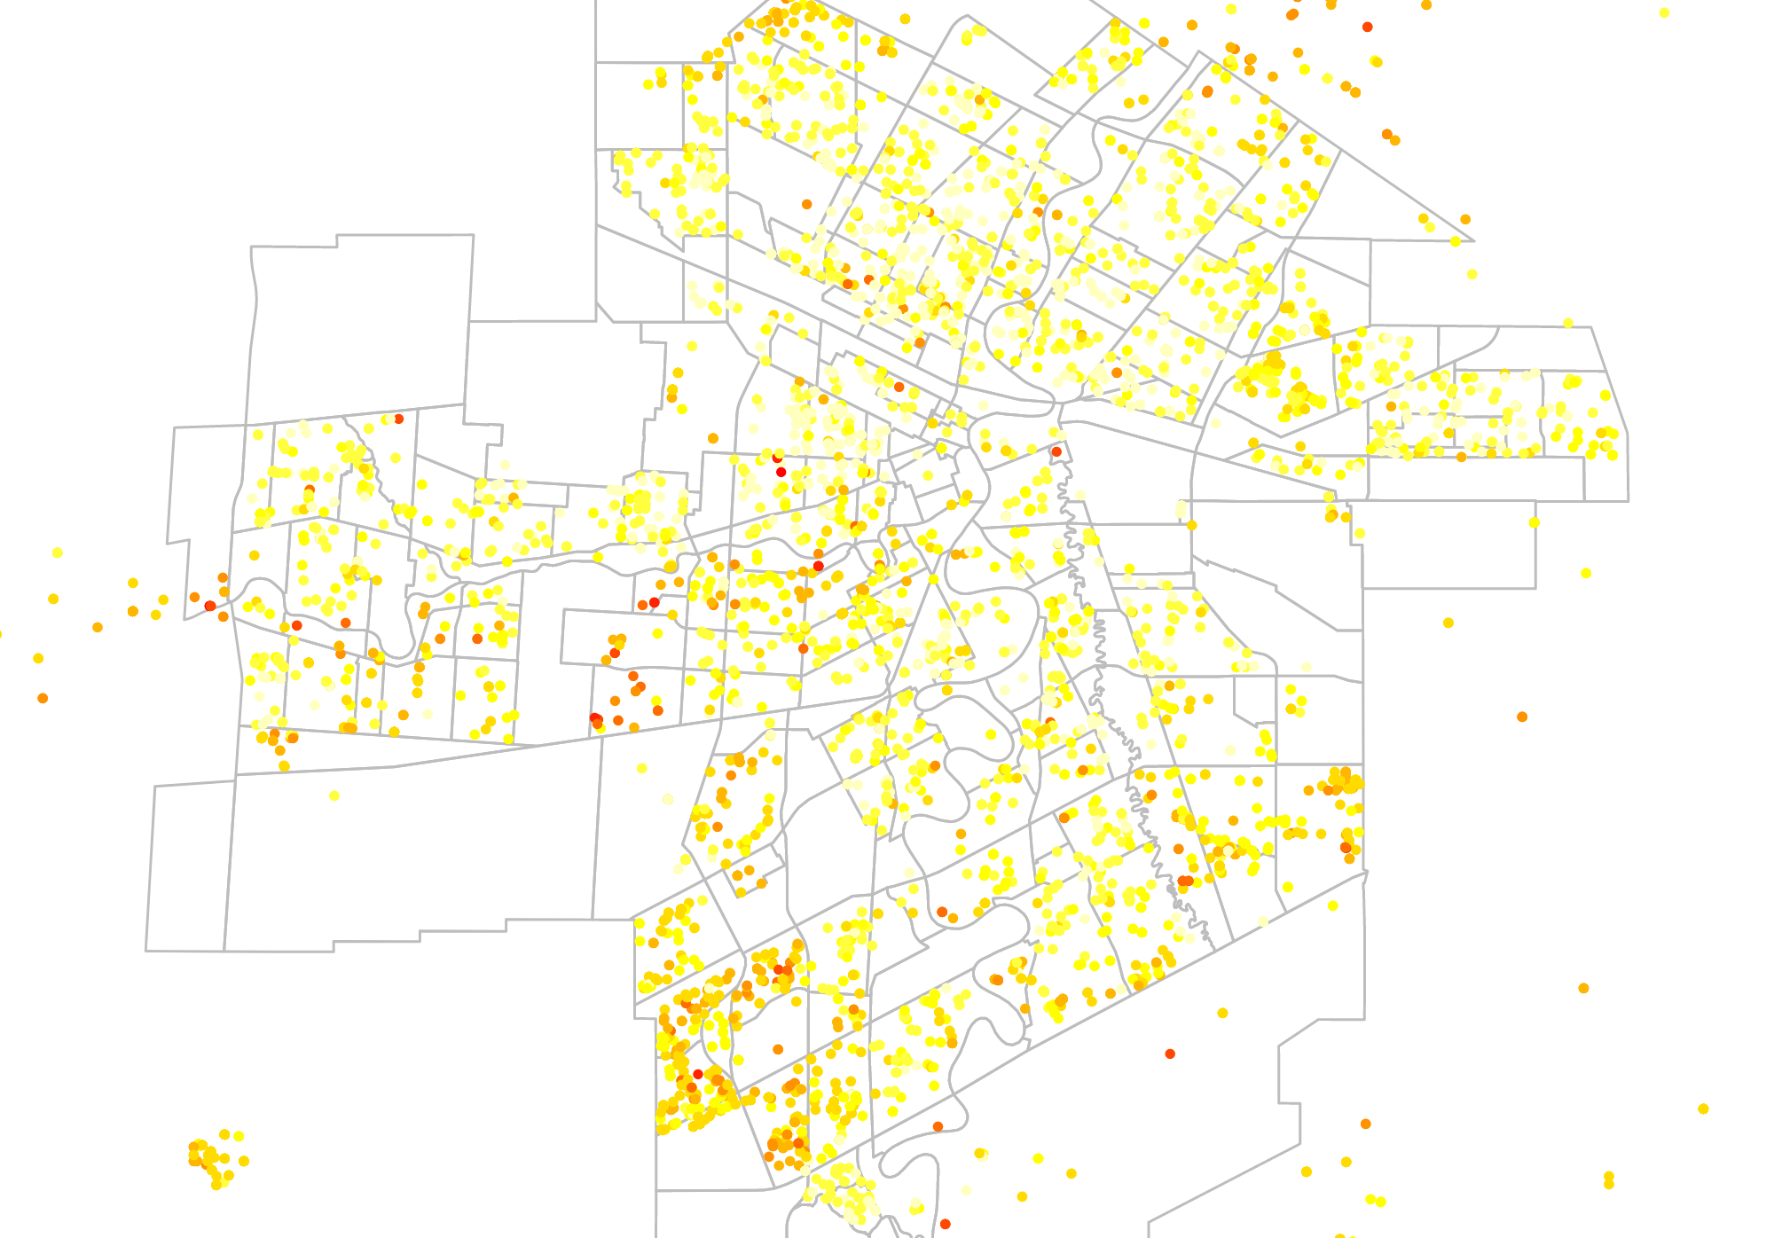
Community Crime rate

Slide 5
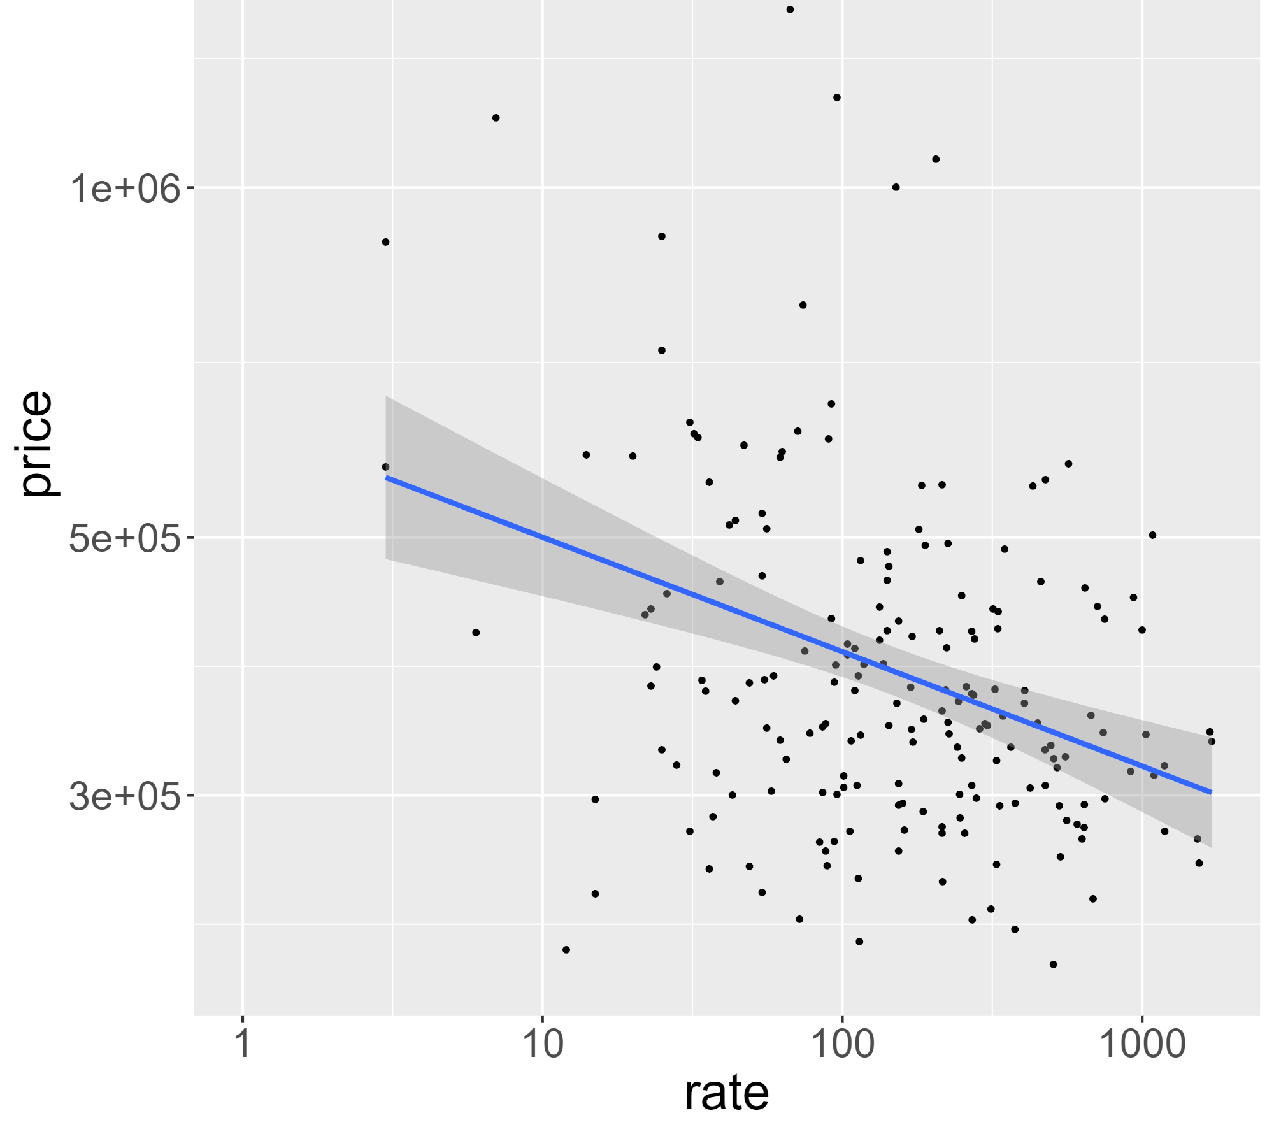
How to predict housing price?
Data was collected from crime rate, housing price and population density per neighborhood.
Correlation: -0.33
Scatterplot crime rate

Slide 6
Why? - Benefits
Rise and falls in crime rate will suggest decrease and increase in future housing price.
Housing market affects neighbourhood economy & decision making of policies and plans

Slide 7
Who is going to get benefits? What else can we do?
TAXPAYERS: Home owners / Home buyers
Predicting their property tax
City (Government): Winnipeg Housing, Land Development, Infrastructure Development, School
Third Party: Insurance company, Land development & Real estate

Slide 8
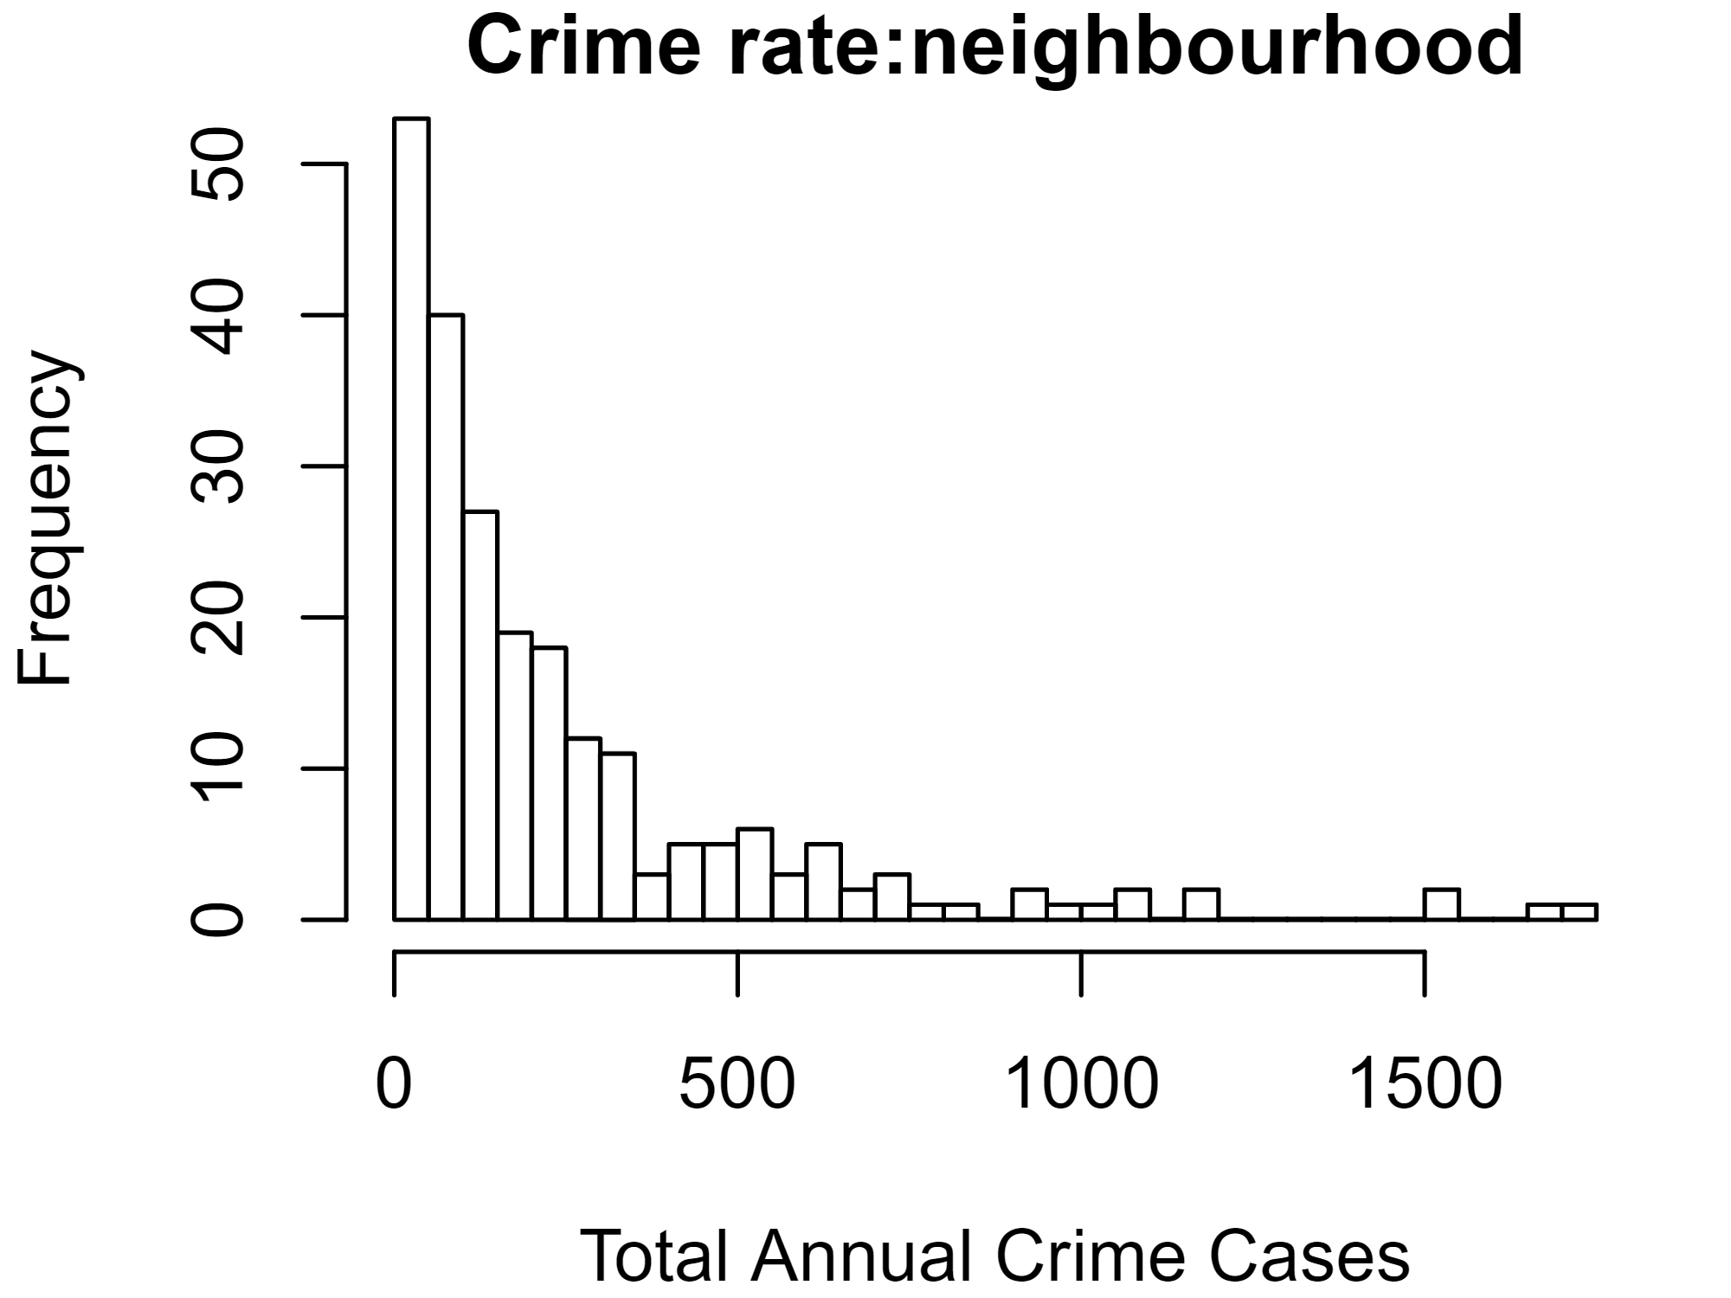
$ implications
Less crime rate -0.09846..
Taxpayers (Public)
City (Goverment)
Total number of crime (2018 September – 2019 November) : 55252
Price of the average house: 627,538

