Slide 1
2d and 3d ground response analysis of pond ash deposit
-by
Jubin kumar soni

Slide 2
Introduction
Ash is waste material generated after combustion of coal.
Ashes can be efficiently used in concrete , bricks ....or filling low lying areas as a filling materials.
In this study an attempt is being made to use pond ash as a filling material
Pond ash sample is being collected from talcher(odisha).

Slide 3
Some different types of ashes
Fly ash is one of the coal combustion products, composed of the fine particles that are driven out of the boiler with the flue gases.
Bottom ash is part of non-combustible residue of combustion in a furnace or incinerator
Pond ash is mainly obtained from the wet disposal of fly ash. The fly ash gets mixed with bottom ash and disposed off in large pond or dykes as slurry. It is also termed as ponded fly ash and contains relatively coarse particles.
So..pond ash =slurry=wet mixture of(fly ash + bottom ash))

Slide 4
Difference between flyash and pond ash
The main difference between pond ash and fly ash is in their particle size. The pond ash being coarser
Pond ash is less pozzolonic and hence is not being accepted as pozzolona
(Pozzolans are a broad class of siliceous and aluminous materials which, in themselves, possess little or no cementious value but which will, in finely divided form and in the presence of water, react chemically with calcium hydroxide at ordinary temperature to form compounds possessing cementitious properties)

Slide 5
What is pond ash?
The pond ash is a waste product from boilers, where the coal is burnt to heat the water for preparing the steam, which is a common process in most of coal based thermal power plants.
It is mainly obtained from the wet disposal of fly ash. The fly ash gets mixed with bottom ash and disposed off in large pond or dykes as slurry.
It is also termed as ponded fly ash and contains relatively coarse particles.

Slide 6
Constituents of pond ash
The metal oxides, sulphur, siliceous & aluminous materials with less pozzolonic properties than fly ash, are some main constituents of pond ash.

Slide 7
What is coal ash pond?
An ash pond is an engineered structure for the disposal of bottom ash and fly ash. The wet disposal of ash into ash ponds is the most common ash disposal method

Slide 8
Why this study?
These ash produced, if disposed off unscientifically, can cause environmental risks i.e. air pollution, surface water and groundwater pollution and thus it should be reused or dumped effectively.

Slide 9
The study
Two dimensional (2D) and three dimensional (3D) domain of pond ash having relative density 50% and 65% have been developed to analyze its response under different dynamic loading conditions.
The North East India earthquake (Mw-7.5), Aug 06, 1988 and Bhuj earthquake (Mw-7.7), Jan 26, 2001 have been considered as input motion for the 2D and 3D ground response analysis of pond ash domain
The response of the pond ash domain in terms of :-
Peak Ground Acceleration (PGA);
Peak Ground Displacements (PGD);
variation of shear stress with shear strain and effective stress;
pore water pressure, acceleration and
liquefaction susceptibility have been presented.

Slide 10
The response of the pond ash domain in terms of :-
Peak Ground Acceleration (PGA);
Peak Ground Displacements (PGD);
variation of shear stress with shear strain and effective stress;
pore water pressure
liquefaction susceptibility
have been presented.

Slide 11
Modelling
In the present study, for 2D analysis a pond ash domain of width 2 meter and height of 30 meter having a slope of zero degree divided into 120 elements along the height has been developed.
Similarly, for 3D analysis a pond ash domain of width 2 meter along X and Z axis and height of 30 meter having a slope of zero degree divided into 120 elements along the height has been developed.
The element used to model the domain is available in OpenSees and is called quadup i.e. four-node plane-strain element using bilinear isoparametric formulation.

Slide 12
What is quadUP element
FourNodeQuadUP is a four-node plane-strain element using bilinear isoparametric formulation.
This element is implemented for simulating dynamic response of solid-fluid fully coupled material, based on Biot's theory of porous medium.

Slide 13
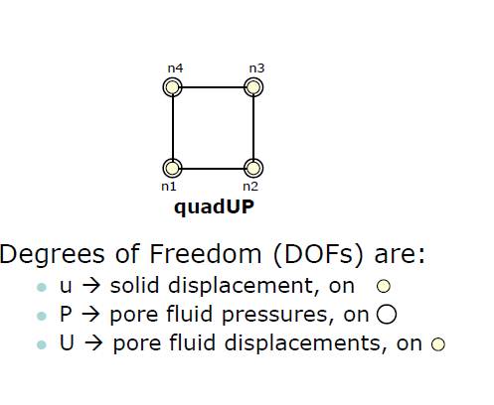
QuadUP

Slide 14
What is porous medium
A porous medium or a porous material is a solid permeated by an interconnected network of pores(voids) filled with a fluid. Usually both solid matrix and the pore network (also known as the pore space) are assumed to be continuous,so as to form two interpenetrating continua such as in a sponge.
A poroelastic medium is characterised by its porosity, permeability as well as the properties of its constituents (solid matrix and fluid). sponge

Slide 15
poroelasticity
The theory postulates that when a porous material is subjected to stress , the resulting deformation leads to volumetric change in the pores
The pores are fluid –filled , the presence fluid not only act as a stiffener of the material , but also results in the flow of the pore fluid (diffusion) between regions of higher and lower pore pressure.

Slide 16
Biot theory
Biot theory generally concerned with soil consolidation and wave propagation problems
The linear model of transient flow and deformation of a homogeneous fully saturated elastic porous medium depend on an appropriate coupling of the fluid pressure and solid stress.

Slide 17
Biot Diffusion-Deformation Model
The linear model of transient flow and deformation of a homogeneous fully saturated elastic porous medium depend on an appropriate coupling of the fluid pressure and solid stress.
The total stress consist of both the effective stress , given by the strain of the structure and the pore pressure arising from the fluid

Slide 18
Two poroelastic behaviour:
1.solid to fluid coupling :occurs when change in applied stress produces a change in fluid mass
2.fluid to solid coupling :occurs when a change in fluid pressure or fluid mass is responsible for change in volume of porous material

Slide 19
Uncoupled problem
If only fluid to solid coupling were important then a change in fluid pressure or fluid mass is changes volume of porous material
This one way coupling is called uncoupled problem

Slide 20
Coupled problem
When solid to fluid coupling then change in stress causes significantly change in pore pressure and this in turn causes change in volume of porous material.
This two way coupling is called coupled problem

Slide 21
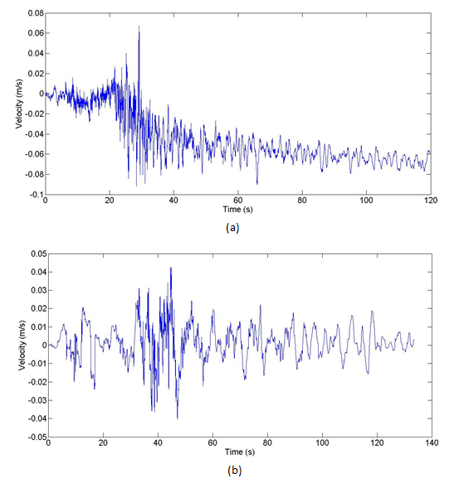
Input motion
Input Motions: (a) North-East India (Mw=7.5) and (b) Bhuj (Mw=7.7) Velocity Time History

Slide 22
What is moment magnitude(Mw)?
The moment magnitude scale (abbreviated as MMS; denoted as M_{W} or M) is used by seismologists to measure the size of earthquakes in terms of the energy released.
Several scales have been defined, but the most commonly used are
(1) local magnitude (ML), commonly referred to as "Richter magnitude“
(2) surface-wave magnitude(Ms)
(3) body-wave magnitude (Mb)
(4) moment magnitude (Mw).

Slide 23
Local magnitude(ML) OR Richter scale
The Richter scale is a base-10 logarithmic scale, which defines magnitude of an earthquake is determined from the logarithm of the amplitude of waves recorded by seismographs.

Slide 24
Surface wave magnitude(Ms)
The surface wave magnitude scale is one of the magnitude scales used in seismology to describe the size of an earthquake. It is based on measurements in Rayleigh surface waves that travel primarily along the uppermost layers of the Earth

Slide 25
Body wave magnitude(Mb)
Body wave magnitude is a way of determining the size of an earthquake, using the amplitude of the initial P-wave to calculate the magnitude. The P-wave is a type of body wave and is the first wave from an earthquake to reach a seismometer. Because of this, calculating the body wave magnitude can be the quickest method of determining the size of an earthquake that is of a large distance from the seismometer.

Slide 26
Relative Density | Earthquakes | Pore-Water Pressure Ratio
 | Depth (m) | 5 |  | 10 |  | 15 |  | 20 |  | 25
 |  | 2D | 3D | 2D | 3D | 2D | 3D | 2D | 3D | 2D | 3D
50 % | North East India (Mw-7.5) | 0.078 | 0.302 | 0.16 | 0.27 | 0.11 | 0.209 | 0.12 | 0.173 | 0.11 | 0.144
 | Bhuj (Mw-7.7) | 0.119 | 0.142 | 0.109 | 0.128 | 0.078 | 0.094 | 0.061 | 0.074 | 0.051 | 0.063
65 % | North East India (Mw-7.5) | 0.08 | 0.217 | 0.125 | 0.194 | 0.114 | 0.15 | 0.099 | 0.12 | 0.086 | 0.104
 | Bhuj (Mw-7.7) | 0.089 | 0.09 | 0.08 | 0.085 | 0.055 | 0.06 | 0.05 | 0.05 | 0.04 | 0.04
Pore Water Pressure Ratio Variation with depth

Slide 27
2D Analysis Results
The 2D analysis for the pond ash domain at 50% and 65% relative density show that the pond ash domains are not susceptible to liquefaction since the excess pore pressure does not reach unity in any of the loading cases (Mw:7.5, Mw:7.7).
The minimum and maximum PGA developed is 1.3078 (m/s/s) for Bhuj earthquake with relative density 65% and 1.4784 (m/s/s) for North East India earthquake with relative density 50%(Figure 2).
The minimum and maximum PGD developed is and 0.1941m for North East India earthquake with relative density 65%. and 0.2058m for North East India earthquake with relative density 50%
The minimum and maximum shear stress developed is 4.39 kPa at 5m for Bhuj earthquake with relative density 65% and 10.78 kPa at 15m for North East India earthquake with relative density 65%.
The minimum and maximum pore water pressure developed is 0.04 at 25m for Bhuj earthquake with relative density 65% and 0.16 at 10m for North East India earthquake with relative density50%.
The minimum and maximum acceleration developed is 0.649 m/s/s at 25m for Bhuj earthquake with relative density 65% and 1.38 m/s/s at 20m for North East India earthquake with relative density 50%.

Slide 28
3D Analysis Result
The 3D analysis for the pond ash domain 50% and 65% show that the pond ash domains are not susceptible to liquefaction since the excess pore pressure does not reach unity in any of the loading cases for North East India (Mw:7.5) and Bhuj (Mw:7.7) earthquake for either cases.
The minimum and maximum PGA developed is 1.6458 m/s/s for North East India earthquake with relative density 65% and 1.7431 m/s/s for North East India earthquake with relative density 50% (Figure 2).
The minimum and maximum PGD developed is 0.1928 m for North East India earthquake with relative density 65%. and 0.2048 m for North East India earthquake with relative density 65%
The minimum and maximum shear stress developed is 4.48 kPa at 5m for Bhuj earthquake with relative density 65% and 11.3 kPa at 15m for North East India earthquake with relative density 50%.
The minimum and maximum pore water pressure developed is 0.302 at 5m for North East India earthquake with relative density 50% and 0.04 at 25m for Bhuj earthquake with relative density 65%(Table 1).
The minimum and maximum acceleration developed is 0.72 m/s/s at 25m for Bhuj earthquake with relative density 65%. and 1.670 m/s/s at 5m for North East India earthquake with relative density 50%

Slide 29
conclusions
Pond ash domain of relative density 65% show higher strength and resistance against liquefaction as compared to pond ash domain of 50% showing the stability of pond ash domain increases as the relative density increases.

Slide 30
Def pore water pressure
Pore water pressure (sometimes abbreviated to pwp) refers to the pressure of groundwater held within a soil or rock, in gaps between particles (pores). Pore water pressures in below the phreatic level (see also groundwater) are measured in piezometers.

Slide 31
relative density
the ratio of the density of a substance to the density of a standard, usually water for a liquid or solid, and air for a gas.

Slide 32
Shear stress
Shear stress is a stress state where the stress is parallel to the surface of the material, as opposed to normal stress when the stress is perpendicular to the surface. Shear stress is relevant to the motion of fluids upon surfaces, which result in the generation of shear stress

Slide 33
PGA
Peak ground acceleration (PGA) is equal to the maximum ground accelerationthat occurred during earthquake shaking at a location. PGA is equal to the amplitude of the largest absolute acceleration recorded on an accelerogram at a site during a particular earthquake.

