Slide 1
CONVOLUTIONAL NEURAL NETWORK

Slide 2
1-CONVOLUTION
0 | 0 | 0 | 0 | 0 | 0 | 0
0 | 1 | 0 | 0 | 0 | 1 | 0
0 | 0 | 0 | 0 | 0 | 0 | 0
0 | 0 | 0 | 1 | 0 | 0 | 0
0 | 1 | 0 | 0 | 0 | 1 | 0
0 | 0 | 1 | 1 | 1 | 0 | 0
0 | 0 | 0 | 0 | 0 | 0 | 0
0
0 | 0 | 1
1 | 0 | 0
0 | 1 | 1
INPUT IMAGE
FEATURE DETECTOR
FEATURE MAP

Slide 3
1-CONVOLUTION
0 | 0 | 0 | 0 | 0 | 0 | 0
0 | 1 | 0 | 0 | 0 | 1 | 0
0 | 0 | 0 | 0 | 0 | 0 | 0
0 | 0 | 0 | 1 | 0 | 0 | 0
0 | 1 | 0 | 0 | 0 | 1 | 0
0 | 0 | 1 | 1 | 1 | 0 | 0
0 | 0 | 0 | 0 | 0 | 0 | 0
0 | 1
0 | 0 | 1
1 | 0 | 0
0 | 1 | 1
INPUT IMAGE
FEATURE DETECTOR
FEATURE MAP

Slide 4
1-CONVOLUTION
0 | 0 | 0 | 0 | 0 | 0 | 0
0 | 1 | 0 | 0 | 0 | 1 | 0
0 | 0 | 0 | 0 | 0 | 0 | 0
0 | 0 | 0 | 1 | 0 | 0 | 0
0 | 1 | 0 | 0 | 0 | 1 | 0
0 | 0 | 1 | 1 | 1 | 0 | 0
0 | 0 | 0 | 0 | 0 | 0 | 0
0 | 1 | 0
0 | 0 | 1
1 | 0 | 0
0 | 1 | 1
INPUT IMAGE
FEATURE DETECTOR
FEATURE MAP

Slide 5
1-CONVOLUTION
0 | 0 | 0 | 0 | 0 | 0 | 0
0 | 1 | 0 | 0 | 0 | 1 | 0
0 | 0 | 0 | 0 | 0 | 0 | 0
0 | 0 | 0 | 1 | 0 | 0 | 0
0 | 1 | 0 | 0 | 0 | 1 | 0
0 | 0 | 1 | 1 | 1 | 0 | 0
0 | 0 | 0 | 0 | 0 | 0 | 0
0 | 1 | 0 | 0
0 | 0 | 1
1 | 0 | 0
0 | 1 | 1
INPUT IMAGE
FEATURE DETECTOR
FEATURE MAP

Slide 6
1-CONVOLUTION
0 | 0 | 0 | 0 | 0 | 0 | 0
0 | 1 | 0 | 0 | 0 | 1 | 0
0 | 0 | 0 | 0 | 0 | 0 | 0
0 | 0 | 0 | 1 | 0 | 0 | 0
0 | 1 | 0 | 0 | 0 | 1 | 0
0 | 0 | 1 | 1 | 1 | 0 | 0
0 | 0 | 0 | 0 | 0 | 0 | 0
0 | 1 | 0 | 0 | 0
0 | 0 | 1
1 | 0 | 0
0 | 1 | 1
INPUT IMAGE
FEATURE DETECTOR
FEATURE MAP

Slide 7
1-CONVOLUTION
0 | 0 | 0 | 0 | 0 | 0 | 0
0 | 1 | 0 | 0 | 0 | 1 | 0
0 | 0 | 0 | 0 | 0 | 0 | 0
0 | 0 | 0 | 1 | 0 | 0 | 0
0 | 1 | 0 | 0 | 0 | 1 | 0
0 | 0 | 1 | 1 | 1 | 0 | 0
0 | 0 | 0 | 0 | 0 | 0 | 0
0 | 1 | 0 | 0 | 0
0
0 | 0 | 1
1 | 0 | 0
0 | 1 | 1
INPUT IMAGE
FEATURE DETECTOR
FEATURE MAP

Slide 8
1-CONVOLUTION
0 | 0 | 0 | 0 | 0 | 0 | 0
0 | 1 | 0 | 0 | 0 | 1 | 0
0 | 0 | 0 | 0 | 0 | 0 | 0
0 | 0 | 0 | 1 | 0 | 0 | 0
0 | 1 | 0 | 0 | 0 | 1 | 0
0 | 0 | 1 | 1 | 1 | 0 | 0
0 | 0 | 0 | 0 | 0 | 0 | 0
0 | 1 | 0 | 0 | 0
0 | 1
0 | 0 | 1
1 | 0 | 0
0 | 1 | 1
INPUT IMAGE
FEATURE DETECTOR
FEATURE MAP

Slide 9
1-CONVOLUTION
0 | 0 | 0 | 0 | 0 | 0 | 0
0 | 1 | 0 | 0 | 0 | 1 | 0
0 | 0 | 0 | 0 | 0 | 0 | 0
0 | 0 | 0 | 1 | 0 | 0 | 0
0 | 1 | 0 | 0 | 0 | 1 | 0
0 | 0 | 1 | 1 | 1 | 0 | 0
0 | 0 | 0 | 0 | 0 | 0 | 0
0 | 1 | 0 | 0 | 0
0 | 1 | 1
0 | 0 | 1
1 | 0 | 0
0 | 1 | 1
INPUT IMAGE
FEATURE DETECTOR
FEATURE MAP

Slide 10
1-CONVOLUTION
0 | 0 | 0 | 0 | 0 | 0 | 0
0 | 1 | 0 | 0 | 0 | 1 | 0
0 | 0 | 0 | 0 | 0 | 0 | 0
0 | 0 | 0 | 1 | 0 | 0 | 0
0 | 1 | 0 | 0 | 0 | 1 | 0
0 | 0 | 1 | 1 | 1 | 0 | 0
0 | 0 | 0 | 0 | 0 | 0 | 0
0 | 1 | 0 | 0 | 0
0 | 1 | 1 | 1
0 | 0 | 1
1 | 0 | 0
0 | 1 | 1
INPUT IMAGE
FEATURE DETECTOR
FEATURE MAP

Slide 11
1-CONVOLUTION
0 | 0 | 0 | 0 | 0 | 0 | 0
0 | 1 | 0 | 0 | 0 | 1 | 0
0 | 0 | 0 | 0 | 0 | 0 | 0
0 | 0 | 0 | 1 | 0 | 0 | 0
0 | 1 | 0 | 0 | 0 | 1 | 0
0 | 0 | 1 | 1 | 1 | 0 | 0
0 | 0 | 0 | 0 | 0 | 0 | 0
0 | 1 | 0 | 0 | 0
0 | 1 | 1 | 1 | 0
0 | 0 | 1
1 | 0 | 0
0 | 1 | 1
INPUT IMAGE
FEATURE DETECTOR
FEATURE MAP

Slide 12
1-CONVOLUTION
0 | 0 | 0 | 0 | 0 | 0 | 0
0 | 1 | 0 | 0 | 0 | 1 | 0
0 | 0 | 0 | 0 | 0 | 0 | 0
0 | 0 | 0 | 1 | 0 | 0 | 0
0 | 1 | 0 | 0 | 0 | 1 | 0
0 | 0 | 1 | 1 | 1 | 0 | 0
0 | 0 | 0 | 0 | 0 | 0 | 0
0 | 1 | 0 | 0 | 0
0 | 1 | 1 | 1 | 0
1
0 | 0 | 1
1 | 0 | 0
0 | 1 | 1
INPUT IMAGE
FEATURE DETECTOR
FEATURE MAP

Slide 13
1-CONVOLUTION
0 | 0 | 0 | 0 | 0 | 0 | 0
0 | 1 | 0 | 0 | 0 | 1 | 0
0 | 0 | 0 | 0 | 0 | 0 | 0
0 | 0 | 0 | 1 | 0 | 0 | 0
0 | 1 | 0 | 0 | 0 | 1 | 0
0 | 0 | 1 | 1 | 1 | 0 | 0
0 | 0 | 0 | 0 | 0 | 0 | 0
0 | 1 | 0 | 0 | 0
0 | 1 | 1 | 1 | 0
1 | 0
0 | 0 | 1
1 | 0 | 0
0 | 1 | 1
INPUT IMAGE
FEATURE DETECTOR
FEATURE MAP

Slide 14
1-CONVOLUTION
0 | 0 | 0 | 0 | 0 | 0 | 0
0 | 1 | 0 | 0 | 0 | 1 | 0
0 | 0 | 0 | 0 | 0 | 0 | 0
0 | 0 | 0 | 1 | 0 | 0 | 0
0 | 1 | 0 | 0 | 0 | 1 | 0
0 | 0 | 1 | 1 | 1 | 0 | 0
0 | 0 | 0 | 0 | 0 | 0 | 0
0 | 1 | 0 | 0 | 0
0 | 1 | 1 | 1 | 0
1 | 0 | 1
0 | 0 | 1
1 | 0 | 0
0 | 1 | 1
INPUT IMAGE
FEATURE DETECTOR
FEATURE MAP

Slide 15
1-CONVOLUTION
0 | 0 | 0 | 0 | 0 | 0 | 0
0 | 1 | 0 | 0 | 0 | 1 | 0
0 | 0 | 0 | 0 | 0 | 0 | 0
0 | 0 | 0 | 1 | 0 | 0 | 0
0 | 1 | 0 | 0 | 0 | 1 | 0
0 | 0 | 1 | 1 | 1 | 0 | 0
0 | 0 | 0 | 0 | 0 | 0 | 0
0 | 1 | 0 | 0 | 0
0 | 1 | 1 | 1 | 0
1 | 0 | 1 | 2
0 | 0 | 1
1 | 0 | 0
0 | 1 | 1
INPUT IMAGE
FEATURE DETECTOR
FEATURE MAP

Slide 16
1-CONVOLUTION
0 | 0 | 0 | 0 | 0 | 0 | 0
0 | 1 | 0 | 0 | 0 | 1 | 0
0 | 0 | 0 | 0 | 0 | 0 | 0
0 | 0 | 0 | 1 | 0 | 0 | 0
0 | 1 | 0 | 0 | 0 | 1 | 0
0 | 0 | 1 | 1 | 1 | 0 | 0
0 | 0 | 0 | 0 | 0 | 0 | 0
0 | 1 | 0 | 0 | 0
0 | 1 | 1 | 1 | 0
1 | 0 | 1 | 2 | 1
0 | 0 | 1
1 | 0 | 0
0 | 1 | 1
INPUT IMAGE
FEATURE DETECTOR
FEATURE MAP

Slide 17
1-CONVOLUTION
0 | 0 | 0 | 0 | 0 | 0 | 0
0 | 1 | 0 | 0 | 0 | 1 | 0
0 | 0 | 0 | 0 | 0 | 0 | 0
0 | 0 | 0 | 1 | 0 | 0 | 0
0 | 1 | 0 | 0 | 0 | 1 | 0
0 | 0 | 1 | 1 | 1 | 0 | 0
0 | 0 | 0 | 0 | 0 | 0 | 0
0 | 1 | 0 | 0 | 0
0 | 1 | 1 | 1 | 0
1 | 0 | 1 | 2 | 1
1
0 | 0 | 1
1 | 0 | 0
0 | 1 | 1
INPUT IMAGE
FEATURE DETECTOR
FEATURE MAP

Slide 18
1-CONVOLUTION
0 | 0 | 0 | 0 | 0 | 0 | 0
0 | 1 | 0 | 0 | 0 | 1 | 0
0 | 0 | 0 | 0 | 0 | 0 | 0
0 | 0 | 0 | 1 | 0 | 0 | 0
0 | 1 | 0 | 0 | 0 | 1 | 0
0 | 0 | 1 | 1 | 1 | 0 | 0
0 | 0 | 0 | 0 | 0 | 0 | 0
0 | 1 | 0 | 0 | 0
0 | 1 | 1 | 1 | 0
1 | 0 | 1 | 2 | 1
1 | 4
0 | 0 | 1
1 | 0 | 0
0 | 1 | 1
INPUT IMAGE
FEATURE DETECTOR
FEATURE MAP

Slide 19
1-CONVOLUTION
0 | 0 | 0 | 0 | 0 | 0 | 0
0 | 1 | 0 | 0 | 0 | 1 | 0
0 | 0 | 0 | 0 | 0 | 0 | 0
0 | 0 | 0 | 1 | 0 | 0 | 0
0 | 1 | 0 | 0 | 0 | 1 | 0
0 | 0 | 1 | 1 | 1 | 0 | 0
0 | 0 | 0 | 0 | 0 | 0 | 0
0 | 1 | 0 | 0 | 0
0 | 1 | 1 | 1 | 0
1 | 0 | 1 | 2 | 1
1 | 4 | 2
0 | 0 | 1
1 | 0 | 0
0 | 1 | 1
INPUT IMAGE
FEATURE DETECTOR
FEATURE MAP

Slide 20
1-CONVOLUTION
0 | 0 | 0 | 0 | 0 | 0 | 0
0 | 1 | 0 | 0 | 0 | 1 | 0
0 | 0 | 0 | 0 | 0 | 0 | 0
0 | 0 | 0 | 1 | 0 | 0 | 0
0 | 1 | 0 | 0 | 0 | 1 | 0
0 | 0 | 1 | 1 | 1 | 0 | 0
0 | 0 | 0 | 0 | 0 | 0 | 0
0 | 1 | 0 | 0 | 0
0 | 1 | 1 | 1 | 0
1 | 0 | 1 | 2 | 1
1 | 4 | 2 | 1
0 | 0 | 1
1 | 0 | 0
0 | 1 | 1
INPUT IMAGE
FEATURE DETECTOR
FEATURE MAP

Slide 21
1-CONVOLUTION
0 | 0 | 0 | 0 | 0 | 0 | 0
0 | 1 | 0 | 0 | 0 | 1 | 0
0 | 0 | 0 | 0 | 0 | 0 | 0
0 | 0 | 0 | 1 | 0 | 0 | 0
0 | 1 | 0 | 0 | 0 | 1 | 0
0 | 0 | 1 | 1 | 1 | 0 | 0
0 | 0 | 0 | 0 | 0 | 0 | 0
0 | 1 | 0 | 0 | 0
0 | 1 | 1 | 1 | 0
1 | 0 | 1 | 2 | 1
1 | 4 | 2 | 1 | 0
0 | 0 | 1
1 | 0 | 0
0 | 1 | 1
INPUT IMAGE
FEATURE DETECTOR
FEATURE MAP

Slide 22
1-CONVOLUTION
0 | 0 | 0 | 0 | 0 | 0 | 0
0 | 1 | 0 | 0 | 0 | 1 | 0
0 | 0 | 0 | 0 | 0 | 0 | 0
0 | 0 | 0 | 1 | 0 | 0 | 0
0 | 1 | 0 | 0 | 0 | 1 | 0
0 | 0 | 1 | 1 | 1 | 0 | 0
0 | 0 | 0 | 0 | 0 | 0 | 0
0 | 1 | 0 | 0 | 0
0 | 1 | 1 | 1 | 0
1 | 0 | 1 | 2 | 1
1 | 4 | 2 | 1 | 0
0
0 | 0 | 1
1 | 0 | 0
0 | 1 | 1
INPUT IMAGE
FEATURE DETECTOR
FEATURE MAP

Slide 23
1-CONVOLUTION
0 | 0 | 0 | 0 | 0 | 0 | 0
0 | 1 | 0 | 0 | 0 | 1 | 0
0 | 0 | 0 | 0 | 0 | 0 | 0
0 | 0 | 0 | 1 | 0 | 0 | 0
0 | 1 | 0 | 0 | 0 | 1 | 0
0 | 0 | 1 | 1 | 1 | 0 | 0
0 | 0 | 0 | 0 | 0 | 0 | 0
0 | 1 | 0 | 0 | 0
0 | 1 | 1 | 1 | 0
1 | 0 | 1 | 2 | 1
1 | 4 | 2 | 1 | 0
0 | 0
0 | 0 | 1
1 | 0 | 0
0 | 1 | 1
INPUT IMAGE
FEATURE DETECTOR
FEATURE MAP

Slide 24
1-CONVOLUTION
0 | 0 | 0 | 0 | 0 | 0 | 0
0 | 1 | 0 | 0 | 0 | 1 | 0
0 | 0 | 0 | 0 | 0 | 0 | 0
0 | 0 | 0 | 1 | 0 | 0 | 0
0 | 1 | 0 | 0 | 0 | 1 | 0
0 | 0 | 1 | 1 | 1 | 0 | 0
0 | 0 | 0 | 0 | 0 | 0 | 0
0 | 1 | 0 | 0 | 0
0 | 1 | 1 | 1 | 0
1 | 0 | 1 | 2 | 1
1 | 4 | 2 | 1 | 0
0 | 0 | 1
0 | 0 | 1
1 | 0 | 0
0 | 1 | 1
INPUT IMAGE
FEATURE DETECTOR
FEATURE MAP

Slide 25
1-CONVOLUTION
0 | 0 | 0 | 0 | 0 | 0 | 0
0 | 1 | 0 | 0 | 0 | 1 | 0
0 | 0 | 0 | 0 | 0 | 0 | 0
0 | 0 | 0 | 1 | 0 | 0 | 0
0 | 1 | 0 | 0 | 0 | 1 | 0
0 | 0 | 1 | 1 | 1 | 0 | 0
0 | 0 | 0 | 0 | 0 | 0 | 0
0 | 1 | 0 | 0 | 0
0 | 1 | 1 | 1 | 0
1 | 0 | 1 | 2 | 1
1 | 4 | 2 | 1 | 0
0 | 0 | 1 | 2
0 | 0 | 1
1 | 0 | 0
0 | 1 | 1
INPUT IMAGE
FEATURE DETECTOR
FEATURE MAP

Slide 26
1-CONVOLUTION
0 | 0 | 0 | 0 | 0 | 0 | 0
0 | 1 | 0 | 0 | 0 | 1 | 0
0 | 0 | 0 | 0 | 0 | 0 | 0
0 | 0 | 0 | 1 | 0 | 0 | 0
0 | 1 | 0 | 0 | 0 | 1 | 0
0 | 0 | 1 | 1 | 1 | 0 | 0
0 | 0 | 0 | 0 | 0 | 0 | 0
0 | 1 | 0 | 0 | 0
0 | 1 | 1 | 1 | 0
1 | 0 | 1 | 2 | 1
1 | 4 | 2 | 1 | 0
0 | 0 | 1 | 2 | 1
0 | 0 | 1
1 | 0 | 0
0 | 1 | 1
INPUT IMAGE
FEATURE DETECTOR
FEATURE MAP

Slide 27
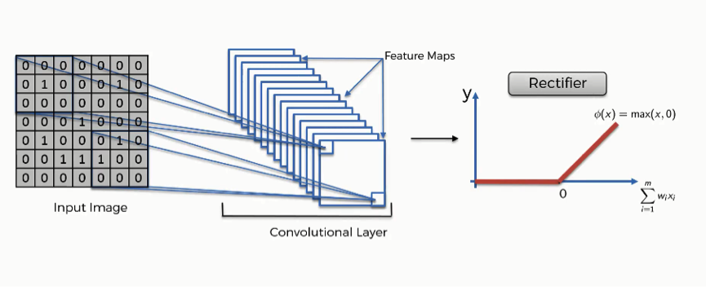
2-RELU LAYER

Slide 28
3-POOLING LAYER
0 | 1 | 0 | 0 | 0
0 | 1 | 1 | 1 | 0
1 | 0 | 1 | 2 | 1
1 | 4 | 2 | 1 | 0
0 | 0 | 1 | 2 | 1
MAX POOLING
1
POOLED FEATURE MAP
FEATURE MAP

Slide 29
3-POOLING LAYER
0 | 1 | 0 | 0 | 0
0 | 1 | 1 | 1 | 0
1 | 0 | 1 | 2 | 1
1 | 4 | 2 | 1 | 0
0 | 0 | 1 | 2 | 1
MAX POOLING
1 | 1
POOLED FEATURE MAP
FEATURE MAP

Slide 30
3-POOLING LAYER
0 | 1 | 0 | 0 | 0
0 | 1 | 1 | 1 | 0
1 | 0 | 1 | 2 | 1
1 | 4 | 2 | 1 | 0
0 | 0 | 1 | 2 | 1
MAX POOLING
1 | 1 | 0
POOLED FEATURE MAP
FEATURE MAP

Slide 31
3-POOLING LAYER
0 | 1 | 0 | 0 | 0
0 | 1 | 1 | 1 | 0
1 | 0 | 1 | 2 | 1
1 | 4 | 2 | 1 | 0
0 | 0 | 1 | 2 | 1
MAX POOLING
1 | 1 | 0
4
POOLED FEATURE MAP
FEATURE MAP

Slide 32
3-POOLING LAYER
0 | 1 | 0 | 0 | 0
0 | 1 | 1 | 1 | 0
1 | 0 | 1 | 2 | 1
1 | 4 | 2 | 1 | 0
0 | 0 | 1 | 2 | 1
MAX POOLING
1 | 1 | 0
4 | 2
POOLED FEATURE MAP
FEATURE MAP

Slide 33
3-POOLING LAYER
0 | 1 | 0 | 0 | 0
0 | 1 | 1 | 1 | 0
1 | 0 | 1 | 2 | 1
1 | 4 | 2 | 1 | 0
0 | 0 | 1 | 2 | 1
MAX POOLING
1 | 1 | 0
4 | 2 | 1
POOLED FEATURE MAP
FEATURE MAP

Slide 34
3-POOLING LAYER
0 | 1 | 0 | 0 | 0
0 | 1 | 1 | 1 | 0
1 | 0 | 1 | 2 | 1
1 | 4 | 2 | 1 | 0
0 | 0 | 1 | 2 | 1
MAX POOLING
1 | 1 | 0
4 | 2 | 1
0
POOLED FEATURE MAP
FEATURE MAP

Slide 35
3-POOLING LAYER
0 | 1 | 0 | 0 | 0
0 | 1 | 1 | 1 | 0
1 | 0 | 1 | 2 | 1
1 | 4 | 2 | 1 | 0
0 | 0 | 1 | 2 | 1
MAX POOLING
1 | 1 | 0
4 | 2 | 1
0 | 2
POOLED FEATURE MAP
FEATURE MAP

Slide 36
3-POOLING LAYER
0 | 1 | 0 | 0 | 0
0 | 1 | 1 | 1 | 0
1 | 0 | 1 | 2 | 1
1 | 4 | 2 | 1 | 0
0 | 0 | 1 | 2 | 1
MAX POOLING
1 | 1 | 0
4 | 2 | 1
0 | 2 | 1
POOLED FEATURE MAP
FEATURE MAP

Slide 37
4-FLATTENING
1
1
0
4
2
1
0
2
1
1 | 1 | 0
4 | 2 | 1
0 | 2 | 1
FLATTENING
Pooled Feature Map

Slide 38
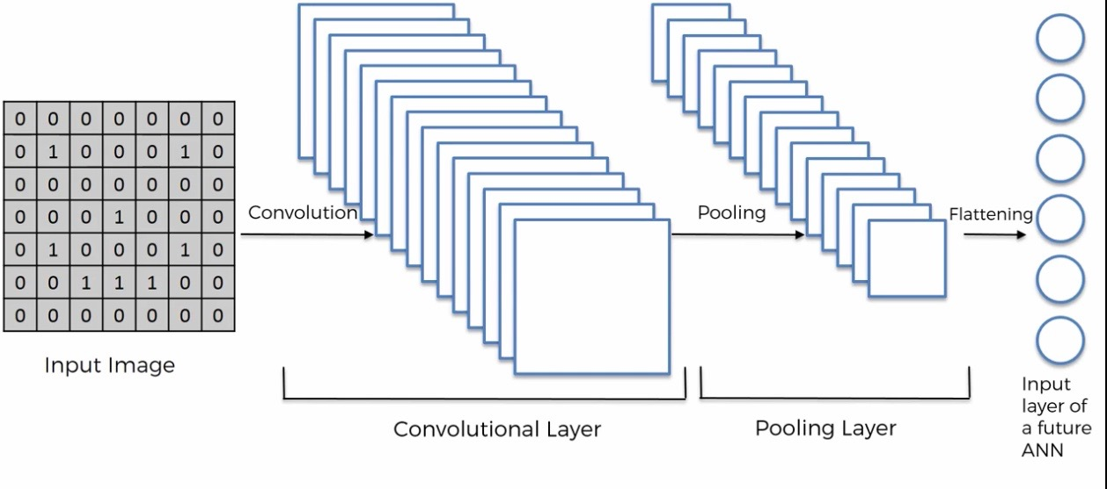
5-FULL CONNECTION

Slide 39
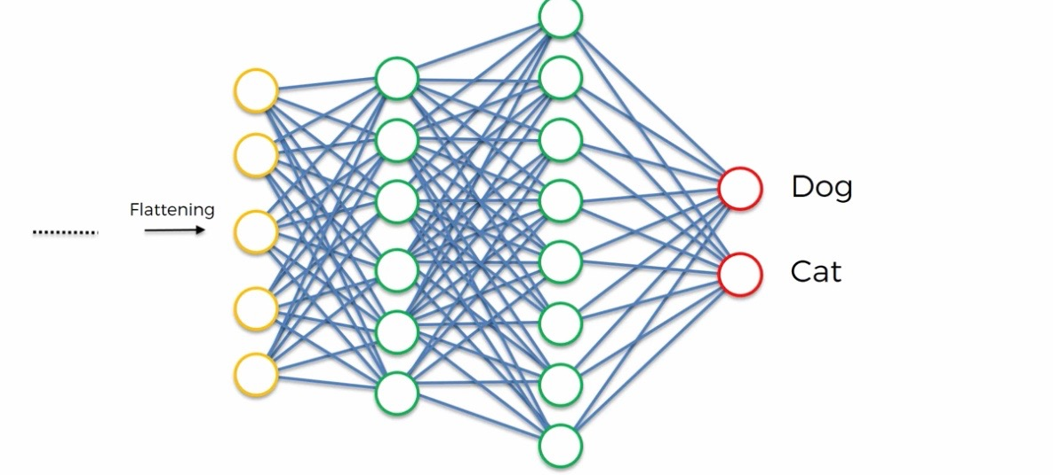
5-FULL CONNECTION

Slide 40
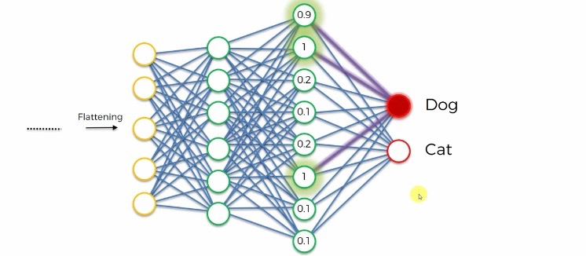
5-FULL CONNECTION

Slide 41
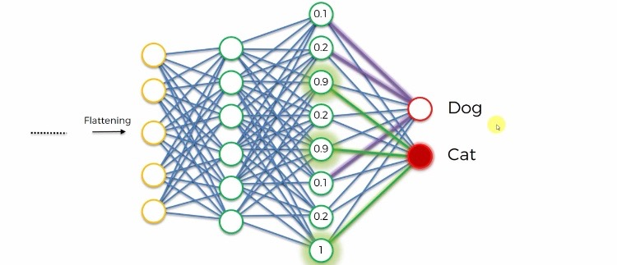
5-FULL CONNECTION

Slide 42
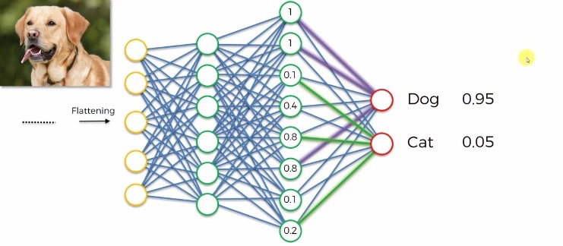
5-FULL CONNECTION

Slide 43
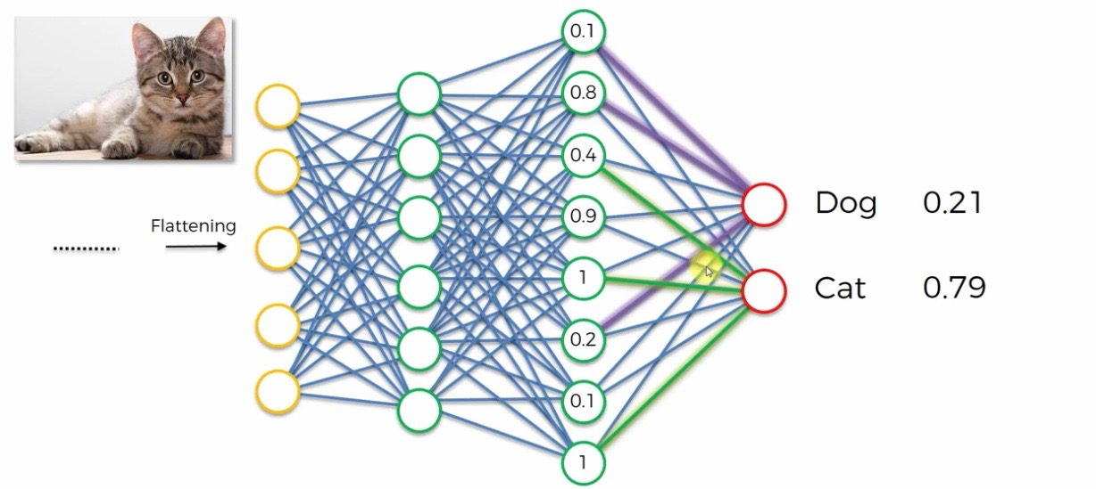
5-FULL CONNECTION

