Slide 1

Optimal spike-based signal representation on a neuromorphic chip

Slide 2
Outline
Introduction & Problem statement
Goals of the thesis
The DYNAP-SE
Learning in-the-loop
Experiments & Discussion

Slide 3
Signal representation is a fundamental problem
Unclear how population of neurons represent a signal
effectively with usable precision
Coding error using Poisson rate codes scales with
Representing multiple signals requires many spikes → waste of energy
(caused by irregularity of Poisson codes)
Goal: Learning rule driving network in state where
  Coding error scales with
  Code is robust to noise
  Code is energy efficient

Slide 4
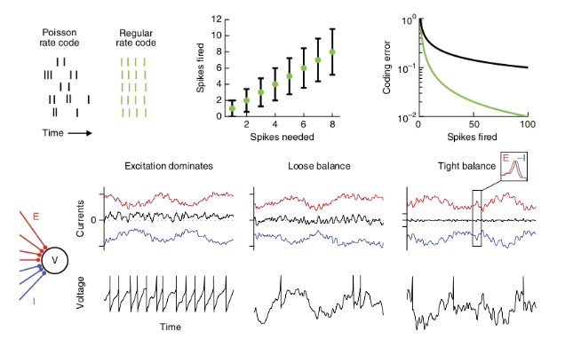
Possible solution: Tightly balanced networks
Balance achieved by matching
excitatory with inhibitory input
(E/I-balance)
Balanced networks produce
Poisson-like codes
Tight balance: Small fluctuations are
matched (e.g. excitation followed by
inhibition)

Slide 5
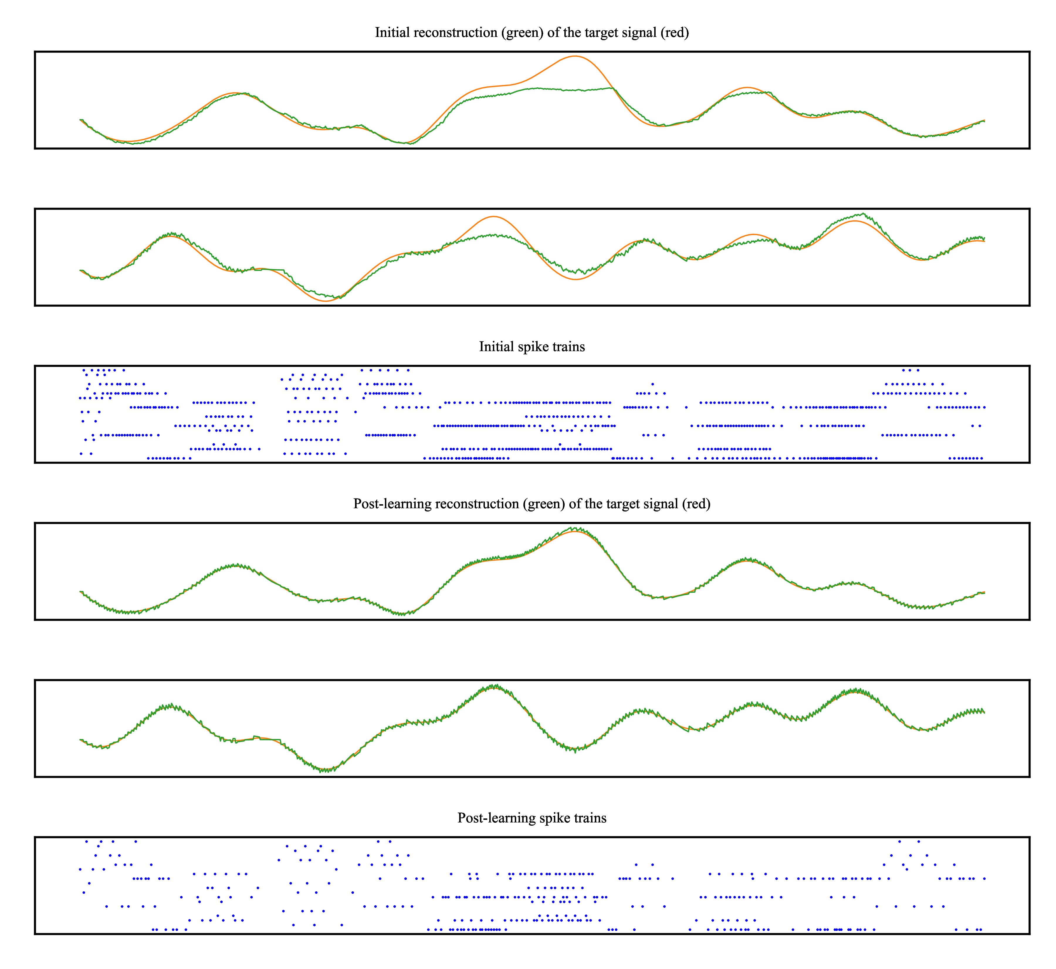
Learning to represent signals spike by spike
Key insights/contributions:
  Neural circuits behave accurately
  and every spike “counts”
  Derivation of local online learning rule:
    Condition for spike: Neuron reduces
    reconstruction error (error-driven coding)
    → Derivation of optimal weights
    Minimizing voltage deviations → reaching
    optimal weights → low reconstruction error

Slide 6
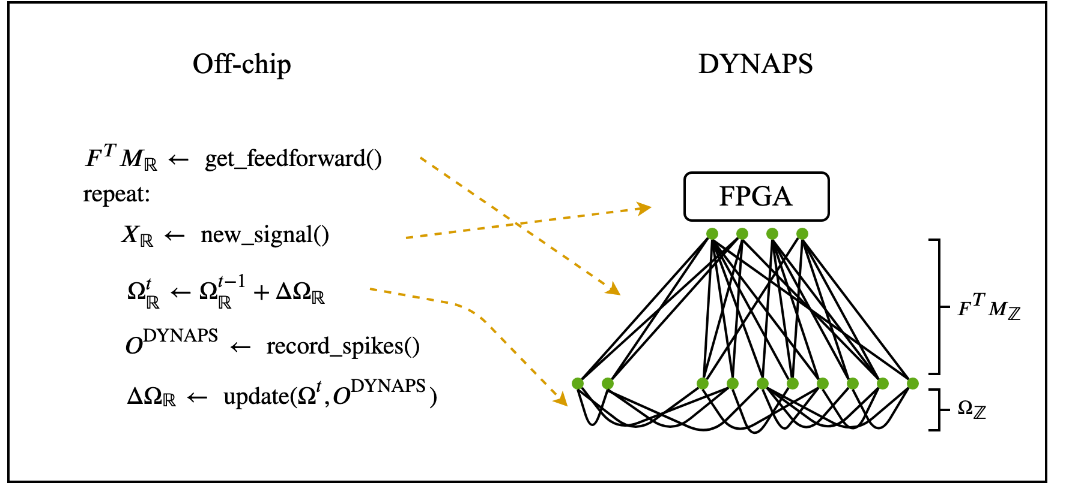
Goals of the thesis
Implement this learning rule on neuromorphic chip (DYNAP-SE)
in-the-loop
Lay foundation to implement directly on-chip
Identify possible weaknesses and suggest improvements

Slide 7
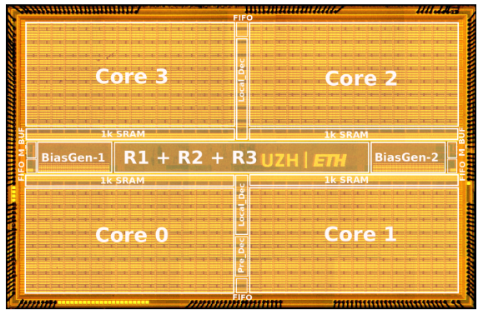
DYNAP-SE
Mixed analog/digital circuits
Completely asynchronous (no central clock)
Ultra low power consumption e.g. 276uA @ 1.3V with all neurons firing at
30Hz (CPU uses 30W @14V = 2.1A)
Fan-in: 64 | Fan-out: 4064
256 silicon neurons/core, 64 synapses/neuron
Neuron model: Adaptive-Exponential I&F

Slide 8
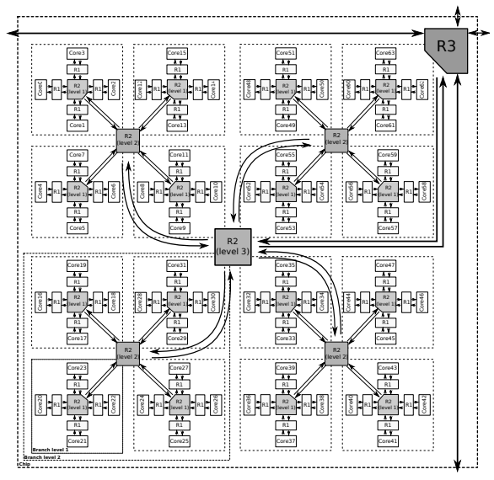
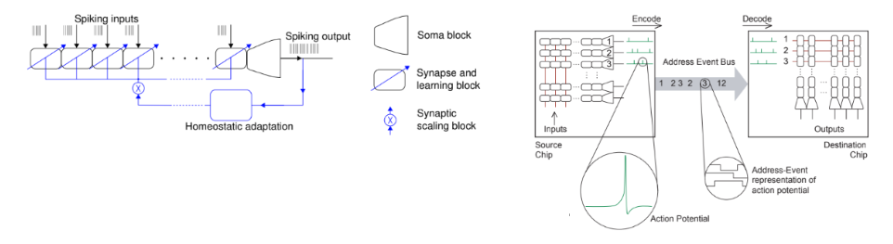
DYNAP-SE - Routing
Address-Event-Representation
Combination of hierarchical and 2D-mesh routing
Why hierachical? Smaller address space when assuming locality → save memory
Spike times encoded in Address Event times

Slide 9
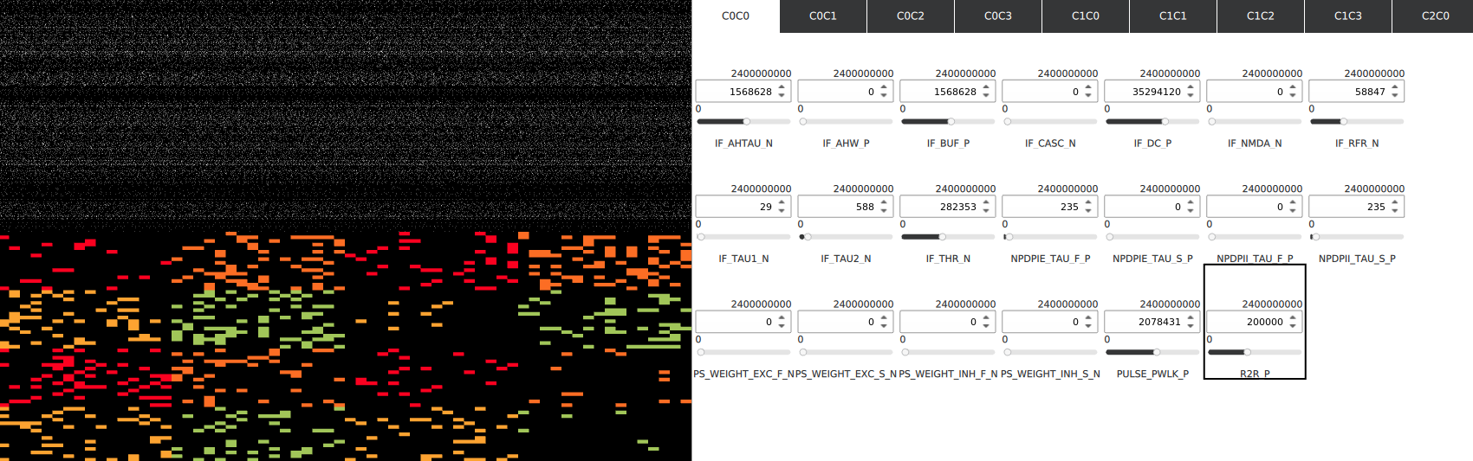
Demo

Slide 10
Learning in-the-loop
Only train recurrent connections
Mismatches between simulation and
in-the-loop implementation:
  Input must be in spike-form
  Weight updates must be batched
  Weight matrices must be discrete
  Cannot measure voltage in software → Need to estimate from spikes and input
  Update only neuron with highest voltage above threshold

Slide 11
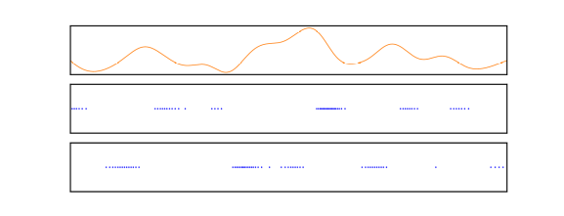
Learning in-the-loop - Input
Use delta modulation to transform continuous
signal to spikes
Could simply integrate signal using
General form for 2 inputs : with
→ Feed-forward matrix becomes and integration is performed by
synapses

Slide 12
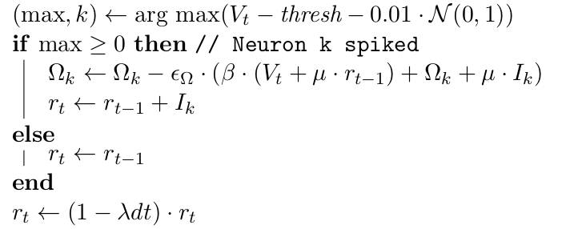
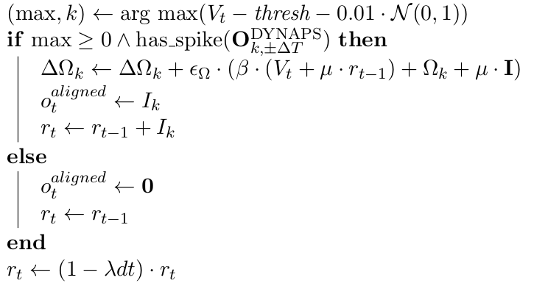
Learning in-the-loop - Updates
In the simulation: Update rate and weights only
for neuron highest above the threshold
To align with the DYNAP-SE, check if
assumption of highest neuron above
threshold matches DYNAP-SE recordings
within some time-frame

Slide 13
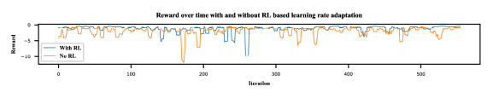
Experiments & Discussion
Used 20 Neurons, trained for 140 iterations, 2 input signals
Used Reinforcement Learning based approach to adapt learning rate
Reward = Reconstruction error
Action = Scale learning rate
Intuition: Rewards for good signal representation should keep weights
in current regime

Slide 14
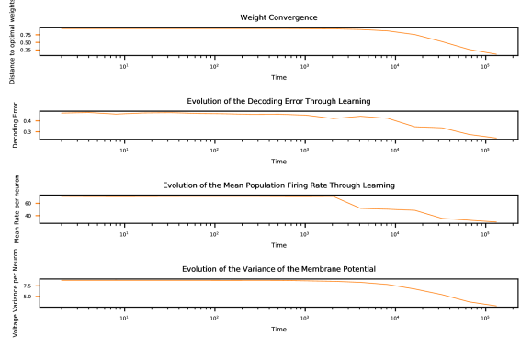
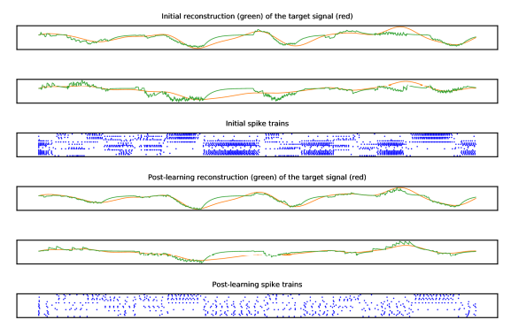
Experiments & Discussion

Slide 15
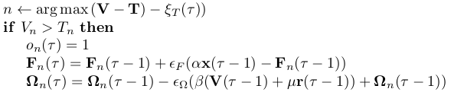
Experiments & Discussion
Very close to simulation → constant excitement would render
condition always true and produce same results as simulation
Update rule from the paper utilizes voltage before spike propagated,
but can rewrite to use voltage after
Last problem: Learning fails when discretizing weights
Derive for discrete weights?
Goal: Resolve issues and implement in circuit on next chip-iteration

