Slide 1

Team 1
Play Store apps for analysing the Android market.

Slide 2
Goal
What is the most popular category that has the largest number of installs.
Most popular category & Most popular ?

Slide 3
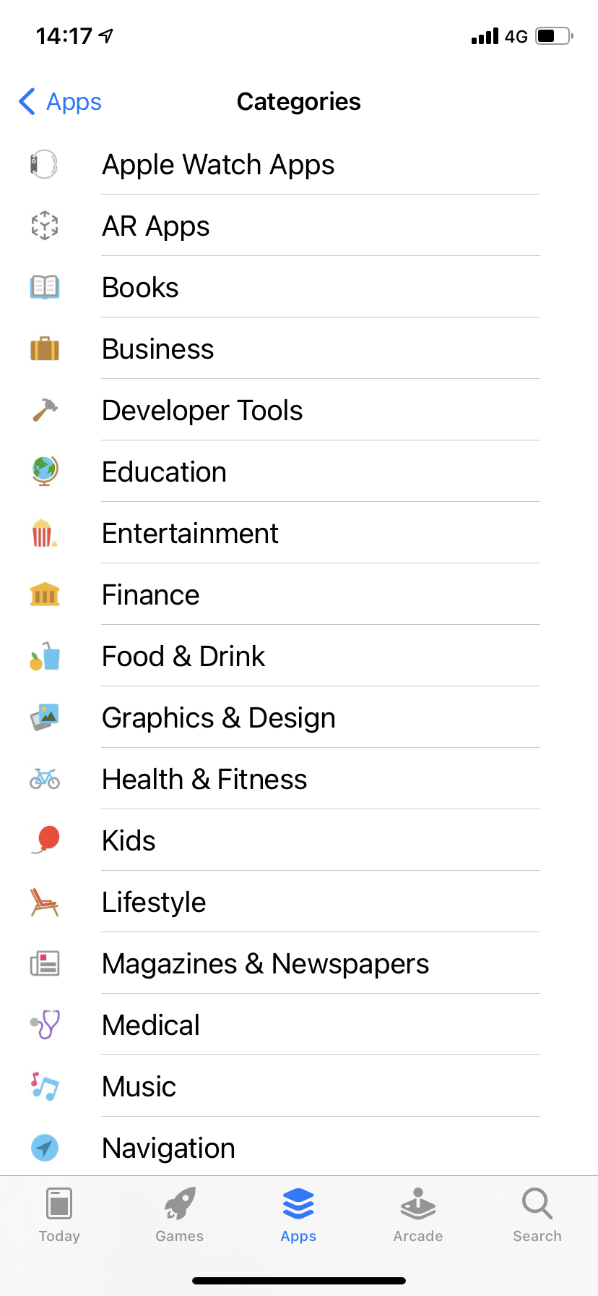
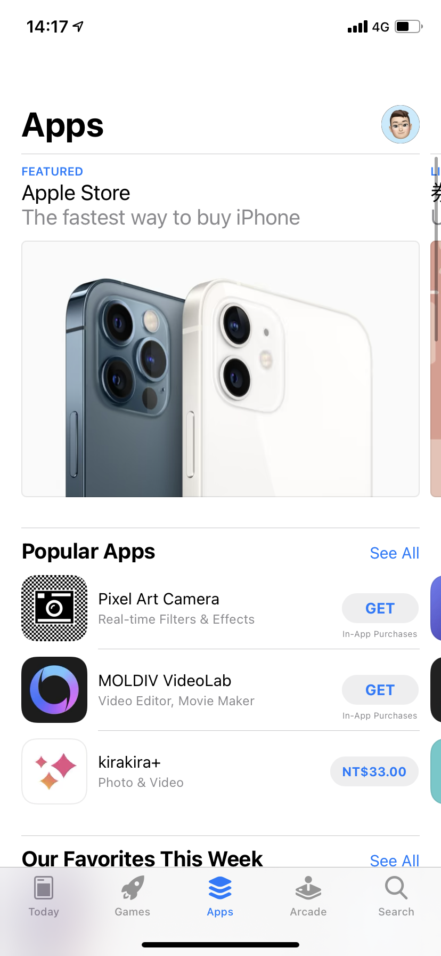

Slide 4
